Slide 1
Lecture No. 13
Financial Operations of Insurers

Slide 2
Agenda
Property and Casualty Insurers
Life Insurance Companies
Ratemaking in Property and Casualty Insurance
Ratemaking in Life Insurance
The Financial Crisis and Insurers

Slide 3
Financial Statements of Property and Casualty Insurers
Balance Sheet: a summary of what a company owns (assets) and what it owes (liabilities)
Total Assets = Total Liabilities + Owners’ Equity

Slide 4
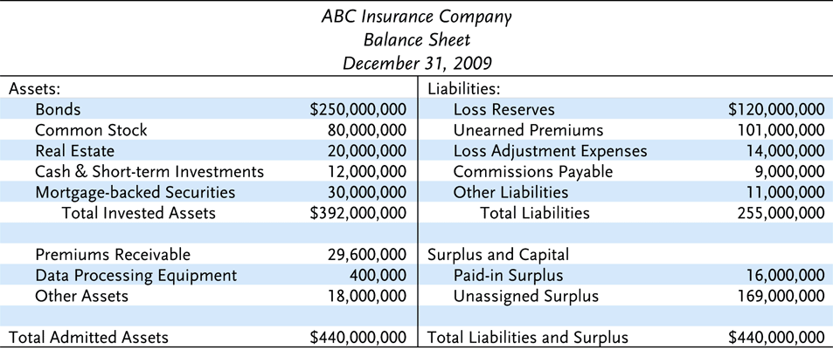
Exhibit 7.1 ABC Insurance Company

Slide 5
Financial Statements of Property and Casualty Insurers
The primary assets for an insurance company are financial assets
Insurers’ liabilities include required reserves
A loss reserve is an estimated amount for:
    Claims reported and adjusted, but not yet paid
    Claims reported and filed, but not yet adjusted
    Claims incurred but not yet reported to the company

Slide 6
Financial Statements of Property and Casualty Insurers
Case reserves are loss reserves that are established for each individual claim
  Methods for determining case reserves include:
    The judgment method: a claim reserve is established for each individual claim
    The average value method: an average value is assigned to each claim
    The tabular method: loss reserves are determined for certain claims for which the amounts paid depend on data derived from mortality, morbidity, and remarriage tables

Slide 7
Financial Statements of Property and Casualty Insurers
The loss ratio method establishes aggregate loss reserves for a specific coverage line
  A formula based on the expected loss ratio is used to estimate the loss reserve
The incurred-but-not-reported (IBNR) reserve is a reserve that must be established for claims that have already occurred but that have not yet been reported

Slide 8
Financial Statements of Property and Casualty Insurers
The unearned premium reserve is a liability item that represents the unearned portion of gross premiums on all outstanding policies at the time of valuation
  Its purpose is to pay for losses that occur during the policy period
  It is also needed so that refunds can be paid to policyholders that cancel their coverage
  It also serves as the basis for determining the amount that must be paid to a reinsurer for carrying reinsured polices
  The annual pro rata method is one method of calculating the reserve

Slide 9
Financial Statements of Property and Casualty Insurers
Policyholders’ surplus is the difference between an insurance company’s assets and liabilities
  The stronger a company’s surplus position, the greater is the security for its policyholders

Slide 10
Financial Statements of Property and Casualty Insurers
The income and expense statement summarizes revenues and expenses paid over a specified period of time
The two principal sources of revenue are premiums and investment income
  Earned premiums are those premiums for which the service for which the premiums were paid (insurance protection) has been rendered
Expenses include the cost of adjusting claims, paying the insured losses that occurred, commissions to agents, premium taxes, and general insurance expenses

Slide 11
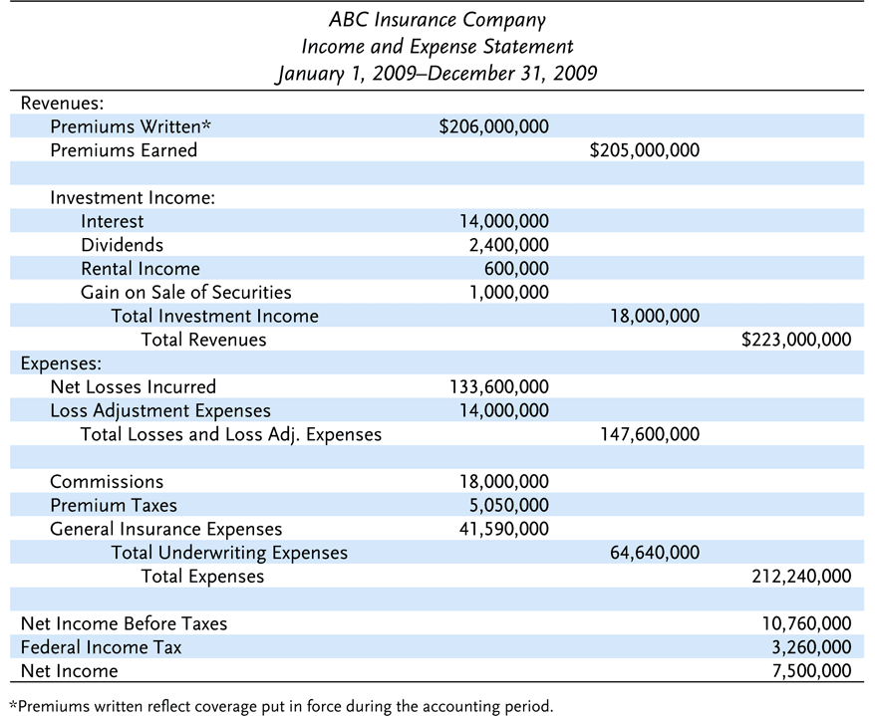
Exhibit 7.2 ABC Insurance Company

Slide 12
Measuring the Performance of Property and Casualty Insurers
The loss ratio is the ratio of incurred losses and loss adjustment expenses to premiums earned
The expense ratio is equal to the company’s underwriting expenses divided by written premiums
The combined ratio is the sum of the loss ratio and the expense ratio. A positive ratio indicates an underwriting loss

Slide 13
Measuring the Performance of Property and Casualty Insurers
The investment income ratio compares net investment income to earned premiums
The overall operating ratio is equal to the combined ratio minus the investment income ratio
  This ratio measures the company’s total performance (underwriting and investments)

Slide 14
Financial Statements of
Life Insurers
The balance sheet
  The assets of a life insurer have a longer duration, on average, than those of property and casualty insurers
  Because many life insurance policies have a savings element, life insurers keep an interest-bearing asset called “contract loans” or “policy loans”
  A life insurance company may have separate accounts for assets backing interest-sensitive products, such as variable annuities

Slide 15
Financial Statements of
Life Insurers
Policy reserves are a liability item on the balance sheet that must be offset by assets equal to that amount
  State laws specify the minimum basis for calculating policy reserves
The reserve for amounts held on deposit is a liability representing funds that are owed to policyholders and to beneficiaries
The asset valuation reserve is a statutory accounting account designed to absorb asset value fluctuations not caused by changing interest rates

Slide 16
Financial Statements of
Life Insurers
Policyholders’ surplus is less volatile in the life insurance industry than in the property and casualty insurance industry
Benefit payments, including death benefits paid to beneficiaries and annuity benefits paid to annuitants, are the life insurer’s major expense
A life insurer’s net gain from operations equals total revenues less total expenses, policyowner dividends, and federal income taxes

Slide 17
Measuring the Performance of Life Insurers
A number of measures can be used to gauge the performance of life insurers
  Pre-tax or after-tax net income vs. total assets
  Rate of return on policyowners’ surplus

Slide 18
Ratemaking in Property and Casualty Insurance
State Laws Require:
  Rates should be adequate for paying all losses and expenses
  Rates should not be excessive, such that policyholders are paying more than the actual value of their protection
  Rates must not be unfairly discriminatory; exposures that are similar with respect to losses and expenses should not be charged significantly different rates
Notes:
Transparency Master 1.2

Slide 19
Ratemaking in Property and Casualty Insurance
Business Rate-Making Objectives include:
  Rates should be easy to understand.
  Rates should be stable over short periods of time
  Rates should be responsive to changing loss exposures and changing economic conditions
  Rates should encourage loss prevention
Notes:
Transparency Master 1.2

Slide 20
Ratemaking in Property and Casualty Insurance
A rate is the price per unit of insurance.
An exposure unit is the unit of measurement used in insurance pricing, e.g., a car-year
The pure premium is the portion of the rate needed to pay losses and loss adjustment expenses
Loading is the amount that must be added to the pure premium for other expenses, profit, and a margin for contingencies
The gross rate consists of the pure premium and a loading element
The gross premium paid by the insured consists of the gross rate multiplied by the number of exposure units

Slide 21
Ratemaking in Property and Casualty Insurance
There are three basic rate making methods in property and casualty insurance:
  Judgment rating means that each exposure is individually evaluated, and the rate is determined largely by the judgment of the underwriter
  Class rating means that exposures with similar characteristics are placed in the same underwriting class, and each is charged the same rate

Slide 22
Ratemaking in Property and Casualty Insurance
  Class rates are determined using two basic methods:
    Under the pure premium method, the pure premium can be determined by dividing the dollar amount of incurred losses and loss-adjustment expenses by the number of exposure units
    Under the loss ratio method, the actual loss ratio is compared with the expected loss ratio, and the rate is adjusted accordingly

Slide 23
Ratemaking in Property and Casualty Insurance
  Merit rating is a rating plan by which class rates are adjusted upward or downward based on individual loss experience
    Under a schedule rating plan, each exposure is individually rated
      A basis rate is determined for each exposure, which is then modified by debits or credits depending on the physical characteristics of the exposure
      Commonly used in commercial property insurance

Slide 24
Ratemaking in Property and Casualty Insurance
    Under experience rating, the class or manual rate is adjusted upward or downward based on past loss experience
      The insurer’s past loss experience is used to determine the premium for the next policy period
    Under a retrospective rating plan, the insured’s loss experience during the current policy period determines the actual premium paid for that period
      A provisional premium is paid at the beginning of the policy period; the final premium is calculated at the end of the policy period
      Commonly used in workers compensation insurance

Slide 25
Ratemaking in Life Insurance
Life insurance actuaries use a mortality table or individual company experience to determine the probability of death at each attained age
The annual expected value of death claims equals the probability of death times the amount the insurer must pay if death occurs

Slide 26
The Financial Crisis and Insurers
The recent financial crisis has affected financial institutions in different ways
  Banks were more negatively impacted as they issued the sub prime mortgage loans
  Insurers were not heavily involved in sub prime lending
  Insurers did not securitize the bad mortgage loans and mortgage debt was not a significant share of insurers’ investment portfolios
  Insurers were most affected by the sharp decline in the value of their investment portfolios

Slide 27
End of Lecture 13

