Slide 1
Teaching Speaking Skills: part 2
        Lecture # 22

Slide 2
Review of lecture 21
Characteristics of spoken language
Principles for designing speaking activities
Using group work in speaking activities
Common types of speaking activities

Slide 3
Teaching Speaking Skills…part 2
Today’s Lecture

Slide 4
Dialogues and role-plays
Two problems with most dialogues in textbooks:
Not authentic or natural. The natural speech of native speakers is often phrases or sentence fragments full of pauses, false starts, and repetitions.
The way most dialogues are taught. Teachers ask students to memorize dialogues by heart.

Slide 5
What can a teacher do to make a dialogue more communicative?
Example 1: Playing the roles in a dialogue

Slide 6
Step 1. Practise the dialogue in pairs
A: What time is it?
B: It’s 3:00. Why?
A: Oh, I need to go to the store! Do you want to come?
B: OK. Just a minute. I need to finish this first.

Slide 7
Step 2. Ask a few pairs to perform the dialogue in front of the whole class, speaking in different moods such as happy, irritated, bored, or in different role relationships such as parent and a child, husband and wife, two friends, etc.
Example # 1
The students may paraphrase the underlined parts:
“go to the post office”, “go to the bank”, etc. instead of “go to the store”.
“find my jacket/shoes”, etc. instead of “finish this first”.

Slide 8
Example 2: Using cue cards
Card A
You are talking to a new classmate. Begin the conversation with a greeting.
1. Greet your partner.
2. Ask your partner which school he/she went to before.
3. Ask your partner if he/she lives near the school.
4. Suggest you go shopping together after school.

Slide 9
Card B
You are a new student at this school. One of your classmates greets you.
1. Greet your partner back.
2. Answer the question.
3. Answer the question.
4. Respond to the suggestion.

Slide 10
Then students should be ready to move quickly into less controlled types of role plays, where only the situation and the relationship between the two speakers are specified:
Card A
You and your friend are going out to eat lunch. You need to decide where to go. You would like to try something different because you’re tired of the same food. You make a suggestion.

Slide 11
Notice that the outcome of this role play is not specified in the cue cards. It only sets up a point of disagreement.
Card B
You and your friend are going out to eat lunch. You need to decide where to go. You would like to go to the place where you always go, because you like the food. You don’t agree with your friend’s suggestion.

Slide 12
Factors that affect the success of role-plays (Ur, 1996:133)
Teacher’s enthusiasm;
Careful instructions;
Clear situation and roles;
Making sure that the students have the language they will need to carry out the role-play.

Slide 13
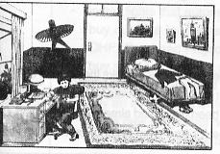
Activities using pictures
In groups of 3 or 4:

Slide 14
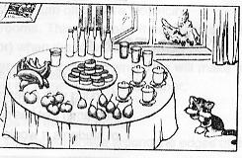
A secretary is appointed to mark a tick for each sentence said. Check which group has got most ticks.

Slide 15
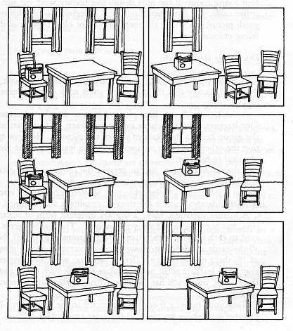
In pairs: (Littlewood 1981: 23-4)

Slide 16
In groups of 5:

Slide 17
Problem-solving activities
You are on a committee that is in charge of deciding what to do with a small amount of money that has been donated to improve your language centre/institute/university/college. You have a list of things to do, but you only have enough money for 5 of the items. You must reach a consensus (agreement) in your group on which 5 items you will spend the money. Here is the list:

Slide 18
Repaint 3 classrooms.
Paint lines for games on the playground.
Install lights that automatically turn off to save electricity.
Buy curtains for 8 classrooms. This will make it easier to see the OHP (Overhead Projector) when the room is darker.
Buy sound absorption panels for 2 classrooms. This will make the classroom quieter so it will be easier to hear each other.
Buy an air conditioner for one classroom.
Buy 4 new basketball hoops for the playground.
Buy 15 young trees to be planted for shade around the edge of the playground.
Buy fans for 6 classrooms.
Remodel bathroom faucets so students can wash their hands using hot and cold water.
Add soap dispensers and hand dryers to bathrooms.

Slide 19
Problem solving activities require a higher level of language proficiency, but the difficulty levels can be controlled somewhat by the topic.
In problem-solving activities, “participants tend to become personally involved; they begin to relate the problem as an emotional issue as well as an intellectual and moral one” (Ur 1996:128).

Slide 20
Other speaking activities
Find someone who …
e.g. Sand up and walk around the room. Ask your classmates what they like to do. Remember, you must speak in English only!

Slide 21
Find someone who … | Name
likes to swim
likes to play basketball
likes to play badminton
likes to play tennis
likes to play football
likes to play volleyball
likes to roller skate
likes to ice skate
…

Slide 22
A model conversation can be provided.
A: Hi, Tom.
B: Hi, Sherry.
A: I’m conducting a survey for our school newspaper. Could you tell me, do you like to swim?
B: Yes, I do. In fact, usually go swimming once or twice a week.
A: Great. Would you mind signing your name here for me please?
B: Sure, there you are.
A: thanks a lot. See you around.
B: See you.

Slide 23
Bingo activities
(This seems to be practising listening rather than speaking if the words are called out by the teacher.)

Slide 24
Change the story
Step 1: Form groups of 3-5;
Step 2: The group together makes a list of about 20 random verbs.
e.g. go, sleep, teach, learn, jump, fall, look (at), hear, laugh, sing, etc.
Step 3: Each one writes a short story, and underlines all the verbs in the story;
e.g.

Slide 25
Yesterday I saw a cat. She was running in the street. She had a fish in her mouth. A dog was running after the cat. The dog wanted to eat the fish too. Then the cat climbed up a tree. The dog stopped under the tree. He could not climb the tree. At last the cat ate the fish.

Slide 26
Step 4: Each one read his/her story, but pauses at every verb. The group then supplies one of the random verbs into that slot.
The results can be very funny.
A possible version may be:

Slide 27
Yesterday I taught a cat. She was sleeping in the street. She learned a fish in her mouth. A dog was laughing after the cat. The dog fell to hear the fish too. Then the cat sang up a tree. The dog jumped under the tree. He could not heard the tree. At last the cat looked at the fish.

Slide 28
No specific responses
The teacher calls out a verb and students hold up a letter card each and rush to spell a word. (This seems to be practising listening rather than speaking.)

Slide 29
Mr Chen’s example: A card game
On the table are a set of picture cards, face down. No one can see the pictures. Student B holds one of the cards with a picture on it. Student A cannot see the picture, so she asks Student B a question.
A: “What can you see?”
B: “I can see…”
A: “No. You are lying.” /“Yes, I believe you.”
If Student A is right, he gets the card. If Student A is wrong, Student B gets the card. Then they take turns. When the game is over, the one who has got more cards is the winner.

Slide 30
Conclusion
The most important aspect of preparing students to speak in real life is to give them as many opportunities as possible to practise producing unplanned, spontaneous and meaningful speech under time pressure.

Slide 31
Summary
Role Plays and dialogues
Picture description
Other Speaking Activities:
i) inviting someone as a guest speaker
ii) Asking students to hold a workshop.

