Slide 1
Business English Lecture 9

Slide 2
SYNOPSIS
Memos and E-mail writing
1. Two important elements of Technical Communication: Audience, Purpose
2. Difference of conventions: Letters, Memos, Emails
3. Writing strategies: Tone; YOU approach; 7 C’s
4. Context study – Good-news-first strategy, Reader center strategy
5. Logical organization: Headings, subheadings, lists – tables

Slide 3
SYNOPSIS
6. Active conclusion
7. Writing Memos
8. Types: Procedure; information; request; reply;
9. Bread and butter – Body parts and persuasive strategies
10. Writing process: Plan – Draft – Write / Prewriting-writing-postwriting
11. Formats
12. Writing: Intro-body-closing
13. Effective/ineffective memos
14. Memo Writing Workshop

Slide 4
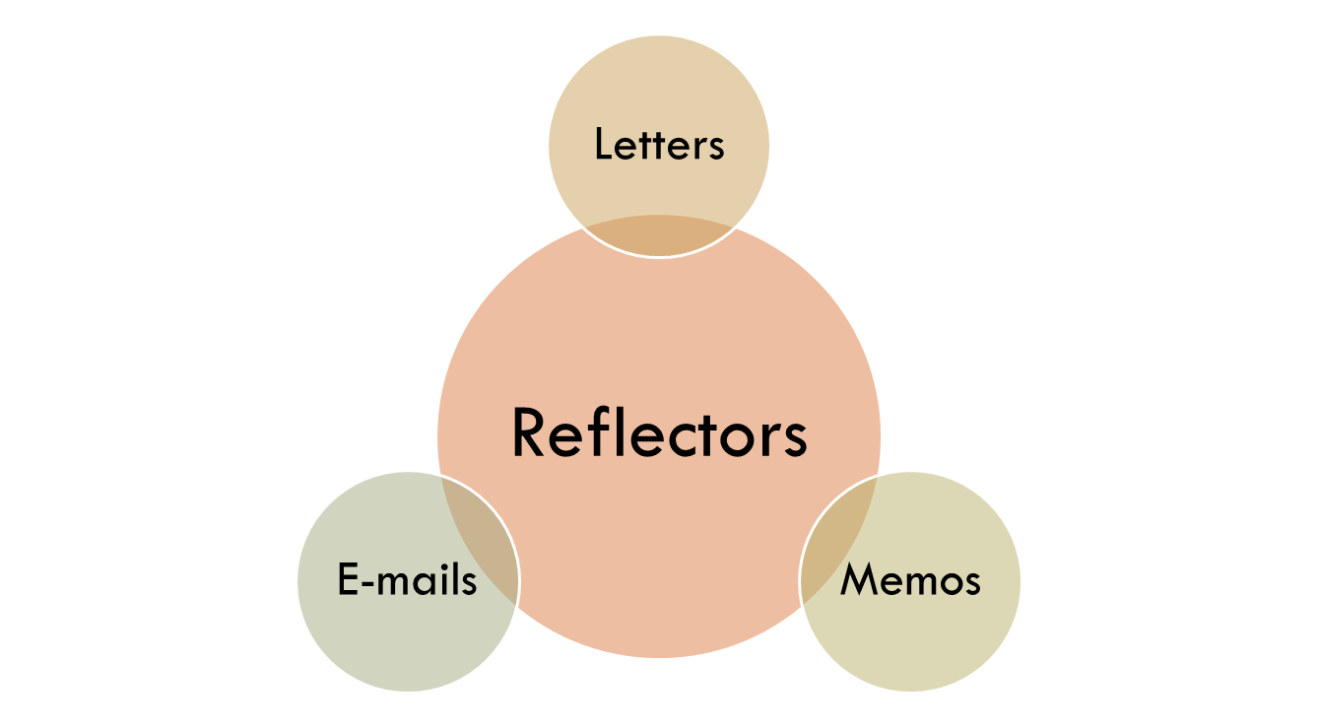
Memos and Emails
Three genres you will encounter most often in the workplace

Slide 5
Reflect and Act
  Reflects image of you and your company
Often act as the “wrapper” to larger technical documents
  Résumés
  Proposals
  Reports

Slide 6
When you encounter a new genre, remember the two most important elements to technical communication:
Audience
2. Purpose

Slide 7
Letter Conventions
Oldest, most formal of the three genres
Addressed to someone in another organization
Always concluded with a signature in ink

Slide 8
Memo Conventions
Less formal and shorter than letters
Used most often for communication within one organization

Slide 9
E-mail Conventions
Least formal of the three genres
Replacing memos because of its technological advantages
Always professional and free of errors

Slide 10
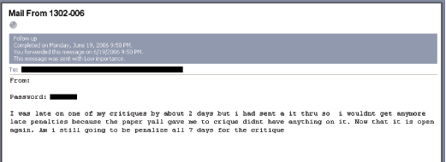

Slide 11
Review writing strategies

Slide 12
1: Pay Attention to Tone
Always consider audience and purpose
  E-mail to an expert = respectful, friendly and professional
  Complaint letter = firm, formal, demanding, but not threatening

Slide 13
The word “YOU” really effects your tone.
Congratulate and thank with “you”
  “Your company always provides the best service.”
Do NOT use “you” when giving bad or negative information
  “Your shoddy work produced a bad toaster.”
  “My toaster no longer works.”
Vs.

Slide 14

Not Good.
You must have dropped the engine. The housing is badly cracked.

Slide 15
Better
The badly cracked housing suggests that your engine must have fallen onto a hard surface from some height.

Slide 16
2: Brief, purposeful Introduction
The first line should clarify topic & purpose
No more than four or five lines
Avoid diving into details too early or before the purpose of the communication is mentioned.

Slide 17

3: Review the context
We’re forgetful and busy people
Your reader may not be familiar with the situation
Image from: http:// www.mchenrycountyblog.com/uploaded_images/T-Shirt-Not%20Now,%20I'm%20Busy-705334.jpg

Slide 18
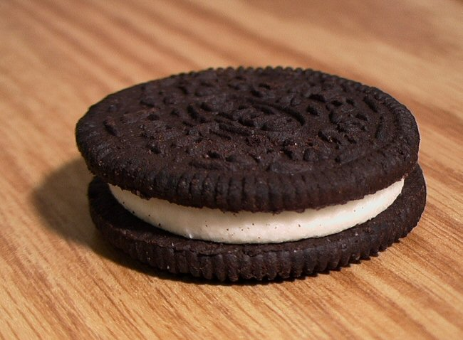
4: Follow a good-news first strategy
Image from: http://blog.1800dessert.com/2006/05/oreo_powered_rocket.html

Slide 19
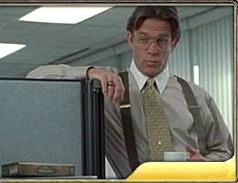
5. Use a reader-centered strategy
Image from: http://www2.fileplanet.com/images/170000/170715ss_sm2.jpg

Slide 20
6: Organize your paragraphs logically
State the subject and purpose.
Explain the problem in detail.
Describe how the problem inconvenienced you.
State what you would like the reader to do.
Thank the reader for his or her response.
Provide contact information.
Claim Letters and Memos: from Johnson-Sheehan, Technical communication Today, 2nd ed., p. 482

Slide 21
7: Keep your paragraphs short!
No more information than necessary!

Slide 22
8: Use headings, lists, and tables
Headings - categories
Lists – clarify
Tables – illustrate

Slide 23
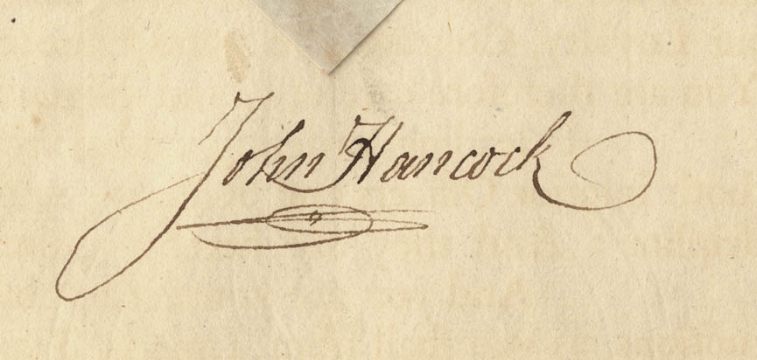
9: Have an active conclusion
Tell your reader what you want
Give your contact information
Image from: http://www.masshist.org/cabinet/november2002/hancocksignaturelg.jpg

Slide 24
Review Basics
Pay attention to tone
Have a brief “state-your-purpose” introduction
Review the context
  If writing a response to some other communication, repeat the details of the context
Follow a good-news-first, bad-news-last strategy
Use a reader-centered strategy
  Reader and writer usually have a mutual goal – they both want something!! Both parties needs to feel they have gained something.
  Organize paragraphs logically
    Intro, Narration, Petition and Justification

Slide 25
E-Mail Messages and Memos

Slide 26
Writing Memos
Why Learn to Write Memos?
Although e-mail has reduced the paper
flow, many professionals continue to
write memos.
You will, as a professional, spend
considerable time reading and
responding to memos.

Slide 27
Points to Remember
Memos are a form of internal
correspondence for employees
The format of memos differ extensively from letters
Memo formats may vary

Slide 28
Procedure and Information Memos
These routine messages usually flow downward; they deliver company information and describe procedures.
Tone is important; managers seek employee participation and cooperation.

Slide 29
Request and Reply Memos
Memo requests for information and action follow the direct pattern.
Memo replies are also organized directly with the most important information first.

Slide 30

Characteristics of Successful Memos and E-Mail Messages
Headings: To, From, Date, Subject
Single topic
Conversational tone-Informal
Conciseness
Visual signalling
Highlighting
Numbers
Bullets

Slide 31
The Writing Process
Analyze and anticipate
Research and compose
Revise, proofread, and evaluate

Slide 32
Memo Formatting
Line up all heading words with those following Subject.
Leave side margins of about 1¼ inches.
Indent the lines following bulleted or enumerated items.
Do not include complimentary close or signature.

Slide 33
Analyze and Anticipate
Do I really need to write?
What is my purpose?
How will the reader react?

Slide 34

Research and Compose
Check files; collect information.
Study relevant documents.
Make an outline.
Write first draft.

Slide 35
Revise, Proofread, and Evaluate
Revise for clarity.
Revise for correctness.
Plan for feedback.

Slide 36

Organization of Memos
Memo headings
Subject line
Opening
Body
Closing

Slide 37
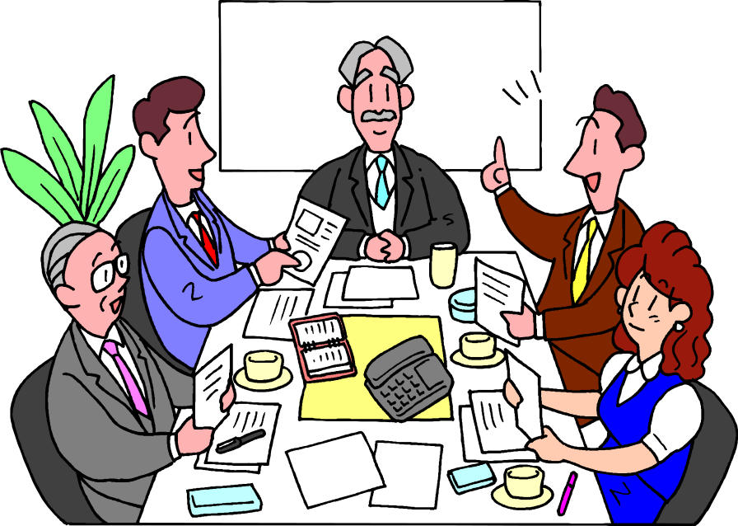
Memo Heading
To_____________
From___________
Date___________
Subject_________
Date:_____________
To:_______________
From:_____________
Subject:__________
Date:_____________
To:_______________
From:_____________
Through:__________
Subject :__________

Slide 38
Subject Line
Summarize the main idea.
Budget Meeting June 3, 10 a.m.
Required
Brief
Does not need to be whole sentence
Omit articles
Does not need period

Slide 39
Opening
Start directly; restate and amplify the main idea.
Indirect (ineffective) opening:
This is to inform you that we must complete the annual operating budgets shortly. Over the past two months many supervisors have met to discuss their departmental needs.
Direct (effective) opening:
All supervisors and coordinators will meet June 3 at 10 a.m. to work out the annual operating budgets for their departments.

Slide 40
Body
Explain and discuss the topic.
Use graphic highlighting to facilitate reading, comprehension, and retention.
Consider columns, headings, enumerations, bulleted lists, and so forth.

Slide 41
Closing
Request action, including an end date.
Summarize the message, or
Provide a closing thought.

Slide 42
Writing Plan for Memos
Closing
Requests action
Summarizes message or
Ends with a concluding statement

Slide 43
Ineffective Memo
Effective memo
TO: All Employees
FROM: Robert Mendes
DATE: January 26, 2004
SUBJECT: Retirement Series
TO: All Employees
FROM: Robert Mendes, Employee
Benefits Manager
DATE: January 26, 2004
SUBJECT: Retirement Planning
Series Begins March 8, 2004

Slide 44
Listening Exercise

Slide 45
Listening Exercise
Activity
Answers

Slide 46
Review
Memos and E-mail writing
1. Two important elements of Technical Communication: Audience, Purpose
2. Difference of conventions: Letters, Memos, Emails
3. Writing strategies: Tone; YOU approach; 7 C’s
4. Context study – Good-news-first strategy, Reader center strategy
5. Logical organization: Headings, subheadings, lists – tables

Slide 47
Review
6. Active conclusion
7. Writing Memos
8. Types: Procedure; information; request; reply;
9. Bread and butter – Body parts and persuasive strategies
10. Writing process: Plan – Draft – Write / Prewriting-writing-postwriting
11. Formats
12. Writing: Intro-body-closing
13. Effective/ineffective memos
14. Memo Writing Workshop

