Slide 1
Business English Lecture 7

Slide 2
SYNOPSIS
Business Letters continues….
1. Types: Personal – Business
2. Parts
3. Formatting
4. Parameter Possibilities
5. Punctuation: Example

Slide 3
SYNOPSIS
6. Letterhead
7. Model
8. Return address, date line, inside address,
9. Salutations
10. Letter of Inquiry

Slide 4
Writing a Business Letter Continues…

Slide 5
Types of Letters
Personal—Business Letter
A personal-business letter is a letter that is sent from an individual to a person or business/organization.
Business Letter
A business letter is sent from a business or organization to another or to an individual.

Slide 6
Types of Letters
Personal—Business Letter
A personal-business letter is a letter that is sent from an individual to a person or business/organization.
Business Letter
A business letter is sent from a business or organization to another or to an individual.

Slide 7
Major Parts of a Letter
10 Parts
Must be in order
Must know what each part does

Slide 8
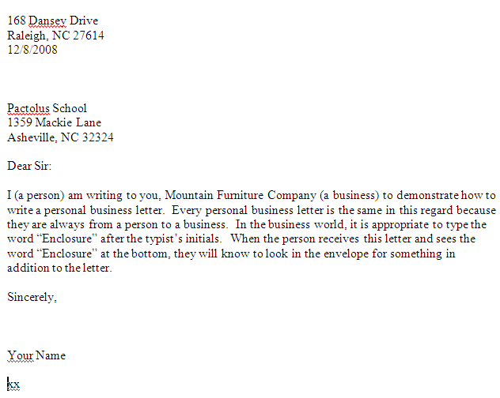
Major Parts of a Letter
1. Letterhead if the letter is from a business.

Slide 9
Major Parts of a Letter
2. Return Address-the address of the person writing the letter.

Slide 10
Major Parts of a Letter
3. Dateline-Complete and current date.

Slide 11
Major Parts of a Letter
4. Letter Address/Inside Address-the address of the person receiving the letter.

Slide 12
Major Parts of a Letter
5. Salutation-the greeting of the letter. Example: Dear Sir or Madam:

Slide 13
Major Parts of a Letter
6. Body-the message of the letter.

Slide 14
Major Parts of a Letter
7. Complimentary Close-the ending of the letter. Example: Sincerely yours,

Slide 15
Major Parts of a Letter
8. Handwritten Signature-the author signs the letter after it has been printed.

Slide 16
Major Parts of a Letter
9. Keyed Name-the authors typed name.

Slide 17
Major Parts of a Letter
10. Typist Initials-initials of the typist.

Slide 18
Major Parts of a Letter
Letterhead if the letter is from a business.
Return Address-the address of the person writing the letter.
Dateline-Complete and current date.
Letter Address/Inside Address-the address of the person receiving the letter.
Salutation-the greeting of the letter. Example: Dear Sir or Madam:
Body-the message of the letter.
Complimentary Close-the ending of the letter. Example: Sincerely yours,
Keyed Name-the authors typed name.
Handwritten Signature-the author signs the letter after it has been printed.
Typist Initials-initials of the typist.

Slide 19
Formatting – 1st Page
Top Margin – 2”
Right Margin – 1”
Left Margin – 1”
Bottom Margin - 1”

Slide 20
Example Letter
123 Main St
Stokes, NC 28574
5/12/2009
[QS]
Pactolus School
3405 Yankee Hall Road
Greenville, NC 27834
[DS]
Dear Mr. Jones,
[DS]
On October 24, 2008 we received great news regarding the . . . .
[DS]
This is great news because of . . . .
[DS]
Sincerely,
[QS]
Chris Young
[DS]
cy
Parts of a letter:
Return Address/Letterhead
Dateline
Letter Address/Inside Address
Salutation
Body (most of paper)
Complimentary Close
Handwritten Signature
Keyed Name
Typist Initials

Slide 21
Notes to Remember!
The top margin is 2”, side and bottom margins are 1".
Typist initials are the initials of the typist and are used when someone other than the writer prepares the letter. Lowercase letters are used, with no space, and with no punctuation, appearing a double space below the signature.
Get spacing correct (QS & DS)

Slide 22
Example Letter
123 Main St
Stokes, NC 28574
4/19/2010
[QS]
School Name
3405 Yankee Hall Road
Greenville, NC 27834
[DS]
Dear Mr. Jones,
[DS]
On October 24, 2008 we received great news regarding the . . . .
[DS]
This is great news because of . . . .
[DS]
Sincerely,
[QS]
Chris Young
[DS]
cy
Parts of a letter:
Return Address
Dateline
Letter Address/Inside Address
Salutation
Body (most of paper)
Complimentary Close
Handwritten Signature
Keyed Name
Typist Initials
GREEN – You change for Project!
RED – Spacing – Do not type!

Slide 23

Understand that parameters can be mixed and matched –8 Possibilities

Slide 24
Example: Block/mixed punctuation

Slide 25
Example: Modified Block/Open Punctuation

Slide 26
Letterhead

Slide 27
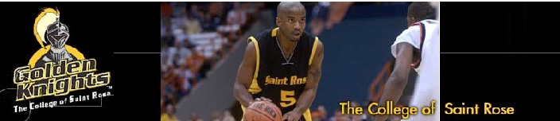
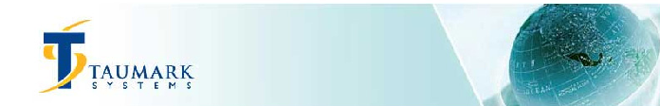
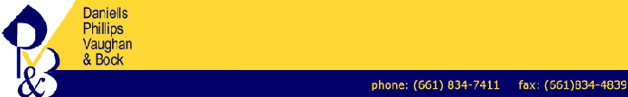
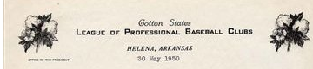
Letterhead Examples

Slide 28
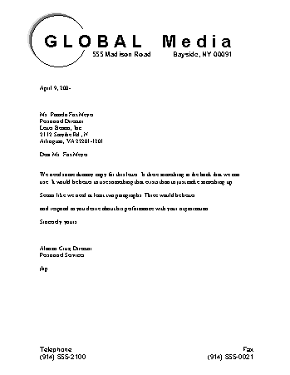
Overview of Letter Parts
Letterhead
Dateline
Letter Address
Salutation
Body
Complimentary Closing
Writer’s Name and Title
Reference Initials

Slide 29
Letterhead
The letter head is the heading at the top of a letter.
It usually consists of the name, address, telephone number and fax number of the company.
The letterhead can be typed out but it is usually printed on the company’s stationery

Slide 30

Return Address
McNeal Arts and Crafts
2650 Jean Way West Jordan Utah 84084
Phone 1 801 569 9463 Fax 1 801 784 6734
If you do not have a letter head you must write your name, address and telephone number at the top of the page or above the inside address

Slide 31
Return address
Gayle McNeal
2650 Jean Way
West Jordan Utah 84084
Phone 1 801 569 9463
September 15, 2005
Xi’an International Studies University

Slide 32
Date Line
The date line is used to indicate the date the letter was written.
If your letter is completed over a number of days, use the date it was finished and mailed.

Slide 33
Date Line Cont.
If you are writing to England use the day/month/ year
If you are writing to China use the year/month/day
Depending which format you are using for your letter, either left justify the date or center it horizontally.
Write out the date two inches from the top of the page.

Slide 34
Inside Address
The inside address is the recipient’s address.
It is always best to write to a specific individual at the firm to which you are writing.
If you do not have the person’s name, do some research by calling the company or speaking with employees from the company

Slide 35
INSIDE ADDRESS Cont.
Follow a woman’s preference in being addressed as:
Miss, Mrs., or Ms.
If you are unsure of a woman’s preference in being addressed, use Ms.

Slide 36
INSIDE ADDRESS Cont
If there is a possibility that the person to whom you are writing is a Dr. or has some other title, use that title.
Usually, people will not mind being addressed by a higher title than they actually possess.

Slide 37
INSIDE ADDRESS Cont
For international addresses, type the name of the country in all-capital letters on the last line.
The inside address begins two lines below the date.
It should be left justified, no matter which format you are using.

Slide 38
Salutation
Use the same name as the inside address, including the personal title.
If you know the person and typically address them by their first name, it is acceptable to use only the first name in the salutation (i.e., Dear Lucy:).
In all other cases, however, use the personal title and full name followed by a colon.
Leave one line blank after the salutation.

Slide 39
Salutation Cont.
If you don’t know a reader’s gender, use a nonsexist salutation, such as "To Whom it May Concern."
It is also acceptable to use the full name in a salutation if you cannot determine gender.
For example, you might write Dear Chris Harmon:

Slide 40
Examples or Salutations
Dear Personnel Director,
Dear Sir or Madam (use if you don't know who you are writing to)
Dear Mr., Mrs., Miss or Ms (use if you know who you are writing to.
VERY IMPORTANT use Ms for women unless asked to use Mrs. or Miss)
Dear Frank (use if the person is a close business contact or friend)

Slide 41
Body
For block and modified block formats, single space and left justify each paragraph within the body of the letter.
Leave a blank line between each paragraph.
When writing a business letter, be careful to remember that conciseness is very important.

Slide 42
Body (Cont.)
In the first paragraph, consider a friendly opening and then a statement of the main point.
The next paragraph should begin justifying the importance of the main point.
In the next few paragraphs, continue justification with background information and supporting details.
The closing paragraph should restate the purpose of the letter and, in some cases, request some type of action.

Slide 43
The Reference
Give a reference for the reason you are writing
With reference to your advertisement in the Times,
your letter of 23 rd March,
your phone call today,
Thank you for your letter of March 5 th

Slide 44
The Reason for Writing
I am writing to enquire about
I am writing to apologize for
I am writing to confirm

Slide 45
Requesting
Could you possibly?
I would be grateful if you could
Agreeing to Requests
I would be delighted to

Slide 46
Giving Bad News
Unfortunately
I am afraid that
Enclosing Documents
I am enclosing
Please find enclosed
Enclosed you will find

Slide 47
Closing Remarks
Thank you for your help.
Please contact us again if we can help in any way.
If there are any problems.
If you have any questions.

Slide 48
Reference to Future Contact
        I look forward to ...
        hearing from you soon.
        meeting you next Tuesday.
        seeing you next Thursday.

Slide 49
Closing
The closing begins at the same horizontal point as your date.
One line after the last body paragraph.
Capitalize the first word only (i.e., Thank you)
Leave four lines between the closing and the sender’s name for a signature.
Put your position if you would like to.

Slide 50
Closing (Cont.)
If a colon follows the salutation, a comma should follow the closing
otherwise, there is no punctuation after the closing.

Slide 51
Finish The
Yours faithfully, (If you don't know the name of the person you're writing to)
Yours sincerely, (If you know the name of the person you're writing to)
Best wishes,
Best regards, (If the person is a close business contact or friend)

Slide 52
Typist Initials
Typist initials are used to indicate the person who typed the letter.
If you typed the letter yourself, omit the typist initials.

Slide 53
Enclosures Notation
If you have enclosed any documents along with the letter, such as a resume, you indicate this simply by typing Enclosures one line below the closing.
As an option, you may list the name of each document you are including in the envelope.
For instance, if you have included many documents and need to insure that the recipient is aware of each document, it may be a good idea to list the names.

Slide 54
Copy Notation
If you are sending a copy of the letter to another person or company, include that information at the bottom of the page.
It should have the letters Cc in front of the information.

Slide 55
Postscript
The postscript is used to add an afterthought.
In sales letters, it is used mainly as added punch.
Use the initials PS before the message.

Slide 56
Review Business Letter Formats
There are certain standards for formatting a business letter, though some variations are acceptable (for example between European and North American business letters). Here are some basic guidelines:
Use A4 (European) or 8.5 x 11 inch (North American) paper or letterhead
Use 2.5 cm or 1 inch margins on all four sides
Use a simple font such as Times New Roman or Arial
Use 10 to 12 point font
Use a comma after the salutation (Dear Mr Bond,)
Lay out the letter so that it fits the paper appropriately
Single space within paragraphs
Double space between paragraphs
Double space between last sentence and closing (Sincerely, Best wishes)
Leave three to fives spaces for a handwritten signature
cc: (meaning "copies to") comes after the typed name (if necessary)
enc: (meaning "enclosure") comes next (if necessary)
Fold in three (horizontally) before placing in the envelope
Use right ragged formatting (not justified on right side)

Slide 57
Activity
you will write a letter.
Use all the parts of a letter
  The return address
  Date line
  Inside address
  Salutation
  Body of the letter three paragraphs
  Complimentary closing
  Signature

Slide 58
LETTER OF INQUIRY (ENQUIRY)

Slide 59
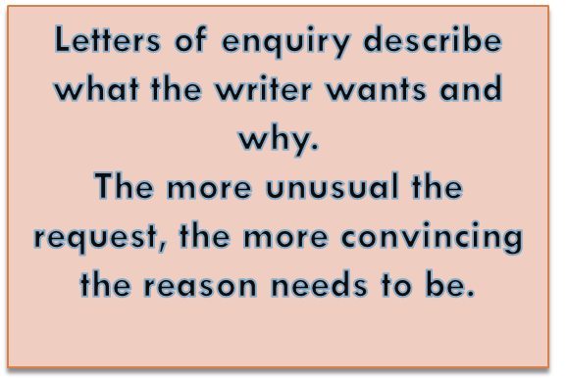

Slide 60
The purpose of this form is to obtain information from the reader. If the reader is expecting the letter, the writer’s task is easy.
If the reader is not expecting your letter, then it is more difficult. In this case, following these four guidelines will be helpful:
  State your purpose
  List your questions or requested action
  Offer something in return to encourage action
  Follow up with a thank you note, e-mail, or phone call to the person who helped you with your request

Slide 61
It is important to recognize that a well-written letter of inquiry is crucial to securing funding for your project.
The letter of inquiry should be brief—no more than three pages—and must be a succinct but thorough presentation of the need or problem you have identified, the proposed solution, and your organization's qualifications for implementing that solution.
The letter of inquiry should be addressed to the appropriate contact person at a foundation or to its CEO and should be sent by regular mail.
This type of letter is often written to suppliers you have not done business with before. Such a letter often asks for a brochure, catalogue or price list. It is sometimes considered useful to give some details of your business, and also where or how you heard of the supplier's name and address.
You should always address your letter “Dear Sirs”, “Dear Sir or Madam” – in this way you are writing to a company. If you address it to an individual, it may mean delay if the person is away or ill.

Slide 62
A.Q.Electronics Ltd.
Calle Estoril 1701
Barselona
Ref: JR/ct
Standart Office Furniture Ltd.
Cantley Rd.
London, SW4 9HX
Great Britain 12 Oct., 1998
Dear Sirs,
We have read an article in “Office News” about your range of visible record system filing cabinets. We are interested in introducing a modern filing system in our main office. We also wish to install an electronic system for the storage and retrieval of data.
Please send us price list and catalogues of your manual and electronic data processing systems, quoting your price f.o.b. London if possible. We are particularly interested in type TW37, so we would be grateful if you would enclose more detailed information about this particular model.
We look forward to hearing from you soon.
Yours faithfully,
J. Rodriguez,
Office Manager
Letters of
Inquiry generally are 2-3 pages;
oftentimes, the foundation will indicate a page limit.
Do not go
over that limit!

Slide 63

Content
Subject Heading
This should inform the reader that this is an enquiry or request
Enquiry about Textbooks
Request for Brochure
Query about Website
Question regarding Product Components
EXAMPLE

Slide 64
Content
First Paragraph
This should tell the reader what you want
The introduction serves as the executive summary for the letter of inquiry and includes the name of your organization, the amount needed or requested, and a description of the project. The qualifications of project staff, a brief description of evaluative methodology, and a timetable are also included here

Slide 65

Content
First Paragraph
Please send me...
Could you please send me...
(for things that the organization offers to send)
I would be grateful if you could tell me…
(for things that are not normally offered)
I am writing to enquire whether…
I would be grateful if you could…
(to see if something is possible)
I would especially like to know…
Could you send me more details…
( + a more detailed request)
Could you also…
I would also like to know...
Could you tell me whether...
( + an additional enquiry or request)
EXAMPLE

Slide 66
Content
Second Paragraph
This paragraph tells the reader why you are contacting his or her organization, and gives further details of the enquiry
There are two reasons why you may contact an organization:
  you have contacted this organization before, and want to again.
  you have not contacted this organization before, but you have heard about them. You should describe from where, such as from an advert or a recommendation

Slide 67
Content
Second Paragraph
EXAMPLE
I saw your advert in the HK Daily on Wednesday, 13 June 2007.
Your company was recommended to me by Ms. Elsie Wong of Far Eastern Logistics.
With reference to your advertisement (ad) in...
Regarding your advertisement (ad) in ...

Slide 68

Content
Final Paragraph
This paragraph should contain a polite expression and/or an expression of thanks to the reader. The degree of politeness (and therefore the length), depends on how unusual or difficult your request is. Possible language includes:
  Thanks. (For a very informal and normal enquiry or request)
  I look forward to hearing from you.
  I am looking forward to hearing from you.
  Thank you for your assistance.
  Thank you very much for your kind assistance.
  I appreciate that this is an unusual request, but I would be very grateful for any help you could provide. I look forward to hearing from you.
If you think the reader might have further questions, you can suggest that he or she contact you.

Slide 69

__________Better Widget Makers, Inc.__________
5555 Widget Avenue
Silver City, CO 80456
September 26, 2003
Mr. Russ Hamilton
Vice President, Sales and Marketing
Golden Bread Company
123 Loaf Street
Silver City, CO 80451
Dear Mr. Hamilton:
Construction on the new employee cafeteria at Better Widget Makers, Inc. is nearing
completion and I am looking for a supplier capable of fulfilling our weekly bakery needs.
Do you have an information packet that would help me project the cost of doing business
with your company? We will need daily deliveries of pastries, pies, dinner rolls and
sandwich bread. Our facility operates 24/7, Monday through Friday, with a flextime
workforce of 1,500 employees. To complete my operational budget I will need the
following information:
      • Wholesale price sheets
      • Quantity cost breaks
      • Annual contract discounts
      • Delivery and or any other service charges.
To submit my proposal to the finance committee at their October 20th meeting I will need
to receive your information by the 10th. I will also need to meet with you after reviewing
the requested materials. Please call me for an appointment at your earliest convenience.
My personal extension is 216-8080, # 29.
In keeping with long-standing policy we would like to place this contract locally. I look
forward to working with you and am hopeful that the Golden Bread Company can fulfill
our needs.
Sincerely,
Ida Mae Knott
Purchasing Agent

Slide 70
Content of replies
How to Reply to Enquiries
Acknowledging receipt of an enquiry/request
Thank you for your letter of … regarding / concerning / in connection with …
I refer to your enquiry about / relating to…
I have received your letter of… requesting information about …
We would like to thank you for enquiring about ...
Explaining action taken as a consequence of the enquiry
I have (reviewed our available stock) …
We held a meeting on 21 January to discuss possible solutions.
I have checked/looked into/investigated (the possible approaches) …

Slide 71

Content of replies
The best choice would be … since …
I highly recommend … as / due to the fact that …
…would probably be more suitable because…
… seems to suit you better although …
Perhaps you should choose … even though…
I suggest that you (should) choose …
I recommend this item since …
In view of the fact that …, I would strongly recommend … as …
Making suggestions / justifying recommendations / pointing out pros and cons / hedging

Slide 72

Content of replies
While I appreciate your firm’s need for this information, I regret that …
It will not be possible to … for legal reasons. We are bound to …
Your proposal is of interest to us, and we have had consultations about it.
However, we feel that it will not be in our interests to … for reasons of (privacy).
We are concerned that …
Apologizing and rejecting proposals
Stipulating action requested or to be taken
We shall arrange for … by …at the latest.
I shall see to it that …
Our company will arrange for …

Slide 73

Content of replies
I hope this suggestion/information will be useful to you.
I hope this information will prove useful to you.
I hope that this information will help you to make decisions on your order.
I look forward to hearing from you.
I look forward to receiving your confirmation of …
I look forward to doing business with your company in the future …
Please feel free to contact me again if you have any further queries on …
Do contact me on 27615432 if you need further information.
Please do not hesitate to contact me on 27615432 if I can be of further assistance.
Establishing goodwill and suggesting contact

Slide 74

Everlong Batteries 171, Choi Hung Road Hung Hom, Hong Kong Tel/Fax 2235 2449 18 Jun 2007 Mr J Wong Purchasing Officer Fortune Goods 317 Orchard Road Singapore Dear Mr Wong Enquiry about Batteries Thank you for your letter of Thursday, 14 June 2007 regarding making copies of the sample battery you sent us. I have investigated the situation and found that your specifications are exactly the same as the design of a proprietary camera battery manufactured by a large Japanese electronics company. We feel that it would not be in our interests to supply this type of battery. However, I would like to thank you for considering our company as your supplier. I look forward to doing business with your company in the future Yours sincerely David Choi David Choi Distributions Manager
Notice these sentences in which the writer thanks his correspondent for an inquiry: Pay attention that we “inquire” about general information, and “request” an object or a statement.

Slide 75

notice
the following terms of delivery frequently used in business letters:
F.o.b. – free on board – means that the seller bears responsibility for the goods until they are delivered to the port and placed on board the ship, which will further deliver them to the port of destination. Accordingly, the price, which the buyer pays, doesn't include transportation and insurance in transit.
C.i.f. – cost, insurance, freight – means that the seller bears responsibility for the goods during all the way to the port of destination – charters the vessel, organizes loading and insurance payments – everything up to the final point; all these payments are, of course, included into the price paid buy the buyer.
Ex-works – free from the factory – means that the seller bears no responsibility for the goods after they leave factory gates.
c.a.f. – cost and freight paid
f.a.s. – free along side boat
They are all enumerated in a document called “Incoterms” which is issued every several years.

Slide 76

  ADDITION
Unless otherwise indicated by the foundation, the contents will generally follow this format:
Opening Paragraph
This serves as your summary statement.
It should be able to stand-alone. If the reviewer reads nothing else they should know what you want to do from reading this paragraph. Make it clear what you want the reader to do (ie: consider funding the project)
Answer the following: who wants to do what? how much is being requested? is this a portion of a larger project cost? over what period of time is money being requested?
Example: “The School of Nursing at the University of Massachusetts at Amherst (UMass) seeks support for developing an innovative undergraduate and graduate curriculum in psychiatric mental health nursing that will prepare expert nurse clinicians in the delivery of mental health services to at-risk adolescents in the community setting. We are requesting $87,000 over a two year period.”
You also may want to say if you are responding to an RFP (Request for Proposals) or make the connection between the foundation’s interest and your project.
Keep this paragraph short! You will have time later for explaining your rationale for why you want to do the project, your methodology, or for establishing your credibility.

Slide 77


  ADDITION
Statement of Need (1-2 paragraphs)
This section answers the “why” of the project.
Explain what issue you are addressing.
Explain why you have chosen to respond to this set of issues in the way that you have.
State briefly why this matters in the area in which you will be working.
Note who benefits. Make sure you can indicate the public good achieved.
Project Activity (this will be the bulk of the letter)
This section answers the “what” and “how” of the project.
Give a general overview of the activities involved. Give more detailed information to the degree that space allows
Highlight why your approach is novel and deserving of the special attention that funding connotes.
Indicate if there will be collaboration with other organizations and what their roles will be. Be specific about who does what.

Slide 78


  ADDITION
Outcomes (1-2 paragraphs; you can put this before or after the discussion of activities)
State the specific outcomes you hope to achieve.
Indicate how evaluation is part of the project – how will you know you’ve achieved these outcomes?
Credentials (1-2 paragraphs)
Demonstrate why your institution or your staff is best equipped to carry out this activity.
Put any historic background about the institution here.
Brag with substance. Indicate awards, rankings, and tangible measures that set you apart from your peers.

Slide 79



  ADDITION
Budget (1-2 paragraphs)
State what the total project cost will be and how much of that you would be requesting from the foundation. Indicate broad categories of activities to be funded.
Include other sources of funding, both cash and in-kind. Especially indicate what your institution will contribute. Do not overlook the value of all in-kind contributions, including those of your collaborators.
Closing (1 paragraph)
Offer to give any additional information the foundation might need.
Give a contact name and contact information for foundation follow-up.
Express appreciation for the reader’s attention or the opportunity to submit if it is in response to a Request for Proposals (RFP).
Specifically indicate you are interested in discussing the project and will “contact their office” by a certain date (allowing time for them to receive and read the letter).
Generally it is best to have the highest ranking person available sign the letter even if they are not identified as the “contact” person. This indicates institutional support
Go back

Slide 80
__________Better Widget Makers, Inc.__________
5555 Widget Avenue
Silver City, CO 80456
September 26, 2003
Mr. Russ Hamilton
Vice President, Sales and Marketing
Golden Bread Company
123 Loaf Street
Silver City, CO 80451
Dear Mr. Hamilton:
Construction on the new employee cafeteria at Better Widget Makers, Inc. is nearing
completion and I am looking for a supplier capable of fulfilling our weekly bakery needs.
Do you have an information packet that would help me project the cost of doing business
with your company? We will need daily deliveries of pastries, pies, dinner rolls and
sandwich bread. Our facility operates 24/7, Monday through Friday, with a flextime
workforce of 1,500 employees. To complete my operational budget I will need the
following information:
      • Wholesale price sheets
      • Quantity cost breaks
      • Annual contract discounts
      • Delivery and or any other service charges.
To submit my proposal to the finance committee at their October 20th meeting I will need
to receive your information by the 10th. I will also need to meet with you after reviewing
the requested materials. Please call me for an appointment at your earliest convenience.
My personal extension is 216-8080, # 29.
In keeping with long-standing policy we would like to place this contract locally. I look
forward to working with you and am hopeful that the Golden Bread Company can fulfill
our needs.
Sincerely,
Ida Mae Knott
Purchasing Agent

Slide 81
Listening Exercise

Slide 82
Listening Exercise
Activity
Answers

Slide 83
REVIEW
Business Letters continues….
1. Types: Personal – Business
2. Parts
3. Formatting
4. Parameter Possibilities
5. Punctuation: Example

Slide 84
REVIEW
6. Letterhead
7. Model
8. Return address, date line, inside address,
9. Salutations
10. Letter of Inquiry

