Slide 1
Business English
Lecture 3

Slide 2
SYNOPSIS
Language Expansion Activity continues
Listening Exercise
Communication: Discernment vs. dialogue
Forms of Communication: Formal vs. Informal
Non-verbal Communication
Communication in Crises
Defensive vs. Non-defensive Communication

Slide 3
Language Expansion Activity

Slide 4
1. You might have to pay two month’s rent as a deposit before you move into a flat
2. When you move out of a flat your landlord will check the inventory
3. You can have an overdraft for free with most banks
4. You can use your bank card from home to withdraw money from a cashpoint
5. You need to be registered with a doctor to get medical treatment
6. Most employers include medical insurance as part of their employment package
7. Using top-ups means you don’t need to sign a contract for your mobile phone
8. You need to check that there is broadband access in the area where you live
Which pieces of advice are true for your country?
Which are different?
What other advice and information could you give?
You’d better...
You don’t need to
You must
It’s a good idea to
You have to...
you need to

Slide 5
Question forms- Use the present simple to make questions for these answers
Where do you come from?
___________________________________________________________
1. From a small village in south west France called Marsac.
What time do you usually start work at?
____________________________________________________________
2. Usually at 9am but sometimes at about 8.45.
What languages can you speak?
____________________________________________________________
3. Languages? English and French quite fluently and also a bit of Chinese
Where do you live?
____________________________________________________________
4. In a small apartment near the centre of town.
How do you come to work/school?
____________________________________________________________
5. Usually by bus, but if the weather is really good I sometimes walk.
When do you usually go on holiday?
____________________________________________________________
6. I usually go on holiday in June.
Where do you have lunch?
____________________________________________________________
7. Sometimes in the company canteen, but more often I go to the cafe round the corner.
Notes:
1. A visual warmer based around pictures of four countries - Japan,
India, US and Russia? (bit sterotypical but thought easier to represent
with pics)
'Which countries would you like and not like to go and work in?'
(SB p7)
Nice idea. I would keep this as 'Which country would you like to work in and why?' to avoid any brutal negatives in a multilingual class. I know they will arise, but best not be seen encouraging them! Perhaps add a few more countries such as Spain or Australia? Ss can guess the countries from the pics first.

Slide 6
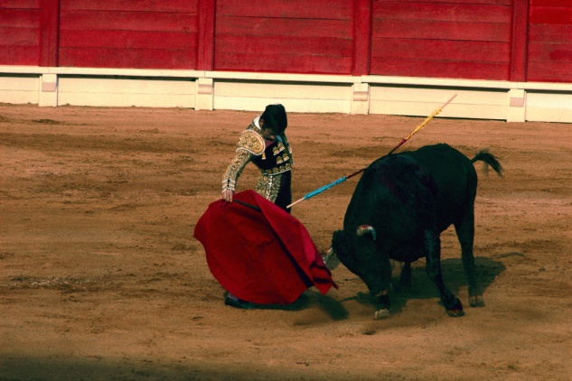

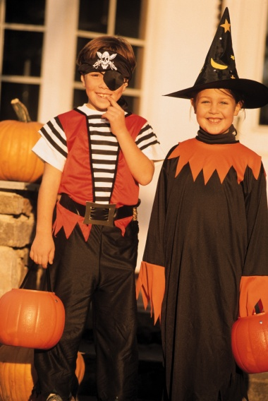

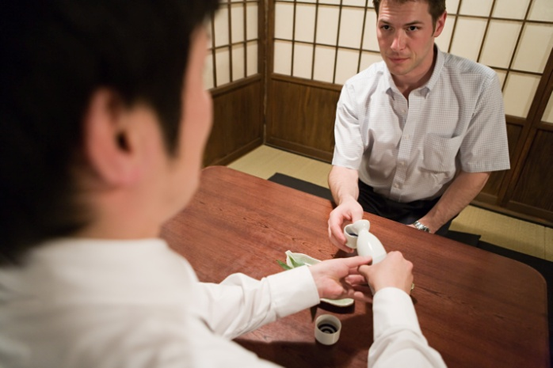
Halloween USA
Throwing the bouquet
Bullfighting, Spain
Halloween USA
Customs
Describe a local custom or festival in your home town
Japanese Tea Ceremony
Chinese New Year
Harvest Festival
Notes:
1. A visual warmer based around pictures of four countries - Japan,
India, US and Russia? (bit sterotypical but thought easier to represent
with pics)
'Which countries would you like and not like to go and work in?'
(SB p7)
Nice idea. I would keep this as 'Which country would you like to work in and why?' to avoid any brutal negatives in a multilingual class. I know they will arise, but best not be seen encouraging them! Perhaps add a few more countries such as Spain or Australia? Ss can guess the countries from the pics first.

Slide 7
Put the words in the correct order
Sorry but I have to go now
It’s been nice meeting you
Are they ‘beginnings’ or ‘endings’?
E
E
1. but Sorry have to go I now
2. meeting It’s been nice you.
I can’t believe how busy it is
Did you have a good journey here?
3. believe can’t how busy it I is
B
B
4. journey have you Did a good here?
How was your weekend?
5. your was How weekend?
Enjoy the rest of the conference
6. Enjoy rest the of the conference
E
B
7. to talking Nice you
Nice talking to you
It’s lovely weather today
E
8. It’s weather lovely today
B

Slide 8
Beginnings
Endings
I can’t believe how busy it is
Sorry but I have to go now
How was your weekend?
It’s been nice meeting you
It’s lovely weather today
Nice talking to you
Enjoy the rest of the conference
Did you have a good journey here?

Slide 9
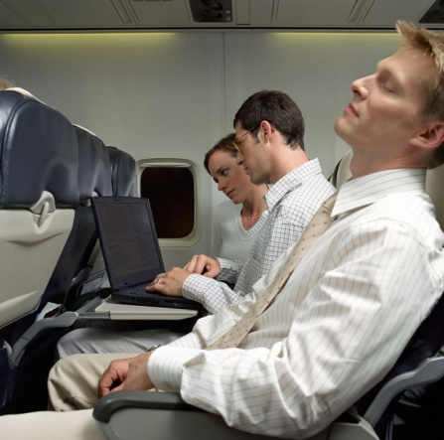
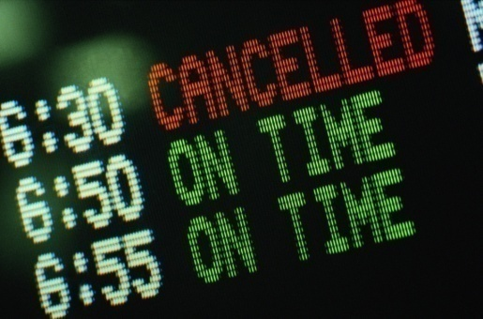

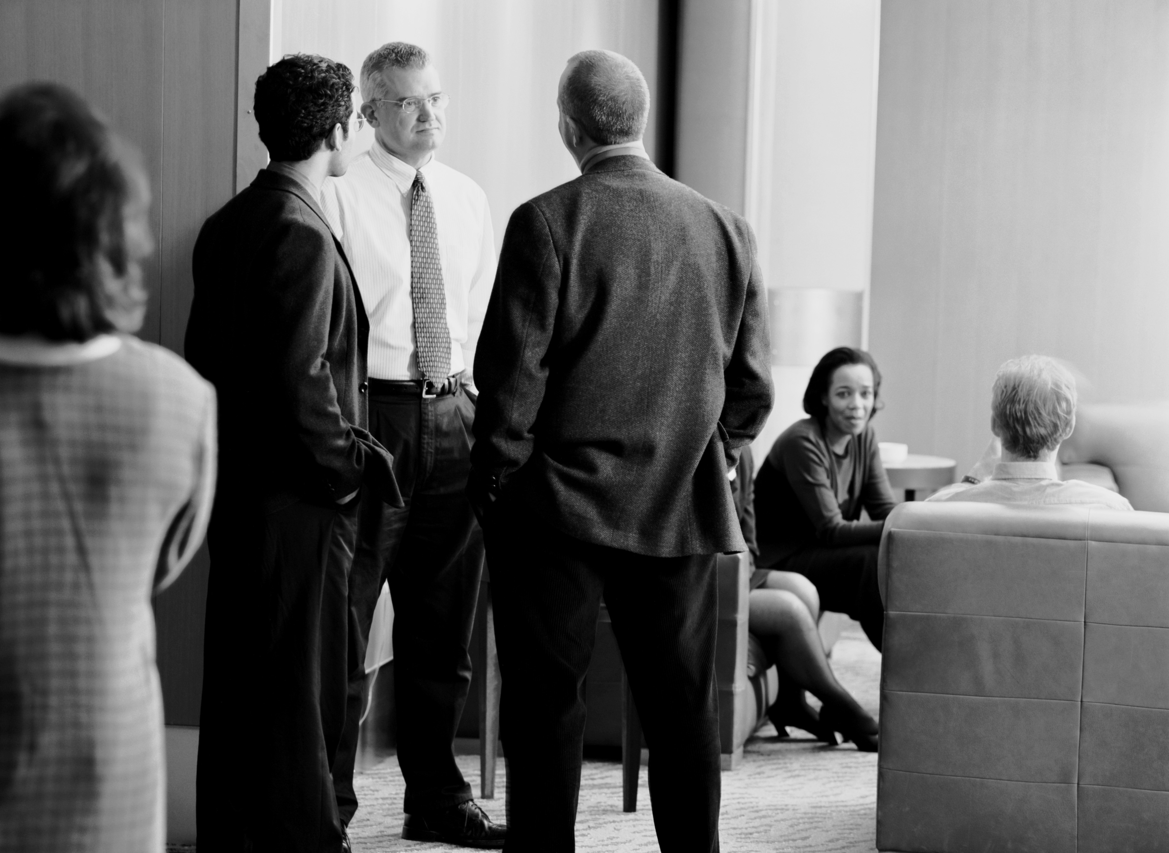
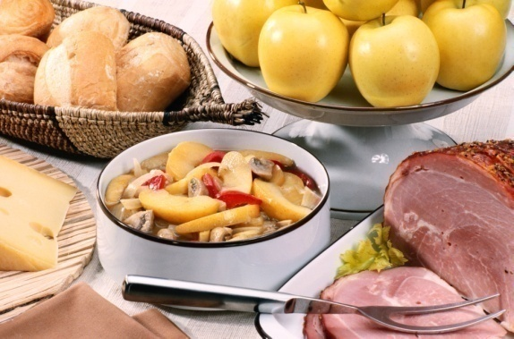
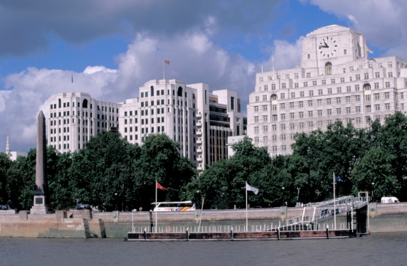
?
?
?
Make small talk!
?
?
?

Slide 10
Formal and informal language
Formal OR Informal
Thanks for your message earlier
I look forward to meeting you in person
Thank you for your e mail received yesterday
I would be grateful if you could send me your catalogue
Could you possibly arrange an interpreter?
See you at the meeting
Please accept my apologies for this misunderstanding
Can you please bring Lars to translate?
Can you book the same hotel as last time?
I’m sorry but I can’t see you this week
Would it be possible for you to organise my accommodation?
All the best
Can you give me a copy of the bill?
With best regards

Slide 11
Formal
OR
Informal
Thank you for your e mail received yesterday
Thanks for your message earlier
I would be grateful if you could send me your catalogue
Can you give me a copy of the bill?
Would it be possible for you to organise my accommodation?
Can you book the same hotel as last time?
I look forward to meeting you in person
See you at the meeting
With best regards
All the best
Please accept my apologies for this misunderstanding
I’m sorry but I can’t see you this week
Could you possibly arrange an interpreter?
Can you please bring Lars to translate?

Slide 12
Listening Exercise

Slide 13
Listening Exercise
Activity
Answers

Slide 14
Business English
Basics continues….

Slide 15
Open Communication
Discernment
  Listening in which a leader detects unarticulated messages hidden blow the surface of spoken interaction.
Dialogue
  Active sharing and listening in which people explore common ground and grow to understand each other and share a world view.

Slide 16
Dialogue and Discussion: The Differences
Conversation
Lack of understanding, disagreement, divergent points of view, evaluate others
Dialogue
Discussion
Reveal feelings
Explore assumptions
Suspend convictions
Build common ground
State positions
Advocate convictions
Convince others
Build oppositions
Result
Result
Long-term, innovative solutions
Unified group
Shared meaning
Transformed mind-sets
Short-term resolution
Agreement by logic
Opposition beaten down
Mind-sets held onto

Slide 17
Communication Champion
Establish credibility
Build goals on common ground
Make your position compelling to others
Connect emotionally

Slide 18
Communication Apprehension
An individual’s level of fear or anxiety associated with either real or anticipated communication with another person or persons.

Slide 19
Forms of Communications

Slide 20
Formal vs. Informal

Slide 21
Formal Communication Strategy
  Who: Source/Audience
  What: Content
  When: Delivery & Effective Date
  Where: Impacts/Contacts/Additional Information

Slide 22
A Continuum of Channel Richness
Electronic mail, IM, Web, intranet
Face-to-face verbal
Formal report
Disadvantages
Impersonal
One-way
Slow feedback
Advantages
Personal
Two-way
Fast feedback
Low channel richness
High channel richness
Advantages
Provides record
Premeditated
Easily disseminated
Disadvantages
No record
Spontaneous
Dissemination hard
Memos, letters
Telephone

Slide 23
Effective Use of Electronic Communication Channels
Combine high-tech with high-touch
Consider the circumstances
Read twice before you hit the “send” button
Know what is off limits

Slide 24

Informal Communication
Leaders are watched (nonverbal communication)
  Appearance
  Behavior
  Actions
  Attitudes
Selection of communication channel
Management by Walking Around

Slide 25
Non Verbal Communication

Slide 26
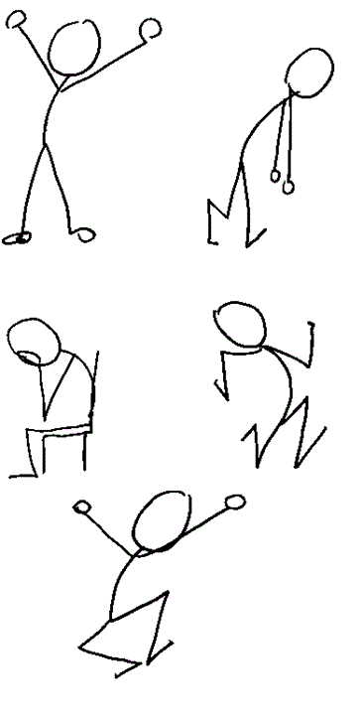
Nonverbal Behaviors
Eye Contact
Facial Expressions
Gestures
Posture and Body Orientation
Proximity
Vocal (other than words)

Slide 27
Question #1
___ A. When conversing with others, I usually do most of the talking
___ B. When conversing with others, I usually let the other person do most of the talking
___ C. When conversing with others, I try to equalize my participation in the conversation
Notes:
(read through choices) – by a show of hands, who thinks A) is the best answer? B)? C)?
Question 1
___ A. When conversing with others, I usually do most of the talking.
___ B. When conversing with others, I usually let the other person do most of the talking.
___ C. When conversing with others, I try to equalize my participation in the conversation.
Best answer: c. Conversations should be a balanced two-way flow of dialogue.

Slide 28
Question # 2
___ A. I make eye contact while conversing
___ B. I sometimes make eye contact while conversing
___ C. I never make eye contact while conversing
Notes:
Correct Answer??

Slide 29
Question #3
___ A. When I'm listening to the speaker, I often cross my arms over my chest
___ B. When I'm listening to the speaker, I often lean back and turn my body away from the speaker
___ C. When I'm listening to the speaker, I often lean slightly forward and face my body toward the speaker

Slide 30
Question #4
___ A. When I have a negative opinion or comment, I just say it
___ B. When I have a negative opinion or comment, I lead in with a positive comment first
___ C. When I have a negative opinion or comment, I say nothing
Notes:
Answer??

Slide 31
Question 5
___ A. When I disagree with a person, I listen first, ask questions for clarification, then disagree non-judgmentally
___ B. When I disagree with a person, I quickly point out the person is wrong and why
___ C. When I disagree with a person, I say little or nothing

Slide 32
Communicating in a Crisis
Stay calm; listen harder
Be visible
Tell the truth
Communicate the vision for the future

Slide 33

Benefits of Good Communication
Quicker problem solving
Better decision making
Steady work flow
Strong business relations
Better professional image

Slide 34
Communication
Communication - the evoking of a shared or common meaning in another person
Interpersonal Communication - communication between two or more people in an organization
Communicator - the person originating the message
Receiver - the person receiving a message
Perceptual Screen - a window through which we interact with people that influences the quality, accuracy, and clarity of the communication
Notes:
2

Slide 35
So…

Slide 36
Communication
Message - the thoughts and feelings that the communicator is attempting to elicit in the receiver
Feedback Loop - the pathway that completes two-way communication
Language - the words, their pronunciation, and the methods of combining them used & understood by a group of people
Notes:
4

Slide 37
Communication
Data - uninterpreted and unanalyzed facts
Information - data that have been interpreted, analyzed, & and have meaning to some user
Richness - the ability of a medium or channel to elicit or evoke meaning in the receiver
Notes:
4

Slide 38
Basic Interpersonal Communication Model
/
/
/
/
/
/
/
/
/
/
/
/
/
/
/
/
/
/
/
/
/
/
/
/
/
/
/
/
/
/
/
/
/
/
/
/
Event
X
Communicator
Receiver
Message
Context
Affect
Perceptual screens
Perceptual screens
Influence message quality, accuracy, clarity
Include age, gender, values, beliefs, culture, experiences, needs
Notes:
3

Slide 39

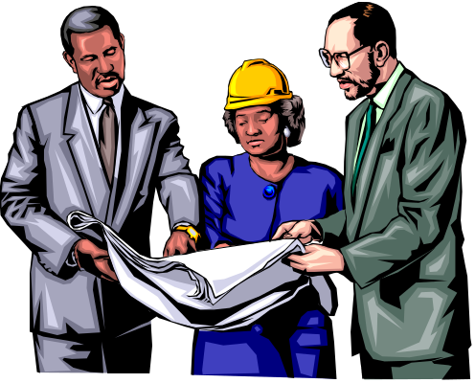
One-way vs. Two-way Communications
One-Way Communication - a person sends a message to another person and no questions, feedback, or interaction follow
  Good for giving simple directions
  Fast but often less accurate than 2-way communication
Two-Way Communication - the communicator & receiver interact
  Good for problem solving
Notes:
10

Slide 40

Key to Effective Written Communication
Expressive writing
Empathetic listening/addressing
Persuasive leadership
Sensitivity to feelings
Informative management
Notes:
11

Slide 41

Barriers/Limitations to Communication
Communication Barriers -
factors that block or significantly distort successful communication
Physical separation
Status differences
Gender differences
Cultural diversity
Language
Notes:
12
23
23

Slide 42
Communication Failure
Defensive Communication
Defensive Communication - communication that can be aggressive, attacking & angry, or passive & withdrawing
Leads to
  injured feelings
  communication breakdowns
  alienation
  retaliatory behaviors
  nonproductive efforts
  problem solving failures
Notes:
13

Slide 43
Nondefensive Communication
Nondefensive Communication - communication that is assertive, direct,
& powerful
Provides
  basis for defense when attacked
  restores order, balance, and effectiveness
Notes:
14

Slide 44
Two Defensiveness Patterns
Subordinate Defensiveness - characterized by passive, submissive, withdrawing behavior
Dominant Defensiveness - characterized by active, aggressive, attacking behavior
Notes:
15

Slide 45
Defensive Attitudes
Defensive Tactic | Speaker | Example
Power Play | Boss | “Finish this report by month’s end or lose your promotion.”
Put-Down | Boss | “A capable manager would already be done with this report.”
Labeling | Boss | “You must be a slow learner. Your report is still not done?”
Raising Doubts | Boss | “How can I trust you, Chris, if you can’t finish an easy report?”
Notes:
16

Slide 46
Defensive Attitudes
Defensive Tactic | Speaker | Example
Misleading Information | Employee | “Morgan has not gone over with me the information I need for the report.” [Morgan left Chris with a copy of the report.]
Scapegoating | Employee | “Morgan did not give me input until just today.”
Hostile Jokes | Employee | “You can’t be serious! The report isn’t that important.”
Deception | Employee | “I gave it to the secretary. Did she lose it?”
Notes:
16

Slide 47
Effective Communication:
A Powerful Tool
Writer observed as centered, assertive, controlled, informative, realistic, and honest
Writer exhibits self-control & self possession
Reader feels accepted rather than rejected
Catherine Crier’s rules to non-defensive communication
  Define the situation
  Clarify the person’s position
  Acknowledge the person’s feelings
  Bring the focus back to the facts
Notes:
17

Slide 48
Review Lecture 3
Language Expansion Activity continues
Listening Exercise
Communication: Discernment vs. dialogue
Forms of Communication: Formal vs. Informal
Non-verbal Communication
Communication in Crises
Defensive vs. Non-defensive Communication

