Slide 1
Business English
Lecture 22

Slide 2
Synopsis
Proposal Writing continues…
Common section: title page, Abstract, Table of Contents. Introduction, Body, Conclusion
Appendices
Organization and format concerns
Cover letter/ Memo
Writing Workshop

Slide 3
Common Sections in Proposals
The general outline of the proposal should be adapted and modified according to the needs of the readers and the demand of the topic proposed. For example, long complicated proposals might contain all the following sections. In contrast, shorter or simpler proposals might contain only some of the sections or the main ones.

Slide 4
Title page
Specific formats for title pages vary from one proposal to another but most include the following:
    The title of the proposal ( as short as informative as possible)
    A reference number for the proposal
    The name of the potential funder ( the recipient of the proposal)
    The proposal's date of submission
    The signature of the project director and responsible administrator(s ) in the proposer`s institution or company

Slide 5
Abstract
The Abstract is a very important part of the proposal because it provides a short overview and summary of the entire proposal.
The Abstract of the proposal is short, often 200 words or less.
In a short proposal addressed to someone within the writer's institution, the Abstract may be located on the title page.
In a long proposal, the Abstract will usually occupy a page by itself following the Title page.
The Abstract should briefly define the problem and its importance, the objectives of the project, the method of evaluation, and the potential impact of the project.

Slide 6
Table of contents
The table of contents lists the sections and subsections of the proposal and their page numbers.

Slide 7
Introduction
Plan the introduction to your proposal carefully. Make sure it does all of the following things (but not necessarily in this order) that apply to your particular proposal:
  Indicate that the document to follow is a proposal.
  Refer to some previous contact with the recipient of the proposal or to your source of information about the project.
  Find one brief motivating statement that will encourage the recipient to read on and to consider doing the project.
  Give an overview of the contents of the proposal.

Slide 8
Background
Often occurring just after the introduction. The background section discusses what has brought about the need for the project—what problem, what opportunity there is for improving things, what the basic situation is.
It's true that the audience of the proposal may know the problem very well, in which case this section might not be needed. Writing the background section still might be useful, however, in demonstrating your particular view of the problem. And, if the proposal is unsolicited, a background section is almost a requirement—you will probably need to convince the audience that the problem or opportunity exists and that it should be addressed.

Slide 9
Benefits and feasibility of the proposed project
Most proposals discuss the advantages or benefits of doing the proposed project. This acts as an argument in favor of approving the project. Also, some proposals discuss the likelihood of the project's success. In the unsolicited proposal, this section is particularly important.

Slide 10
Description of the proposed work (results of the project):
Most proposals must describe the finished product of the proposed project. In this course, that means describing the written document you propose to write, its audience and purpose; providing an outline; and discussing such things as its length, graphics, and so on.

Slide 11
Method, procedure, theory
In most proposals, you'll want to explain how you'll go about doing the proposed work, if approved to do it. This acts as an additional persuasive element; it shows the audience you have a sound, well-thought-out approach to the project. Also, it serves as the other form of background some proposals need. Remember that the background section (the one discussed above) focused on the problem or need that brings about the proposal. However, in this section, you discuss the technical background relating to the procedures or technology you plan to use in the proposed work.

Slide 12
Schedule
Most proposals contain a section that shows not only the projected completion date but also key milestones for the project. If you are doing a large project spreading over many months, the timeline would also show dates on which you would deliver progress reports. And if you can't cite specific dates, cite amounts of time or time spans for each phase of the project.

Slide 13
Qualifications
Most proposals contain a summary of the proposing individual's or organization's qualifications to do the proposed work. It's like a mini-resume contained in the proposal. The proposal audience uses it to decide whether you are suited for the project. Therefore, this section lists work experience, similar projects, references, training, and education that shows familiarity with the project.

Slide 14
Costs, resources required
Most proposals also contain a section detailing the costs of the project, whether internal or external. With external projects, you may need to list your hourly rates, projected hours, costs of equipment and supplies, and so forth, and then calculate the total cost of the complete project. With internal projects, there probably won't be a fee, but you should still list the project costs: for example, hours you will need to complete the project, equipment and supplies you'll be using, assistance from other people in the organization, and so on.

Slide 15
Conclusions
The final paragraph or section of the proposal should bring readers back to a focus on the positive aspects of the project (you've just showed them the costs).
In the final section, you can end by urging them to get in touch to work out the details of the project, to remind them of the benefits of doing the project, and maybe to put in one last plug for you or your organization as the right choice for the project.

Slide 16
Appendices
Appendices (supplementary material that is collected and appended at the end of a proposal)should be devoted to those aspects of your project that are of secondary interest to the reader.
Begin by assuming that the reader will only have a short time to read your proposal and it will only be the main body of your proposal (not the Appendices).
Then, assume that you have gotten the attention of the reader who would now like some additional information. This is the purpose of the Appendices.

Slide 17
Here are some possible sections to include in the Appendices:
Dissemination Plan - An important aspect of your proposal will be the plan for disseminating information of/from the project to other audiences. Most funding agencies are interested in seeing how their financial support of your project will extend to other audiences.
This may include newsletters, workshops, radio broadcasts, presentations, printed handouts, slide shows, training programs, etc.
If you have an advisory group involved with your project they can be very helpful in disseminating project information to other audiences.

Slide 18
Time Line - A clear indication of the time frame for the project and the times when each aspect of the project will be implemented.
Try creating the time line as a graphic representation (not too many words). If done well, it will help demonstrate the feasibility of the project in a very visible way.

Slide 19
Letters of Support - Funding agencies would like to know that others feel strongly enough about your project that they are willing to write a letter in support of the project.
Talk through with the potential letter writers the sort of focus that you think will be important for their letter.

Slide 20
(Try and draw on the reputation of the letter writing group.) Do not get pushed into writing the letters for the agencies - they will all sound alike and will probably defeat your purpose of using them.
The letters must be substantive. If not, do not use them! Have the letters addressed directly to the funding agency.

Slide 21
(Do not use a general "To Whom It May Concern" letter - it makes it appear that you are applying to many different potential funding agencies and are using the same letter for each.
This may really be the case, so make sure you personalize each letter to the specific potential funding agency).

Slide 22
Organization of Proposals
As for the organization of the content of a proposal, remember that it is essentially a sales, or promotional kind of thing. Here are the basic steps it goes through:
You introduce the proposal, telling the readers its purpose and contents.
You present the background—the problem, opportunity, or situation that brings about the proposed project. Get the reader concerned about the problem, excited about the opportunity, or interested in the situation in some way.
State what you propose to do about the problem, how you plan to help the readers take advantage of the opportunity, how you intend to help them with the situation.

Slide 23
Discuss the benefits of doing the proposed project, the advantages that come from approving it.
Describe exactly what the completed project would consist of, what it would look like, how it would work—describe the results of the project.
Discuss the method and theory or approach behind that method—enable readers to understand how you'll go about the proposed work.

Slide 24
Provide a schedule, including major milestones or checkpoints in the project.
Briefly list your qualifications for the project; provide a mini-resume of the background you have that makes you right for the project.

Slide 25
Now (and only now), list the costs of the project, the resources you'll need to do the project.
Conclude with a review of the benefits of doing the project (in case the shock from the costs section was too much), and urge the audience to get in touch or to accept the proposal.

Slide 26
Format of Proposals
You have the following options for the format and packaging of your proposal.
It does not matter which you use as long as you use the memorandum format for internal proposals and the business-letter format for external proposals

Slide 27
Cover letter with separate proposal:
In this format, you write a brief "cover" letter and attach the proposal proper after it. The cover letter briefly announces that a proposal follows and outlines the contents of it. In fact, the contents of the cover letter are pretty much the same as the introduction.

Slide 28
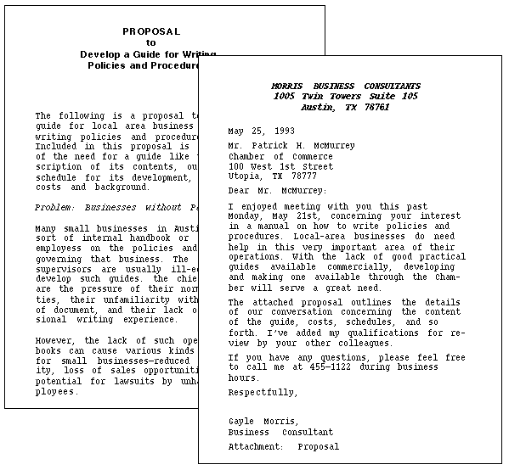

Slide 29
2. Cover memo with separate proposal: In this format, you write a brief "cover" memo and attach the proposal proper after it. The cover memo briefly announces that a proposal follows and outlines the contents of it.

Slide 30
In fact, the contents of the cover memo are pretty much the same as the introduction. The proposal proper that repeats much of what's in the cover memo. This is because the memo may get detached from the proposal or the reader may not even bother to look at the memo and just dive right into the proposal itself.

Slide 31
3. Business-letter proposal: In this format, you put the entire proposal within a standard business letter. You include headings and other special formatting elements as if it were a report.

Slide 32
4. Memo proposal: In this format, you put the entire proposal within a standard office memorandum.
You include headings and other special formatting elements as if it were a report. This format is illustrated in the right portion of the illustration below)

Slide 33
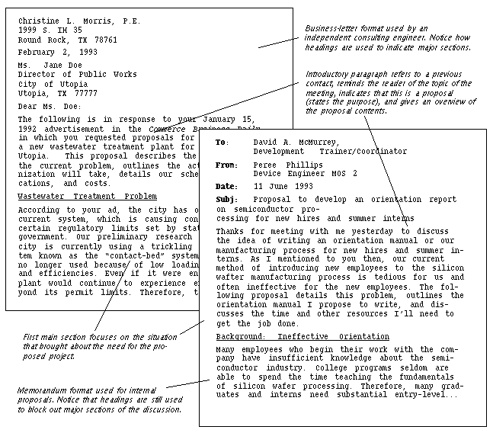

Slide 34
Check List for your Proposal
As you reread and revise your proposal, watch out for problems such as the following:
Make sure you use the right format. Remember, the memo format is for internal proposals; the business-letter format is for proposals written from one external organization to another. (Whether you use a cover memo or cover letter is your choice.)
Write a good introduction—in it, state that this is a proposal, and provide an overview of the contents of the proposal.
Make sure to identify exactly what you are proposing to do.

Slide 35
Make sure that a report—a written document—is somehow involved in the project you are proposing to do. Remember that in this course we are trying to do two things: write a proposal and plan a term-report project.
Make sure the sections are in a logical, natural order. For example, don't hit the audience with schedules and costs before you've gotten them interested in the project.

Slide 36
Break out the costs section into specifics; include hourly rates and other such details. Don't just hit them with a whopping big final cost.
For internal projects, don't omit the section on costs and qualifications: there will be costs, just not direct ones.
For example, how much time will you need, will there be printing, binding costs? Include your qualifications—imagine your proposal will go to somebody in the organization who doesn't know you.

Slide 37
Research Proposal Writing Workshop

Slide 38
Contents
The Larger Context
Getting a Topic
Finding a Home
Writing the Summary
Intellectual Merit and Broader Impact Statements
Ethics
Supplements
Progress/Final reports
Highlights (Nuggets)
Getting Involved

Slide 39

The Larger Context
Notes:
1

Slide 40
Business Proposals
We look for proposals that
  Are innovative and push the frontiers of knowledge
  Contribute to national needs and priorities
  Go beyond marginalia
  Integrate well with educational goals
  Involve research
We do not support (except as incidental to the research goals of the research)
  Developmental efforts
  Computer programming
  Design of…
  Commercialization
Notes:
2

Slide 41
Your Strategic Plan
A strategic plan has three parts:
  Where are you today?
  Where do you want to be in the future (5, 10, 20 years from now)?
  How do you get from here to there?
A strategic plan is a roadmap for your life

Slide 42
Your Proposal
Should advance you toward your life goals
  Should be a stepping stone to the next thing
Should be compatible with your institution’s goals
Should represent a contribution to society at large
Test: If you accomplish your research objectives, are you better off for the effort?

Slide 43
Initiatives
ENG is backing off on initiatives
An initiative is right for you if:
  It’s your topic
  You are already working in the field
  It fits with your strategic plan
  You contribute through your collaboration
Be sure to read the announcement for what it says, not what you want it to say

Slide 44
Your Funding Base
FS should not be the sole source of funding for your research
  Internal support
  State support
  Industry support
  Other Federal agency support
List the potential funding sources for your research area

Slide 45
DOs
Have a strategic plan
Build on your strengths
Differentiate this proposal from your Ph.D. thesis work and other sponsored work
Perform thorough literature search and exploratory research before writing the proposal
  Journal articles (update with personal contact)
  Read the Grant Proposal Guide (GPG)
Establish and keep your contacts

Slide 46
DON’Ts
Rush
Wait until last minute (1 month) to contact program directors
Make the proposed work (research and education) too broad
Make the proposed work too narrow
Ask for too much (or too little) money
Ignore rules (Grant Proposal Guide) and misc. items

Slide 47
Proposal Basics
Write to the reviewers (not to me and not to yourself)
Your proposal will be judged by the reviewers
Reviewers want to know four things:
  What is it about (the research objective)?
  How will you do it (accomplish the objective)?
  Can you do it (you and your facilities)?
  Is it worth doing?
This is, basically, all the proposal needs to convey – but it needs to convey this

Slide 48

Getting a Research Topic
Notes:
1

Slide 49
The Research Topic
It must be research
It must not have been done before
It must be significant
There must be higher than probability zero that you can do it
It must lend itself to a viable research plan
You must have the facilities to accomplish the research
It should fit into your strategic plan

Slide 50
Groundwork
Do you know in your field:
  What is the current state-of-the-art
  Who are the top ten researchers
  What they are doing right now
  Where they get their funding
  What they consider to be the key research issues
  Who would likely review your proposal
  How much money is available for a grant/what the grant opportunities are

Slide 51
What is Research?
Research is the process of finding out something that we (everyone) don’t already know
Scientific research builds upon the extant knowledge base and it is methodical, repeatable and verifiable
  Methodical means that you can specify, in advance, a procedure to accomplish your stated objective
Question: Exactly what will your research contribute to the knowledge base?

Slide 52
The Research Objective
The research objective is a concise statement of what you intend to find out that we don’t already know

Slide 53
The Research Objective
This is probably the hardest part of the proposal
Examples of how not to do it:
  The objective of my research is to provide a quantum leap in the design of anti-gravity boots.
  The goal of this project is to develop an integrated modeling tool for the hardening process.
  The goal of this project is to develop innovative advances to enhance wire sawing processes.
  Rapid prototyping machines are an important part of the vast array of tools. This research will bridge the accuracy gap in these processes by developing theoretical and technological means to implement significant gains in accuracy.

Slide 54
The Research Objective
Four acceptable ways to do it right:
  The research objective of this proposal is to test the hypothesis H.
  The research objective of this proposal is to measure parameter P with accuracy A.
  The research objective of this proposal is to prove conjecture C.
  The research objective of this proposal is to apply method M from field Q to problem X in field R.

Slide 55
The Research Objective
How to do it right:
  The research objective of this project is to measure the cross-section of the muon-nutrino interaction at 5 GeV accurate to 10%.
  The research objective of this proposal is to test the hypothesis that chip formation in high-speed machining of brittle materials is determined by parameters x, y and z.
  The research objective of this project is to account for uncertainty in engineering design decision making through the application of utility theory.

Slide 56

Writing the Summary
Notes:
1

Slide 57
Writing the Summary
The most important statement is your statement of the research objective
  It should be sentence 1 of paragraph 1
  Do not begin with a weather report: “The sky is falling. Tools are breaking. Designs are failing…”
  Do not begin with a state-of-the-union address: “Business is moving off shore. Manufacturing is going to the …”
Remember, this is not a tech paper, it is not a murder mystery (where we find out what the objective is on page 15)
Don’t forget the Intellectual Merit and Broader Impact statements

Slide 58
What We Want to Know
What is your research objective?
  This is what directs your proposal to the appropriate program
What is your approach?
  Outline — just two or three sentences
Why is your contribution important to your research community (the intellectual merit)?
If successful, what will be the benefit to society (the broader impact)? Why is your project important to society?

Slide 59
Summary Template
The objective of this research project is to prove the hypothesis that too many monkeys in a tree will cause the tree to break. The approach will be to take a sample of ten trees and load them with monkeys until they break…
Intellectual Merit – It is important that we know how many monkeys can climb a tree before it breaks because this affects our perceptions of monkey procreation and… The Snerd Theory holds that tree size limits monkey procreation. This study challenges that theory with the notion that… If the objective hypothesis is correct therefore, it will transform our approach to…
Broader Impact – Monkeys are used in medical research. By knowing how many monkeys can fit in a tree, we will be able to provide more monkeys for such research thereby advancing medical science more quickly and improving the quality of life. Also, by watching the monkeys get hurt when the tree breaks, graduate students will be less likely to climb trees, thereby increasing their probability of graduating.

Slide 60
Remember
Your proposal will be returned without review if:
  You fail to include explicit statements of intellectual merit and broader impact (entitle them Intellectual Merit, Broader Impact)
  You use the wrong font or it is too small
  The margins are too narrow
  Your bio is incorrectly formatted
  You have an unauthorized attachment

Slide 61
The Rest of Your Proposal
The next 15 pages of your proposal give backup and detail to your summary
Start with a restatement of your research objective, clarify it, and provide a research plan to accomplish it
Provide a convincing argument that you can carry out your proposed plan
Restate and provide detail on your intellectual merit and broader impact
This is a good time to put forth your best effort

Slide 62
Tips on Proposal Writing
Use only 12 point type
Do not use figures or tables as filler—everything should contribute
Everything should be legible—do not use 2 point type on figures or tables
Be sure to include a clearly stated research objective
Use only the required format
Be sure to include intellectual merit and broader impact statements in the body of the proposal

Slide 63
Tips on Proposal Writing
Don’t include letters of support from industry if
  They aren’t very supportive
  Letters from several companies are identical
  They are letters from previous proposals
  You don’t have them before the submission deadline
Don’t cut and paste together new proposals from old declined proposals
Proofread your proposal before you submit it (and after you submit it)

Slide 64
Listening and Language Expansion

Slide 65
Activity 00:12 – 04:52
Listening Questions
1. Why does Mike mention NVP’s “huge volume”, “huge network”, and “strong foothold in SE Asia”?
2. What does Mike suggest as a way around the China problem?
3. Which idea does the team agree to save for later in the negotiation?

Slide 66
Discussion concerns 04:52 – 08: 12
Techniques
1. Getting discussion going…idea initiated
(person’s take – interpretation) example
2. Summarizing the key benefits to substantiate your idea – example
3. Providing negatives / problems (not ignoring any side of picture) starting with BUT – potential problem

Slide 67
08:12 – 11:24
Anticipating problem – shows participation (practice)
Scope of the partnership – issue (how to raise issue)
How to respond in an unclear situation (I think there is a way…)
Pointing solutions
Response to suggestions

Slide 68
11:24 – 22:00
What happens next… (persuasion and negotiation)
Make sure everyone understands – outline basic idea
Stating initial positions
Sharing agreement / disagreement and adding extension of idea (basic understanding and play it slow)
Proposing a strategy – example

Slide 69
Review
Proposal Writing continues…
Common section: title page, Abstract, Table of Contents. Introduction, Body, Conclusion
Appendices
Organization and format concerns
Cover letter/ Memo
Writing Workshop
Negotiation and persuasion strategy: Language expansion

