Slide 1
BUSINESS ENGLISH
Lecture 10

Slide 2
SYNOPSIS
E-Mail Writing
1. The writing Process
2. Structure and Format
3. Opening-body-closing
4. Critical thinking
5. 10 mistakes – sabotage your career

Slide 3
Memo Workshop
Some guidelines…
Whats and Hows of Consistency, Organization, Clarity, Tone…

Slide 4
Form: Consistency
There are different ways to format a memo, although you should follow some general guidelines on formatting
All memorandum must be consistent:
  In terms of style:
    Margins should line up to create clean, straight lines down the left side of the page (no indentation of paragraphs)
    Section headings should all be the same size with the same font and relative location.

Slide 5
Templates for Consistent Format
Remember to consult a template when constructing a memorandum for a specific organization.
This can be:
  a copy of a previous memo
  a guide-book outlining the proper forms for interoffice correspondence

Slide 6
Initial Headings
Date: December 30, 2003
To: Vice President of Human Resources
From: Shauna Goldberg
Subject: Adopting Telecommuting as a New Company Practice
The first letter of all major words in the titles and headings should be capitalized.

Slide 7
Memo Format: Subject-Line
Subject-line titles in memos function like the tiles of reports: They announce the topic
The memo should deal only with the single subject announced in the subject line
Remember that the title in the subject line should not substitute for an opening that provides a context for the message
VAGUE Subject: Adopting Telecommuting
VAGUE Subject: A New Company Practice
SPECIFIC Subject: Adopting Telecommuting as a New Company Practice

Slide 8
Suggested Format for Spacing and Margins
Introduction does not need a heading.
First Section Heading
Single space between the section titles, paragraphs, and
between sections.
Second Section Heading
Continue in this manner until the end of the memo.
Conclusion does not need a a heading.

Slide 9
Dividing a Memo into Sections: Headings
Divide a memo into sections to clarify your points
The order of the sections must be logical to develop meaning as a well-written essay
The headings should be specific and clear to allow the reader some idea of the content of the whole memo.
The introduction and conclusion do not take headings
Examples of headings:
Benefits of Telecommuting
The Influence of Technology on Telecommuting
Action Needed to Implement Change

Slide 10
Organization of Content
A memo can be written in different ways.
There is no right way to write a memo.
The way you choose to write your memo depends on many things, including the purpose of the memo:
  Persuade
  Inform
  Instruct

Slide 11
Example: Organizing a Persuasive Memo
Introduction: state the purpose of the memo
Body:
  Explain the issue or address the problem. If there are two sides to the issue, explain both sides.
  Make your argument and explain the purpose that your argument serves. If you choose one side over the other, explain why.
  Use examples to illustrate your point and demonstrate why your argument is the best one.
  Present counter-arguments or actions needed to carry out the suggested action.
Conclusion:
  Restate your argument in 1-2 sentences
  Use the last sentence to state how you will follow up

Slide 12
Clarity
To write a clear memo, you must:
avoid vague, wordy sentences
use specific and relevant examples
avoid the use of jargon and acronyms

Slide 13
Clarity Exercise: Introduction
The following is an introduction of a memo. As you read it, pay close attention to clarity.
To: Vice President of Human Resources
From: Shauna Goldberg
Subject: Adopting Telecommuting as a New Company Practice
Telecommuting, or the employment practice of utilizing technological advances such as the internet to enable personnel to labor from their home computers and workplaces, is a flexible working opportunity that would significantly benefit our exemplary employees by giving them the option of working from home for some or even all of the time. Our wonderful organization would also benefit extraordinarily from adopting telecommuting as a new and improved company practice, therefore chiefly because flexible working has a really positive effect on peoples’ productivity and their individual professional motivation themselves. Our company should really highly consider adopting telecommuting as a new and unique form of work options for our employees.

Slide 14
Questions to Consider Related to Clarity
Is this memo effective?
How is it ineffective?
How would you change it?

Slide 15
Comments on Clarity
As you may have noticed, the memo has
two main problems in terms of clarity:
redundancy
overly complex language
How would you revise the introduction of this memo to be more clear?

Slide 16
Revision: Clear Introduction
To: Vice President of Human Resources
From: Shauna Goldberg
Subject: Adopting Telecommuting as a New Company Practice
Telecommuting is a flexible working opportunity that would give employees the ability to work from home some, or even all, of the time. Our organization would benefit from adopting telecommuting as a new company practice, as flexible working has a positive effect on productivity and motivation.

Slide 17
An Effective and Clear Introduction
Notice how the writer makes the proposal. He/she clearly states the purpose of the memo in the introduction. Note that he/she does not state “I propose that…” or “the purpose of the memo is to…”
Telecommuting is a flexible working opportunity that would give employees the ability to work from home some, or even all, of the time. Our organization would benefit from adopting telecommuting as a new company practice, as flexible working has a positive effect on productivity and motivation.

Slide 18
Clarity throughout the Memo
Remember that a clear introduction leads to an effective opening
Of course, clarity should be maintained throughout the body and closing of the memo as well

Slide 19
Tone
To use an appropriate tone, you must:
specify the intended message and audience
determine the desired tone:
  persuasive, angry, accommodating, etc.
effectively utilize the appropriate tone through the use of language

Slide 20
Tone Exercise
The following is the first section of the previous memo we looked at. Think about its tone:
Benefits of Telecommuting
I think telecommuting is a really good option, especially now-a-days. First, many people work so they don’t have a lot of time to spend with their family. But if we were to offer employees in our company the option to telecommute to work, they could spend more time with their family while working. So, for example, let’s say a working mother wants to raise her kids herself (without a babysitter); she could do that if she had the option to telecommute.

Slide 21
Questions to Consider Related to Tone
What tone is used?
Is this written to an equal, a subordinate, or a superior?
If it is addressed to a superior, how would he/she react?
If it is addressed to a coworker, does it use an appropriate tone?

Slide 22
Comments on Tone
As you may have noticed, the memo is:
Informal
Casual
Forceful
In other words, it is written to an equal (perhaps a coworker).

Slide 23
Revisions Needed to Write to a Superior
A memo to a coworker who is also a friend can be informal
A memo to several readers or to a superior (such as a supervisor or a manager) should be formal.
How would you revise the memo section to address a superior?

Slide 24
Revision: Addressing a Superior
Benefits of Telecommuting
In today’s society, many working men and women face poverty of time. As a result, some individuals are reluctant to work and want to spend more time with their family. However, offering both current and potential employees the option of telecommuting to work would allow them to arrange their time around their work, instead of their workplace. For instance, a mother who wants to raise her kids herself and pursue a career can do so by working at home instead of at the office.

Slide 25
Audience
To argue your point effectively, you must consider your audience:
  understand how the audience is likely to feel about the information
  find common links with your audience
  consider what you want the audience to feel about the information

Slide 26
Examples to Illustrate Your Point
Once you know:
Your argument
The tone you will use and
The audience you will address…
Use examples to illustrate your point.

Slide 27
Use of Examples
In today’s society, many working men and women face poverty of time. As a result, some individuals are reluctant to work and want to spend more time with their family. However, offering both current and potential employees the option of telecommuting to work would allow them to arrange their time around their work, instead of their workplace. For instance, a mother who wants to raise her kids herself and pursue a career can do so by working at home instead of at the office.
Notice how this example helps illustrate the benefits of telecommuting. Whether or not the intended audience is a working mother, the reader is likely to understand the need for parents to spend time with their children.

Slide 28
Other Examples?
Research to find other advantages of Telecommuting
Come up with real-life examples to support your claim

Slide 29
Counter Arguments
The following is the last section in the memo before the conclusion.
Action Needed to Implement Change
The company will have to make some exceptions in this new policy. First, some job functions cannot be performed through telecommuting and must be completed in the office. Furthermore, employees who feel more productive in the office should not feel pressured into adopting this practice. However, once an employee considers this option and decides that his or her working space at home does not hinder productivity, the organization can give the employee the option to telecommute.

Slide 30
Use of Counter Arguments
Notice how the writer presents counter arguments but, then, claims that certain exceptions must be made in this new policy. Such exceptions and counter arguments should generally come in a new section after making your argument for this new policy.
The company will have to make some exceptions in this new policy. First, some job functions cannot be performed through telecommuting and must be completed in the office. Furthermore, employees who feel more productive in the office should not feel pressured into adopting this practice. However, once an employee considers this option and decides that his or her working space at home does not hinder productivity, the organization can give the employee the option to telecommute.

Slide 31
Exercise: Conclusion
Write a possible conclusion to the telecommuting memo, keeping these in mind:
  Restate the argument in 1-2 sentences
  Use the last sentence to state how you will follow up with the issue

Slide 32
An Effective Conclusion
By considering employees’ flexible working needs and implementing suitable technologies, the organization would benefit from adopting telecommuting as a new company practice. I will be happy to discuss this policy with you and will contact you next week so that we can work to implement this policy.

Slide 33
E-Mail Writing

Slide 34
E-Mail Messages
The Writing
Process
Structure
and Format
Smart E-Mail
Practices
Typical E-Mail
and Memos

Slide 35

The Writing Process
1
Do I really need to write?
E-mail or hard copy memo?
Why am I writing?
How will the reader react?
How can I save the reader’s time?
Prewriting
Analyze
Anticipate
Adapt

Slide 36
The Writing Process
2
Check files.
Collect information.
Study relevant documents.
Make an outline.
Write a first draft.
Writing
Research
Organize
Compose

Slide 37

The Writing Process
3
Revise for clarity.
Revise for correctness.
Plan for feedback.
Revising
Edit
Proofread
Evaluate

Slide 38
E-Mail and Memos: Structure and Format
  Date:
  To:
  From:
  Subject:
Opening
Body
Closing

Slide 39
E-Mail and Memos: Subject Lines
  Date:
  To:
  From:
  Subject: New Employee Fitness Center

Slide 40
E-Mail and Memos: Subject Lines
  Date:
  To:
  From:
  Subject: Your Vacation Request Deadline

Slide 41
E-Mail and Memos: Subject Lines
  Date:
  To:
  From:
  Subject: Sending Feasibility Report
The headline of your memo.
Summarize the main idea.
Use nouns and phrases, not complete sentences.

Slide 42
E-Mail and Memos: Opening
  Date:
  To:
  From:
  Subject:
Opening

Slide 43

E-Mail and Memos: Opening
Start directly; amplify the main idea.
Indirect Opening
  This is to inform you that we must complete the annual operating budgets smoothly. Over the past two months many supervisors have expressed concern about their departmental budget needs.

Slide 44
E-Mail and Memos: Opening
Start directly; amplify the main idea.
Direct Opening
  All supervisors and coordinators will meet June 30 at 10 a.m. to work out the annual operating budgets for all departments.

Slide 45
E-Mail and Memos: Body
  Date:
  To:
  From:
  Subject:
Body

Slide 46
E-Mail and Memos: Body
  Explain and discuss the topic.
  Introduce relevant details or examples.
  Use graphic highlighting to enhance reading, comprehension, and retention.
  Consider columns, headings, numbered or bulleted lists, and so forth.

Slide 47
E-Mail and Memos: Closing
  Date:
  To:
  From:
  Subject:
Closing

Slide 48

E-Mail and Memos: Closing
  To end the message, you have the following options:
    Action information
    Dates or deadlines
    Summary of the message
    Closing thought

Slide 49
Formatting Hard-Copy Memos
  DATE: Current
  TO: Dawn Stewart, Manager
  FROM: Jay Murray, Vice President
  SUBJECT: Telephone Service Request Forms
  To speed telephone installation and improve service within the main facility, we are starting a new application procedure.
  Service request forms will be available at various locations within the three buildings. When you require telephone services, pick up a request form at your nearest location. Fill in the pertinent facts, obtain approval from your division head, and send the form to Brent White.
  Please call me at 451-0593 if you have any questions about this new procedure.
2 inches from top
1blank line
JM
Sign your initials
2 blank lines
Align items 2 spaces after Subject
At least 1-inch side margins

Slide 50
“Before”—Ineffective Request Memo
  DATE: Current
  TO: Kim Johnson, Corporate Communications
  FROM: Tim Rudolph, CEO
  SUBJECT: New Policy
  This memo is written to inform you that I continue to receive disturbing reports about the misuse of e-mail by employees. In the course of the past three months I have heard of defamatory messages, downloads of pornography for all staff to see, and even a basketball pool that turned into a gambling operation.
  In view of the foregoing, I am herewith instructing your office that an e-mail policy for the staff is needed. By October 1 a rough draft of a policy should be forthcoming. At the very minimum it should inform each and every employee that e-mail is for business only. Employees must be told that we reserve the right to monitor all messages. No pictures or attachments should be in the e-mail system without there being a valid reason. And we should not be using e-mail to be saying anything about personnel matters—such as performance reviews and salaries.
  If you have any questions, do not hesitate to call.
TR

Slide 51
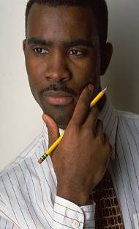
Memo Revision: Critical Thinking Questions
What is the purpose of the routine request?
How effective is the subject line?
Is the opening direct or indirect?
What does the writer want the reader to do?
How should the memo begin? What should be in the body?
What highlighting techniques could be used?
What should be included in the closing?
Should a reason be given along with an end date?

Slide 52
“After”—Improved Request Memo
  DATE: Current
  TO: Kim Johnson, Corporate Communications
  FROM: Tim Rudolph, CEO
  SUBJECT: Developing Staff E-Mail Policy
  Please draft a policy outlining appropriate e-mail use for employees.
  We need a policy because I have received reports of misuse including defamatory messages, pornography downloads, and even gambling. Here are a few points that the policy should cover:
    E-mail is for business use only.
    E-mail messages may be monitored.
    No pictures or attachments should be sent without a valid reason.
    E-mail should not be used to discuss personnel matters.
  Please submit a draft to me by October 2 because we hope to have a final policy completed by November 5. Call if you have questions.
TR

Slide 53
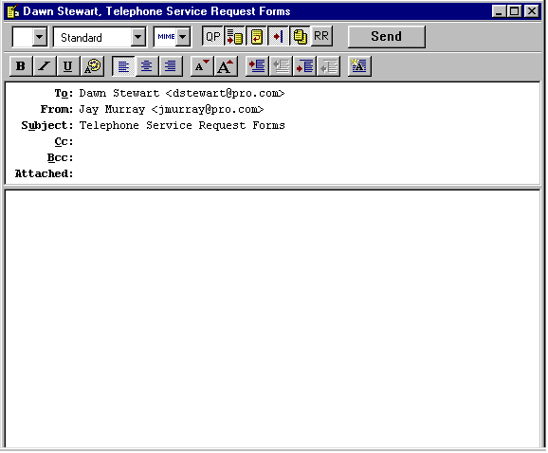
Formatting E-Mail Messages
Single-space body;
double-space between
paragraphs.
Use angle brackets
for Internet addresses
Include a salutation
for a friendly tone.
Dear Dawn:
To speed telephone installation and improve service within the main facility, we are starting a new application procedure.
Service request forms will be available at various locations within the three buildings. When you require telephone service, pick up a request form at your nearest location. Fill in the pertinent facts, obtain approval from your division head, and send the form to Brent White.
Please call me at 451-0593 if you have any questions about this new procedure.
Best,
Jay Murray, Vice President, Facilities and Operations
Phone: (245) 451-0593 ● Fax: (245) 451-3389
E-Mail: jmurray@pro.com
Write complete
sentences and use
upper and lower-
case letters.
Use a complimentary
close and include your
contact information.

Slide 54

Smart E-Mail Practices
Getting Started
Consider composing off line.
Type the receiver’s address correctly.
Avoid misleading subject lines.
Apply the top-of-the screen test.
Notes:
8

Slide 55
Smart E-Mail Practices
Content, Tone, Correctness
Be concise.
Don’t use e-mail to avoid contact.
Care about correctness and tone.
Resist humor and tongue-in-cheek comments.
!
Don’t send anything you wouldn’t want
published or posted on your office door!
Notes:
8

Slide 56

Smart E-Mail Practices
Netiquette
Limit any tendency to send blanket copies.
Never send “spam.”
Consider using identifying labels, such as ACTION, FYI, RE, URGENT.
Use uppercase only for emphasis or titles.
Announce attachments.
Seek permission before forwarding.
Notes:
8

Slide 57

Smart E-Mail Practices
Reading and Replying to E-Mail
Scan all messages before replying.
Acknowledge receipt.
Don’t automatically return the sender’s message.
Revise a subject line if the topic in a series of messages (a “thread”) changes.
Provide a clear, complete first sentence.
Never respond when you are angry.
Notes:
8

Slide 58

Smart E-Mail Practices
Personal Use
Don’t use company computers for personal matters unless allowed by your organization.
Assume that all e-mail is monitored, even when you connect to your ISP from work.
© George Doyle & Ciaran Griffin / Stockbyte / Getty Images
Notes:
8

Slide 59


Smart E-Mail Practices
Other Smart Practices
Use design to improve readability of longer messages.
Consider cultural differences.
Double-check before hitting the Send button.
Use instant messaging professionally to expand your communication channel choices.
Notes:
8

Slide 60
Top Ten Mistakes That Can Sabotage Your Career
1
Responding when angry
2
Making address goofs
3
Forgetting a subject line or failing to change it to match “thread”
Not personalizing your message
4
Skipping the salutation and closing identification
Notes:
8

Slide 61
Top Ten Mistakes That Can Sabotage Your Career
Including inappropriate content
5
Instant indiscretions, off-color jokes, and statements you will later regret
6
Forgetting to check for spelling and grammar
7
Thinking no one else will ever see your e-mail
Notes:
8

Slide 62
Top Ten Mistakes That Can Sabotage Your Career
8
Copying and forwarding recklessly
Completing “To” line first
9
A slip of the fingers can send a message before its time, and you can never take it back.
10
Expecting an instant response
Notes:
8

Slide 63
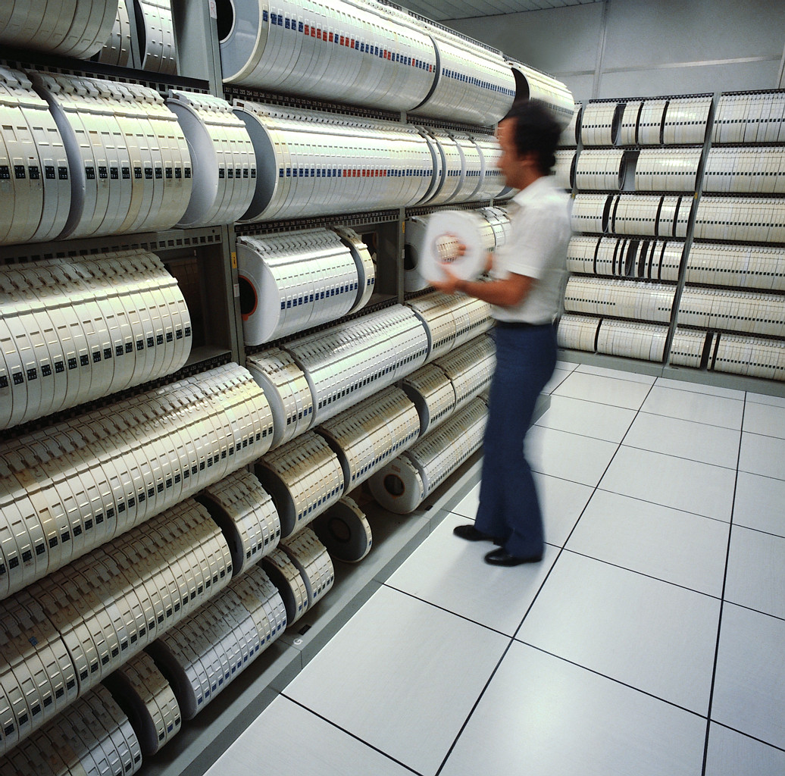






Oops! I thought I deleted that e-mail!
Sends message to
server.
Once a message is
sent, its distribution
cannot be controlled.
Sender
World
Server
Stores and processes
messages; a second
computer may keep
duplicates
Retain from weeks’
to years’ worth of
back mail
May duplicate, print,
forward, or post the
message to the Web
Archives
Receiver

Slide 64
Typical E-Mail Messages and Memos
Request Messages
  DATE:
  TO:
  FROM:
  SUBJECT:
Closing
Include end date and reason, if possible. Express appreciation.
Opening
Frontload your direct request.
Body
Explain and justify your request. Use listing techniques to improve readability.

Slide 65
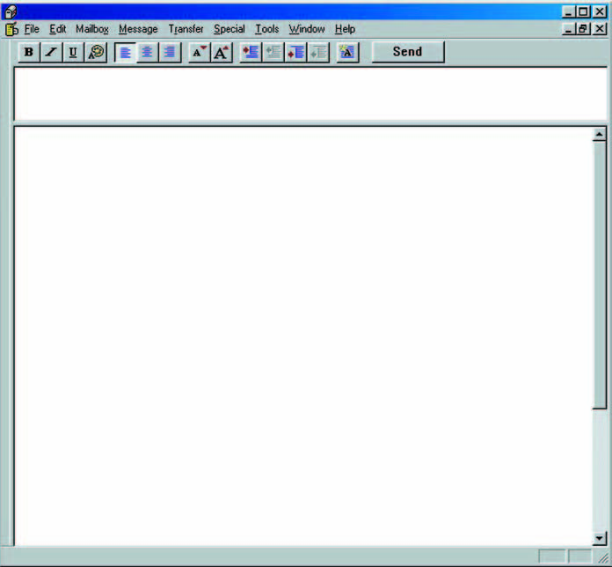
Typical E-Mail Messages and Memos
Response Messages
Opening
Summarize response facts.
Body
Provide details in a readable form.
Closing
Offer concluding remark, summary, or further assistance.

Slide 66
Typical E-Mail Messages and Memos
Procedural Messages
  DATE:
  TO:
  FROM:
  SUBJECT:
Closing
Reinforce benefits and provide source of further information.
Body
Explain its need. List numbered steps to explain the procedure. Use “command” language (do this; don’t do that).
Opening
Announce the procedure.

Slide 67
Typical E-Mail Messages and Memos
Confirmation Messages
Opening
Explain purpose for writing.
Body
Itemize major issues or points concisely. Include names and titles of involved people.
Closing
Offer concluding remark, summary, or further assistance.

Slide 68
Review
Memo Workshop
E-Mail writing : Conventions, Strategies and Practices

