Slide 1
Psycholinguistics
LECTURE# 13

Slide 2
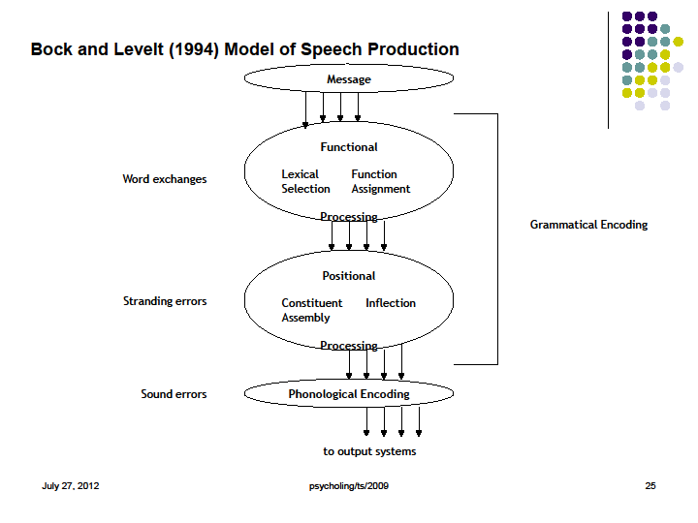
Psycholinguistics

Slide 3
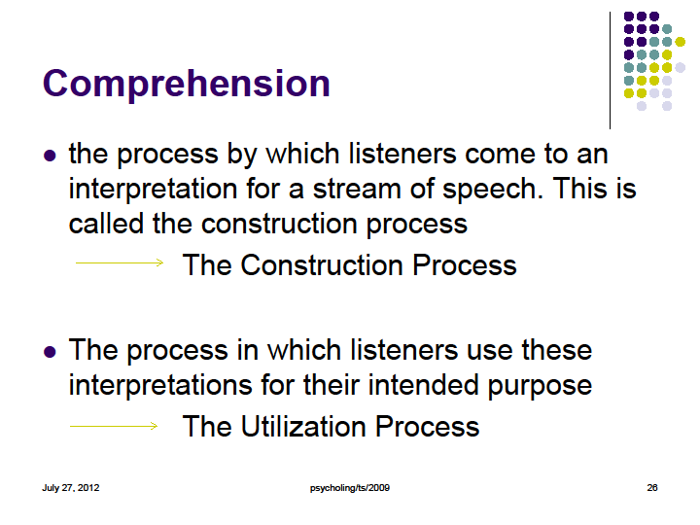
Psycholinguistics

Slide 4
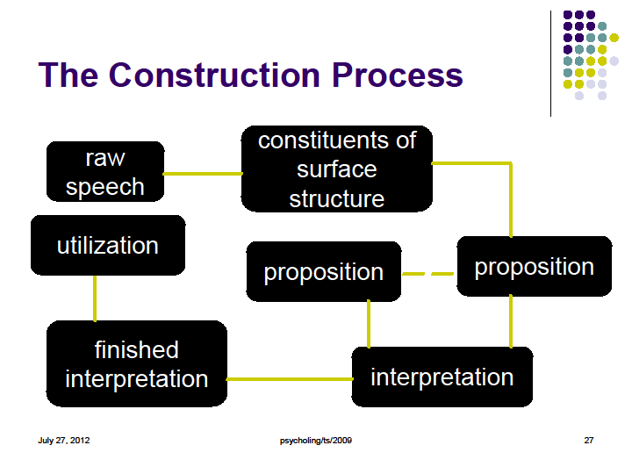
Psycholinguistics

Slide 5
Psycholinguistics
First Language Acquisition How Children Learn Language
Language Acquisition
Language acquisition is the process by which language develops in humans.
First language acquisition concerns the development of language in children
Second language acquisition focuses on language development in adults.
Historically, theories and theorists may have emphasized either nature or nurture as the most important explanatory factor for acquisition.

Slide 6
Psycholinguistics
Chomsky’s Universal Grammar
→ children are born with a hard-wired language acquisition device (LAD) in their brains
→ without an innate ability for language, human infants would be incapable of learning such complete speech patterns in a natural human environment

Slide 7
Psycholinguistics
Learning Condition of L1
The L1 is picked up at home in the most natural situations, guided and controlled by those who are near and dear to a child,
The learning of L1 takes place along with other aspects of biological growth such as walking
The learning of L1 is governed by the principles of proximity, usefulness, concreteness, particularity and interest

Slide 8
Psycholinguistics
Factors Affecting L1 Acquisition
Physical environment
→ the material surroundings of a child, e.g. dog, house, cat, tree, table
Social environment
→ family and neighborhood
Physical and economic resources
→ the economical condition of the family

Slide 9
Psycholinguistics
Motivation
→ internal: the need for food, warmth, shelter; constant care, love and affection
→ external: social interaction, self expression, creative behavior
e.g. children sometimes talk to cat, dog or dolls

Slide 10
Psycholinguistics
An outstanding feature of the early language learning experience is egocentricity
→ children only pick up language items that are absolutely essential for them
→ the earliest pronouns: I, me, my, mine

Slide 11
Psycholinguistics
Stages of Language Acquisition
Pre-babbling
It is difficult to test children when they are first born. We can measure their interest in speech sounds by measuring their sucking rate. By doing this we have discovered that they come pre-equipped to head phonetic contrasts even for languages not spoken around them.
→ the first cry of an infant functions as the crude starting point which makes possible all activities of the lungs and the speech organs

Slide 12
Psycholinguistics
Babbling
→ sounds produced in the first few months after birth which include sounds that do and do not occur in the language of the household.
Even deaf children babble. They seem to be testing out their vocal apparatus, and perhaps tuning the articulation to their own audition. They babble with hand gestures similar to the vocal babbling of hearing children.

Slide 13
Psycholinguistics
Holophrastic
→ refers to the one-word stage in which children produce one-word sentences (usually between 12 and 18 months)
At this stage utterances are one word long, though they often contain complex messages. Children have been shown to understand differences in word order at this stage even though they can't produce sentences with different word orders.

Slide 14
Psycholinguistics
Two-word stage
→ around the beginning of the second year; children begin to produce sentences of two words with clear syntactic and semantic relations.
Most children go through a stage where sentences seem to be limited to two words. There can be a large variety of two-word patterns, however, and the sentences continue to encode much more complex meanings.

Slide 15
Psycholinguistics
Telegraphic speech
→ utterances of children after the two-word stage when many grammatical morphemes are omitted
After the two-word stage there is an explosion in the child's capacity to form sentences, and developmental patterns are more difficult to describe. At this point it is better to simply test particular aspects and constructions from adult grammars to determine which aspects the children have acquired.

Slide 16
Psycholinguistics
Internalization of Linguistic System
The entire language learning is a process of internalization of systems.
Internalization of linguistic systems occurs at a variety of levels.
→ an infant is bombarded by the language utterances of the people around

Slide 17
Psycholinguistics
Random Articulation
stimulated by the pleasurable experiences of the child, the main stimulus: reflex; produces non-distinctive sounds
Auditory organs
Internalization
  an infant takes in whatever it can
Production
internalizes the basic sound system of a language: phonology; produces distinctive sounds
Random Articulation
stimulated by the pleasurable experiences of the child, the main stimulus: reflex; produces non-distinctive sounds
Auditory organs
Internalization
  an infant takes in whatever it can
Production
Internalizes the basic sound system of a language: phonology; produces
Getting familiar with the basic morphological sets of the language
etc

Slide 18
Psycholinguistics
M L U
mean length of utterance
A measure used to refer to the number of words or morphemes in a child’s utterance
More accurate measure of acquisition stage than chronological age of child

Slide 19
Psycholinguistics
Parentese & Baby Talk
Parentese
refer to the sort of speech which children receive when they are young
Characteristics:
- shorter syllables
- parsing down words to phonemes
- highly repetitive usage
- raising pitch
- slowing down the pace of speaking
- simplifying the subject matter and sentence structure

Slide 20
Psycholinguistics
About what?
names for relatives
good and bad behavior
animal names
eating
sleeping
bathroom matters

Slide 21
Psycholinguistics
Baby Talk
uses sounds and nonsense words
involves the use of vocabulary and syntax that is overly simplified and reduced
involves modification in vocabulary

Slide 22
Psycholinguistics
Pre-birth
Speech & Language Milestones
0 – 7 years old children
Auditory skills begin to develop
Necessary for sound association
0 - 6 months
Cooing and babbling;
Continual awareness of sound (turns to sound, stops crying when spoken to);
Uses eye gaze to indicate interest

Slide 23
Psycholinguistics
7 – 12 months
First true words appear (they are often people, or nouns);
Same syllable is repeated (mama, dada);
Child demonstrates increased understanding of daily routines.

Slide 24
Psycholinguistics
12 months
Child says 3-5 words;
Child recognizes his/her name & understands simple instructions;
Initiates familiar words, gestures, and sounds;
Child understands common objects and actions (e.g., cookie, eat, juice)

Slide 25
Psycholinguistics
18 months
Child uses about 10-20 words at age 18 months including names;
Recognition of pictures of familiar persons, objects‘
Early 2-word combinations of words emerge;
Needs are requested verbally such as "more, up";
Child will point, gesture, follow simple commands, imitate simple actions, hum or sing;
Distinguishes print from non print.

Slide 26
Psycholinguistics
24 months (2 years)
Child understands simple questions and commands;
Identifies familiar actions/activities in pictures (i.e. "sleeping, eating");
Follows directions to put objects "on, off, in";
Puts two words together on average;
Sentence length of up to three words;
Child will refer to self by name;
Labels pictures;
Start to use the negative "not go";
Final "s" is used for plurals;
Vocabulary jumps to 300 words during the year! In fact between the ages of 2 and 4, kids may increase their vocabulary to 2 words per day;
Children will stay with one activity about 6-7 minutes.

Slide 27
Psycholinguistics
30 months (2.5 years)
Child has about 450 word vocabulary;
Child is able to give his/her first name;
Child uses past tense, plurals, and combines nouns and verbs;
Begin to identify objects from a group by their function and parts (ie. "which one has wheels?", "which one can we eat?");
Begin to use verbs with "ing" endings (i.e. "eating");
Early concepts such as "big, little" are identified;
Child will use "no, not" and answer "where" questions.

Slide 28
Psycholinguistics
3 years
Child will name at least one color;
Child will often talk during play, or when alone;
Child can tell a basic story or idea;
Child can use 3-4 word sentences;
Begins to understand "not";
Can identify items in a familiar category or group (i.e. "show me the animal");
Child can have a vocabulary of up to 1000 words;
Children are often able to tell their name and street.

Slide 29
Psycholinguistics
4 years
Child will follow 2-3 step commands;
Child will ask many questions, including "who/why";
Child talks in 4-5 word sentences;
Understands and verbalizes spatial concepts more readily such as "on, under, next to..";
Child will talk in the past tense correctly.

Slide 30
Psycholinguistics
5 years
Child defines objects by their function;
Identifies spatial concepts such as "on, behind";
Child uses 5-6 word sentences;
Child understands many opposites;
Child can use different tenses (past, present, future), and many sentence types.

Slide 31
Psycholinguistics
6 – 7 years
Child is developing phonological (sound/letter) awareness skills, and sound/word segmentation skills;
Can generate creative sentences;
Understands time/space concepts such as "before/after, first/second/last".

Slide 32
Psycholinguistics
When to be concerned?
Point to an object when it's named
Recognize names of familiar people, objects and body parts
Say about 50 words
Use simple phrases by linking two words, such as "me up" (for "pick me up")
Use simple pronouns (he, she, me) and prepositions (with, by)
Most children are saying simple words, such as "mama" and "dada" by age 1. But it's important to remember that children vary greatly in their speech development. Even so, a doctor would likely be concerned if a 2-year-old was not yet speaking. Children at this age can typically:

Slide 33
Psycholinguistics
A child whose speech isn't progressing should be checked by a doctor. Speech delays occur in up to 10 percent of young children. Causes include:
Being a twin
Slow development
Mental retardation
Autism
In addition, children living in bilingual homes may experience some speech delays as they learn to interpret and use two languages. This is normal.

Slide 34
Psycholinguistics
THE ACQUISITION OF PHONOLOGY, MORPHOLOGY, SYNTAX, SEMANTIC, & DISCOURSE IN CHILDREN

Slide 35
Psycholinguistics
The Acquisition of Phonology
Early Perception:
By 1-2 months of age (perhaps from birth) infants have the basic sensory capabilities to discriminate speech sounds → “High-Amplitude Sucking”
6 months infants are able to discriminate any phonological contrast, independent of the surrounding language → “Visually reinforced head-turn”
Between the end of their first year and the beginning of their fifth year children learn to distinguish among words that differ in only a single segment. Infant perception starts to resemble adult perception

Slide 36
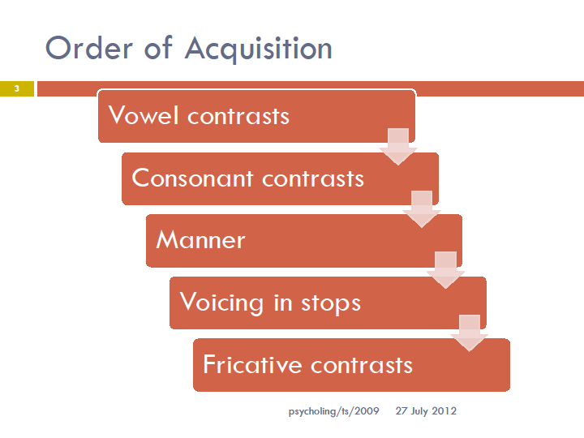
Psycholinguistics

Slide 37
Psycholinguistics
During the Preverbal Vocalization
(2-4 months): mainly vocalic sounds, palatal, velar (resting place of tongue)
  (rest of first year) Anatomical and neuromotor factors play a critical role during this development (vocal tract length, position of tongue, velum, neuromuscular control of the tongue)
  Increased control of laryngeal (voicing) and oral articulatory mechanisms
  Labial and dental sounds
  Both periodic and aperiodic sounds
  Pitch and loudness manipulated
  Gradually babbling starts to resemble adult-like syllables: true consonant+vowel

Slide 38
Psycholinguistics
During the Second Year
  General increase in use of true consonants labials more frequent than coronals
  coronals more frequent than velars
  stops, nasals more common
  fricatives less frequent – they require more precise articulatory control
  Vowels tend to be the basic “cardinal” vowels [i a u] CV is the preferred syllable structure
  Omission of word final consonant
  Omission of fricative or liquid in cluster
  Early words consist of 1 or 2 syllables

Slide 39
Psycholinguistics
Constraints on Speech Production
Syllable deletion; e.g. animals [Qmz]
Final consonant deletion; e.g. because [pikÃ]
Consonant harmony; e.g. yellow [lEloU]
Cluster reduction; e.g. pretty [pii], smile [saIl], blocks [baks]
Fronting of velars, palatals; e.g. cow [taU], show [soU]
Stopping; e.g. move [mub], juice [dus]
Gliding; e.g. love [jÃv], red [wEd]

Slide 40
Psycholinguistics
Simplification Strategies
Substitution; e.g. fis > fish
Deletion: fish > ish
Cluster reduction: spider > pider
Metathesis: snow > nos
Assimilation: dog > dod; duck > guck
Chain shifts: truck as duck, duck as guck: substitution+assimilation
Avoidance: comprehends the word but avoids it in articulation

Slide 41
Psycholinguistics
Phonological idioms: Child words which do not follow the pattern of sound changes attested elsewhere in the child’s productions.
◻Regression: a phonological idiom taking on a less mature form to become consistent with the rest of the system.

Slide 42
Psycholinguistics
Individual Variations in Acquiring Phonology
Whether the child’s earliest productions are segmentally detailed or whether they are better described as maintaining the suprasegmental pattern of the ambient language at the expense of phonological accuracy
Whether they avoid words which they cannot produce and as a result give relatively accurate renditions of the words they do produce, or whether they attempt many words, resulting in substantial deviations fro the adult forms.

Slide 43
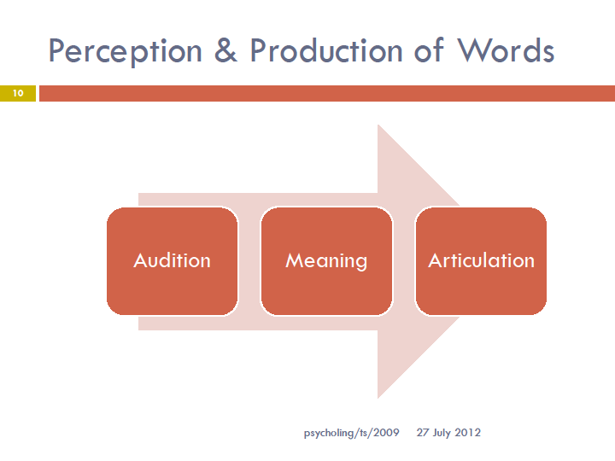
Psycholinguistics

Slide 44
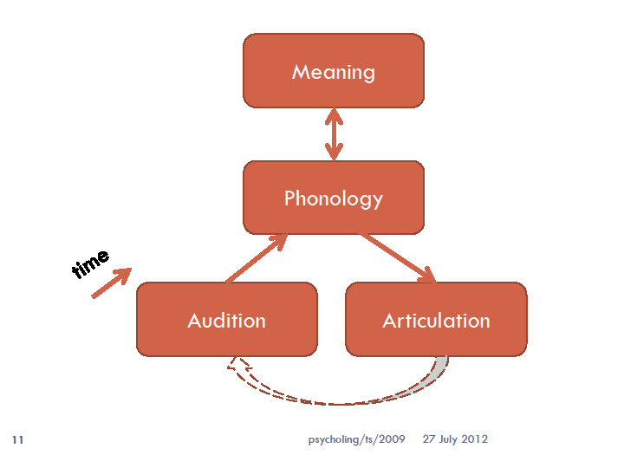
Psycholinguistics

Slide 45
Psycholinguistics
The Acquisition of Morphology
Word comprehension: mapping auditory form onto meanings (the concept of ‘here & now’ in parentese)
Children start to show knowledge of morphophonemic rules around age 4.
In English, children also “regularize” irregular forms

Slide 46
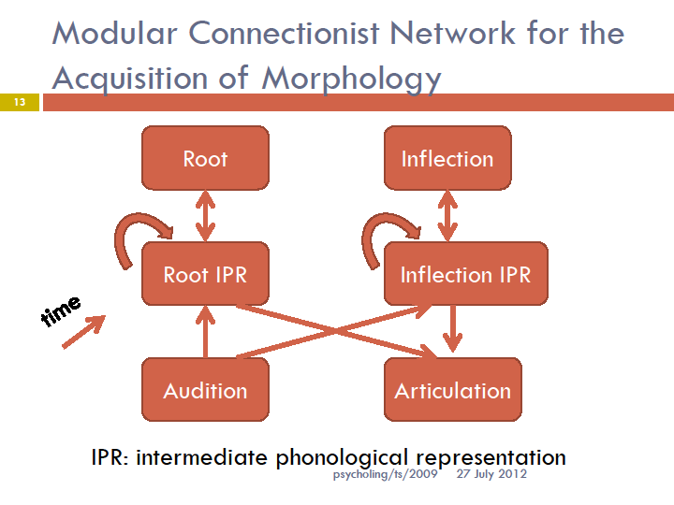
Psycholinguistics

Slide 47
Psycholinguistics
Lexicon Acquired
The principle of ‘here and now’
Content words before function words
→ nouns > verbs > adjectives
Basic level category: generic nouns
Overextension vs underextension

Slide 48
Psycholinguistics
Strategies for Acquiring Lexicon
Reference: everything has referents
Object scope: the concept of bicycle
Extendability: black cat? white cat?
Categorial scope: hyponymy
Novel name/nameless category: putting new words in the mental lexicon
Conventionality: use of familiar words

Slide 49
Psycholinguistics
The Acquisition of Syntax
The stage of child language where it progresses from mere concatenation of lexical items to adult language
Child acquires morphosyntax – syntax & grammatical morphemes

Slide 50
Psycholinguistics
Learning a grammatical morpheme
How does it sound? (including allomorphs)
Where is it likely to occur in a sentence? (distribution)
What is it used for? (syntactic function)

Slide 51
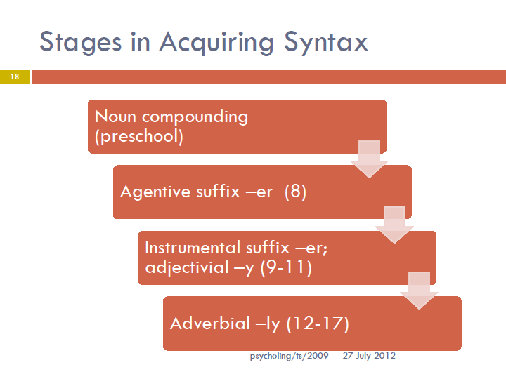
Psycholinguistics

Slide 52
Psycholinguistics
The Acquisition of Semantics & Pragmatics
Communicative intents: egocentricism
  Discourse Organization (in Conversation) Competence, maxims, rules
  Speech acts
  Conversational routines: opening, turn taking, closing
  Conversational Exchange: Adjacency Pair, Question and Answer, Complex exchanges
  Interactive Speech : Turn Taking, Simultaneous talk and Interruption

Slide 53
Psycholinguistics
Language and Communication
Animal Communication
Wild Children and Language

Slide 54
Psycholinguistics
Animal Communication
Animal communication is any behavior on the part of one animal that has an effect on the current or future behavior of another animal.
The study of animal communication → zoosemiotics
Animal communication is a rapidly growing field, and even in the 21st century so far, many prior understandings related to diverse fields such as personal symbolic name use, animal emotions, animal culture and learning, and even sexual conduct, long thought to be well understood, have been revolutionized.

Slide 55
Psycholinguistics
Intraspecies vs Interspecies Communication
The sender and receiver of a communication may be of the same species or of different species.
The majority of animal communication is intraspecies (between two or more individuals of the same species).
However, there are some important instances of interspecies communication (between two or more individuals of different species).

Slide 56
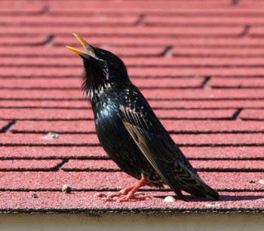
Psycholinguistics
What is this bird doing?
With whom does he communicate?

Slide 57
Psycholinguistics
Interspecies Communication
Prey to Predator
Predator to Prey
Symbiotic Species

Slide 58
Psycholinguistics
Prey to Predator
warning coloration: species such as wasps that are capable of harming potential predators are often brightly colored, and this modifies the behavior of the predator, who either instinctively or as the result of experience will avoid attacking such an animal. Hoverflies are colored in the same way as wasps, and although they are unable to sting, the strong avoidance of wasps by predators gives the hoverfly some protection.

Slide 59
Psycholinguistics
mimicry
canines such as wolves and coyotes may adopt an aggressive posture, such as growling with their teeth bared, to indicate they will fight if necessary
rattlesnakes use their well-known rattle to warn potential predators of their poisonous bite.

Slide 60
Psycholinguistics
Sometimes, a behavioral change and warning coloration will be combined, as in certain species of amphibians which have a brightly colored belly, but on which the rest of their body is colored to blend in with their surroundings. When confronted with a potential threat, they show their belly, indicating that they are poisonous in some way.
A more controversial example of prey to predator communication is stotting, a highly noticeable form of running shown by some antelopes such as Thomson's gazelle. In the presence of a predator; it has been argued that this demonstrates to the predator that the particular prey individual is fit and healthy and therefore not worth pursuing.

Slide 61
Psycholinguistics
Predator to Prey
Some predators communicate to prey in ways that change their behavior and make them easier to catch, in effect deceiving them. A well-known example is the angler fish, which has a fleshy growth protruding from its forehead and dangling in front of its jaws; smaller fish try to take the lure, and in so doing are perfectly placed for the angler fish to eat them.

Slide 62
Psycholinguistics
Symbiotic Species
Interspecies communication also occurs in various kinds of mutualism and symbiosis. For example, in the cleaner fish/grouper system, groupers signal their availability for cleaning by adopting a particular posture at a cleaning station.

Slide 63
Psycholinguistics
Intraspecies Communication
Forms of Communication
Functions of Communication
Evolution of Communication

