Slide 1
Lecture # 31
Review of lectures 15 - 21

Slide 2
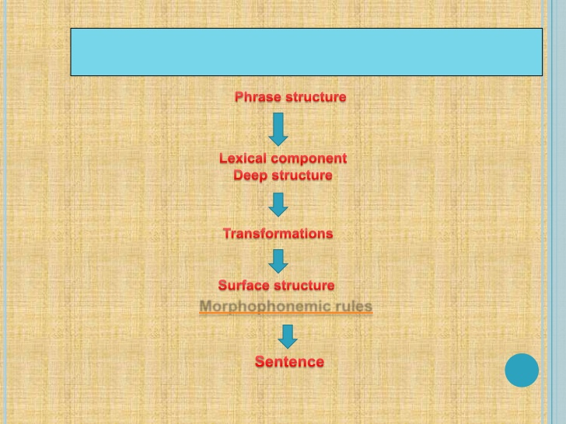

Slide 3
Three Generative Grammars
Finite state grammars are less powerful than phrase structure grammars &
Phrase structure grammars are less powerful than
transformational grammars
Finite state grammars:
A finite set of rules operates upon a finite vocabulary and is capable of generating an infinite set of sentences.

Slide 4
Three Generative Grammars
Function of PS grammar – to generate strings of symbols and to assign to each a labelled bracketing
TG talks about form and meaning both.
It analyses the sentences, divides them into parts, demonstrates function of various parts, and rearranges them

Slide 5
Three Generative Grammars
TG consists of two levels of representation of a sentence: Deep and surface.
Surface structures are derived from deep structures
The ‘rules’ in TG do not tell us how to produce language – they tell us the order in which to put words and phrases.

Slide 6
TGG -Some common transformations
Common transformations
Passive agent deletion
We fit an indefinite pronoun to fill the gap when the subject is not given
Extraposition
Subject moved at the end and a dummy ‘it’ is put in the initial position. It has a grammatical meaning but no lexical meaning

Slide 7
TGG- Some common transformations
End focus
The old piece is put in the start and the most important information is put at the end
End focus and genitives
Choice between ‘s’ genitive and ‘o’ genitive
More important put at the end

Slide 8
TGG- Some common transformations
Reversed wh-clefts
Wh-cleft is put at regular position
Wh-cleft is reversed
Sentence transformations
Grammatically correct but meaningless

Slide 9
Final words
Chomsky is clear that a generative grammar models only the knowledge that underlies the human ability to speak and understand.

Slide 10
Final words
Internal language ( I language) is the mentally represented linguistic knowledge that a native speaker of a language has, and is therefore a mental object –from this perspective most of the theoretical linguistics is a branch of psychology &
External knowledge

Slide 11
Final words
External language (E language) encompasses all other notions of what a language is, for example that it is a body of knowledge or behavioral habits shared by community

Slide 12
Structuralism
Study of language in terms of observable and verifiable data obtained from the behaviour of language users
This new movement – reaction against the traditional and universal grammar.
It studies a language employing certain procedures which linguists have formulated, tested, and improved.

Slide 13
Structuralism
A structuralist treats grammar as a devise by which words are combined into larger units of discourse.
Basic assumptions -Priority of the spoken
language, Objective treatment of all languages,
Importance of synchronic description,
Linguistics – descriptive, not prescriptive
science, System structure, Language & Utterance
,

Slide 14
Structuralism
Strengths
Chomsky says, “ The major contributions of structural linguistics is methodological rather than substative.
It made study of language scientific, precise, verifiable and objective

Slide 15
Structuralism
It examines all languages in terms of their phonological and grammatical systems.
It recognizes uniqueness of each language

Slide 16
Weakness of Structural linguistics,
Functionalism
The Prague school rejected Saussurean distinction of synchronic and diachronic linguistics & homogeneity of language system

Slide 17
Functionalism
Functionalists emphasize on the multi-functionality of language and the importance of its expressive, social, and cognitive functions along with its descriptive function
Functionalism in linguistics emphasize the instrumental character of language

Slide 18
Functionalism
Functionalism in linguistics emphasizes the instrumental character of languageFunctionalists maintain that the structure of natural languages is determined by the several independent semiotic functions – expressive, descriptive and social.
Furthermore, it says that the structure of language systems is partly though not wholly, determined by functions.

Slide 19
Functionalism
Functionalism in linguistics emphasizes the instrumental character of language Functionalists maintain that the structure of natural languages is determined by the several independent semiotic functions – expressive, descriptive and social.
Furthermore, it says that the structure of language systems is partly though not wholly, determined by functions.

Slide 20
Pragmatics
Pragmatics: The study of "how to do things with words“. People use language to accomplish certain kinds of acts, broadly known as speech acts.
They are distinct from physical acts like drinking a glass of water, or mental acts like thinking about drinking a glass of water.

Slide 21
Pragmatics
Direct Speech Acts
Indirect Speech Acts
Performatives
Assert, ask, Order, Promises, Threats, Warnings,

Slide 22
Pragmatics
More speech acts to analyze task –oriented dialogues: "answer", "accept", "reject" and so forth.
Cooperative speakers respect four maxims:
(1)The maxim of quality,(2) The maxim of quantity. (3) The maxim of relevance (4) The maxim of manner.

Slide 23
Pragmatics
Contributions should be perspicuous -- in particular, they should be orderly and brief, avoiding obscurity and ambiguity.

Slide 24
Stylistics
A branch of applied linguistics concerned with the study of style in texts, especially (but not exclusively) in literary works.
linguistic stylistics - the description of literary texts by methods derived from general linguistic theory, using the categories of the description of language as a whole.

Slide 25
Stylistics
A comparison of each text by the same or by different authors in the same and in different genres.
Technically speaking, stylistics is the study of the linguistic features of a literary text - phonological, lexical, syntactical

Slide 26
Stylistics
Style as an embellishment – just ornamentation
Style as choice between alternate expression

Slide 27
Stylistics
Style as a set of individual or collected
characteristics
Almost all writers have their individual
individuality
Style as deviation from a norm
It becomes evident that it is difficult to
separate style from context.
No way to know what an accepted norm is

Slide 28
Stylistics
Style as set of those relations among linguistic
entities that are stable in terms of wider spans
of text than the sentence.
Even a single sentence possesses style and one cannot write a single sentence without style.
Concept of spans not so much stylistic as grammatical

Slide 29
Stylistics
Style is the aggregate of frequencies because it is the result of more than one linguistic item.
Any satisfactory stylistic analysis would be a combination of all the six approaches:
All stylistic analysis is ultimately based on the matching of a text against a contextually related norm.

