Slide 1
Discourse Analysis
Lecture # 23

Slide 2
Review of Lecture 22
Linguistics leads to the development and critical maintenance of a sensitive attitude to language
The problems of stylistic reconstruction involves all aspects of language: sounds, vocabulary, morphology, syntax and semantics.
‘Stylistics of word’ or lexical stylistics will explore the expressive resources available in the vocabulary of a language.

Slide 3
Review of lecture 22
Word formation – an important source of particular literary effects.
‘Stylistics of sentences’ or ‘syntactic stylistics’ will express the expressive values of syntax at three superimposed planes: components of the sentence (individual grammatical forms, passages from one word-class to another), sentence- structure (word order, negation etc.), and the higher units into which single sentences combine (direct, indirect and free indirect speech, etc.)

Slide 4
Why analyse discourse?
Some (many?) things happen primarily (only?) in language
From (say) promising to come to dinner
To (say) telling someone you love them
(Or indeed: talking to the dog)

Slide 5
Definitions of Discourse (1)
A particular unit of language (above the sentence), or discourse in structure;
A particular focus on language use, discourse as function.

Slide 6
Discourse as structure ?
Problem:you can have a unit which looks like a sentence but doesn’t mean anything
e.g. Colourless green ideas sleep furiously
… but on the other hand the units in which people speak do not always look like sentences.
e.g. You can run a hou- whatcha- now whatcha you can run a house-you can run a house a- and do the job, which is important, y’ can’t y- a man can’t do it himself, and a woman can’t do it himself w- if y’ want it to be successful. In most cases.
How do you analyse something which is not a
sentence?

Slide 7
Discourse as a System of functions ?
e.g. “what’s the time?”
Phatic function (opens a contact)
Emotive function (conveys the need of the speaker)
Conative function (asks something of the addressee)
Referential function (makes reference to the world outside the language)
PROBLEM:
Discourse analysis may turn into a more general and broader analysis of language functions.

Slide 8
Definition of Discourse (2)
Discourse – written and spoken
Speaker/ writer
Hearer/ reader
Discourse
Context

Slide 9
Objects of discourse
‘Discourse’ refers to any utterance which is
meaningful. These texts can be:
- written texts
- oral texts (‘speech’/’talk’)
- mixed written/oral texts (e.g. Internet chat)
Discourse does not depend on the size of a text
(“P” and “Ladies” can both be analysed as
discourse)

Slide 10
Definitions of ‘discourse’ (3)
A set of terms, metaphors, allusions, ways of talking, references and so on, which constitute an object
A to-and-fro of exchanges in talk (or text) that performs social actions

Slide 11
Doing discourse analysis
Scope
Influences
Approaches

Slide 12
The scope of discourse analysis
Discourse analysis is not a discipline which exists on its own. It is influenced by other disciplines and influences them as well. It is a two-way process …
For this reason discourse analysis examines spoken and written texts from all sorts of different areas (medical, legal, advertising) and from all sorts of perspectives (race, gender, power)
Discourse analysis has a number of practical applications - for example in analysing communication problems in medicine, psychotherapy, education, in analysing written style etc.

Slide 13
Influences on discourse analysis
psycholinguistics
sociolinguistics
other non-linguistic disciplines
Discourse Analysis
other linguistic disciplines
computational linguistics
pragmatics

Slide 14
Approaches to Discourse
Deborah Schiffrin “Approaches to Discourse”
(1994) singles out 6 major approaches to
discourse:
the speech act approach;
interactional sociolinguistics;
the ethnography of communication;
pragmatic approach;
conversation analysis;
variationist approach.

Slide 15
Approaches to Discourse (1)
The Speech Act Approach
Founders of the speech act theory: John Austin & John
Searle.
There are different types of speech acts:
e.g. “speak louder” (directive)
“Oxford Street is a shopper’s paradise“ (assertive)
Although speech act theory was not first developed as a means of analyzing discourse, particular issues in speech act theory (indirect speech acts, multiple functions of utterances) led to discourse analysis

Slide 16
Approaches to Discourse (2)
Interactional sociolinguistics
Represents the combination of three disciplines: anthropology, sociology, and linguistics.
Focuses on how people from different cultures may share grammatical knowledge of a language but contextualize what is said differently to produce different messages.
e.g. “yeah, bring them down here. I’ll flog them for you” (Australian English)

Slide 17

Approaches to Discourse (3)
The ethnography of communication
The way we communicate depends a lot on the culture we come from. Some stereotypes:
Finnish people: the hardest nation for communication, quiet and serious?
Turkish people: very talkative and friendly?
Ethnography investigates
speaker culture

Slide 18
Approaches to Discourse (4)
Pragmatics
H. P. Grice: the cooperative principle and conversational maxims.
People interact by using minimal assumptions about one another.

Slide 19
Approaches to Discourse (5)
Conversation analysis
e.g. A: This is Mr. Smith may I help you
B: I can’t hear you
A: This is Mr. Smith
B: Smith.
Conversational analysis is particularly interested in the sequencing of utterances, i.e. not in what people say but in how they say it

Slide 20
Summary of approaches to discourse
Approaches to Studying Discourse |  | Focus of Research | Research Question
Structural | CA | Sequences of talk | Why say what at what moment?
 | Variationist | Structural categories within texts | Why that form?
Functional | Speech Acts | Communicative acts | How to do things with words?
 | Ethnography of Communication | Communication as cultural behaviour | How does discourse reflect culture?
 | Interactional Sociolinguistics | Social and linguistic meanings created during communication | What are they doing?
 | Pragmatics | Meaning in interaction | What does the speaker mean?

Slide 21
How do you analyse discourse?
Various ways. Depends on what sort of discourse you’re interested in.
Constituting an object vs realising a social action

Slide 22
Constituting an object
Usually some cultural object (marriage, crime, obesity etc)
Data:
Media texts (eg news reports, magazine articles, newspaper features)
Personal accounts (eg in interviews, diaries)

Slide 23
Ecuador’s capital Quito is 9,300ft above sea level, giving their footballers a home advantage when they play in the thin air.
They were a Spanish colony until they seized their independence in 1822. Out of a population of 14 million, 3,000 Ecuador fans are in Germany. Football is the No1 sport but they also love basketball and bullfights.
The main exports are coffee and bananas.
The language is Spanish. But let’s hope their fans get no chance to shout Olé against England in Stuttgart on Sunday.
Other facts not chosen?
Who’s ‘us’?
Inevitable Spanish-speaker behaviour?

Slide 24
PRESIDENT BUSH sought to repair his tattered reputation in Europe yesterday, talking of his “deep desire” to close the Guantanamo Bay prison camp and conceding that his response to the 9/11 terrorist attacks had not been understood by much of the continent.
Assumes it is tattered
Compare expressing his deep desire
Assumes (someone) has made an accusation

Slide 25
Discourse as language-in-interaction
Language in interaction comes through in a sequence, in turns. Each turn has an implication for the next.
An example analysis: doctors delivering diagnoses.
Do they tell the patient immediately?

Slide 26
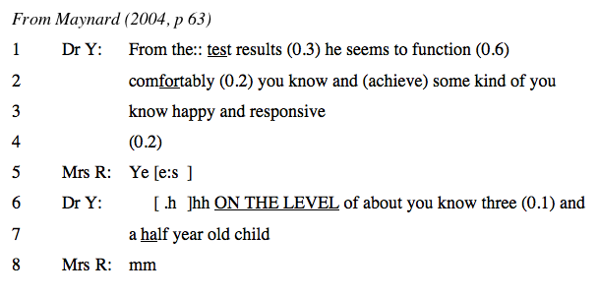
Dr. is telling mother about son
Notice that Dr. describes test results first

Slide 27
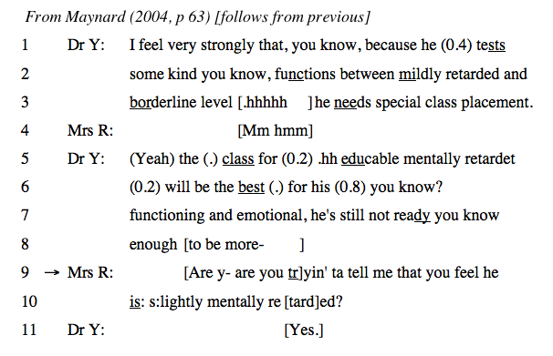
Dr. moves from test to treatment without explicit diagnosis

Slide 28
What does this results-first practice achieve?
Gives patient the sight of the evidence first
Shows that the diagnosis when given is well-founded
Allows the patient to guess or predict what is to come
Allows them to voice it themselves

Slide 29
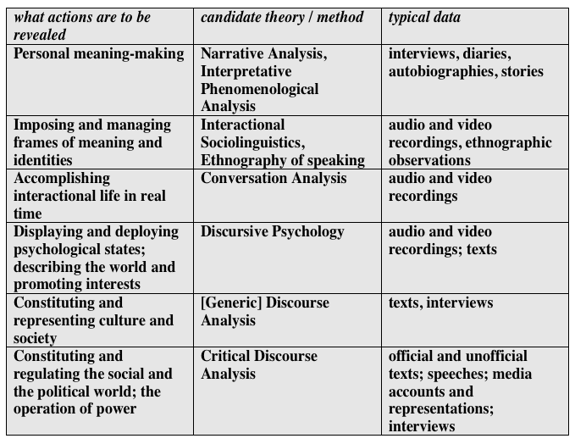

Slide 30
Some worries & objections
It’s not quantitative, so is it ‘subjective’?
not particularly; argument still has to convince readers, editors etc., by appeal to established findings & theory
Is it useful?
reveals how objects get constituted & unmasks the interests that serves (and perhaps could be resisted)
shows how mundane interaction achieves its business (and perhaps could be improved)

Slide 31
Why you shouldn’t do Discourse Analysis
recording the data (other than media texts) isn’t always easy
transcribing the data is laborious
mastering the craft of explicating what’s going
on, without over-interpreting it or merely
describing it, is hard
or a survey of the incidence of A is X in Y
population etcetera

Slide 32
Why you might do Discourse Analysis
- you get close to the data
the data (eg video recordings) are of life as it’s lived
you uncover the subtle organisation of language, the prime medium of our social lives (and selves)
You plug in to social practices that - at the grandest - constitute reality and our place in it

Slide 33
Other reasons why discourse analysis might interest you
it might be connected to your life (job, family, friends and so on)
it can go on your cv
if you get interested in the subject you might want to take it further (specialization)
so it’s worth starting to think about what you are interested in (linguistically)

