Slide 1
Three Generative grammars
Lecture # 15

Slide 2
Review of lecture 14
Generative grammar is set of rules which, operating upon a finite vocabulary of units , generates a set of (finite or infinite) strings, which is well formed in the language that is characterized by the grammar.
The word ‘generate’ does not relate to any process of sentence production

Slide 3
Review of lecture 14
Grammar of a particular language is a system of rules & principles that link sounds and meaning
human beings are endowed with a number of special faculties (mind)
Chomsky says that there are certain phonological, syntactic and semantic units that are universal.

Slide 4
Review of lecture 14
Human beings are independent of any external stimuli
All human languages are similar in structure.
All human languages make reference to the properties and objects of the physical world

Slide 5
Generative grammars
Noam Chomsky demonstrated that some kinds of generative grammars are intrinsically more powerful than others.
He proved that Finite state grammars are less powerful than phrase structure grammars &
Phrase structure grammars are less powerful than transformational grammars

Slide 6
Generative grammars
Three models of generative grammars
Finite state grammar
If the grammar is to consist of a finite set of
rules operating upon a finite vocabulary and
is to be capable of generating an infinite set of
sentences, it means that some of the rules must
be applicable more than once in generating the
same sentences

Slide 7
Generative grammars
The rules and structures they generate are called recursive
The simplest grammars capable of generating infinite set of sentences by means a finite number of recursive rules operating upon finite vocabulary are called finite state grammars

Slide 8
Generative grammars
Sentences are made/generated by means of choices made from left to right.
Every different sequence of words (well formed) is a different sentence.

Slide 9
Generative grammars
Transformational & Phrase structure grammar
Transformational Generative Grammar (TGG) consists of not only transformational rules but includes a set of phrase structure rules as well
Transformational rules depend upon the previous application of the phrase structure rules

Slide 10
Generative grammars
Transformational rules have the effect not only of converting one string of elements into another, but in principle, of changing the associated phrase marker.
They are also formally more heterogeneous and more complex than phrase-structure rules

Slide 11
Generative grammars
Chomsky states that two properties of language must be taken into account for searching the right generative grammar.
A. Recursiveness
B. Constituent – structure
Both are present in phrase structure grammar

Slide 12
Generative grammars
Function of PS grammar – to generate strings of symbols and to assign to each a labelled bracketing
This labelled bracketing is called “phrase markers”
[ on [ the [ wooden table ]]]
[pp[p on] [NP [Art the] [N [ A wooden] [N table]]]]

Slide 13
Generative grammars
Chomsky followed a deductive approach in giving theoretical account of grammar.
Competence/performance
The competence of a native speaker enables a speaker to produce an infinite number of sentences from a finite set.
The sentences generated are grammatical & meaningful equally

Slide 14
Generative grammars
Structuralists focus on ‘Form’
TG talks about form and meaning both
Form is important in generation of sentences.
Language is productive, complex and arbitrary
TG grammar is both transformational and generative

Slide 15
Generative grammars
Role of transformational grammar:
Analyses the sentences
Divides them into parts
Demonstrates function of various parts
Rearranges them
Shows interrelatedness between sentences
It is the most powerful among the three types.

Slide 16
Generative grammars
TGG shows that only a meaningful form is not important but meaning is also important.
It also shows how sentences are related to one another in a sentence
TGG takes each part of sentence and talks about its role.
It is different from structural grammar

Slide 17
Generative grammars
TG is not a mathematical grammar. The processes it describes are not mathematical processes and the symbols it describes are not used with their mathematical meaning.
Chomsky’s grammar is a generative grammar of the transformational type.

Slide 18
Generative grammars
He means that among the rules are those for transforming one type of sentences into another (affirmative into negative, simple into compound or complex, and so forth)

Slide 19
Generative grammars
TG consists of two levels of representations of the structure of sentences which incudes an underlying more abstract form, termed ‘deep structure’, and the actual form of the sentence produced called ‘surface structure’
Surface structures are derived from deep structures by a series of transformations

Slide 20
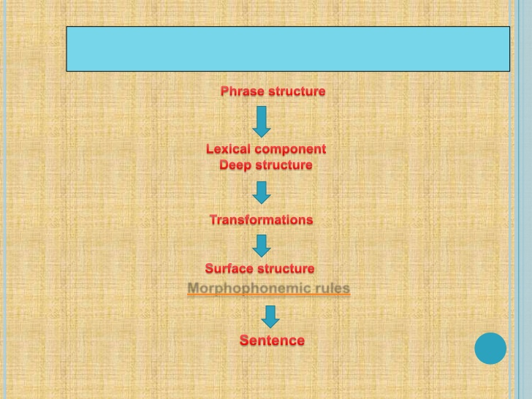

Slide 21
Generative grammars
Deep structure – an abstract representation of a sentence . It can be represented in the form of a hierarchical tree diagram , or ‘phrase structure tree, depicting the abstract grammatical relationship between the words and phrases within a sentence.
Surface structure – version of a sentence that can be heard or spoken

Slide 22
Generative grammars
Example: The dog bit the cat (Deep structure)
The cat was bitten by the dog
( surface structure)
It’s system of formal rules specifying how deep structures are to be transformed into surface structures.

Slide 23
Generative grammars
The ‘rules’ in TG do not tell us how to produce language – they tell us the order in which to put words and phrases.
TGG allows us to generate an infinite number of sentences via transformations
Grammatical transformations are the rules relating deep and surface structures

Slide 24
Summary
Finite state grammars are less powerful than phrase structure grammars &
Phrase structure grammars are less powerful than
transformational grammars
Finite state grammars:
A finite set of rules operates upon a finite vocabulary and is capable of generating an infinite set of sentences.

Slide 25
Summary
Function of PS grammar – to generate strings of symbols and to assign to each a labelled bracketing
TG talks about form and meaning both.
It analyses the sentences, divides them into parts, demonstrates function of various parts, and rearranges them

Slide 26
Summary
TG consists of two levels of representation of a sentence: Deep and surface.
Surface structures are derived from deep structures
The ‘rules’ in TG do not tell us how to produce language – they tell us the order in which to put words and phrases.

