Slide 1
Writing by Maggie Sokolik, University of California, Barkeley (USA)
Lecture # 28

Slide 2
Review of the last lectures
Principles for Teaching Reading:
Exploit the reader’s background knowledge
Build a Strong Vocabulary Base
Teach for comprehension
Work on increasing reading rate
Teach reading strategies
Encourage readers to transform strategies into skills
Build assessment and evaluation into your teaching
Strive for continuous improvement as a reading teacher.
Classroom Techniques and Tasks: ACTIVE:
Activate prior knowledge; Cultivate vocabulary, Teach for Comprehension
Increase Reading rate, Verify Reading Strategies, Evaluate Progress
Extensive Reading and Intensive Reading
What is Writing?

Slide 3
Review of the last lecture
Understand your students’ reason for writing
Provide many opportunities for students to write
Make feedback helpful and meaningful
Clarify for yourself, and for your students, how their writing will be evaluated: what is rubric; a kind of scoring grid that elaborates the elements of writing that are to be evaluated.
Rubric:
i) Weighted Rubric
ii) un-weighted Rubric
iii) Holistic Rubric

Slide 4
Review of the last Lectures…
Concerns with teaching of Writing goes back to thousands of years.
A student essay was then graded for its grammatical accuracy and correct organization as well as it content.
This idea was given clearly for Harvard University’s entrance requirements of 1874.
This was the time when rules of writing were concerned more with correctness of form over function, like we do in native language.
A movement for more progressive writing instruction started in 1911 when the national council of teacher of English (NCTE) was founded.
NCTE protested against the rigid practices of writing.

Slide 5
Review cont….
In 1960, a broader understanding of writing and the teaching of writing began to take hold in classroom.
Second language writing instruction generally included the principles and methods followed in first language writing classes, however, additional concerns surfaced in the 1960s.
EFL/ESL instructors began to recognize that certain writing problems seem to be related to students’ first languages.
Scholars of first language writing, Peter Elbow and Donald Murray called for teachers to take student writers’ needs into consideration.
This methodology has been called “ Expressivism” ?
Teachers are seen as facilitators to urge students to write without thinking to the “ the rules” of writing.
Peter Elbow encouraged “FREE WRITING”.
In 1970s, interest in cognitive science and sociology of languages broadened writing instruction even further.

Slide 6
Classroom Techniques and Tasks
Today, we will talk about some techniques and tasks, that can be used to teach writing. All of these techniques are part of what has been called process approach or process writing.
What is process approach or process writing?
Kroll points out:
The “process approach” serves today as an umbrella term for many types of writing courses….what the term captures is the fact that student writers engage in their writing tasks through a cyclical approach rather than through a single shot approach”

Slide 7
Classroom Techniques and Tasks
In other words, these activities serve to encourage brainstorming, drafting, writing, feedback, revising, and editing in a cyclical fashion.
These types of activities encourage the idea that learning to write is more than creating a final product.
It is the learning of series of skills leading to that product.

Slide 8
Classroom Techniques and Tasks
Invention Techniques:
Brainstorming
Word mapping
Quick writing

Slide 9
Classroom Techniques and Tasks
Invention Techniques:
Brainstorming:
Can be done individually or in pairs or in groups.
Give students plenty of time for this activity.
Word Mapping:
It is more visual form of brainstorming.
Quick writing:
Students begin with a topic, but then write rapidly about it. You can give the students a time limit, usually 10 -15 minutes and instructs them not to erase……

Slide 10
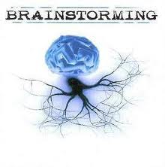
Brainstorming

Slide 11
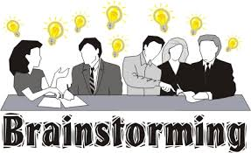
Brainstorming

Slide 12
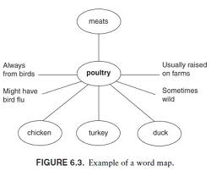
Word Mapping

Slide 13
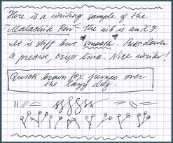
Quick Writing

Slide 14
Classroom Techniques and Tasks
Writing: Drafting, feedback, and Revising
Once students develop their topics and ideas, it is time for them to write their first draft.
Ample time should be given for the first draft, and students should be reminded that they need to focus on the development of ideas and the organization of those ideas more than the development of perfect grammar, punctuation, or spelling.
.

Slide 15
Classroom Techniques and Tasks
Writing: Drafting, feedback, and Revising
After the draft is handed in, the instructor can make comments, but only in keeping in mind with the instructions given to students.
Make Comments more on ideas and Organization than on grammar and spellings.
Peer feed back can be utilized at this point of time.
After receiving the feedback, students begin the process of revising their papers.
Have discussion with students on
What is revision?
What is correction of mistakes?

Slide 16
Classroom Techniques and Tasks
Writing: Drafting, feedback, and Revising
Proofreading and Editing :
Before the final draft is turned in for evaluation.
Students should read for mistakes in spellings, grammar, punctuation and so forth.
Students can help each other to proofreading and edit.
Teacher’s involvement in proofreading and editing need to be minimum.
To develop independent writers, it is important that students learn to proofread and edit on their own as much as possible.

Slide 17
Classroom Techniques and Tasks
Writing in the Classroom:
It depends on the level of students…….
Design activities accordingly.

Slide 18
Summary
The “process approach” serves today as an umbrella term for many types of writing courses….what the term captures is the fact that student writers engage in their writing tasks through a cyclical approach rather than through a single shot approach
Classroom techniques and task for writing.
Inventions activities:
Writing
Revising
Proofreading

