Slide 1
Language and Society
Dr. Ansa Hameed

Slide 2
Today’s Lecture
Sociolinguistics
Language and Society
Language and Speakers
Sapir-Whorf Hypothesis
Language reflects Society
Society changes Language
Important Terms in Sociolinguistics

Slide 3
Sociolinguistics
Sociolinguistics - the study of the relationships between a language system (langue) and speaking (parole) in a social and cultural context
Study of the structure and use of language as it relates to its social setting

Slide 4
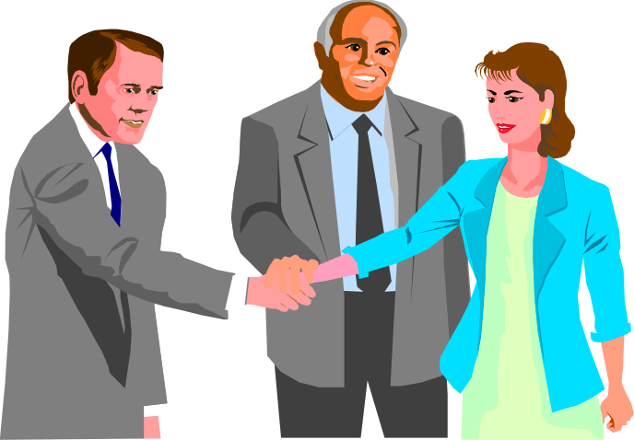
Language and Society
Language has a social function: it helps us to
establish and maintain relationships.
Convey information about the speaker.

Slide 5
Language and Speakers
Users of the same language in a sense all speak differently. The kind of language each of them chooses to use is in part determined by his social background. Language, in its turn, reveals information about its speaker

Slide 6
To some extent, language, especially the structure of its lexicon, reflects the physical environments of a society

Slide 7
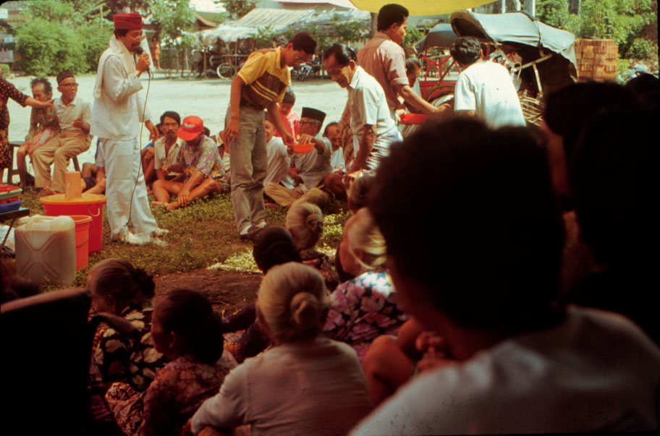
Language in its Social & Cultural Settings
  Does language influence the perception of reality and cultural behavior?
  Does language reflect reality in a culture?
  Or, is it both?

Slide 8
LINGUISTIC RELATIVISM and DETERMINISM
Edward Sapir/Benjamin Lee Whorf – the “Sapir-Whorf Hypothesis”
  language & culture intrinsically linked
  "language is a guide to social reality... it powerfully conditions all our thinking about social problems and processes."

Slide 9
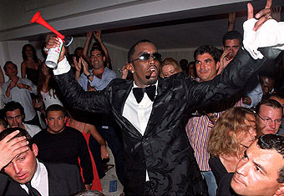
Language and Thought
Sapir-Whorf hypothesis
  Language predisposes people to see the world in a certain way guiding behavior
Language reflects reality
  Rich vocabulary reflects a cultural focus

Slide 10
Language determines thought
Whereas English, for example, has only one word for snow ( or two if we include sleet), Eskimo has several. The reasons for this are obvious. It is essential for Eskimos to be able to distinguish efficiently between different types of snow.
English, of course, is quite able to make the same distinctions: fine snow, dry snow, soft snow, and so on, but in Eskimos this sort of distinction is lexicalized---made by means of individual words.
Because snow is most common thing in culture of eskimos

Slide 11
Language Reflects society
To some extent, language, especially the structure of its lexicon reflects social environments of a society.
For example, a society's kinship system is generally reflected in its kinship vocabulary.

Slide 12
Society changes Language
As society is reflected in language in this way, social change can produce a corresponding linguistic change.
This has happened in the case of Russian. During the period from 1860 to the present day the structure of the Russian kinship system has undergone a very radical change as a result of several important events: (PTO)

Slide 13
For example: the emancipation of serfs in 1861, the First World War, the revolution, the collectivization of agriculture and the Second world War. There has been a marked social as well as political revolution, and this has been accompanied by a corresponding change in the language.

Slide 14
In the middle of the last century, wife's brother was shurin, whereas now now it is simply brat zheny, brother of wife. Similarly, brother's wife, formerly nevestka, is now zhena brata, wife of brother. In other words, distinctions that were formerly lexicalized, because they were important, are now made by means of phrases. The loss of importance of these particular relationships are due to the fact that social changes in Russia have led to the rise of the small, nuclear family.

Slide 15
In the last century most Russians lived in large patrilocal extended-family households. brother's wives, at that time part of the family now normally live, in different households. Similarly, the term yatrov, signifying husband's brother's wife has now disappeared entirely.

Slide 16
Important terms in Sociolinguistics
Speech Community
Language Varieties
Regional Dialects
Social Dialects
Idiolect
Diglossia
Style, Context and Register

Slide 17
Speech Community
A speech community is defined as a group of people who form a community and share the same language or a particular variety of language.
Characteristics of Speech Community:
A. They speak the same language or dialect.
B. the members of the group must interact linguistically with other members of the community.
C. They may share similar attitudes toward linguistic norms.

Slide 18
Speech Variety
Speech variety, also known as language variety, refers to any distinguishable form of speech used by a speaker or group of speakers.
The distinctive characteristics of a speech variety are mainly reflected in its pronunciation, syntax and vocabulary
Speech variety is a neutral term, which is often used to replace the such terms as standard language, dialect, pidgin and creole.

Slide 19
Language Varieties
People who claim to be users of the same language do not speak the language in the same manner. For example all the English–speaking people do not speak the same type of English. And the language used by the same individual varies as circumstances vary.
Dialectal Varieties
1. Regional Dialects
2. Social Dialects
Functional Varieties: Style, Register

Slide 20
Dialectal Varieties
1. Regional Varieties
Regional dialects are linguistic varieties used by people living in different regions.
Example:
North: You need your hair cutting.
South: You need your hair cut

Slide 21
English: Scottish:
It needs washing
It needs washed

Slide 22

Regional dialect boundaries often coincide with geographical barriers such as mountains, rivers, or swamps.
This differentiation is accounted for by the lack of communication in the old days when travel was difficult.

Slide 23
Regional Varieties: Isoglosses and Dialect Boundaries*
Isogloss: lines on a map that mark a border between areas of contrasting speech features
The lines we can draw between areas that differ with respect to any feature of language are called isoglosses. (Bloomfield)
Dialect Boundary: When a number of isoglosses come together, a more solid line indicates dialect boundary

Slide 24
Dialectal Varieties
2. Social Dialects
Just as regional dialect is associated with separation caused by physical conditions, social dialect has to do with separation brought about by different social conditions.
Social-class dialect, or sociolect, refers to the linguistic variety characteristic of a particular social class

Slide 25
Variables of Social Dialect
“A dialect or variety based purely on societal norms is known as social variety of a language or a dialect.”
Social class
Education
Ethnicity/race
Age
Religion
Gender

Slide 26
Language and Social Class
When we look at the language used by two speakers A and B, we can estimate roughly their relative social status:
Speaker A speaker B
I did it yesterday. I done it yesterday.
He hasn’t got it. He ain’t got it.
It was she that said it It was her what said it.

Slide 27
Language and Sex
Differences between women and men have always been a topic of interest to the human species and supposed linguistic differences are often enshrined in proverbs:
A woman's tongue wags like a lamb's tail.
(England)
The North Sea will sooner be found wanting in water than a woman at a loss for a word.
( Jutland )
Foxes are all tail and women are all tongue.
( England-Cheshire)

Slide 28
a. Oh dear, you've put the peanut
butter in the refrigerator again.
b. Shit, you've put the peanut
butter in the refrigerator again.

Slide 29
Functional variations: Style and Context
Style, in the most general sense, refers to the distinctive way of speaking or writing. People adopt different styles in different contexts.
The influence of the addressee on the speaker’s language: solidarity (social closeness) between participants is an important influence on speech style.
Casual, relaxed, vernacular forms with friends
Standard forms with strangers
Many factors affect social distance\solidarity between people

Slide 30
Style, Context and Register
Register is Occupational style: a jargon which a group of specialists develop to talk about their specialty, eg. Journalese, legalese, sport commentators.

Slide 31
Idiolect
Language users move around in the variety space defined by these three dimensions and the territory in variety space which is covered by a single user is known as idiolect.
Regional
social
functional
idiolect

Slide 32
Diglossia
Speech communities in which two or more varieties of the same language are used by some speakers under different conditions
Classic Arabic of the Koran and diversified local forms of Arabic
Java – Javanese and Bahasa Indonesia

Slide 33
Recap
Sociolinguistics
Language and Society
Language and Speakers
Sapir-Whorf Hypothesis
Language reflects Society
Society changes Language
Important Terms in Sociolinguistics

Slide 34
References
Holmes, Janet. An Introduction to Sociolinguistics. 1992
Hudson. Sociolinguistics.
Labov. “The Social Stratification of (r) in New York City Departmental Stores”. 1966. http://www.stanford.edu/class/linguist62n/labov001.pdf
Poole, Sturat, C. An Introduction to Linguistics.
Trudgill. “The Social Differentiation of English in Norwich”. 1974.
Yule, George. The Study of Language. 1985
“Language Variation”. http://www.uio.no/studier/emner/hf/ikos/EXFAC03-AAS/h05/larestoff/linguistics/Chapter%207.(H05).pdf

