Slide 1
Historical Linguistics (1)
Ferdinand de Saussure
Dr. Ansa Hameed

Slide 2
Today’s Lecture
History of Linguistics
Schools of Thought in Linguistics
Structuralism
Ferdinand de Saussure
Structuralism in America

Slide 3
Before Linguistics
Prelude: 19th Century
Dominated by Philology, Comparative Philology and Traditional Grammar Approach
Language was a describable entity
Diachronic Approaches

Slide 4
Emergence of Linguistics
Emergence of Modern Linguistics
Shift from historic & descriptive study of language to scientific study of language
Language is itself a system
Synchronic Approach
Emergence of Structuralist Approach

Slide 5
Major Schools of Thought in Linguistics
STRUCTURALISM
FUNCTIONALISM OR FUNCTIONAL LINGUISTICS
GENERATIVE LINGUISTICS
THE PRAGUE SCHOOL
THE LONDON SCHOOL

Slide 6
Structuralism
Focus on Language Structure/ Form
Structural linguistics is based on the idea that language is a self-regulating and self-contained system.
Pioneer: Ferdinand de Saussure
A Course in General Linguistics

Slide 7
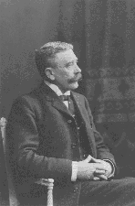
Structuralism
Ferdinand de Saussure (1857-1913)
Father of Modern Linguistics

Slide 8
Saussure’s Brief Life History
Born 26 November 1857
  (French origin, moved to Geneva)
From a family of many scholars
Studied Latin, Greek, chemistry, theology and law at University of Geneva (1875-76)
At age 21, wrote Mémoire sur le système primitif des voyelle dans les langues indo-européennes in which he proved scholars wrong.

Slide 9
1880 awarded doctorate at University Leipzig (Germany).
Taught at Paris.
1891 returned to Geneva to teach there.
Taught ancient Sanskrit for 21 (!) years!
Was asked to teach a course in General Linguistics (taught it three times 1907 - 11)

Slide 10
Influenced many different linguists, but also other disciplines:
Anthropology
Psychiatry
Literary criticism

Slide 11
Saussure died in 1913.
His Course in General Linguistics was published by students posthumously in 1916 and has been translated into many different languages.

Slide 12
Saussure’s Ideas: 1
The subject matter of Linguistics is Human speech
The object of Linguistics is Language which is itself a system
Language is different from speech, speaking and writing
Language (langue) is though a part of a system i.e. Human Speech (langage) but at the same time it is itself a system
Language is different from Speech

Slide 13
Language is Different from Speech
Speech involves:
  Psychological Phenomenon (sound images, concepts in brain)
  Psychological Phenomenon (vocal-auditory organs)
  Physical Phenomenon (sound waves)
Language is not all about this
Language is homogenous in heterogeneous mass of speech facts

Slide 14
Langue vs Parole
Parole - “living language” or individual speech acts. It is about the way language is employed in actual speech.
Langue - the shared system of language in a society. It is about the formal structure of language

Slide 15
Saussure’s Idea: 2
Language is a system of Signs
Language is a process of naming, but this does not mean that “ready made ideas exist before words” (Saussure 65), but rather:
“The linguistic sign unites, not a thing and a name, but a concept and a sound-image” (66).

Slide 16

Linguistic Sign= Signifier + Signified
  Signifier: the mental impression of sound image e.g. “tree”
  Signified: The concept of tree e.g. “tree”

Slide 17

Signifier 1
Image
(Roses)
Signified 1
Concept
(Passion)
Sign I
(passionified roses)

Slide 18

Relationship between signifier and signified is arbitrary
  Based on convention
  No natural resemblance
  Arbor = Tree

Slide 19
Signifier and Signified are conventional divisions of plane of sound and plane of thought
  Signified plane of thought
  (chair, stool……)
  Signifier plane of sound
  (chair, cheer, char…)

Slide 20

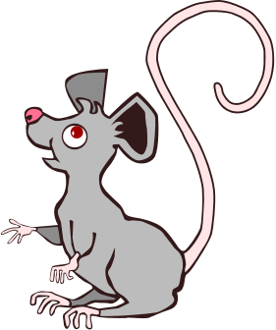
  Time changes the relationship between signi-fier (sound-image), signified (concept) and therefore the sign.
  E.g. “mouse” =
= Mouse

Slide 21
Saussure’s Ideas: 3
Linguistic Signs have values in relation to other signs (synonyms)
As there is no 1-1 relationship between signifier and signified thus value of language is not determined by relationship between them but by relationship between signs within the system of signification

Slide 22
Saussure’s Ideas: 4
Language without society exists artificially
Language
Community of speakers

Slide 23
Saussure’s Ideas: 5
When we talk about society, we cannot ignore time factor thus there are Static & Evolutionary Linguistics
Static : talk about language at a time (Synchronic)
Evolutionary: talk about language over history (Diachronic)

Slide 24
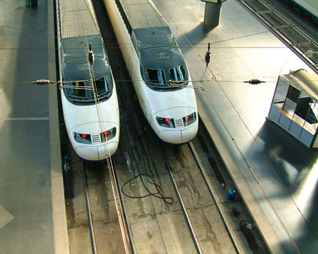
Saussure’s Ideas: 6
Language is a system of Difference
“Each linguistic term derives its value from its opposition to all other terms”

Slide 25
For a linguistic sign: “its more precise characteristics is to be what the others are not”
This idea is important in structuralism regarding the concepts of binary opposition & linearity of language

Slide 26
Saussure’s Ideas: 7
Language is not a nomenclature
Language is not something that provides its own names for categories that exist outside language

Slide 27
Saussure’s Ideas
Summary
1. Language is different from speech, speaking and writing
2. Language is a system of Signs
3. Linguistic Signs have values in relation to other signs
4. Language without society exists artificially
5. When we talk about society, we cannot ignore time factor thus there are Static & Evolutionary Linguistics
6. Language is a system of Difference
7. Language is not a nomenclature

Slide 28
Structuralism & Literature
According to this theory “ text can be understood as a construct to be analyzed and explained significantly in terms of deep structure of the system itself”

Slide 29
Saussure’ Ideas inspired:
Linguists in America who further extended ‘Structuralism’ to ‘American Structuralism’
Also known as DESCRIPTIVISTS
Major Proponents:
Bloomfield
Franz Boas
Edward Sapir
Whorf

Slide 30
Criticism on ‘Structuralism
Meaning is based on a shared system of signification then what about private experience to create meaning??? (Husserl)
If individuals are more a product of the system than producers then it creates a sense that we don’t speak language rather language speaks us??? (Hiedeggar)
Ideas are efficient for phonology and morphology because they have finite number of units but not for syntax (Chomsky)
Signifier and signified are not two things but they are same as concepts are no more than the words(Post- Structuralism)
Meaning is contextual (Post- Structuralism)

Slide 31
Recap
History of Linguistics
Schools of Thought in Linguistics
Structuralism
Ferdinand de Saussure
Structuralism in America

Slide 32
References
Eagleton, Terry. Literary Theory: An Introduction. Minnesota: The University of Minnesota Press, 2001.
Matthews, P.H. Linguistics: A Very Short Introduction. Oxford: Oxford University Press, 2003.
Sanders, Carol. Ed. The Cambridge Companion to Saussure. Cambridge: Cambridge University Press, 2004.
Saussure, Ferdinand. Course in General Linguistics. Ed. Charles Bally and Albert Reidlinger. Trans. Wade Baskin. New York: Philosophical Library, 1959.

