Slide 1
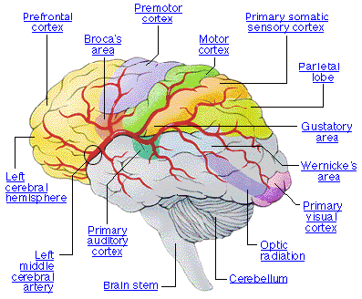
Language and Brain
Dr Ansa Hameed

Slide 2
Today’s Lecture
Language and Brain
The structure of the brain
Brain Areas Involved in Language
Language Disorders
Aphasia

Slide 3
The Human Brain
The brain is composed of neurons, nerve cells that are the basic information processing units of the nervous system.
The cerebral cortex is the gray wrinkled mass that sits over the rest of the brain and accounts for language representation and processing.
The longitudinal fissure separates the left and right hemispheres of the brain.
The corpus callosum is the bundle of nerve fibers that connects the two hemispheres.

Slide 4
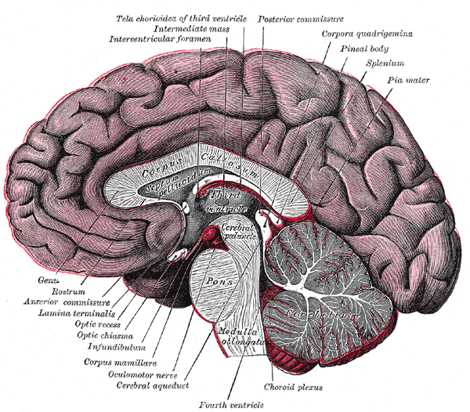

Slide 5
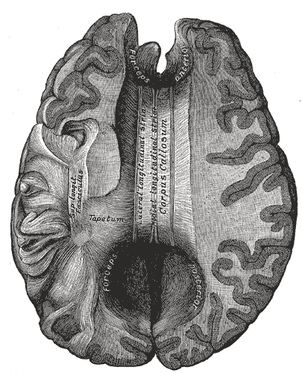

Slide 6
FUNCTIONS of the BRAIN HEMISPHERES
In terms of muscle movement, each hemisphere is responsible for half of the body – contralateral responsibilities.
  Right hemisphere -> left side of body
  Left hemisphere -> right side of the body
In terms of higher cognitive functions, the hemispheres are lateralized –
  Left hemisphere -> analytic tasks
    Math, Language
  Right hemisphere -> recognition of complex patterns
    Faces, Melodies

Slide 7
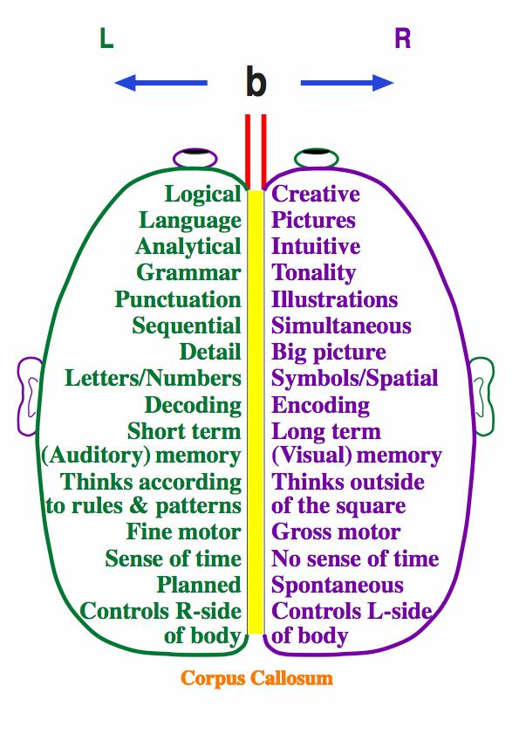
Functions of Brain Hemispheres

Slide 8
Lateralization
Specialization of brain functions in either left or right hemisphere of the brain
Said to occur around puberty
More pronounced with right-handed people than left-handed people
  RH people exhibit language difficulties with damage to the right hemisphere
  LH people show language representation in both hemispheres
Said to contribute to differences between children and adults with respect to second language learning

Slide 9
Lateralization
Left Hemisphere Dominant:
  Art Critics
  Literary Critics
  Music Critics
Right Hemisphere Balanced:
  Artists
  Authors
  Musicians

Slide 10
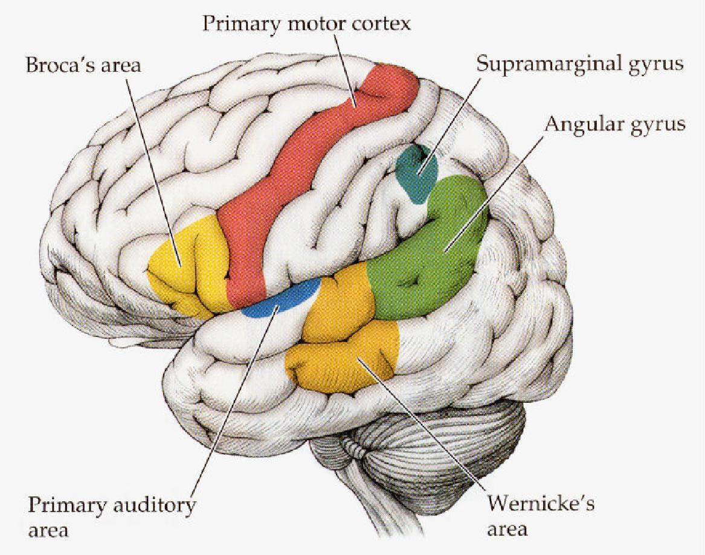
Brain Areas Involved in Language

Slide 11
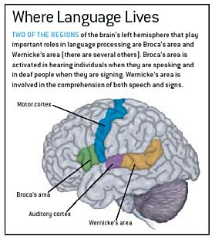

Slide 12
Brain Areas Involved in Language
1. Visual Cortex
Receives written words as visual stimulation
2. Angular Gyrus
Transforms visual representations in to auditory codes
3. Wernicke’s Area
Interprets auditory code
4. Broca’s Area
Controls speech muscles via motor cortex
5. Motor Cortex
Word is pronounced

Slide 13
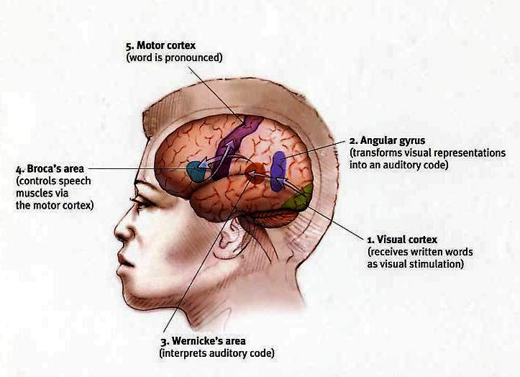

Slide 14
Right Hemisphere Contribution to Language
Since Broca, the left hemisphere’s role in language has been central and right hemisphere has viewed as non-language hemisphere
In split-brain patients language can emerge from the right hemisphere
The right hemisphere can not produce speech, use phone-to-grapheme correspondence or understand syntax
The right hemisphere can extract basic meaning

Slide 15
Language Disorders
Egyptians reported speech loss after blow to head 3000 years ago
Broca (1861) finds damage to left inferior frontal region (Broca’s area) of a language impaired patient, in postmortem analysis
In language disorders
  90-95% of cases, damage is to the left hemisphere
  5-10% of cases, to the right hemisphere

Slide 16
Language Disorders
Paraphasia:
  Substitution of a word by a sound, an incorrect word, or an unintended word
Neologism:
  Paraphasia with a completely novel word
Nonfluent speech:
  Talking with considerable effort
Agraphia:
  Impairment in writing
Alexia:
  Disturbances in reading

Slide 17
1. Aphasia
A language deficit caused by damage to the brain, often be a stroke or an accident

Slide 18
Three major types of Aphasia
Rosenzweig: Table 19.1, p. 615
Borca’s aphasia
  Nonfluent speech
Wernicke’s aphasia
  Fluent speech but unintelligible
Global aphasia
  Total loss of language
  Others: Conduction, Subcortical, Transcortical Motor/Sensory

Slide 19
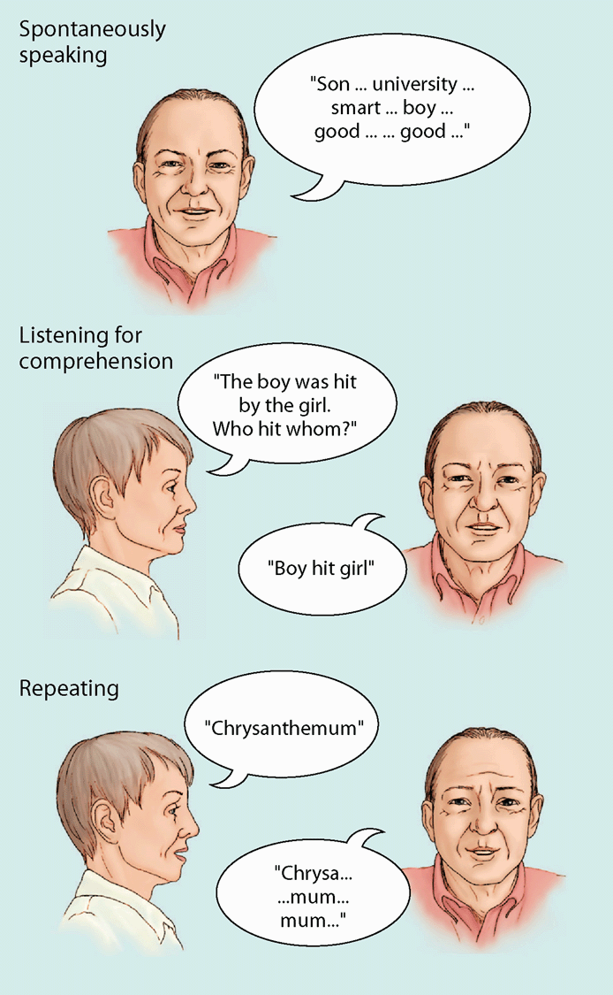
Broca’s Aphasia
Non fluent
“Cookie jar…fall over…chair…water…empty…ov…ov…[Examiner: “overflow?”] Yeah.”
(Heny 637)

Slide 20
Broca’s Aphasia (Brodmann, 44-45)
Lesions in the left inferior frontal region (Broca’s area)
Nonfluent, labored, and hesitant speech
Most also lost the ability to name persons or subjects (anomia)
Can utter automatic speech (“hello”)
Comprehension relatively intact
Most also have partial paralysis of one side of the body (hemiplegia)
If extensive, not much recovery over time

Slide 21
Broca’s Aphasia
  Broca’s aphasia –
    Speech is very halting
    Function words are omitted (it, is, to, a, etc.)
    Pronunciation is simplified (spoon > poon, etc.)
    Inflectional endings are omitted (running > run, etc.)
  Broca’ aphasics are aware of their language deficit

Slide 22
Broca’s Aphasia
Broca's patients turn out to have a comprehension problem, when carefully tested
  a. passive sentences
  i. The dog chased the cat
  ii. The girl threw the ball
  iv. The ball was thrown by the girl
  --> using word order 'strategies' rather than syntax
  b. attention to determiners
  i. He showed her baby pictures
  iii. He showed her baby the pictures
--> deficit may be in syntactic component of language

Slide 23
Wernicke’s Aphasia
        Fluent Aphasia
        Examiner: What kind of work have you done?
        Patient: We, the kids, all of us, and I, we were working for a long time in the ... you know ... it's the kind of space, I mean place rear to the spedawn ...
        Examiner: Excuse me, but I wanted to know what work you have been doing.
        Patient: If you had said that, we had said that, poomer, near the fortunate, porpunate, tamppoo, all around the fourth of martz. Oh, I get all confused.

Slide 24
Wernicke’s Aphasia (Brodmann, 22-23)
Lesions in posterior of the left superior temporal gyrus, extending to adjacent parietal cortex
Fluent speech
But contains many paraphasias
  “girl”-“curl”, “bread”-“cake”
Syntactical but empty sentences
Cannot repeat words or sentences
Unable to understand what they read or hear
Usually no partial paralysis

Slide 25
Wernicke’s Aphasia
Wernicke's patients clearly don't have just a comprehension problem
  a. speech is typically somewhat incoherent
  b. patients perform very poorly on semantic judgments
  dog cat turnip
  man woman trout
--> deficit may be in semantic component of language

Slide 26
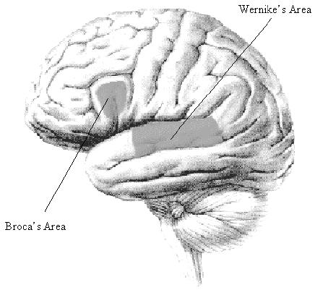

Slide 27
Global Aphasia
Associated with extensive left hemisphere damage
Deficits in comprehension and production of language

Slide 28
Summary of Aphasias
Type of Aphasia | Spontaneous speech | Paraphasias | Comprehension | Repetition | Naming
Broca’s | Nonfluent | - | Good | Poor | Poor
Wernicke’s Aphasia | Fluent | + | Poor | Poor | Poor
Global | Nonfluent | - | Poor | Poor | Poor

Slide 29
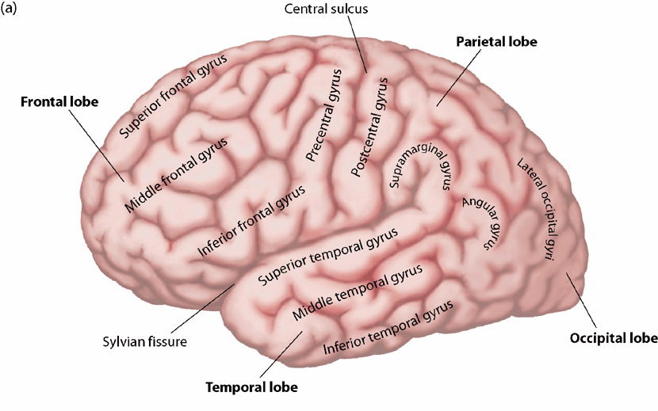
Neurological Bases for Visual Language Processing
Brain damage can produce alexia or agraphia
Alexia – inability to read
Agraphia – inability to write

Slide 30
Dyslexia
Problem in learning to read
Common in boys and left-handed
High IQ, so related with language only
Postmortem observation revealed anomalies in the arrangement of cortical cells
  Micropolygyria: excessive cortical folding
  Ectopias: nests of extra cells in unusual location
Might have occurred in mid-gestation, during cell migration period

Slide 31
Acquired Dyslexia= Alexia
Disorder in adulthood as a result of disease or injury
Deep dyslexia (pays attn. to wholes):
  “cow” -> “horse”, cannot read abstract words
  Fails to see small differences (do not read each letter)
  Problems with nonsense words
Surface dyslexia (pays attn. to details):
  Nonsense words are fine
Suggests 2 different systems:
  One focused on the meanings of whole words
  The other on the sounds of words

Slide 32
Recap
Language and Brain
The structure of the brain
Brain Areas Involved in Language
Language Disorders
Aphasia

Slide 33
References
Heny, Jeannine. “Brain and Language (Clark, 634-657).
Clark, Virginia, Paul Eschholz, and Alfred Rosa. Language: Readings in Language and Culture, 6th Edition. New York, NY: St. Martin’s Press, 1998.
Gazzaniga, M., Ivry, R., & Mangun, G. (2001). Cognitive Neuroscience: The Biology of the Mind. New York: W.W. Norton and Co. Chapter 9: Language and the brain, pp. 351-399.
Friederici, Angela D. (2011). THE BRAIN BASIS OF LANGUAGE PROCESSING: FROM STRUCTURE TO FUNCTION. Physiol Rev 91: 1357–1392, 2011
Geschwind, Norman. Language and the Brain.
Yule, George. The Study of Language. 1996.
Fromkin, Rodman & Hymas. 2007. Language: Nature, Psychology and Grammatical Aspects. Us: Wadsworth

