Slide 1
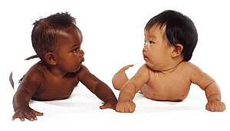
Development of Language
(In Children)
Dr. Ansa Hameed

Slide 2
Today’s Lecture
The Development of language with reference to:
What are the elements of speech?
How do children develop speech?
How do children learn the meaning of words?

Slide 3
Infants begin making sounds at birth. They cry, coo, and laugh…but in the first year they don’t really do much talking
It could be argued that infants DO communicate with others, but do not have language
Is it really so?????

Slide 4
What is Language?
To check the validity of statement that children in first year do not have any language, so we need to define language
Think about your language…maybe you even speak more than one! What makes a language?
This is a broad concept…language is a system that relates sounds or gestures to meaning.
  Language is expressed through speech, writing and gesture.

Slide 5
Distinct Features of Language
  -Phonology refers to the sounds of a language
  Grammar refers to the rules used to describe the structure of a language
    Which involves syntax or rules that specify how words are combined to form sentences
    -Semantics is the study of words and their meaning
  Pragmatics is the study of how people use language to communicate effectively

Slide 6
To have Language
Children must learn to hear the differences in speech sounds and how to produce them; they must learn the meaning of words and rules for combining them into sentences and they must learn effective ways to talk with others
In other words, they should have knowledge of phonetics, syntax and pragmatics to have a language…………….. Do they have??? Let’s See

Slide 7
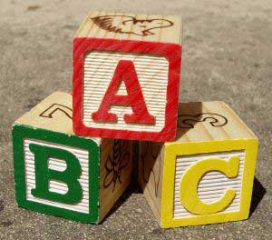
Children knowledge of Phonemes
Phoneme is the basic building blocks of language
  The unique sounds that can be joined to create words
    The sound of “p” in pin, pet, and pat
    The sound of “b” in bed, bat, and bird
Infants can distinguish many of these sounds, some of them as early as 1 month after birth
  Can discriminate sounds they have never
  heard before such as phonemes from a
  foreign language

Slide 8
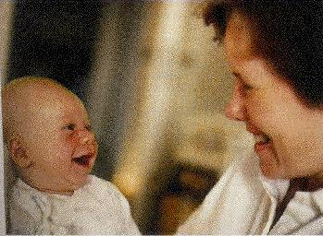
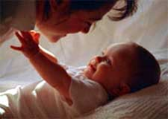
The language environment for infants is not solely auditory. Much language exposure comes from face-to-face interaction with adults

Slide 9
Infants use many tools to identity words in speech. They don’t understand the meaning of the word yet, but they can recognize a word as a distinct configuration of sounds

Slide 10
Parents and adults help infants master language sounds by talking in a distinctive style
Think on your own…
In what distinctive way do adults talk to infants? How can this help infants master the language?

Slide 11
Language Development
Infants are equipped for language even before birth, partly due to brain readiness, partly because of auditory experiences in the uterus
  Children around the world have the same sequence of early language development
Newborns prefer to hear speech over other sounds- they prefer to listen to “baby talk”- the high pitched, simplified and repetitive was adults speak to infants
The sound of a human voice, whether familiar or strange always fascinates infants

Slide 12
Adults use Infant Directed Speech
Adults speak slowly and with exaggerated changes in pitch and loudness and elongated pauses between utterances
    Also known as parentese, motherese, or child-directed speech
Infant-direct speech may attract infants’ attention more than adult-directed speech because its slower pace and accentuated changes provide the infant with more salient language cues
  Helps infants perceive the sounds that are fundamental to their language

Slide 13
When talking to girls, adults use more words like “doggie” and “blankie” whereas with boys, adults use more words like “dog” and “blanket”.
Girls hear twice as many diminutives.

Slide 14
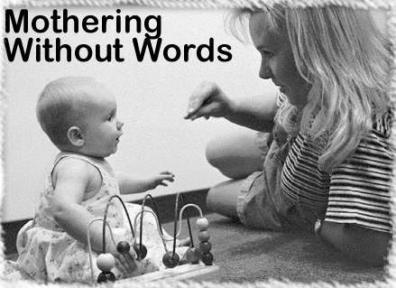
If infant-directed speech helps infants perceive sounds that are essential to the development of their language…
What about children
who cannot hear?

Slide 15



Deaf Children
About 1 in every 1,000 American infants is born deaf
  Over 90% of deaf children have hearing parents
  These children are often delayed in language and complex make-believe play
  Mommy Daddy Baby

Slide 16

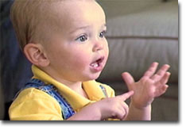
Deaf infants and toddlers seem to master sign language in much the same way and at about the same pace that hearing children master spoken language.
  Deaf 10-month-olds often “babble” in signs: they produce signs that are meaningless but resemble the tempo and duration of real signs

Slide 17
Compared to hearing children, babbling of deaf children is delayed
  However, if they are exposed to sign language development will be right on schedule with normal-hearing children’s speech development
Hearing “dog”, infants in the middle of the first year of life may first say “dod” then “gog” before finally saying “dog” correctly
  The same gradual progression will occur with sign language – infants will make mistakes at first before making the correct sign for dog

Slide 18
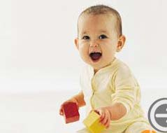
Speech Production
--Cooing
At 2 months, infants begin making sounds that are language-based
  Starts with cooing
They begin by producing vowel-like sounds, such as “ooooo” and “ahhhh”
At 5 to 6 months, infants begin making speech-like sound that have no meaning
  Cooing turns into babbling

Slide 19
Baby Talks
Babbling is the extended repetition of certain single syllables, such as “ma-ma-ma, da-da-da, ba-ba-ba” that begins at 6-7 months of age.
Babbling is experience-expectant learning
  All babies babble
  All babies gesture
  The sounds they make are similar no matter what language their parents speak

Slide 20
Babbling
Over the next few months, babbling incorporates sounds from their native language.
Even untrained listeners can distinguish between babbling infants who have been raised in cultures in which French, Arabic, or Cantonese languages were spoken.
  Many cultures assign important meanings to the sounds babies babble:
  “ma-ma-ma”, “da-da-da” and “pa-pa-pa” are usually taken to apply to significant people in the infant’s life

Slide 21
First Words
Infants first recognize words, then they begin to comprehend words
At about 4 ½ months of age, infants will listen longer to a tape repeating their own name than to a tape of different but similar name
At about 7-8 months of age, infants readily learn to recognize new words and remember them for weeks

Slide 22

At 6 months – if an infant hears either “mommy” or “daddy”, they look toward the appropriate person.

Slide 23
By their 1st birthday, infants usually say their first words, usually an extension of babbling.

Slide 24
By the age of 2 most children have a vocabulary of a few hundred words, and by age 6 the vocabulary includes over 10,000 words!

Slide 25
Children use Symbols: Important step
Children begin using gestures, which are symbols shortly before their first birthday.
Gestures and words convey a message equally well…sometimes gestures pave the way for language
  In one study, 50% of all objects were referred to first by gesture and, about 3 months later, by word (Iverson & Meadow, 2005

Slide 26

After children know that
objects have names,
a gesture is a convenient
substitute for pronouns
like “it” or “that” and
often cause the adult to
say the object’s name

Slide 27
Names for Everything!!!
Once an infant’s vocabulary reaches about 50 words it suddenly begins to build rapidly, at a rate of 50-100+ words per month, mostly nouns.
This language spurt occurs around 18 months and is sometimes called the Naming explosion.

Slide 28
Productive Vocabulary
Early productive vocabularies of children include names for people, objects, and events from the child’s everyday life.
  Frequent events or routines are also labeled, such as “up” or “bye-bye”
  Nouns predominate the early productive vocabularies of children

Slide 29
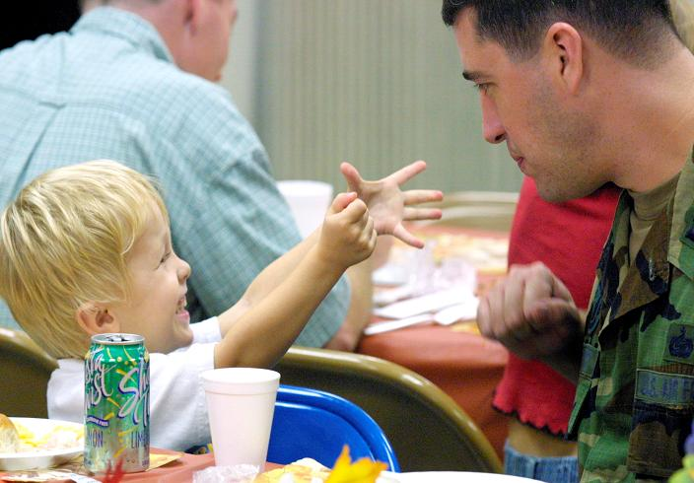
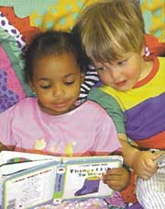
The rate of children’s vocabulary development is influenced by the amount of talk they are exposed to
The more speech that is addressed to a toddler, the more rapidly the toddler will learn new words

Slide 30
Word Comprehension
Fast Mapping is the process of rapidly learning a new word simply from the contrastive use of a familiar word and an unfamiliar word
The children’s ability to connect new words to familiar words so rapidly that they cannot be considering all possible meaning for the new word

Slide 31
Examples of Fast Mapping
In a preschool classroom, an experimenter drew a child’s attention to two blocks – asking the child to “get the celadon block not the blue one”
From this simple contrast, the child inferred that the name of the color of the requested object was “celadon”
After a single exposure to this novel word, about half the children showed some knowledge of it a week later by correctly picking the celadon color child from a bunch of paint chips

Slide 32
Early Errors in Language
One common inaccuracy is underextension –using a word too narrowly.
    Using the word “cat” to refer only to the family cat
    Using the word “ball” to refer only to a favorite toy ball

Slide 33
Early Errors in Language
Overextension
The use a given word in a broader context than is appropriate
  Common between 1 and 3 years of age
  More common than Underextension
Toddlers will apply the new word to a group of similar experiences
  “Open” – for opening a door, peeling fruit, or undoing shoelaces

Slide 34
Making Sentences
Most children begin to combine words into simple sentences by 18 to 24 months of age
Children’s first sentences are two-word combinations referred to as Telegraphic speech
  Words directly relevant to meaning
Words not critical to the meaning are left out – similar to the way telegrams were written such as:
  Function words: a, the in
  Auxiliary words: is, was, will be
  Word endings: plurals, possessives, verb tenses

Slide 35
These sentences are brief and to the point, containing only vital information
“More cookie”, “Mommy go”, “Daddy juice”, “Sue dogs”

Slide 36
By about 2 ½ years of age, children have the ability to produce more complex sentences (four or more words per sentence).
The longer sentences are filled with grammatical morphemes (words or endings of words that make sentences more grammatical).
A 1 ½-year-old might say “kick ball” but a 3-year-old would be more likely to say “I am kicking the ball”

Slide 37
Errors in Language
Speech errors in which children treat irregular forms of words as if they were regular.
  Applying rules to words that are exceptions to the rule
  This leads young children to talk about foots, tooths, sleeps, sheeps and mouses.
Although technically wrong, Overregularization is a sign of verbal sophistication because it shows children are applying the rules to grammar.

Slide 38
Between 3 to 6 years age
Children learn to use negation
  “That isn’t a butterfly”
Children learn to use embedded sentences
  “Jennifer thinks that Bill took the book”
Children begin to comprehend passive voice as opposed to active voice
  “The ball was kicked by the girl” as opposed to “The girl kicked the ball”
By the time most children enter kindergarten, they use most of the grammatical forms of their native language with great skill

Slide 39
The development of language in children is amazing, but how do they do it?
There are several theories that attempt to explain how we develop language (Next Lecture # 22)

Slide 40
References
Language and Communication. (Chapter 9) http://www.sagepub.com/upm-data/36720_Levine_final_PDF_09.pdf

