Slide 1
Language & Levels of Language (Recap)
Dr. Ansa Hameed

Slide 2
Today’s Lecture
Recap of previous 14-15 lectures: Topics
Language: Definitions
Language: Features
Language: Theories about Origin (New addition)
Language: Levels

Slide 3
Language: Definitions
‘Language is a primarily human and non-instinctive method of communicating ideas, emotions and desire by means of a system of voluntarily produced symbols’ (Sapir, 1921)
‘Language may be defined as the expression of thought by means of speech sounds’ (Sweet, 1993)

Slide 4
Language: Definitions
‘Language is a system of conventional, spoken or written symbols by means of which human beings, as members of a social group and participants in its culture, communicate’ (Encyclopedia Britannica)
“Language is a set of finite number sentences, each finite in lingth and constructed out of a finite set of elements”
Noam Chomsky(1957)

Slide 5
Language
In simple words, Language is
A tool of communication
A medium to transfer ideas, thoughts…
The most specific human tool
The biggest need of life on earth

Slide 6
Features of Language
The important features that all human languages have in common (not solely English).
Design features of language by American linguists Charles Hockett:
  1.Use of sound signals
  2.Arbitrarines
  3.The need for learning
  4.Dualtiy of patterns
  5.Displacement
  6.Creativity (productivity)
  7.Patterning
  8.Structure dependence

Slide 7
Minor Features of Language
Language reveals patterns of how mind works.
Language is a means for mental and social development.
Language is a property of the individual as well as of the society.
Language is a predictor of social identity.
Language is a predictor of social identity
Language is used for cultural preservation and transmission
Language can be used by some to exert their power over others.

Slide 8
Language Origin
Two views about origin of language:
MONOGENESIS:18th C. Gottfried Wilhelm Leibniz: all ancient and modern languages branched off from a single proto-language. But it cannot explain that human language arose simultaneously at many different places.
POLYGENESIS: Present language families derive from many original languages.

Slide 9
Language Origin: Theories
5 theories from The Danish Linguist Otto Jespersen(1860-1943)
1. speech arose through Onomatopoeic words but few of these exist in language
2. speech arose through people making instictive sounds caused by pain, anger or emotions. For ex. İnterjections

Slide 10
Language Origin: Theories
3.universal use of sounds for words of a certain menaing-sound symbolism- For example –mam is supposed to reflect the movement of the lips as the mouth approaches to the food. And bye-bye or ta-ta show the lips and tongue respecitively “waving” good-bye.
4. speech arose as peole worked together, theirphysical efforts produced communal, rhythmical grunts which in due course developed into chants, and thus language.

Slide 11
Language Origin: Theories
5.If any single factor was going to initiate human language , it would arise from the romantic side of life-sounds associated with love, play, poetic feeling, perhaps even song.( Crystal, 1987)

Slide 12
Levels of Language: Bottom up Approach
Semantics & Pragmatics | Related to meanings
Syntax | Related to structure of sentences
Morphology | Related to formation of words
Phonology | Related to sound system (symbols) of a particular language
Phonetics | Related to sounds of a language

Slide 13
1. Phonetics
The study of articulation, transmission and perception of speech sounds
Articulatory phonetics
Acoustic phonetics
Auditory phonetics

Slide 14
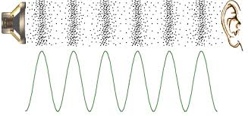

Slide 15
Articulatory Phonetics:
is the study of the way the vocal organs are used to produce speech sounds
It studies:
Organs of speech
Places of Speech
Manner of Speech
Voicing

Slide 16
Acoustic Phonetics
is the study of the physical properties of speech sounds and how they are transmitted
Sound energy is a pressure wave consisting of vibrations of molecules in an elastic medium – a gas, a liquid, a solid; in this case, air – air particles are disturbed through the movements and vibrations of the vocal organs, especially the vocal folds. The process continues as a chain reaction for as long as the energy lasts.
Air particles move in the form of a wave: they are characterized by oscillation , frequency (hertz), amplitude and intensity (decibels).

Slide 17
Auditory Phonetics
is the study of the way people perceive speech sounds; the study of speech perception.
1st step – when sound waves arrive at the ear;
2nd step – transmission of sound along the auditory nerve to the brain

Slide 18
Phonetics: english
English Language (26 Alphabets)
Sounds (44)
Vowels (20) Consonants (24)

Slide 19
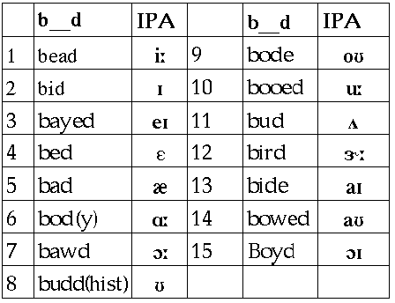
English: Vowel Sounds

Slide 20
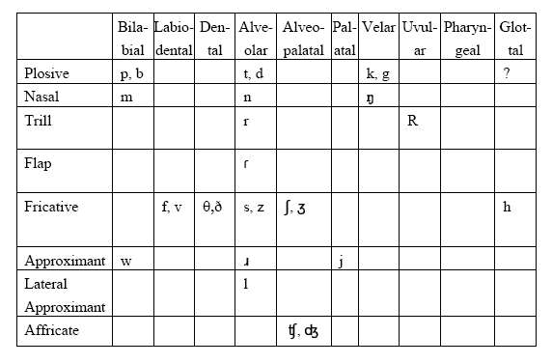
English: Consonant Sounds

Slide 21
2. Phonology
Phonology deals with the system and pattern of speech sounds in a language.
Phonological knowledge permits us to;
produce sounds which form meaningful utterances,
to recognize a “foreign” accent,
to make up new words,
To know what is or is not a sound in one’s language
to know what different sound strings may represent

Slide 22
In phonology, smallest segment is phonemes
In human language, a phoneme is the smallest unit of speech that distinguishes meaning.
Phonemes are not the physical segments themselves, but abstractions of them.
The /t/ sound found in words like tip, stand, writer, and cat are examples of phonemes.

Slide 23
Allophone:
The different phonetic realizations of a phoneme are called allophones.
Thus:
[p^{h}] and [p] are allophones of the same phoneme in English.
Minimal Pairs:
Minimal pairs are words that are identical except for one sound. For example:
pit [pit] bit [bit]

Slide 24
3. Morphology
“Morphology is the study of patterns of word formations within and across languages” (Prasad, 48)
Morphology is ‘science of word forms’ (Fromkin, 131)
Traditionally, the term “morphology” refers to the study of “morphemes”.
Morphology considers morpheme rather than word as elemental unit of grammatical structure

Slide 25
‘a minimal unit (which cannot be broken down) of meaning or grammatical function’ (Yule, 75)
A morpheme is a piece of phonological information that has a conventionalized meaning arbitrarily associated with it.
e.g. truthfulness
truth ful ness

Slide 26
Word & Morpheme
What is the relationship between words and morphemes?
It's a hierarchical one: a word is made up of one or more morphemes.
Words are made up of morphemes:
Bank (one word= one morpheme)
Childish (one word= two morphemes)
Forgiveness (one word= three morphemes)

Slide 27
Types of Morphemes:
Morpheme
Free Bound
(root) (affix)
Lexical functional Derivational inflectional

Slide 28
4. Syntax
‘Syntax is the way words and clauses are arranged to form sentences’
‘Putting things together in an orderly manner’ that is syntax (Prasad, 73)
Syntax (Paradigmatic view):
sentences: Clauses: Phrases

Slide 29
Sentence:
A sentence is basically a string of words that follow the grammatical rules of a language.
A sentence expresses a complete thought
A sentence is made up of phrases.
Clauses:
a group of words that have a subject and a verb that must always agree
Phrases:
A phrase is a part of a sentence. It does not express a complete thought.
A phrase is a group of words that function as a single unit. Usually they can be substituted by a pronominal form.

Slide 30
Syntax: Syntactic View
Syntactic is about horizontal relationship inside and between the sentences.
The syntactic literature dealing with the study of how sentences are structured throws us a hint that syntactic research should not only concern on how sentences are merged out of their parts, units, or constituents, but also on how constituents are moved according to certain rules

Slide 31
Syntactic analysis is a science of structure which deals with the different structural elements of a language. There are different types of analysis procedures:
Immediate Constituent Analysis (ICA)
Ultimate Constituent Analysis (UCA)
Phrase Structure Grammar (PSG)
Transformational Generative Grammar (TGG)
Case grammar
Stratificational Grammar
Tagmemics

Slide 32
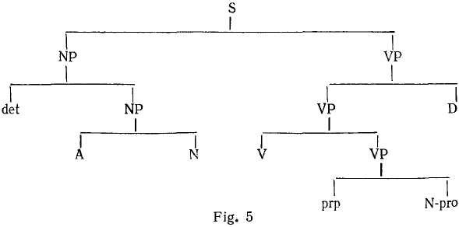
An Example of Syntactic Analysis:
(Immediate Constituent analysis)

Slide 33
5. Semantics
Semantics is traditionally defined as the study of meaning in language.
Meaning are Important
  To understand language
  the meaning of words and of the morphemes that compose them
  Words into phrases and sentences (Semantics)
  Context which determines the meaning (Pragmatics)

Slide 34
Lexical Semantics:
The scientific study of the meanings of Words and the systematic meaning –related connections between words is known as Lexical Semantics.
Sentential Semantics:
It is the branch of Semantics concerned with the meaning of the syntactic units larger than the word.

Slide 35
Pragmatics
Pragmatics is the study of meaning in context dependent on the intentions of participants in a conversational exchange
Importance of context:
We cannot understand pragmatic meanings without the context

Slide 36
We have different ‘contexts’:
Linguistic Context
Non-Linguistic or Situational Context
Theories of Pragmatics
1. Speech acts theory
2. Relevance theory
3. Cooperation theory
4. Argumentation theory

Slide 37
Recap
Language: Definitions
Language: Features
Language: Theories about Origin (New addition)
Language: Levels

