Slide 1
Pragmatics (1)
Dr. Ansa Hameed

Slide 2
Previously….
Semantics
Lexical Semantics
Sentential Semantics

Slide 3
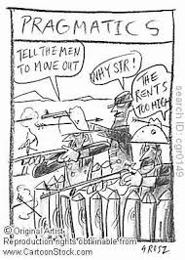
Today’s Lecture
Pragmatics

Slide 4
Pragmatics
Pragmatics is a subfield of linguistics
It studies how the use of language is based on the relationship established between utterance, context and interlocutors.
(Baena, E. 2002)

Slide 5
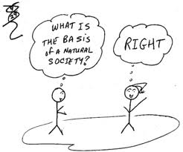
Pragmatics
Pragmatics is the study of meaning in context dependent on the intentions of participants in a conversational exchange.
Not the meaning of single words as we saw in semantics, but the intended meaning of whole exchanges.

Slide 6

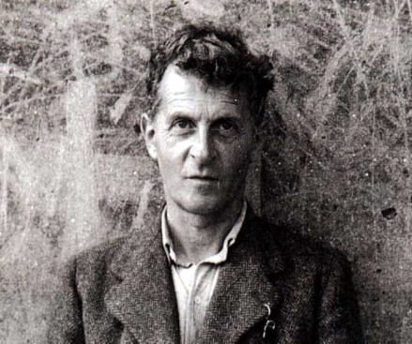

Pragmatics: Key Figures
Charles Morris (1938)
Pragmatics studies (the origins), the uses and the effects of language.
Ludwig Wittgenstein
(*1889 Vienna, +1951 Cambridge)
John L. Austin
How To Do Things with Words (1962)

Slide 7
Pragmatics vs. Semantics
Semantics: the study of meaning that can be determined from a sentence, phrase or word.
Pragmatics: the study of meaning, as it depends on context (speaker, situation)

Slide 8
Pragmatics: Importance of Context
Pragmatics is concerned with importance of contexts

Slide 9
Pragmatics: Importance of Context
A.: I have a 14 year old son
B.: Well that’s right
A.: I also have a dog
B.: Oh, I’m sorry
Can you understand the meaning of this exchange?
It would be hard to catch it, unless you know that A. is trying to rent an apartment from B. and B. doesn’t accept pets.

Slide 10
Pragmatics: Importance of Context
If we don’t have a context or some knowledge about a situation, the meaning can be ‘invisible’ as in the previous example. Or
- have you seen Sam?
- the black car is over there.
This seemingly incoherent text can be easily understood if we know that Sam owns a black car.

Slide 11
Why Pragmatics???
Why have we chosen PRAGMATICS?
Common in everyday life
Wide subject to be studied
Comes out of language study

Slide 12
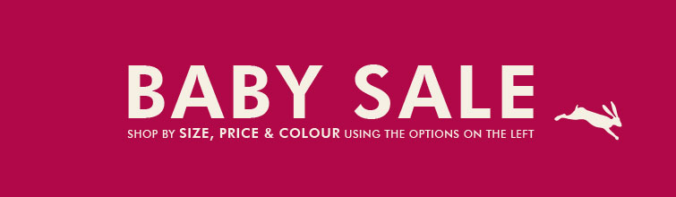
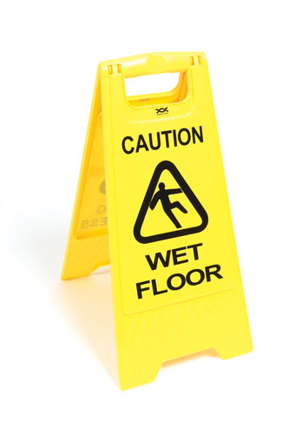
Why Pragmatics???
What do these pics mean?

Slide 13
Pragmatics: Context
We have different ‘contexts’:
Linguistic Context
Non-Linguistic or Situational Context

Slide 14
Pragmatics: Types of Contexts
Linguistic Context
The linguistic context also called co-text is the set of other words used in the same sentence:
Example:
We know that the word ‘pupil’ is a homonym. How do we know which meaning is intended? Usually by means of the linguistic context:
If it is used in a sentence with words like ‘teacher’, ‘classmates’ etc. we understand that pupil here means ?
If it is used in a sentence with words like ‘eye’, ‘dilatation’ or ‘iris’ we know that here it means ?

Slide 15
Pragmatics: Types of Contexts
2. Situational Context
It includes virtually everything non-linguistic in the environment of speaker
Example:
If you see a sign like this near a school: SLOW DOWN. PUPILS CROSSING THE STREET.
It does not mean that you have to slow down because you could run over eye-pupils and reduce them to a pulp.

Slide 16
Pragmatics: Deixis
There are many words in the language that cannot be interpreted alone, without being put in a context.
Here, there, that, now, I, you, them and many other examples if used without a shared knowledge or a clear context can result very vague.
You’ll have to bring them back by tomorrow, because they aren’t here now and they need them.
This sentence could virtually mean everything and nothing.
Deixis comes from Greek and it means ‘pointing’ by means of language.
We can have: person deixis, place deixis, time deixis.

Slide 17
Pragmatics: Theories
1. Speech acts theory
2. Relevance theory
3. Cooperation theory
4. Argumentation theory

Slide 18
Speech Act Theory
We do things with the words.
language is used to act.
By means of language, in terms of requests, commands, asking questions or information, we perform actions, that are called ‘speech acts’.
Proponents: John Austin and John Searle

Slide 19
Speech Act Theory
Direct Speech acts
are you married?’, ‘can they play tennis?’, ‘do you know anything about what happened?’ are forms used to ask for information and they are called ‘direct speech acts’.
Indirect Speech Acts
In questions like ‘Can you pass the wine?’ you don’t want to know if the person is able to pass the wine, but you want the wine. These are called ‘indirect speech acts’.

Slide 20
Speech Act Theory
What speech events and acts would you expect in the following situations????????
A Trial
A Wedding

Slide 21
Speech Act Theory
Kinds of Speech Acts:
Representatives (S conveys a belief)
Directives (S tries to get H to do something)
Commissives (S commits to future action)
Declarations (S creates a new external situation—performatives)
Expressives (S expresses personal feelings)

Slide 22
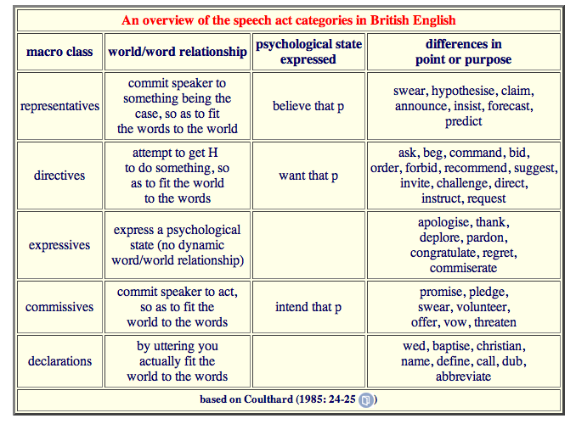
Speech Act Theory

Slide 23
Speech Act Theory
Conditions for Speech Acts
Not all speakers can perform all speech acts
There are certain conditions necessary for an utterance to be considered a certain kind of speech act. Such conditions are called Felicity conditions

Slide 24
Speech Act Theory
Felicity Conditions for Speech Acts
Speech acts judged not by ‘truth value’ but by their ‘happiness’
Language (propositional content)
Context (preparatory condition)
  ‘I now pronounce you man and wife’
  Participants/setting
Intention
  Speaker is sincere, believes the act will have the desired force

Slide 25
Speech Act Theory
Felicity Conditions for Speech Acts
Rules that need to be followed for an utterance to work.
A promise:
  I say I will perform an action in the future
  I intend to do it. I believe I can do it.
  I think I would not normally do it.
  I think the other person wants me to do it.
  I intend to place myself under an obligation to perform the action.
  We both understand what I’m saying.
  We are both normal, conscious human beings.
  Both of us are in normal circumstances.
  The utterance contains an illocutionary force indicating device.

Slide 26
Speech Act Theory
Speech acts can be analysed by three levels
J. L. Austin in his ‘How to do things with words’ identifies three distinct levels of action beyond the act of utterance itself. He distinguishes the act of saying something, what one does in saying it, and what one does by saying it, and calls these the 'locutionary', the 'illocutionary' and the 'perlocutionary' act, respectively.

Slide 27
Speech Act Theory
Speech acts can be analysed by three levels
Locutionary act
Perlocutionary act
Ilocutionary act

Slide 28
Speech Act Theory
1. LOCUTIONARY ACT
The performance of an utterance
Semantic and syntactic aspects
EXAMPLE
‘CLOSE THE WINDOW’

Slide 29
Speech Act Theory
2. ILLOCUTIONARY ACT
Real intended meaning
EXAMPLE:
The person who is talking is cold.

Slide 30

Speech Act Theory
3. PERLOCUTIONARY ACT
It’s actual effect
EXAMPLE:
The action of closing the window

Slide 31
Recap
Pragmatics???
Importance of Context???
Theories
Speech Act Theory
    (Remaining Theories in lecture Pragmatics 2)

Slide 32
References
Searle, J.R. ; Kiefer, F. & Bierwisch, M. (1980). Speech act theory and Pragmatics. Dordnecht; Holland.
Baena, E. ; Lacorte, M. (2002). Para entender la Pragmática. Ed. Gredos.
Yule, G. (1996). Pragmatics. Oxford: University Press.
http://www.helsinki.fi/~pietarin/publications/Relevance%20theory-Pietarinen.pdf
Falk, Julia. Linguistics and Language. 1978.
Hocket, F. C. A Course in Modern Linguistics. New Delhi: Oxford. 1958

