Slide 1
Syntax (4)
Dr. Ansa Hameed

Slide 2
Previously
Syntax
Syntax: Paradigmatic view
Syntax: Syntagmatic View
Syntactic Analysis
Immediate Constituent Analysis
Ultimate Constituent Analysis

Slide 3
Today’s Lecture
Syntactic Analysis
Phrase structure Grammar (PSG)
Generative Grammar
Transformational Grammar

Slide 4
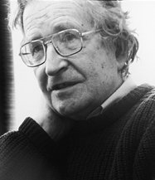
Syntactic Analysis
Phrase structure Grammar (PSG)
Generative Grammar
Transformational Grammar
Syntactic Analysis Models proposed by Chomsky
Book: “Syntactic Structures” (1957)

Slide 5
Syntactic Analysis
Models of Grammar (Chomsky)
Chomsky introduced three models of grammar:
Finite state Grammar (most basic and inadequate)
Phrase Structure Grammar
Transformational Generative Grammar (Extension of Phrase Structure Grammar)

Slide 6
Phrase Structure Grammar (PSG)
Phrase structure grammars: Model a sentence as a set of phrases. Each word is grouped into successively larger units until you account for the sentence. The resulting structure is called a phrase marker.

Slide 7
Phrase Structure Grammar (PSG)
PSG states rules for determining the structure of phrases
Generate a lot of sentences from a small number of rules.
The structure of a phrase will consist of one or more constituents in a certain order.

Slide 8
Phrase Structure Grammar (PSG)
Constituency:
How do words group together?
  Noun phrases:
    three parties from Brooklyn
    a high-class spot such as Mindy’s
    they
    the reason he comes into the Hot Box
Certain linguistic evidence lead us to believe that these words group together (form a constituent).

Slide 9
Phrase Structure Grammar (PSG)
Constituents:
Some words seem to belong together:
  {The crazy man} {is jumping off the bridge}
Groups of words that belong together are called constituents
The component that determines the properties of the constituent is the head, and the constituent can be referred to as a phrase: e.g. noun phrase, adjective phrase etc.

Slide 10
Phrase Structure Grammar (PSG)
Explanation:
V Det N V Det N V Det N
run a marathon eat the food read the book
V Prep Det N V Prep Det N
go to the store talk with a teacher
V Det N Prep Det N
take your sister to the library
“Verb phrases have a V, (sometimes) an NP, and (sometimes) a PP”
VP -> V (NP) (PP)

Slide 11
Phrase Structure Grammar (PSG)
The main phrase structure rules:
1. S → NP VP
2. NP → {Det N, Pro}
3. VP → V (NP) (PP) (Adv)
4. PP → P NP
5. AP → A (PP)

Slide 12
Phrase Structure Grammar (PSG)
Phrase Structure Rules & tree diagrams
NP → (Det) N
PP → P NP The boy in the yard
The boy (NP) Det N PP
Det N P NP
Det N
The boy The boy in the yard

Slide 13
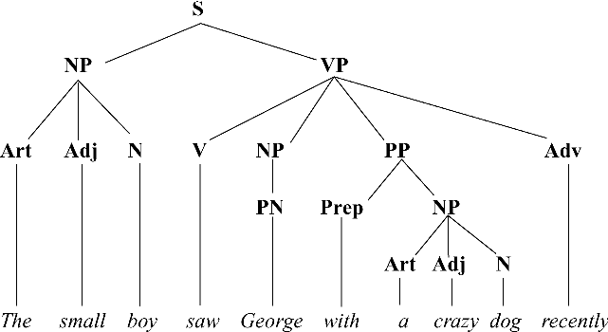
Phrase Structure Grammar (PSG)

Slide 14
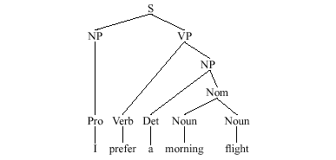
Phrase Structure Grammar (PSG)

Slide 15
Phrase Structure Grammar (PSG)
Plus Points of PSG
Phrase structure grammars solve the problems that are usually identified for finite state grammars.
  Long distance dependencies: The structure can support distant relationships between words and you can have rules that tell you how the parts go together.
  Structure: Structure is inherent in the phrase marker.

Slide 16
Phrase Structure Grammar (PSG)
Problems for phrase structure grammars:
The rules are mostly context free.
The rules explain intra-sentence constituent elements (syntax) but not inter-sentence relations (Syntactic)
Ambiguous sentences cannot be explained

Slide 17
Phrase Structure Grammar (PSG)
Problems for phrase structure grammars:
  Particle movement: Some verbs have a particle included with them (phone up, look up). This can be detached from the verb.
    John looked up the address.
    John looked the address up.
  Phrase structure grammars can’t handle this. How can part of the verb go in various places?

Slide 18
Phrase Structure Grammar (PSG)
Problems for phrase structure grammars:
  Some other things that language does that would be nice to capture in grammar:
    Two sentences with very different surface structures can have similar meanings.
      Arlene is playing the tuba.
      The tuba is being played by Arlene.
    One sentence is active, one is passive, but they mean the same thing. It would be nice if our grammar captured the fact that there is a relationship between these two sentences

Slide 19
Phrase Structure Grammar (PSG)
Problems for phrase structure grammars:
  Some other things that language does that would be nice to capture in grammar:
    One sentence can have two very different meanings:
      Flying planes can be dangerous.
    It would be nice if our grammar could capture this phenomenon as well.

Slide 20
Transformational Generative Grammar
Transformational Generative Grammar has two aspects:
Transformational
Generative

Slide 21
Transformational Grammar
Transformational is a method of stating how the structures of many languages can be generated or explained as the result of specific transformations applied to certain basic* structure.

Slide 22
Transformational Grammar
Transformations
I helped John. (Active)
John was helped by me. (Passive)
He will come. (affirmative)
Will he come? (Interrogative)

Slide 23
Transformational Grammar
When transformational rules are applied to a sentence, not the structure itself changes, but merely the form of representation.
Transformational rules map the Deep Structure onto Surface Structure representations.
Example:
  I can solve this problem!“ (DS)
  The possible surface struture can be:
  This Problem, I can solve. (SS)

Slide 24
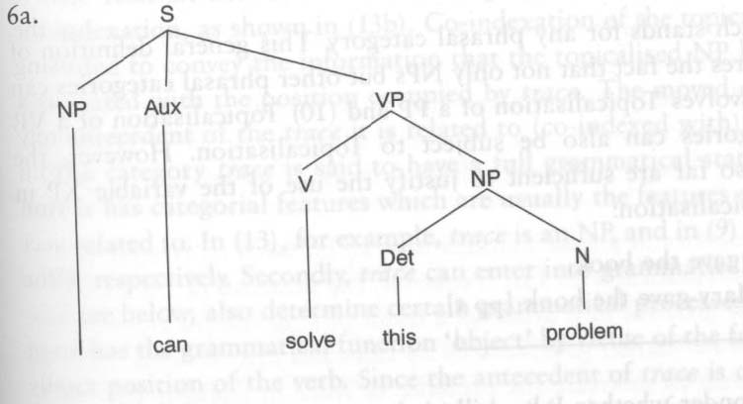
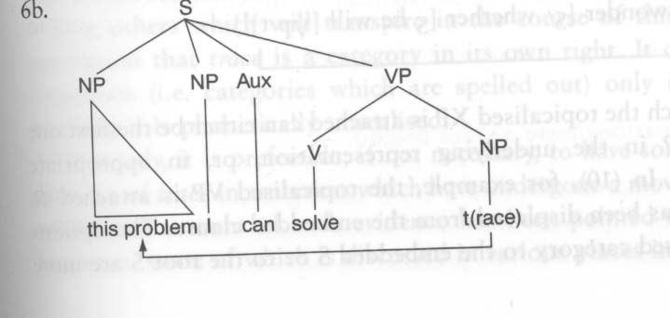
Transformational Grammar

Slide 25
Transformational Grammar
Transformational Rules*
Prescriptive/ Normative Rules:
Avoid ending sentences with prepositions
The difference between ‘owing’ and ‘due to’
Where to use ‘I’ or ‘me’
Other traditional rules derived from other classical languages
Descriptive Rules:
Based on observations and inductive rules what happens in language (e.g. He makes... I make….)
Rewrite Rules:
This system deals with symbols. (use of symbols to represent sentence: Example, S NP+VP)
Notes:
* For details read “A course in Linguistics” by Tarni Parsad (pgs# 91-113)

Slide 26
Transformational Grammar
Interrogative Rules:
Rules to make question statements
(Example: I can read. (DS) / Can I read? (SS))
Affix Switch Rules:
Changing form by moving affix
(Example: He is going. (DS) / Is he going? (SS))
Do-Support Rules:
Use of Do, Does
(Example: He watches T.V. (DS) / Does he watch T.V? (SS))

Slide 27
Transformational Grammar
Negation Rules:
Making negative sentences
(Example: She likes movies. (DS) / She does not like movies. (SS))
Passivation Rules:
Changing voice (active…passive)
(Example: I play Hockey. (DS) / Hockey is played by me. (SS))

Slide 28
Generative Grammar
Formally, a generative grammar is defined as one that is fully explicit. It is a finite set of rules that can be applied to generate all those and only those sentences (often but not necessarily, infinite in number) that are grammatical in a given language (Chomsky)
Explicit means what are possible sentences of language

Slide 29
Generative Grammar
To say a grammar generates a sentence is technical which means grammar assigns a structural description to sentences*
“all and only”= all grammatical sentences and only grammatical sentences
Finite rules infinite number of well-formed sentences

Slide 30
Generative Grammar
Properties of Generative Grammar
It includes whatever is in phrase structure grammar and transformational grammar and further takes into account all possible syntactic structures
The grammar has finite number of rules but capable to produce infinite number of structures. In this way, productivity in language is covered.

Slide 31
Transformational Generative Grammar
Controversies with Transformational Generative Grammar
This grammar has to consider that a sentence can have another sentence inside it, or a phrase can have another phrase inside it. What is explanation?

Slide 32
Transformational Generative Grammar
Controversies with Transformational Generative Grammar
The rules of grammar should be recursive in nature, that is, capacity to be applied more than once in generating a structure. What is explanation?
Example:
The book was on the table.
The book was on the table near the window.
The book was on the table near the window in the hallway……(no end to recursion)

Slide 33
Transformational Generative Grammar
Controversies with Transformational Generative Grammar
It should describe how two superficially different sentences are closely related. How they have different surface structures but same deep structures?
  Charlie broke the window.
  The window was broken by Charlie

Slide 34
Transformational Generative Grammar
Controversies with Transformational Generative Grammar
It should solve structural ambiguity, that is, how two superficially similar sentences are in fact different.
Annie whacked the man with an umbrella.
Same surface structure but different deep structure
  The boy saw the man with a telescope.

Slide 35
Transformational Generative Grammar
What‘s it good for?
Chomsky: „a simple system of phrase structure can provide the basis from which all sentences can be derived by simple transformations“ (Generative Grammar = Transformational Grammar)
Humboldt: Show how language can make infinite use of finite terms.

Slide 36
Recap
Syntactic Analysis
Phrase Structure Grammar
Transformational Generative Grammar

Slide 37
References
Carnie, Andrew. Syntax- A Generative Introduction. 2002.
Falk, Julia. Linguistics and Language. 1978.
Ouhalla, Jamal. Introducing Transformational Grammar. 1999.
Parsad, Tarni. A Course in Linguistics. 2012.
Yule, George. The Study of Language. 1996.

