Slide 1
Phonology(1)
Dr. Ansa Hameed

Slide 2
Previously….
Phonetics
Articulatroy Phonetics
Acousitc Phonetics
Auditory Phonetics
Vowels and Consonants
Phonetic Transcription

Slide 3
Today’s Lecture
Phonology
Phone
Phoneme
Allophone
Minimal Pairs
Free Variation

Slide 4
Phonology
Greek φωνή, phōnḗ, "voice, sound", and the suffix -logy (which is from Greek λόγος, lógos, "word, speech, subject of discussion".
Phonology deals with the system and pattern of speech sounds in a language.
Phonology of a language is the system and pattern of speech sounds.

Slide 5
phonology
"the study of sound pertaining to the system of language", as opposed to phonetics, which is "the study of sound pertaining to the act of speech" (the distinction between language andspeech being basically Saussure's distinction between langue and parole).
(Nikolai Trubetzkoy in Grundzüge der Phonologie (1939)
According to Clark et al. (2007) it means the systematic use of sound to encode meaning in any spoken human language, or the field of linguistics studying this use.

Slide 6
Phonology vs. Phonetics
Phonetics is study of human speech sounds
Phonology is study of speech sounds and their patterns in relation to a particular language

Slide 7
Phonology vs. Phonetics
The phonetician is a person who describes
  Speech and understands the mechanisms of speech production and perception.
  speech sounds in ways that are close to the speech stream, focusing on production, acoustics, and perception.
The Phonologist is a person who describes
  speech systems for particular languages and works to show how sounds may change based on other sounds in the same environment.
  tends to be more abstract, dealing not directly with the physical nature of speech sounds, but rather with the largely unconscious rules for sound patterning that are found in the mind/brain of a native speaker

Slide 8
Phonology
Phonological knowledge permits us to;
produce sounds which form meaningful utterances,
to recognize a “foreign” accent,
to make up new words,
To know what is or is not a sound in one’s language
to know what different sound strings may represent

Slide 9
Phonology
Segmental Units of Sound
Segments: any discrete unit that can be identified, either physically or auditorily, in the stream of speech.
In phonetics, the smallest perceptible segment is a phone.
In phonology, smallest segment is phonemes

Slide 10
Phonology
Phones
A speech segment that possesses distinct physical or perceptual properties
A particular occurrence of a speech segment
The basic unit revealed via phonetic speech analysis

Slide 11
Phonology
Phonemes
Greek: φώνημα, phōnēma, "a sound uttered"
In human language, a phoneme is the smallest unit of speech that distinguishes meaning.
Phonemes are not the physical segments themselves, but abstractions of them.
The /t/ sound found in words like tip, stand, writer, and cat are examples of phonemes.

Slide 12
Phonology
History of Phonemes
The term phonemeas an abstraction was developed by the Polish linguist Jan Niecisław Baudouin de Courtenay and his student Mikołaj Kruszewski during 1875–1895.
The term used by these two was fonema, the basic unit of what they called psychophonetics.
The concept of the phoneme was then elaborated in the works of Nikolai Trubetzkoi and others of the Prague School (during the years 1926–1935), and in those of structuralists like Ferdinand de Saussure, Edward Sapir, and Leonard Bloomfield.

Slide 13
Phonology
Phoneme Theory
Some structuralists (though not Sapir) rejected the idea of a cognitive or psycholinguistic function for the phoneme
The correspondence between symbols and phonemes in alphabetic writing systems is not necessarily a one-to-one correspondence. A phoneme might be represented by a combination of two or more letters (digraph, trigraph, etc.), like <sh> in English or <sch> in German (both representing phonemes /ʃ/)

Slide 14
phonology
Phoneme Theory Continued…..
This is the fundamental unit of phonology, which has been defined and used in many different ways. Virtually all theories of phonology hold that spoken language can be broken down into a string of sound units (phonemes), and that each language has a small, relatively fixed set of these phonemes.
Most phonemes can be put into groups; for example, in English we can identify a group of plosive phonemes p,t, k, b, d, , a group of voiceless fricativesf, θ, s, ʃ, h, and so on.

Slide 15
Phonology
Phoneme Theory Continued…..
An important question in phoneme theory is how the analyst can establish what the phonemes of a language are. The most widely accepted view is that phonemes are contrastive and one must find cases where the difference between two words is dependent on the difference between two phonemes: for example, we can prove that the difference between ‘pin’ and ‘pan’ depends on the vowel, and that i and are different phonemes.

Slide 16
Phonology
Phones vs. Phonemes
We use slashes / / for phonemes
We use brackets [ ] for phones.
The vowel “phoneme” in the words beadand bean is represented as /i/
The “phone” is represented as [i]

Slide 17
phonology
Sequences of Phonemes
b l ı k I b k I
k l ı b ı l b k
b ı l k Possible b k ı l impossible
k ı l b ı b l k
•“I just bought a beautiful new blick” What is a blick?
•“I just bought a beautiful new bkli” WHAT!!

Slide 18
phonology
Sequences of Phonemes
Your knowledge of English “tells” you that certain strings of phonemes are permissible and others are not.
That’s why /bkli/ does not sound like an English word.
It violates the restrictions on the sequencing of phonemes; i.e. it violates the phonological rules of English.

Slide 19
phonology
Minimal Pair
Minimal pairs are pairs of words or phrases which differ in only one phonological element, such as a phone or a phoneme, and have a distinct meaning.
E.g. bit > pit, tip > dip, fan > van
They are used to demonstrate that two phones constitute two separate phonemes in the language.

Slide 20
Phonology
Four golden rules for minimal pairs:
they must have the same number of sounds
they must be identical in every sound except for one
the sound that is different must be in the same position in each word
the words must have different meanings

Slide 21
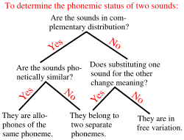
Phonology
A simplified procedure for determining whether two sounds represent the same or different phonemes

Slide 22
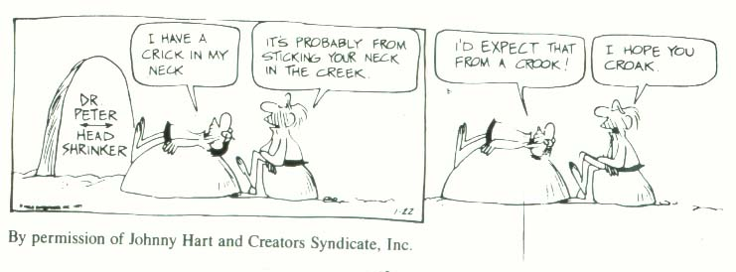
phonology
crick, creek, crook, croak. These words are identical except for one sound. Changing the sound results in completely new words. That means that [i], [i:], [u], and [o:] are phonemes, separate sounds because they create new words.

Slide 23
Phonology
Allophones:
In phonology, an allophone (pron.: /ˈæləfoʊn/; from the Greek: ἄλλος, állos, "other" and φωνή,phōnē, "voice, sound") is one of a set of multiple possible spoken sounds (or phones) used to pronounce a single phoneme.
For example, [pʰ](as in pin) and [p] (as in spin) are allophones for the phoneme /p/ in the English language.

Slide 24
phonology
Allophones continued….
The term "allophone" was coined by Benjamin Lee Whorf in the 1940s. In doing so, he placed a cornerstone in consolidating early phoneme theory.
The term was popularized by G. L. Trager andBernard Bloch in a 1941 paper on English phonology and went on to become part of standard usage within the American structuralist tradition.
Central to the concept of the phoneme is the idea that it may be pronounced in many different ways.

Slide 25
Phonology
Allophones continued….
In English (BBC pronunciation) we take it for granted that the r sound in ‘ray’ and ‘tray’ are “the same sound” (i.e. the same phoneme), but in reality the two sounds are very different – the r in ‘ray’ is voiced and non-fricative, while the r sound in ‘tray’ is voiceless and fricative.
In phonemic transcription we use the same symbol r for both, but we know that the allophones ofr include the voiced nonfricative sound ɹ and the voiceless fricative one .
In theory a phoneme can have an infinite number of allophones, but in practice for descriptive purposes we tend to concentrate on a small number that occur most regularly.

Slide 26
phonology
Free variation complementary distribution
complementary distribution = allophonic variation dependent on the phonetic environment the phoneme occurs in (e.g. [ɫ] vs. [l] in English)
free variation = allophonic variation independent of the phonetic environment the phoneme occurs in; random interchangeability
You can see an example for free variation here:

Slide 27
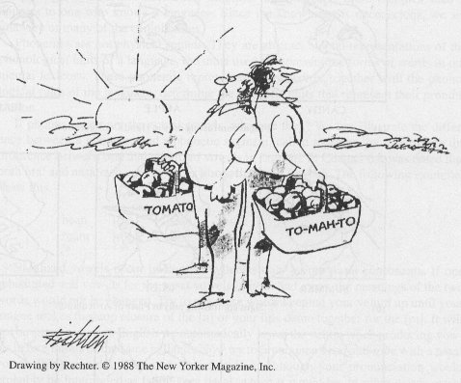
phonology

Slide 28

phonology
Another example is the old song from the 1930s:

Slide 29
phonology
Free Variation continued….
Unlike a speaker of English, a native speaker of Urdu/Hindi could not ignore the difference between aspirated and unaspirated sounds when speaking or hearing Hindi.
To a speaker of Urdu/Hindi, the aspirated sound [p^{h}] is as different from unaspirated [p],as [p] is from [b] to our ears.
Hindi contains many words that are pronounced in nearly the same way, except that one word will have an aspirated stop where the other has an unaspirated stop:

Slide 30
phonology
Urdu/Hindi Examples:
[kap^{h}i] "meaningful"
[kapi] "copy"
[p^{h}al] "knife edge"
[pal] "take care of"

Slide 31
Recap: Phoneme, allophone
A class of speech sounds that are identified by a native speaker as the same sound is called a phoneme. The different phonetic realizations of a phoneme are called allophones.
Thus:
[p^{h}] and [p] are allophones of the same phoneme in English.
Whereas in Hindi, [p^{h}] and [p] are different phonemes.

Slide 32
Recap
Phonology
Phone
Phoneme
Allophone
Minimal Pairs
Free Variation

Slide 33
References
Clark, J. (2007). The progress of phonology. Boston: Blackwell
Goldsmith, J. & Laks B. (n.d.). Generative phonology: its origins, its principles, and its successors. Retrieved from
http://hum.uchicago.edu/~jagoldsm/Papers/GenerativePhonology.pdf
Wolfram, W. (1974). Generative Phonology: The Basic Model. [PDF Document] Retrieved from: http://www.eric.ed.gov/ERICWebPortal/search/detailmini.jsp?_nfpb=true&_&ERICExtSearch_SearchValue_0=ED091943&ERICExtSearch_SearchType_0=no&accno=ED091943
Trommer, J. (2008). Autosegmental phonology: Tone. University of Lepzig Department of Linguistics. Retrieved from: http://www.uni-leipzig.de/~jtrommer/Nonconcatenative/1a.pdf

