Slide 1
PHONETICS (3)
Dr. Ansa Hameed

Slide 2
Previously
Phonetics
Articulatory Phonetics
Acoustic Phonetics
Auditory Phonetics

Slide 3
Today’s Lecture
English Phonetics
Vowels and Cosonants

Slide 4
Phonetics (English)
English Language (26 Alphabets)
Sounds (44)
Vowels (20) Consonants (24)

Slide 5
Vowels
A vowel is defined as:
“a voiced sound in forming which the air issues in a continuous stream through the pharynx and mouth, there being no obstruction and no narrowing such as would cause audible friction”.
-Daniel Jones

Slide 6
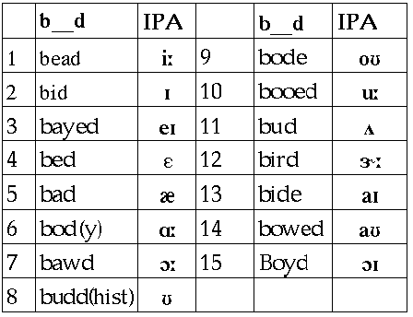
Vowels

Slide 7
vowels
Classification of Vowels
English monophthongs
English diphthongs
English Triphthongs

Slide 8
Vowels
Phonetic classification of Vowels
Vowel sounds are classified according to:
the position of the tongue in the mouth,
the openness of the mouth,
the shape of the lips, and
the length of the vowels.

Slide 9
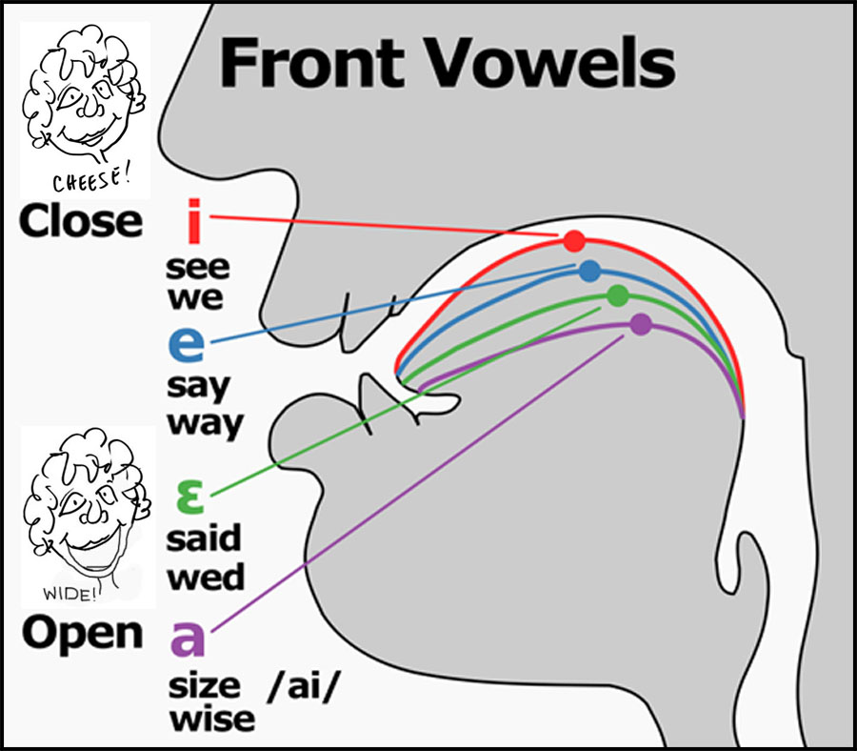
Vowels
1) the position of the tongue in the mouth
Front vowels are the ones in the production of which the front part of the tongue is raised the highest such as [i:] [i] [e] [æ] [a].

Slide 10
vowels
When the central part of the tongue maintains its highest position, the vowels thus produced are central vowels such as [3:] [Ə] and [☹] .

Slide 11
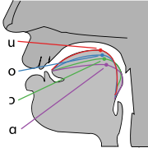
vowels
If the back of the tongue is held the highest, the vowels thus produced are back vowels such as [u:][u]

Slide 12
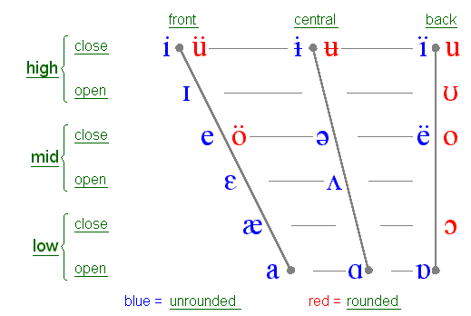
vowels

Slide 13
Vowels
2)the openness of the mouth
close vowels: [i:] [i] [u:] and [u];
semi-close vowels: [e] and [3;]
semi-open vowels: [ə] and [Չ:]
open vowels: [æ] [a] [☹] [Չ ]
and [:].

Slide 14
Vowels
3) the shape of the lips
rounded vowels: All the back vowels in English are rounded except [ɑ:].
unrounded vowels: All the front vowels and central vowels in English are unrounded.

Slide 15
vowels
4)the length of vowels
long vowels: They are usually marked with a colon such as[i:] and [ɑ:]
short vowels: other vowels in English are short vowels such as [e],[ə] and [æ].

Slide 16
Vowels
Diphthongs
RP has large number of diphthongs, sounds which consist of a movement or glide from one vowel to another.
-Peter Roach

Slide 17
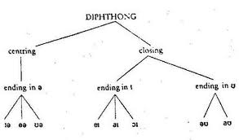
vowels

Slide 18
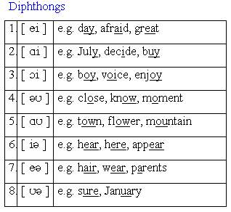
vowels

Slide 19
vowels
Triphthongs
A trophthong is a glide from one vowel to another and then ta third, all produced rapidly and without interruption.
Peter Roach

Slide 20
vowels
The English language has five Triphthongs.
1./ еІә /(এইও) as in the words prayer, player, layer.
2./ αІә/(আইও) as in the words liar, tyre, fire.
3./ )Іә /(ওইও) as in the words loyal, royal.
4./ αuә /(আউও) as in the words hour, tower, power, flower.
5./ әuә /(অউও) as in the words lower, mower, slower, goer.

Slide 21
consonants
All sounds which are voiced, (e.g: p,s) in the production of which the air has an impeded passage through the mouth (b, rolled r), in the production of which the air does vot pass through the mouth (g,m), in which there is an audible friction (f,v,s,z,b), are called consonants.
- Daniel Jones

Slide 22
consonants
Consonants can be classified according to:
Place of articulation
Manner of Articulation

Slide 23
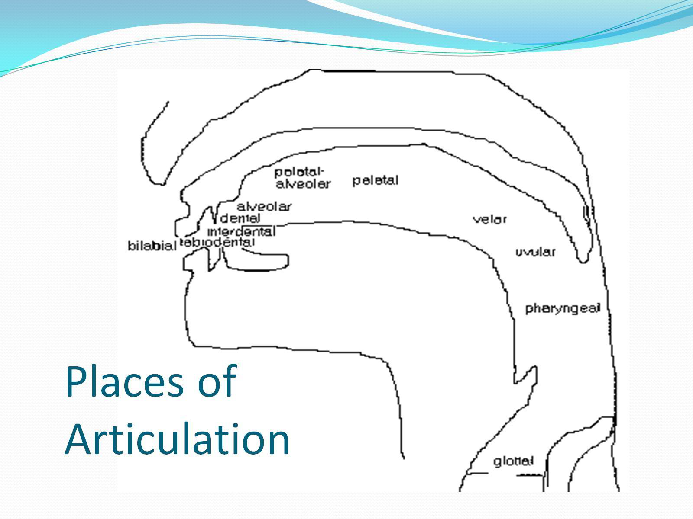
consonants

Slide 24
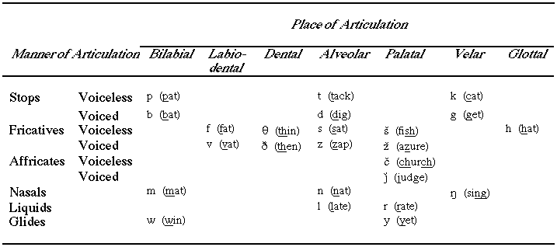
consonants

Slide 25
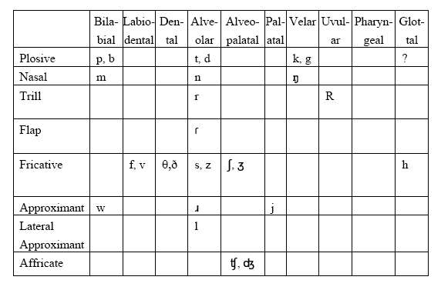
consonants

Slide 26
REcap
Vowels
Consonants

Slide 27
Reference
Jones, Daniel. (1972). An Outline of English Phonetics. Cambridge University Press.

