Slide 1
PHONETICS (2)
Dr. Ansa Hameed

Slide 2
Previously….
Phonetics: Study of human speech sounds
Articulatroy Phonetics
Acoustic Phonetics
Auditory Phonetics
Articulatroy Phonetics (in detail)
Voicing, Manner and Places of Articulation

Slide 3
Today’s Lecture
Acoustic Phonetics
Auditory Phonetics

Slide 4
Acoustic Phonetics
Pronunciation: /əˈko͞ostik/
The branch of phonetics that deals with the frequency and amplitude in the transmission of speech sound is known as acoustic phonetic.
An acoustic phonetician studies the waves of the sound produced with the help of special instruments.

Slide 5
Acoustic Phonetics
Acoustic phonetics investigates properties like the mean square and amplitude of a waveform, its duration, its fundamental frequency, or other properties of its frequency spectrum, and the relationship of these properties to other branches of phonetics (e.g. articulatory or auditory phonetics), and to abstract linguistic concepts like phones, phrases, or utterances.

Slide 6
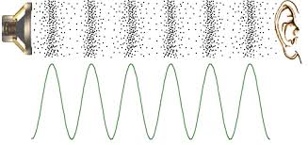
Sound Waves

Slide 7
Acoustic Phonetics
Aspects of sound transmission
Every sound, whether speech or non-speech, begins with a body of air set in vibration. It is this vibrating body of air which stimulates the nerves of the auditory system, thus transmitting sound waves to the inner ear. As a general rule, a forceful initiation will result in a relatively loud sound while a comparatively weak initiation will produce a quieter sound. ( Pendulum in motion is the example)

Slide 8
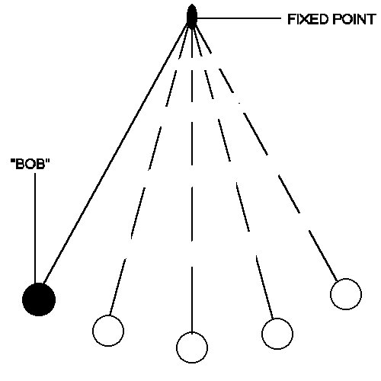
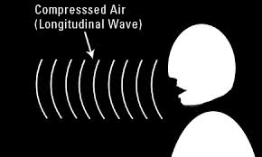
Acoustic Phonetics

Slide 9
Acoustic Phonetics
Components of Study:
1.Sound Waves
Sound is caused by a vibrating object, such as the tuning fork.
When the arm of the tuning fork moves outward, it crowds the neighbouring air molecules together (raising the air pressure in the area). The crowded air molecules will tend to move into less crowded (lower pressure) areas, which causes those areas to get crowded, and so on...
When the arm of the tuning fork moves inward, the neighbouring air molecules become less crowded (i.e., it creates a partial vacuum). Air molecules from surrounding areas will tend to move into the new low-pressure area.
The result is an alternating pattern of high and low pressure areas moving outward from the vibrating object. This is a sound wave.

Slide 10
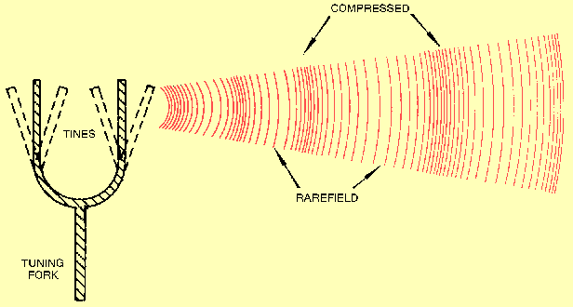
Acoustic Phonetics

Slide 11
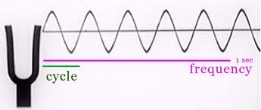
Acoustic Phonetics
Representation of Sound Wave on Graph:
One convenient way to diagram a sound wave is to graph the air pressure at each point in time, the way it might be picked up by a microphone:
Points above mid line represent higher pressure (more crowded air molecules); points below represent lower pressure (less crowded air molecules).

Slide 12
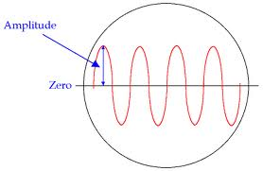
Acoustic Phonetics
Things about Sound Waves:
Amplitude (Loudness):
The amplitude of a wave is the size of the pressure difference it causes.
Amplitude is usually
measured in decibels
(abbreviated dB). People
hear amplitude as
loudness.

Slide 13
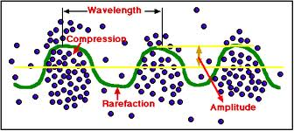
Acoustic Phonetics
Wavelength
The wavelength of a wave is the physical distance between two comparable points in neighbouring cycles (e.g., the distance between to pressure peaks )
For phoneticians, this is. the least interesting property

Slide 14
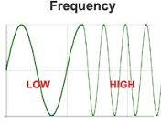
Acoustic Phonetics
Frequency (Pitch):
The frequency of a sound wave is how often the wave repeats itself. It is usually measured in Hertz (abbreviated Hz), sometimes also called "cycles per second".
People will hear the frequency of a sine wave as pitch, i.e., a high-frequency wave will sound like a high note, while a lower-frequency wave will sound like a lower note.

Slide 15
Acoustic Phonetics
For most practical purposes in Acoustic phonetics, we don't care about the actual complex waveform itself. We're only interested in the frequencies (pitch) and amplitudes (loudness) of the simple waves that it's made of.

Slide 16
Acoustic Phonetics
Spectrograms
Spectrograms can be used to identify spoken words phonetically, and to analyse the various calls of animals. They are used extensively in the development of the fields of music, sonar, radar, and speech processing,^{[2]} seismology, etc.
The instrument that generates a spectrogram is called a spectrograph.

Slide 17
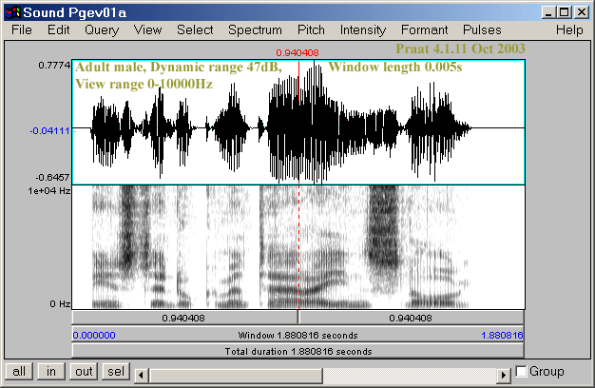
Acoustic Phonetics

Slide 18
Acoustic Phonetics
In a spectrogram, the horizontal dimension represents time and the vertical dimension represents frequency. Each thin vertical slice of the spectrogram shows the spectrum during a short period of time, using darkness to stand for amplitude. Darker areas show those frequencies where the simple component waves have high amplitude.

Slide 19
Acoustic Phonetics
Applications of Acoustic Phonetics
1) Acoustic phonetics deals with the physical aspects of speech sounds associated with the production and perception of speech. Acoustic measurement techniques can be used by speech-language pathologists to assess and treat a variety of speech disorders.
2) When ear based approaches are inadequate ,when our transcription are inadequate, then acoustic analysis offers a useful tool in this process to prove that our descriptions and transcriptions are correct.
3) Acoustic analysis provides a clearer difference b/w two speakers , pitch value than the auditory analysis.

Slide 20
Acoustic Phonetics
4).Males usually speak at a lower pitch level than females, and members of a given speech community may tend to produce vowels and consonants somewhat differently to those outside the community ,acoustics can further prove it.
5) loudness , pitch and nasal resonance, are aspects of the acoustic make-up of the speech signal, and we routinely use them to identify speakers and to decode mood.

Slide 21
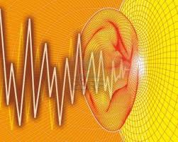
Auditory Phonetics
It is study of how sound waves are perceived by the listeners.

Slide 22
Auditory Phonetics
It is in major about SPEECH PERCEPTION.
sound reception:
reception in the ear, of the sound in the form of air pressure
fluctuations is converted to neural impulses
– adequate hearing ability:
• perceiving the full range of frequencies contained within various speech sounds
• filtering out irrelevant background
• adjusting to speakers’ idiosyncrasies (habitual vocal tract settings)

Slide 23
Auditory Phonetics
sound perception:
interpretation of neural impulses as hearing
Sensations
– decoding the speech signal into meaningful elements
• associate identified elements with mental representations
• associate recognized representations and combinations and constellations thereof with semantic concepts

Slide 24
Auditory Phonetics
Speech perception is part of the complex field of reception of spoken language, which covers the following two main areas:
the ear: anatomy and physiology of the internal structure of the ear,
the brain: processing of sound and models of perception.
Phonetic aspects of perception include, for example:
physical aspects
  the anatomy of the ear
  the functions of the ear
cognitive aspects
  intelligibility of speech
  perception of vowels and consonants, etc.

Slide 25
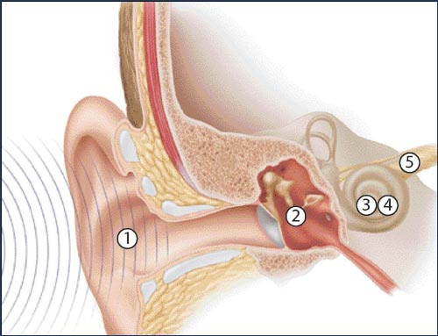
Auditory Phonetics
Structure of Ear:

Slide 26
Auditory Phonetics
Outer Ear:
organs:
– Auricle: externally visible portion of the ear
– Ear Canal: air-filled passageway (2cm) from the outside to the eardrum
Functions:
– acoustic waves fall on the external ear, funnel down the ear canal, set the eardrum into vibration
– auricle and ear canal form an acoustic resonator that amplifies frequencies near the resonant frequency (3000 Hz) to about 10 times the air pressure at ear drum vs. the entrance to the ear canal

Slide 27
Auditory Phonetics
Middle Ear:
organs:
– Eardrum: membrane at inner end of the ear canal (“tympanic membrane”)
– middle ear cavity: air-filled cavity in the bones of the skull
– Auditory Ossicles (Mallet, Anvil, Stirrup): three small bones forming a
mechanical linkage between Eardrum and Inner Ear
– Eustachian Tube: link to the pharynx opened when necessary to equalize air pressure in Middle Ear and outside
Functions:
– transform air pressure variations into mechanical movements
• vibration of the eardrum is transmitted and amplified through the mechanical lever system of the auditory ossicles (maximizing sensitivity in the frequency range between 500 and 4000Hz)
• protecting the ear from excessively loud (90 dB and more) sounds

Slide 28
Auditory Phonetics
Inner Ear
Organs:
Inner Ear: small intricate system of fluid-filled cavities
– Semicircular ducts: responsible for maintaining equilibrium/balance
– Cochlea: coiled structure where transformation of mechanical vibrations to electrical signals to be transmitted and processed by the Central Nervous System takes place
• snail-like shape (2 ¾ turns; 3.5 cm if unrolled) divided into three regions along its length by the cochlear partition

Slide 29
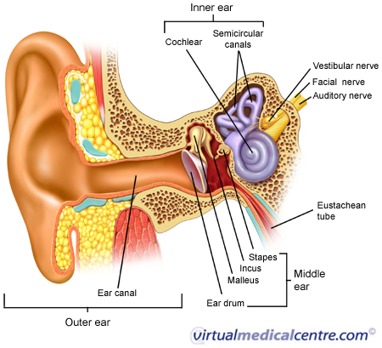
Auditory Phonetics

Slide 30
Auditory Phonetics
Converting Sound Waves in to Neural Impulses
sound pressure variations in the forms of vibratory movements of the Stirrup reach the Oval Window
vibrations are transmitted through the cochlear fluid (Perilymph) and the scala media causing movement along the Basilar Membrane which varies in width from one end to the other
high frequencies produce movement near the Oval Window at the basal end, low frequencies cause movement at the Helicotrema at the apical end
• displacement of the Basilar Membrane causes movement in the hair cells of the Organ of Corti:
• each hair cell consists of hair bundles that in turn are composed of about 100
very fine filaments, called Stereocilia: the movements of the Stereocilia initiate electrical currents through conduction channels in the hair cell cell-membranes
•nerve fibers of the Auditory Nerve transmit the impulses to the auditory center of the brain

Slide 31
Auditory Phonetics
Brain, Speech & Hearing
certain localized areas of the cerebral cortex are essential for performing various
mental and physical functions, including speech production and perception
• linguistic abilities have long been known to be localized primarily in the left hemisphere of the brain

Slide 32
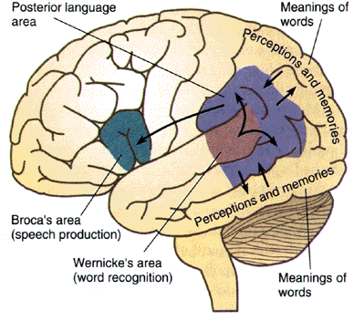
Auditory Phonetics

Slide 33
Recap
Acoustic Phonetics
Sound Waves
Properties of sound waves
Spectrograph
Auditory Phonetics
Ear and Brain
Perception of sound

