Slide 1
Phonetics (Part 1)
Dr. Ansa Hameed

Slide 2
Phonetics
The study of physical properties of sound(s) is called Phonetics

Slide 3
Phonetics
The study of articulation, transmission and perception of speech sounds
Articulatory phonetics
Acoustic phonetics
Auditory phonetics

Slide 4
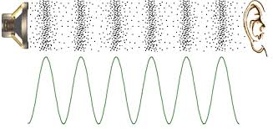

Slide 5
Articulatory phonetics
is the study of the way the vocal organs are used to produce speech sounds
The number of vocal organs varies with languages: there are speech sounds that do not use an air-stream from the lungs (non-pulmonic sounds, e.g. clicks tut tut or tsk tsk)

Slide 6
Acoustic Phonetics
is the study of the physical properties of speech sounds and how they are transmitted
Sound energy is a pressure wave consisting of vibrations of molecules in an elastic medium – a gas, a liquid, a solid; in this case, air – air particles are disturbed through the movements and vibrations of the vocal organs, especially the vocal folds. The process continues as a chain reaction for as long as the energy lasts.
Air particles move in the form of a wave: they are characterized by oscillation , frequency (hertz), amplitude and intensity (decibels).

Slide 7
Auditory Phonetics
is the study of the way people perceive speech sounds; the study of speech perception.
1st step – when sound waves arrive at the ear;
2nd step – transmission of sound along the auditory nerve to the brain

Slide 8
Articulatory Phonetics
The production of any speech sound involves the movement of an air stream.
Most speech sounds are produced by pushing the air out of the lungs through the mouth (oral) and sometimes through the nose (nasal).
Articulatory Phonetics deals with how the sounds are produced.

Slide 9
Three Dimensions of Articulation
Voicing
Place of Articulation
Manner of Articulation

Slide 10
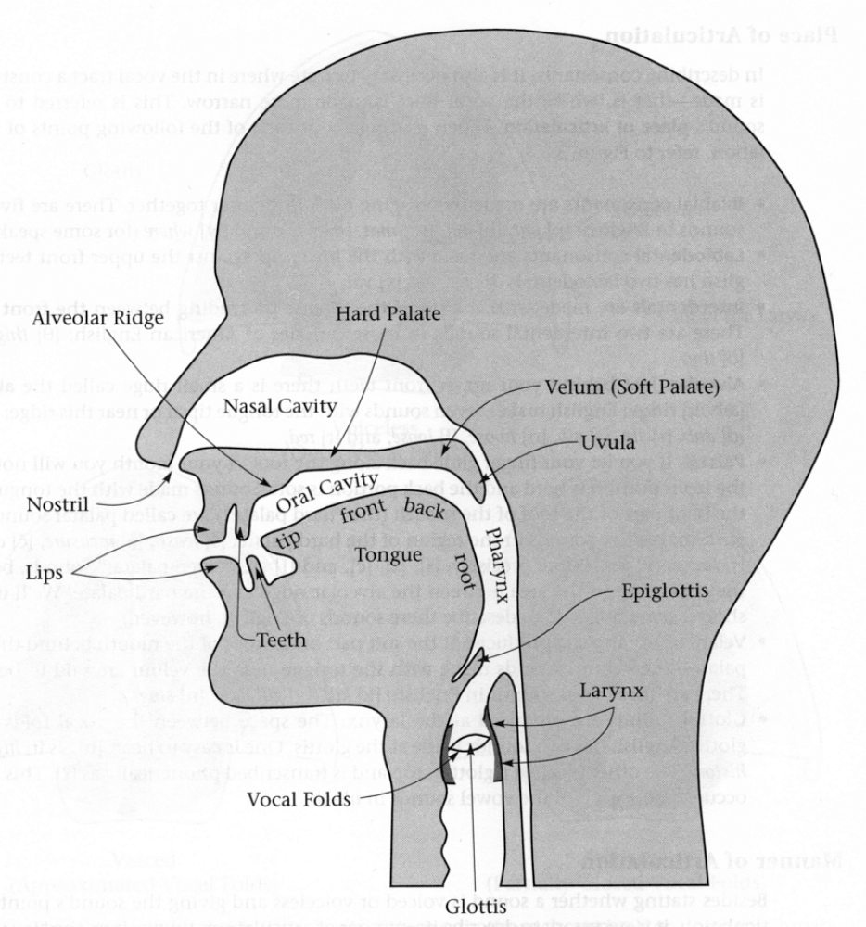
Speech Organs

Slide 11
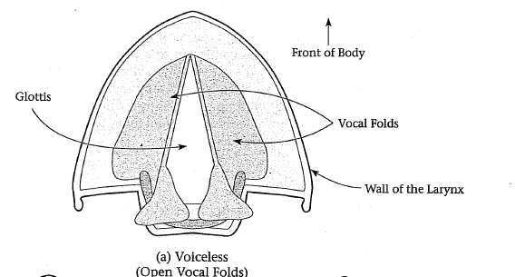
Voicing
Voiced and Voiceless
The air stream from the lungs passes through an opening between the vocal cords, the glottis. If the vocal cords are apart and the airstream is not obstructed at the glottis, the sounds produced this way are voiceless.

Slide 12
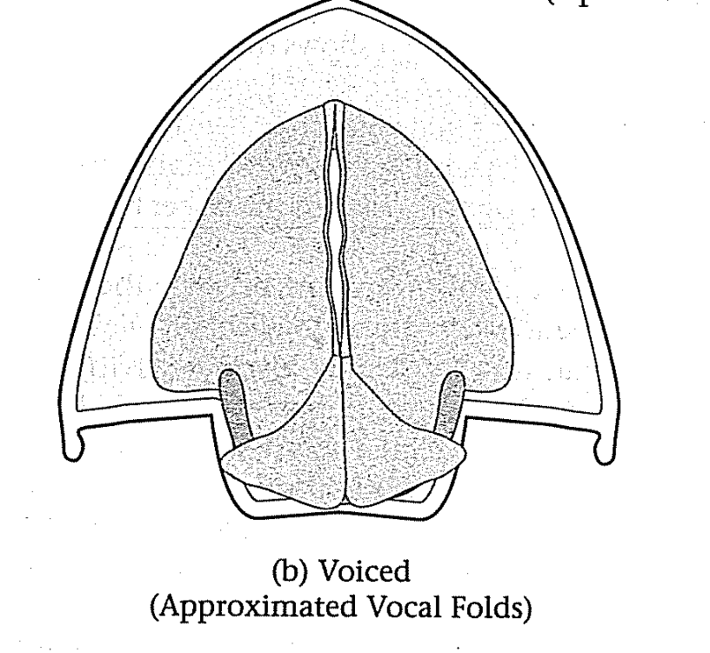
Voicing
If the vocal cords are together and the airstream forces its way through, the vocal cords vibrate and the sounds produced this way are voiced

Slide 13
Voicing
If you put a finger in each ear and say “zzzzz” you can feel the vibrations. (Voiced)
If you put a finger in each ear and say “sssss” you will not feel any vibration. (Voiceless)
When you whisper, you are actually making all the speech sounds voiceless

Slide 14
Voicing
Nasal and Oral Sounds
When the soft palate or velum is raised to block the passage of air stream through the nose and forced through the mouth, sounds produced this way are called oral.
If you force the air out of the nose by closing your lips or blocking the oral passage, sounds produced this way are called nasal.

Slide 15
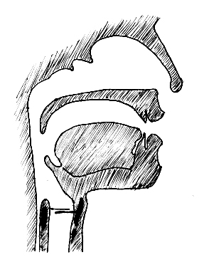
Places of Articulation
Labials (bilabials, labiodentals)
Alveolars
Velars
Interdentals
Palatals
Glottals

Slide 16
Places of Articulation
1. Labials
[b], [p], [m], [f] and [v] are labials
When we produce [b], [p], or [m], we articulate them by bringing together both lips. These speech sounds are called bilabials
When we produce [f] and [v], we articulate by touching the bottom lip to the upper teeth. These speech sounds are called labiodentals

Slide 17
Places of Articulation
2. Alvelors
[t], [d], [s], [z], [n], and [l] are alveolars.
When we produce these sounds we raise the tip of our tongue toward the hard palate and touch the alveolar ridge. These speech sounds are called alveolars

Slide 18
Places of Articulation
3. Velars
[k],[g],[ŋ],[w]are velars.
When we produce these sounds we raise the back of our tongue toward the soft palate or the velum. These speech sounds are called velars

Slide 19
Places of Articulation
4. Interdentals
[Ɵ] and [ð] are interdentals.
When we produce these sounds we insert the tip of our tongue between the upper and the lower teeth. These speech sounds are called interdentals.

Slide 20
Places of Articulation
5. Palatals
[ʃ] [ʒ] [ʧ] [ʤ] are palatals.
When we produce these sounds we raise the front part of our tongue to a point on the hard palate just behind the alveolar ridge. These speech sounds are called palatals.

Slide 21
Manner of Articulation
Stops
Fricatives Obstruents
Affricates
Nasals
Liquids Sonorents
Glides

Slide 22
Manner of Articulation
Obstruents
An obstruent is a consonant sound formed by obstructing the outward airflow, causing increased air pressure in the vocal tract.
Obstruents are those articulations in which there is a total closure or a stricture causing friction,
Obstruents are subdivided into stops, fricatives, and affricates.

Slide 23
Manner of Articulation
Obstruents
Stops
When the air stream enters the oral cavity it may be stopped, obstructed, or flow freely.
When the air is completely stopped for a brief period of time, these speech sounds are called stops.
[b], [p], [t], [d], [k] and [g] are stops

Slide 24
Manner of Articulation
Obstruents
Fricatives
When the air is not stopped completely but is obstructed from flowing freely, these speech sounds are called fricatives.
[f] [v] [θ] [ð] [s] [z] [ʃ] [ʒ]

Slide 25
Manner of Articulation
Obstruents
Affricates
Some sounds are produced by a stop closure followed immediately a slow release of the closure as in a fricative. These speech sounds are called affricates.
[ʧ] and [ʤ] are affricates.

Slide 26
Manner of Articulation
Sonorants
Sonorants are those articulations in which there is only a partial closure or an unimpeded oral or nasal scape of air.
English has the following sonorant consonantal phonemes: /l/, /m/, /n/, /ŋ/, /ɹ/, /w/, /j/

Slide 27
Manner of Articulation
Sonorants
Nasals
A nasal consonant is produced with a lowered velum in the mouth, allowing air to escape freely through the nose. The oral cavity still acts as a resonance chamber for the sound, but the air does not escape through the mouth as it is blocked by the tongue
[m], [n] and [ŋ] are nasals

Slide 28
Manner of Articulation
Sonorants
Liquids
When there is some obstruction of the air stream but not enough to cause friction, these speech sounds are called liquids
[l] [ɹ]

Slide 29
Manner of Articulation
Sonorants
Glides
When there is little or no obstruction of the air stream in the mouth, these speech sounds are called glides or semi-vowels
[w] [j]

Slide 30
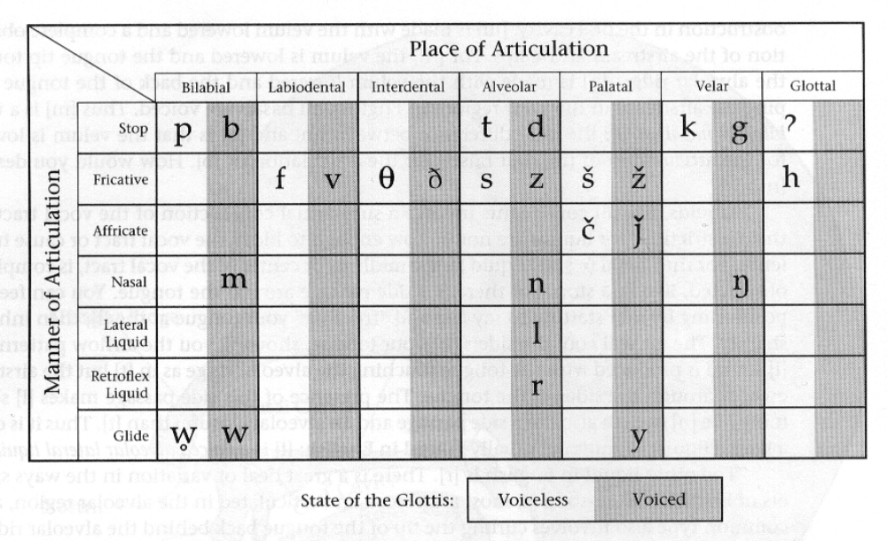

Slide 31
IPA
The International Phonetic Association (IPA; in French, Association phonétique internationale) is an organization that promotes the scientific study of phonetics and the various practical applications of that science.
Purpose Guiding principle:
one sound = one symbol

Slide 32
IPA
The IPA’s major contribution to phonetics is the International Phonetic Alphabet —a notational standard for the phonetic representation of all languages. The acronym IPA is used to refer to both the association and the alphabet.

Slide 33
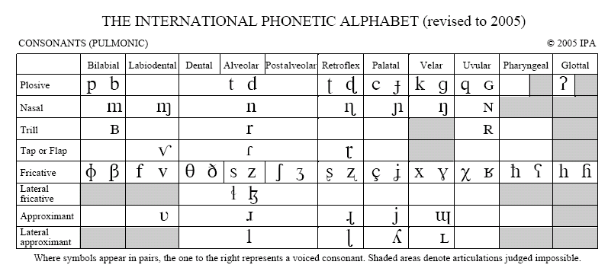
The International Phonetic Alphabet

Slide 34
Recap
Phonetics???
3 types of Phonetics
Articulatory Phonetics
(Places, Manner, Voicing)
Next Week:
Distinctive Feature Analysis
Acoustic and Auditory Phonetics
Vowels and Consonants
Phonetic Transcription

Slide 35
References
Fromkin, Rodman & Hyams. (2007). Language Nature, Psychology and Grammatical Aspects. US: Wadsworth
Jones, Daniel. (1966). The Pronunciation of English. Cambridge University Press.
Jones, Daniel. (1972). An Outline of English Phonetics. Cambridge University press.
Poole, Stuart C. An Introduction to Linguistics. GB: Palgrave.

