Slide 1
Language: Form, Meanings and Functions
Dr. Ansa Hameed

Slide 2
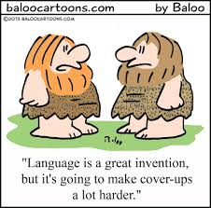
Today’s lecture
Levels of Language
    Nature of Language: Form
    and Meanings
    Functions of Language
What does knowing a language mean????

Slide 3
Language
Language is major concern for Linguistics
Linguistics is scientific study of languages
Language is a tool for human communication different from animal communication system (It is actually one of the most important factors that differentiate us from animals)

Slide 4
Language
We live in a world of language.
(Fromkin & Rodman, 2007, 13)
We talk to our friends, our associates, our wives, our lovers, our neighbours, our parents, our teachers and even our enemies by using language
Language is a complex social activity (Crystal, 2000, 27)

Slide 5
Language
Different aspects of Language
It has form/structure
It has meanings
It has functions

Slide 6
Levels of Language
Semantics | Related to meanings
Syntax | Related to structure of sentences
Morphology | Related to formation of words
Phonology | Related to sound system (symbols) of a particular language
Phonetics | Related to sounds of a language

Slide 7
Language Form/ Structure
1. Phonetics
Science of human speech sounds
It includes
Study of vocal organs through which we pronounce sounds
Study of sound waves
Study of the ways sounds are transmitted
Study of the ways sounds are perceived

Slide 8
2. Phonology
Study of sound systems of a particular language
With reference to a particular language, it studies rules pertaining to the sound system
English, Arabic, Persian, Dutch, Urdu….

Slide 9
3. Morphology
Study of how sounds are combined to make words
Language is made up of Morphemes. Many are words (Lexicon is the dictionary of).
“Papers” has 2 morphemes (paper & s)
3 million words in English (about 200,000 words in common use today).

Slide 10
4. Syntax
Study of formation of phrases and sentences
Rules that enable us to combine morphemes into sentences (bridge between sound and meaning).
When children put words together they are following syntactic rules about how morphemes are put together.

Slide 11
Language with meanings
5. Semantics
The study of meaning of words is called semantics.
Language is a source of expression of meaningful ideas.
The tree ate the elephant.*
The elephant ate the tree.
Meanings are important.

Slide 12
6. Pragmatics
Study of intended meaning of the speaker
Studies the factors which govern a language user’s choices according to the context

Slide 13
Language Functions
Language is highly developed form of human communication which has variety of functions:
Transmission of messages
A vehicle for thoughts to emerge
Social activity
Medium of learning

Slide 14
Knowing a Language
Knowing a language means that you can speak and be understood by those who know that language.
Monolingual, Bilingual, Multilingual communities

Slide 15
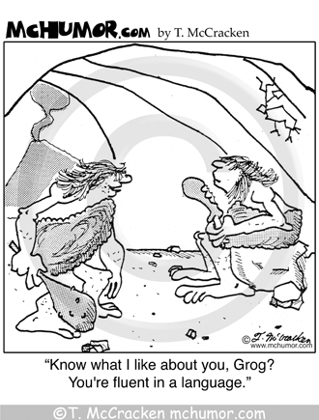

Slide 16
Knowing a Language
When you know a language, You have linguistic knowledge with you (unconscious in case of first language acquisition and conscious in case of second language learning)
Linguistic Knowledge is comprised of:

Slide 17
Knowing a Language
1. Knowledge of the Sound System
When you speak a language you have knowledge of the sound system of that particular language
English
French
Arabic
Urdu

Slide 18
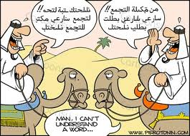
Knowing a Language
2. Knowledge of Words
Knowing a language means also knowing that certain sequences of sounds that signify certain concepts are meanings
Knowing words in that language
Knowing about arbitrary relationships between forms and meanings

Slide 19

Knowing a Language
3. Knowledge to create
Knowledge of a language enables you to combine sounds to form words, words to form phrases and phrases to from sentences.
You cannot buy a dictionary of any language with all the sentences of the language
You need to create on the basis of your existing knowledge

Slide 20
Knowing a Language
4.Knowledge of Sentences and non sentences
Knowledge of language is finite but your production of language is infinite
Novel sentences
Lengthy sentences
You have knowledge about right and wrong sentences
John is anxious to go.
It is anxious to go John.*

Slide 21
Knowing and Performing a Language
You know a language (Linguistic Knowledge/ Competence)
You use a language (Linguistic Performance)

Slide 22
Recap
Language has form, meanings and functions
Language: knowing and Performing

Slide 23
References
Crystal, David. (2000). What is Linguistics.
Fromkin, Rodman & Hyams. (2007). Language Nature, Psychology and Grammatical Aspects. US: Wadsworth

