Slide 1
Language: Is language restricted to humans?
Dr. Ansa Hameed

Slide 2
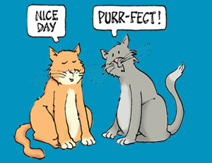
Language: Controversy
What does make language controversial?
Language is only human capacity (Controversy)
Animals do communicate but again no language (Controversy)

Slide 3
Controversy: Is language restricted to Humans??????
An ant who can speak
French, Javanese and Greek
Doesn’t exist.
Why ever not?
(Robert Desnos)
Anne, Anne, come quick as you can
There’s a fish that talks in the frying pan?
(La Mare)

Slide 4
Movies with talking animals
Epic
Dogs and Cats
Finding Nemo
Ice Age
Ratatoullie
Puss in Boots
Children wonder: Do animals really talk?

Slide 5
Do animals talk???
Need to define ‘talk’ properly
Talk
‘to utter words’ ‘to use language in a meaningful way’
Some animals can talk in the first sense
Parrots can talk: simple phrases ‘good morning’
Budgerigars can talk in the first sense
Do animals talk in the second sense of this word?

Slide 6
Are we the only species which possesses language?
Let us compare animal communication
systems with human language to see if
animals can be said to talk in any real
sense.

Slide 7
If we want to find out whether animals use a language in a meaningful way, we have to understand what a language is.
What is language?
Charles Hocket in the 1960’s suggested that we can characterize language by means of a set of design features. A definition of a language should be based on these design features (essential characteristics). What are they?

Slide 8
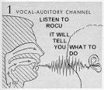
1. Vocal-auditory channel
It is perhaps the most obvious characteristics of a language.
Sounds are made with the vocal organs and a hearing mechanism receives them.

Slide 9
1. Vocal-auditory channel
Is this design feature of a language unique to humans?
The use of sound is widespread as a means of animal communication
Vocal auditory signals are common among birds, cows, apes, foxes etc.
Some animals and birds produce sounds even without using vocal organs like rattlesnakes and woodpeckers

Slide 10
1. Vocal-auditory channel
Even in a human communication vocal-auditory channel is not so all-important since language can be transferred without loss to visual symbols (sign language, writing, Braille). Patients with their vocal cords removed, communicate mainly by writing which means that they have not lost their language ability.
vocal-auditory channel is of little use in an attempt to distinguish animal from human communication.

Slide 11
2. Arbitrariness
Arbitrariness means no connection between the form (word) and its meaning (human languages use neutral symbols)
– when you meet a Martian will he know what you mean when you say a dog – will he deduce the meaning of this word from its form? ein Hund in German, CANIS in Latin, Rhodon in Greek
and pies in Polish
Exceptions: Onomatopoeic words in which there is a relationship between their form and what they mean CUCKOO, POP, BANG, MOO. Onomatopoeic words imitate natural sounds and have meanings that are associated with such sounds of nature.

Slide 12
2. Arbitrariness
Is arbitrariness unique to a human language?
No, arbitrary symbols are not unique to humans and it cannot be regarded as a critical distinction between human and animal communication.
For instance: A crab which wishes to convey extreme aggression will extend a large claw, a less angry crab only raises a leg.
Gulls indicate aggression by turning away from their opponent and uprooting beakfuls of grass
So arbitrariness is not unique to humans.

Slide 13
3. Semanticity
Semanticity is the use of words/symbols to mean or to refer to objects and actions.
When we say ‘chair’ we refer to any object which is a chair, when we say ‘jump’ we refer to an action of jumping.
When a parrot says ‘chair’ does it refer to an object or is it only reacting to some stimulus or is it imitating someone?
Some writers have claimed that semanticity is exclusively human. Animals usually do not refer to objects but to the whole situations (of danger for example).

Slide 14
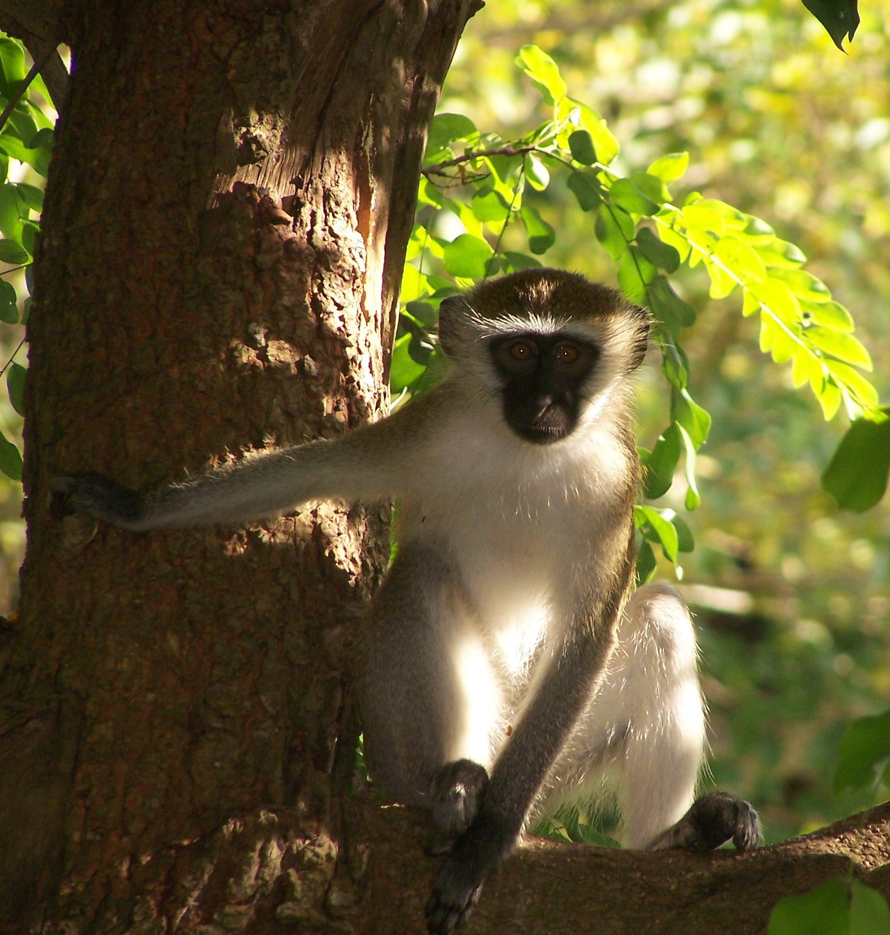
3. Semanticity
Let us consider vervet monkeys:
They have an interesting system of communication: different ALARM CALLS for different types of predators

Slide 15
3. Semanticity
TYPE I – alarm call signaling the presence of a SNAKE: A vervet gives one call when it sees a snake. Other members of the troupe then stand on their hind legs and scan the ground.
TYPE II: an alarm call signaling the presence of a leopard. Other members of the troupe immediately climbed to the smallest branches of nearby trees, safe from the heavy leopard.
TYPE III: an eagle cruising the sky. They climb the tree and stay near the trunk, deep in the tree, or alternatively dove into dense bushes.
Can we say that vervet monkeys use a language which features semanticity? Do vervet monkeys make calls to refer to particular types of objects or are they signaling different types of situations (situations of danger)
Conclusion: The communication of vervet monkeys is not characterized by semanticity.

Slide 16
4. Displacement
we are able to use language about events which are not related to now and here, we can speak about abstract objects and events. We can talk about someone or something which is far away or about an event which happened in the past or will happen in the future.
My aunt Matilda who lives in Australia broke her leg last week.

Slide 17
4. Displacement
Can we find displacement in animal communication? Is it unique to human language?
Animals normally cannot speak about things which happened far away or yesterday.
An interesting exception are bees.
When a worker bee finds a source of nectar she returns to the hive to perform a complex dance which informs the other bees of its location: a ‘round dance’ – the nectar is close to the hive; a ‘waggle dance’ in which she wiggles her tail from side to side if it is far away.

Slide 18
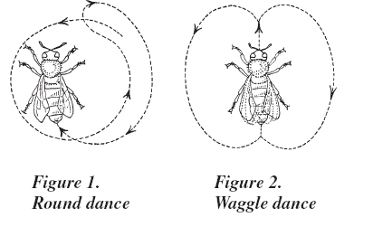
4. Displacement

Slide 19
4. Displacement
But…
A bee cannot say ‘The day before yesterday I visited a lovely clump of flowers’.
She can only say come to the nectar I have just visited located 10 meters from the hive.
Bee communication features (limited) displacement so we can say displacement is quite exclusively human capacity.

Slide 20
5. Duality or Double-articulation
language is organized in two layers – basic units of speech – sounds p, I, g are normally meaningless by themselves. They only become meaningful when combined into sequences such as pig.
Is duality of patterning unique to human communication?

Slide 22
5. Duality or Double-articulation
No, duality of patterning is not unique to humans, when birds produce single notes they are meaningless, but when they are combined they convey meaningful messages.

Slide 23
6. Creativity
the ability to produce and understand an indefinite number of novel sentences.
What is the longest sentence you can produce?
E.g. My mum said that Mary thinks that Bill is aware of the fact that what I found in his room under the carpet in a tiny box under a symbol of a rose was a Christmas present for Sue which she asked for in her letter to a Santa Claus.

Slide 24
6. Creativity
Our syntax allows us to produce never-ending sentences thanks to the process of RECURSION
Recursion
When a linguistic unit (e.g. a sentence) can contain a smaller linguistic unit of the same kind (a sentence contains another sentence:
John said that Mary said that .....).
CREATIVITY is the most important feature of a human language.
Most animals have a fixed number of signals which convey a set number of messages, sent in clearly definable circumstances.

Slide 25
7. Cultural Transmission
It is a tradition of transferring languages from one generation to other.
Children can learns from parents, human beings hand their language down from one generation to another.
On the other hand, in animals and birds, language is believed to be innate.
For example: A child brought up in isolation does not acquire language but birds reared in isolation sing songs.

Slide 26
8. Discreetness
language consists of isolatable units
Two birds sneezed:
Sounds t u: b э: d z s n i: z d
Morphology [two] [bird]-[s] [sneeze]-[ed]
Syntax [ [two birds] [sneezed] ]
Very limited discreetness is found in animal communication.

Slide 27
9. Structure Dependence
Human language has proper patterns and rules for organisation
Human beings when speak, they automatically recognise the patterned nature of language and manipulate structured chunks
we have structure dependent operations
I gave a carrot to a donkey
A donkey was given a carrot
Animals do not use structure dependent operations.

Slide 28
10. Prevarication
Humans have the ability to tell lies (not present in animal communication)

Slide 29
11. Medium – transferability
we can switch from writing to speech – we can express what we want to say and we can also write it down.

Slide 30
12. Reflexiveness
we can use language to talk about language.

Slide 31
13. Turn Taking
We take it in turns to speak.
Hello! John. What are you doing here.
Well! I am looking for a workshop around.
Oh! There’s one on your left side.
It is quite human language’s characteristics but yes there are certain evidences in birds
Birds sing duets together (antiphonal singing)

Slide 32
14. Stimulus-freedom
we can say whatever we like.
What do you think of that book?
We can answer whatever we want – there is no strict response attached to this stimulus.
I animals, there is no stimulus freedom.

Slide 33
15. Learnability
Ability to learn different number of human languages
Can we teach a human language to animals?
At first scientists tried to teach apes to speak, without noting that the vocal tracts of apes are not capable of producing human sounds (properly!).
Once scientists realized the vocal limitations of apes, future experiments focused on teaching apes sign language (invented sign languages or American Sign Language - ASL.

Slide 34
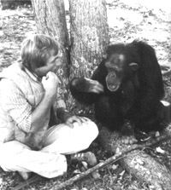
15. Learnability: teaching an ape

Slide 35
15. Learnability
One of the most famous experiments began in 1972, when Francine Patterson began teaching ASL to a gorilla named Koko. Koko now knows more or less 1000 signs. Koko uses a lot of ASL signs. But does she know ASL? Does she know language?
It is controversial. Even though she uses the signs, she does not use the syntactic structure of ASL. As far as syntax goes, she is stuck in the two-word stage.

Slide 36
15. Learnability
Dr. Noam Chomsky, the M.I.T. linguist whose theory that language is innate and unique to people forms the infrastructure of the field, says that attempting to teach linguistic skills to animals is irrational - like trying to teach people to flap their arms and fly.
"Humans can fly about 30 feet -- that's what they do in the Olympics," he said in an interview. "Is that flying? The question is totally meaningless.

Slide 37
Recap
Animals communication has certain features like sound production ability, arbitrariness, duality, etc
But….. No creativity, displacement, structure, stimulus freedom……etc
To characterize animal communication system, it shouls have all features
We can conclude ‘animals do not have a language like humans’.

Slide 38
References
Aitchison, Jean. (1989). The Articulate Mammal. London: Routledge.

