Slide 1
Introduction to Linguistics
Lecture # 1
Dr. Ansa Hameed

Slide 2
What is Linguistics???
Misconceptions
What is your profession?
I am a teacher.
What do you teach?
I teach Linguistics.
Oh! It means you can speak a lot of languages.
Well! I’m sorry. I can’t actually.

Slide 3
Linguistics is not teaching of or knowing about a particular language or set of languages. It’s beyond that.
Do you know what Linguistics is????

Slide 4
Linguistics is study of Languages.
Yes……… At the same time, it’s too much more than it
There are lot of misconceptions regarding the discipline of Linguistics

Slide 5
What is Linguistics???
To know What Linguistics is?
It’s crucial to know what Linguistics is not? (Crystal, 1)

Slide 6
What Linguistics is not??
1. Linguistics is not Philology
Philology is the study of history of language over time (Historical/ Diachronic approach)
Linguistics is concerned with a language(s) at one particular time without tracing history (Synchronic approach)

Slide 7
What Linguistics is not??
2.Linguistics is not about Language Learning or Teaching
Linguistics has not much concern with the discipline of Language Teaching or Learning
But, it can improve ability of language learning because it talks about general forms and rules common to human language

Slide 8
What Linguistics is not??
3. Linguistics is not concerned with Evaluation of a Language in Use
Evaluation is job of critics not linguists
Linguistics is objective

Slide 9
What Linguistics is not??
4. Linguistics is not concerned with Traditional Grammar Approaches towards Languages
Linguistics is modern approach different from traditional grammar approaches

Slide 10
What Linguistics is not??
Linguistics vs. Traditional Grammar
1. Speech vs. Writing
Modern Linguistics value difference between speech and writing E.g. written plural forms are same but oral are different one: Boats ending sound ‘s’ Trains ending sound ‘z’ We speak before we write, sometimes we only speak | Traditional Grammar approaches don’t identify that written and verbal (speech) languages are two different forms Thus they tend to use the rules of one form over other

Slide 11
What Linguistics is not??
Linguistics vs. Traditional Grammar
2. Influence of Latin
Modern Linguistics consider every language separately We cannot measure one language against the yardsticks provided by other | Traditional Grammar approaches try to describe English in terms of Latin because they consider Classical languages (Latin, Greek, Roman etc.) had real models of language

Slide 12
What Linguistics is not??
Linguistics vs. Traditional Grammar
3. Logical Language(s)
According to Modern Linguistics, human language is not a logical construct One cannot apply logical rules over language Languages are rather unpredictable or they can be irregular | Language is a logical construct There are logics behind rules of grammar Some languages are logical and some are illogical

Slide 13
What Linguistics is not??
Linguistics vs. Traditional Grammar
4. complexity
Neither any language complex nor primitive We cannot say Chinese is a hardest one language on the basis of our experience of learning it, its not hard for Chinese | Some languages are complex and some are simple

Slide 14
What Linguistics is not??
Linguistics vs. Traditional Grammar
5. Aesthetic Language(s)
Languages are neither beautiful nor ugly Every language has its own standards for aesthetic sense/ beauty | Classical languages were more beautifully constructed They had higher aesthetic value than the modern ones

Slide 15
What Linguistics is not??
Linguistics vs. Traditional Grammar
6. Historical meanings of languages are correct
Languages change Meanings change and we need to accept the current or latest meanings | Good languages rarely change Correct meaning are the one which were in history E.g. nice (current meaning ‘good’, historic meaning ‘silly’ and Latin origin meaning ‘ignorant’) We should consider original meaning of the word that is ‘ignorant’

Slide 16
What Linguistics is not??
Linguistics vs. Traditional Grammar
7. Vague Definitions
According to Modern Linguistics, the definitions provided by Traditional Grammarians are vague and obscure Need to redefine grammatical terms E.g. If Noun is a naming word for place person and thing then what about abstract nouns, gerunds ??? If verbs are doing words then what about linking and helping verbs??? | There are certain fixed definitions of grammatical terms like of parts of speech E.g. Noun is a naming word for place person and thing E.g. Verbs are doing words

Slide 17
What Linguistics is not??
Linguistics vs. Traditional Grammar
To sum up, Modern Linguistics has a descriptive approach (describe facts about language, describe rules do not make it) whereas, Traditional Grammarians have Prescriptive approach (give prescription and make rules about how people ought to speak and write in conformity with some standards)

Slide 18
What Linguistics is not???
What Linguistics is?

Slide 19
What Linguistics is?
Etymology: Latin origin of word
Linguistics
Lingua istics
Tongue knowledge/ science
Linguistics is ‘scientific study of language’
Scientific????
Language????

Slide 20
What Linguistics is?
Scientific
Systematic
Follows scientific procedure of making observation, making hypothesis, conducting tests, establishing theory

Slide 21
Language
Do you know, What is Language?
Yes, I know what language is. Of course, I speak it all the time.
Well, define it.
Hmmmn, Language is what I speak hmmmn….
An ordinary man has never proper words to define it
Language is a tool of communication

Slide 22
Standard Definitions of Language
‘Language is a primarily human and non-instinctive method of communicating ideas, emotions and desire by means of a system of voluntarily produced symbols’ (Sapir, 1921)
‘Language may be defined as the expression of thought by means of speech sounds’ (Sweet, 1993)
‘Language is a system of conventional, spoken or written symbols by means of which human beings, as members of a social group and participants in its culture, communicate’ (Encyclopedia Britannica)

Slide 23
Linguistics as a Discipline: Scope
Descriptive Linguistics
Descriptive Linguistics is primarily concerned with study of language with special reference to the questions:
(a) what exactly do we know when we know a language
(b) how is this knowledge acquired and
(c) how is such knowledge used?

Slide 24
Linguistics as a Discipline: Scope
Historical Linguistics
It studies the developments in languages in the course of time, the ways in which languages change from period to period and of the causes and results of such changes

Slide 25
Linguistics as a Discipline: Scope
Comparative Linguistics
It deals with distinctions among languages. It is primarily based on synchronic description of languages.

Slide 26
Linguistics as a Discipline: Scope
Psycholinguistics
It studies language as a mental phenomenon. It studies mental processes for production, acquisition and learning of languages. It also studies psychological factors like motivation, anxiety etc. with reference to language

Slide 27
Linguistics as a Discipline: Scope
Sociolinguistics
It is branch of linguistics that studies relationship between language and society. It particularly studies variations in language with reference to social, geographical, political and functional variables.

Slide 28
Linguistics as a Discipline: Scope
Anthropological Linguistics
It is a part of sociolinguistics
It studies a specific area of the evolution of language in human society and its role in the formation of a culture

Slide 29
Linguistics as a Discipline: Scope
Ethno linguistics
It is also a sub branch of sociolinguistics
It studies the variations in languages on the basis of social interaction among a few human races and cultures

Slide 30
Linguistics as a Discipline: Scope
Applied Linguistics
It is about application of linguistics in various fields like teaching of foreign language, translation, lexicography, therapy, error analysis etc
It applies linguistics theories on other areas of knowledge rather than producing new theories

Slide 31
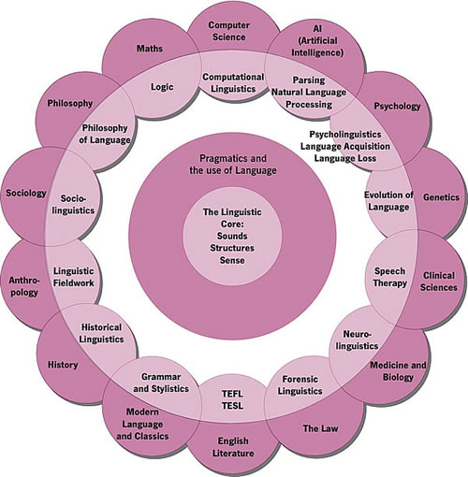
Linguistics is inter-disciplinary

Slide 32
Recap
What linguistics is not?
Modern linguistics vs. traditional Grammarians
What linguistics is?
Branches of Linguistics
Lecture # 2: Language ????

Slide 33
References
Crystal, David. (1985). What is Linguistics?. 4th Edition. USA: Edward Arnold
Falk, Julia. (1978). Linguistics and Language. Canada: John, Wiley & Sons.
Sapir, E. (1921). Language. Brace & World.
Sweet, Henry. (1993). The History of Language from a Secondary Source.

