Slide 1
Introduction to the Course and
Introduction to the Novel
Dr. Sarwet Rasul

Slide 2
My Introduction

Slide 3
Introduction to the Course
Course Overview:
The novel course is mainly concerned with the English novel from the eighteenth and the nineteenth century which is rich in diversity, creativity and popular appeal.
It explores the rise of English Novel as an essential literary genre.
It starts with an introduction to the novel, its origin and definition. It includes elements of the novel, its development and aspects or elements of the novel.
The course includes the works of major novelists of the era namely Henry Fielding, Jane Austen, Charles Dickens, and Thomas Hardy.
Thus, the first novel that is covered in the course is the cheerful moralistic writing of Henry Fielding “Joseph Andrews”. This leads us to explore the perfection of the novel in Jane Austin’s “Emma”. Then “Great Expectations” by the moralist and reformist Charles Dickens is critically examined. Finally, the perennial work of Thomas Hardy “Tess of the d’Urberville” written towards the end of the 19thcentury is explored.

Slide 4
Aim of the Course:
The main aim of this course is to make students enjoy and appreciate the structure and content of the selected novels by reading between lines with a critical eye, to develop in them the ability of textual analysis and critical interpretation of the English novel in the wider socio- cultural and philosophical context.
Objectives of the Course:
To introduce each of the selected novels as a reading activity for interpretation and analysis
To enable the students to observe the chronological development in the genre of novel
To make the students comprehend the structural and thematic aspects of the English Novel

Slide 5
Today’s Session
Introduction to the course
Aim and objectives of the course
Definitions of novel
Novel as a genre
Unique qualities or characteristics of noel as a genre
History and Origin of (English) Novel
Types of Novel

Slide 6
GENERAL PARAMETERS OF THE NOVEL
GENRE: Fiction (Narrative)
STYLE: Prose
LENGTH: Extended

Slide 7
DEFINITIONS…
“A book length story in prose,
whose author tries to create a
sense that, while we read, we
experience actual life.”
By X. J. Kennedy
“An extended fictional narrative,
usually written in prose.”
Anonymous

Slide 8
DEFINITIONS…
“An imaginary work in prose
of a considerable length, which
presentsas real certain characters
living in a given environment and
describes their attitudes,
fate, and adventures.”
By Percy Lubbock
“The novel is like a symphony
In that the closing movement
Echoes and resounds with all
that has gone before…”’
By John Gardner

Slide 9
We can notice all the different ways in which one can define the novel. The most important literary genre, novels are basically just products of writers’ imaginations.
These definitions emphasize various aspects of novel such as real and life-like characters, rising of conflicts and presentation of themes etc.
The universal idea that the novel should be believable is one of the unique qualities of the novel and explains its popularity as a literary form.

Slide 10
The novel has various unique qualities or characteristics that distinguish it from other types of prose.

Slide 11
Length
The first quality of a novel is its length. Although there are no definite rules on the subject of length, it is generally agreed among writers and publishers that the length of the narrative must be good enough, generally more than 100 pages.
If it is less than that, it is usually referred to as a novella, such as Ernest Hemingway’s The Old Man and the Sea and George Orwell’s Animal Farm.

Slide 12
Emphasis on the Character
Another quality of a novel is its emphasis on the character or characters in the story.
Since a novel is longer than a short story, the length of a novel allows the author to give the reader a much fuller description of the characters and to introduce more than one conflict. Therefore, the reader can better understand the character’s motives for action or inaction, relationships with others, and their own personal feelings, dreams and fears.

Slide 13
Structure: Structurally more complicated
A novel has more than one theme, conflict, point of view or plot.

Slide 14
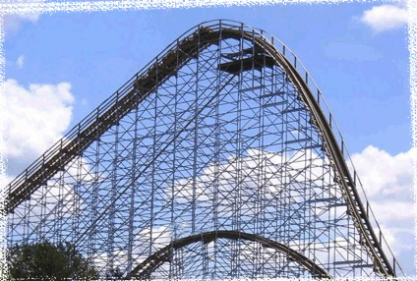
Plot
The plot is what happens in the story.
The plot is what happens in the story. This diagram shows common plot structure, which is a lot like a rollercoaster that climbs slowly up a big hill and then quickly drops down at a sharp angle. A story begins with the exposition, action rises to a climax, or high point in a work, and then falls to a resolution or dénouement.
climax
exposition
Resolution

Slide 15
Plot of novels: The Conflict
In early novels plots centered on three different conflicts. These three major conflicts all dealt with how the individual viewed himself or herself in relation to society, to the self, and to other individuals.
Person versus society
Person versus self
Person versus person

Slide 16
Setting
Where and when a story takes place
Time of day or year
Geographical location
Climate or weather
Immediate surroundings
of character
Purpose of Setting:
Setting serves many purposes in a story such as a backdrop, supporting or antagonistic role etc.

Slide 17
Theme
Theme is the central idea in a literary work which serves to unify the story. It is what the author has to say about death, love, hope, courage, morality, society, etc. Every element of the novel: plot, point of view, setting and character contribute to the theme.

Slide 18
Character
Character: person in a literary work
Main character: the protagonist
Character in direct conflict with the protagonist: the antagonist

Slide 19
Plot explores characters in conflict to understand our own humanity
Another quality of a novel is the complexity of plot. Unlike the short story, a novel will often have more than one major conflict within the plot. Often the author is interested in developing a plot in which the main goal is for the character to better understand his or her own humanity or place in society. The conflict can be internal or external.

Slide 20
Point of View in a Novel
Author’s choice of narrator for a story
A story can be told in many different ways
Point of view refers to the author’s choice of narrator for a story. A story can be told in many different ways. Novels are unique in that they allow for many different views of an event whereas, in short stories there is usually only one view.
In first-person point of view, the narrator is a character in the story. The narrator, or the one telling the story, may or may not be reliable in first person narratives because the narrator is a character within the story and is likely not entirely objective.
Second-person point of view directly addresses the audience with the use of the pronoun “you.” Second-person point of view pulls us into the story by making us one of its characters.
With third person point of view, the narrator is not a character in the story and is basically “outside looking in.” Third person point of view can be written in a variety of ways. In Third Person Limited, the narrator is limited to what one character knows or observes. With Third Person Multiple Viewpoints, the narrator has access to the view of more than one character. Finally, in Third Person Omniscient, the narrator is all-knowing and has access to characters’ thoughts, feelings, and motivations.

Slide 21
Novel and Verisimilitude
Novel is a semblance of truth.
It has recognizable settings and characters in real time.
According to Hazlitt it is “ the close imitation of men and manners… the very texture of society as it really exists.”
The novel emerged when authors fused adventure and romance with verisimilitude and heroes that were not supermen but ordinary people, often, insignificant people.

Slide 22
Novel Compared to the Short Story
NOVEL
50,000 words or more
Many characters
Complex story
Deeper understanding of life or individuals
SHORT STORY
5,000 words or less
Few or one character
Focuses on one event
Better understanding of an event or character

Slide 23
This comparison chart may make it easier to see the differences between two common forms of storytelling—the novel and the short story. Because novels are lengthier than short stories, novels feature additional characters, more complex plots and a deeper exploration of life or characters within the text. The short story, in contrast, focuses on one character, one major conflict or event and provides a simple understanding of the main character or event instead of the “bigger picture” of man’s place in society, multi-faceted characters or an extended period of time in characters’ lives. Just think:

Slide 24
History of the Novel
Oral telling of myths, history, and stories
Written storytelling in the form of the epic
Written prose fiction concerned with adventure known as the romance. (The French word for the novel is roman)
Written prose fiction concerned with reality or actual life. (The English word for new is novel)

Slide 25
How did the novel get its start?
Early peoples depended on the oral tradition to pass their histories, beliefs and stories from one generation to the next.
Various cultures wrote epics, which are long narrative poems such as Beowulf or The Odyssey. Next, consider romances as a literary genre—not the common, modern definition of romance, which means love affair or romantic attraction.
Romances were essentially comprised of a series of adventures and included ideas like Authurian legend and knighthood. Prior to the mid-18th century, the novel as a common, accepted form of prose actually did not exist.
Most people were illiterate, and without a middle-class, there really wasn’t a market for the novel. The affluent were more interested in biographies, journals, memoirs and historical texts. The members of the working-class were poor and illiterate. Social and economic changes were needed to create a market for the novel.

Slide 26
Narrative Precursors to the Novel
Heroic Epics
Gilgamesh, Homer’s Iliad and Odyssey, Mahabharata, Valmiki’s Ramayana, Virgil’s Aeneid, Beowulf, The Song of Roland
Ancient Greek and Roman Romances and Novels
An Ephesian Tale and Chaereas and Callirhoe, Petronius’s, Satyricon, Apuleius’s The Golden Ass
Oriental Frame Tales
The Jataka, A Thousand and One Nights
Irish and Icelandic Sagas
The Tain bo Cuailinge, Njal’s Saga

Slide 27
Narrative Precursors to the Novel
Medieval European Romances
Arthurian tales culminating in Malory’s Morte Darthur
Elizabethan Prose Fiction
Gascoigne’s The Adventure of Master F. J.,Lyly’s Euphues, Greene’s Pandosto: The Triumph of Time, Nashe’s The Unfortunate Traveller, Deloney’s Jack of Newbury
Travel Adventures
Marco Polo, Ibn Batuta, More’s Utopia, Swift’s Gulliver’s Travels, Voltaire’s Candide
Novelle
Boccaccio’s Decameron, Margurerite de Navarre’s Heptameron
Moral Tales
Bunyan’s Pilgrim’s Progess, Johnson’s Rasselas

Slide 28
The Industrial Revolution
Mid 18th Century England
Urban life
Growth of industry
Birth of new “middle class”

Slide 29
Industrial Revolution and Social Changes:
These social and economic changes occurred as a result of the Industrial Revolution. The colonization of the Americas gave England an abundance of raw materials, which led to the creation of a merchant class, members of which sought their success in the profit made from trading goods.
Technological Advancement:
Technological changes, such as new machinery, defined what we now call the Industrial Revolution. With it came the growth of cities and a change in the entire social, political and economic structure in England. From the creation of industry, a new social and economic class of people emerged—the middle class. They gained their wealth through the ownership of factories and the institutions that supported them. Thus, the social issues of old money vs. new money emerged.

Slide 30
The Rise of the English Novel
The Restoration of the monarchy (1660) in England after the Puritan Commonwealth (1649-1660) encouraged an outpouring of secular literature
Appearance of periodical literature: journals and newspapers
  Literary Criticism
  Character Sketches
  Political Discussion
  Philosophical Ideas
Increased leisure time for middle class: Coffee House and Salon society
Growing audience of literate women also added to the strength of the new genre of novel

Slide 31
Birth of the Novel
New market for
the novel by 1700s!
Spending money
available for
entertainment
Increase in the
number of people
able to read
More leisure
time available
Creation
Of
The Middle Class

Slide 32
Change in Reading Habits
Before the emergence of novel, people primarily read plays, poetry, essays and religious texts
With the development of the novel, the longest form of prose writing was developed. The new middle class found themselves with the required education, wealth and time to enjoy this new form of entertainment.
As now there were larger numbers of literate people who had money to spend on books, who were the members of the emerging middle class, a new market was created in which the novel was able to flourish.

Slide 33
Novel as a Representative Genre: Concerned with real problems and real situations of Middle Class
We are talking of the times when a traditional conservative social pattern was followed.
Generally, men pursued careers in law or in the military or in business but women were expected to marry ahead of one’s class to improve her place in society. Jane Austin’s works show this.
As for a real picture of what daily life in industrial England was like, Charles Dickens’ Hard Times and Great Expectations. Hard Times presents the situations that factory workers faced: long work hours, extremely low wages, child workers, and very dangerous working conditions. Dickens’ goal was to alert the middle and upper classes to the inhumanity—the real problems and situations—that the lower classes endured.

Slide 34
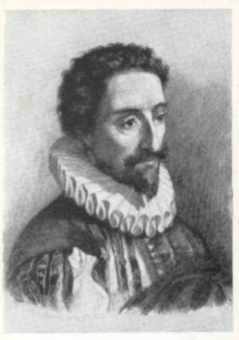
Tracing the History of Novel: Don Quixote by Cervantes
(1547-1616)
First European novel: part I - 1605; part II - 1615
A psychological portrait of a mid-life crisis
Satirizes medieval romances, incorporates pastoral, picaresque, social and religious commentary
What is the nature of reality?
How does one create a life?

Slide 35
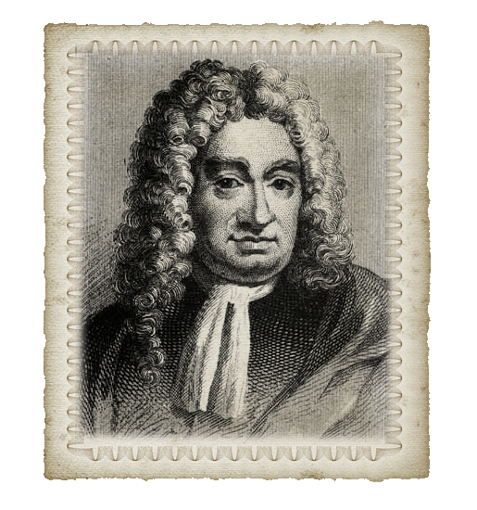
The Founder of the Modern English Novel
Daniel Defoe: Master of plain prose and powerful narrative
Wrote Robinson Crusoe (1719): This is a travel adventure.
Moll Flanders (1722): This is a Picaresque novel.
Born 1660
Died 1731
Established a “middle class” perspective
Most will agree, however, that Daniel Defoe and his novel Robinson Crusoe and later Moll Flanders actually set the structure and themes of the novel. Born in 1660 as a butcher’s son, Defoe soon rose above the expectations of social class by the encouragement of his nonconformist father and was sent to Charles Morton’s Academy in London for a “proper education.” His father intended for him to enter the ministry just as many educated people did in those days, but Defoe embarked on a career as a journalist. Ultimately, Defoe’s creation of believable characters and realistic situations enabled him to meet readers’ demands, thereby becoming the founder of the modern English novel.
Defoe

Slide 36
The First Novels
Don Quixote ( Spain, 1605-15) by Miguel de Cervantes
The Princess of Cleves (France, 1678) by Madame de Lafayette
Love Letters between a Nobleman and His Sister (England, 1683) and Oroonoko (1688)by Aphra Behn
Robinson Crusoe (England, 1719) , Moll Flanders (1722) and A Journal of the Plague Year (1722) by Daniel DeFoe
Pamela, or Virtue Rewarded (England, 1740-1742) by Samuel Richardson
Joseph Andrews (England, 1742) and Tom Jones (1746)by Henry Fielding

Slide 37
Types of Novels
Picaresque
Epistolary
Sentimental
Gothic
Historical
Psychological
Realistic/Naturalistic
Regional
Social
Adventure
Mystery
Science Fiction
Magical Realism

Slide 38
Picaresque Novels
Derives from Spanish picaro: a rogue
A usually autobiographical chronicle of a rascal’s travels and adventures as s/he makes his/her way through the world more by wits than industry
Episodic, loose structure
Highly realistic: detailed description and uninhibited expression
Satire of social classes

Slide 39
Epistolary Novels
Novels in which the narrative is told in letters by one or more of the characters
Allows author to present feelings and reactions of characters, brings immediacy to the plot, allows multiple points of view
Psychological realism

Slide 40
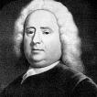
Fathers of the English Novel
Samuel Richardson
1689-1761
Pamela (1740) and Clarissa (1747-48)
  Epistolary
  Sentimental
  Morality tale: Servant resisting seduction by her employer

Slide 41
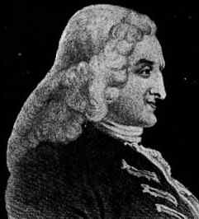
Henry Fielding
1707-1754
Shamela (1741)
Joseph Andrews (1742), and
Tom Jones (1749)
  Picaresque protagonists
  “comic epic in prose”
  Parody of Richardson

Slide 42
Jane Austen and the Novel of Manners
Novels dominated by the customs, manners, conventional behavior and habits of a particular social class
Often concerned with courtship and marriage
Realistic and sometimes satiric
Focus on domestic society rather than the larger world

Slide 43
Gothic Novels
Novels characterized by magic, mystery and horror
Exotic settings – medieval, Oriental, etc.
Originated with Horace Walpole’s Castle of Otranto (1764)

Slide 44
Novels of Sentiment
Novels in which the characters, and thus the readers, have a heightened emotional response to events
Connected to emerging Romantic movement
Laurence Sterne (1713-1768):
Tristam Shandy (1760-67)
The Brontës: Anne Brontë Agnes Grey (1847) Emily Brontë, Wuthering Heights (1847), Charlotte Brontë, Jane Eyre (1847)

Slide 45
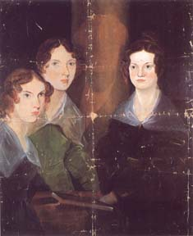
The Brontës
Charlotte (1816-55), Emily (1818-48), Anne (1820-49)
portrait by Branwell Brontë of his sisters,
Anne, Emily, and Charlotte (c. 1834)
Wuthering Heights and Jane Eyre transcend sentiment into myth-making
Wuthering Heights plumbs the psychic unconscious in a search for wholeness, while Jane Eyre narrates the female quest for individuation

Slide 46
Historical Novels
Novels that reconstruct a past age, often when two cultures are in conflict
Fictional characters interact with historical figures in actual events
Sir Walter Scott (1771-1832) is considered the father of the historical novel.

Slide 47
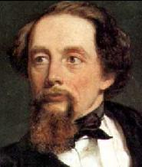
Charles Dickens
1812-1870
By including varieties of poor people in all his novels, Dickens brought the problems of poverty to the attention of his readers:

Slide 48
References of Materials Used
Kettle Arnold (1967) An Introduction to the English Novel 1 . Hutchinson Ltd: Great Britian
http://www.powershow.com/view/15db1- ZjU0M/A_BRIEF_HISTORY_OF_THE_NOVEL_
inghamisd.glk12.org/pluginfile.php/8229/.../ElementsOfANovelPPT.ppt‎

Slide 49
Review of Today’s Session
Introduction to the course
Aim and objectives of the course
Definitions of novel
Novel as a genre
Unique qualities or characteristics of noel as a genre
History and Origin of (English) Novel
Types of Novel

Slide 50
Thank you very much!

