Slide 1
DRAMA II
Lecture 3

Slide 2
PART I
Analysis of Drama
PART II
Henrik Ibsen’s The Doll’s House as Modern Playwright

Slide 3
SYNOPSIS- PART I
Some Ground Rules to Study Drama
What Is Drama, Conflict, Rising and falling action , Plot – denouement, Catharsis
Going Deeper- Meaning Making: Themes, Subtext, Imagery, Symbol, Metaphor, Allegory, Ambiguity, Irony, Allusion, Archetypes
Analysis – Comprehension: 7-stages
Drawing Conclusion

Slide 4
Some Ground Rules to Study Drama
What Is Drama,
Conflict,
Rising and falling action ,
Plot – denouement,
Catharsis

Slide 5
Going Deeper- Meaning Making
Themes
Subtext
Imagery
Symbol
Metaphor
Allegory
Ambiguity
Irony
Allusion
Archetypes

Slide 6
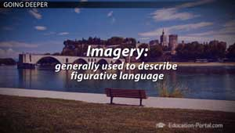

Slide 7
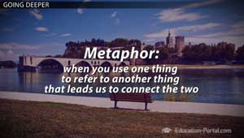

Slide 8
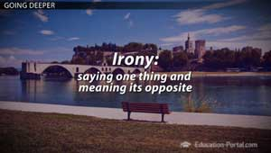

Slide 9
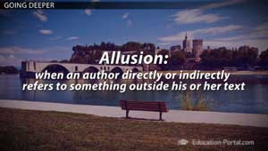

Slide 10
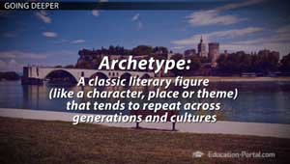

Slide 11
Analyzing Literary work
Comprehending Drama
Does it make sense as a whole?
Do you understand the events that lead from the beginning to the middle to the end - the basic plot?
Are there important parts of the puzzle that you need to recognize?

Slide 12
Comprehension
STEP 1
Setting comprehension
STEP 2
Character comprehension
STEP 3
Plot comprehension

Slide 13
Close Reading and Interpretation
STEP 4
Setting Analysis
STEP 5
Character Analysis
STEP 6
Plot Analysis

Slide 14
STEP 7
Author Style and Language Analysis

Slide 15
REVIEW- PART I
Some Ground Rules to Study Drama
What Is Drama, Conflict, Rising and falling action , Plot – denouement, Catharsis
Going Deeper- Meaning Making: Themes, Subtext, Imagery, Symbol, Metaphor, Allegory, Ambiguity, Irony, Allusion, Archetypes
Analysis – Comprehension: 7-stages
Drawing Conclusion

Slide 16
SYNOPSIS- PART II
Contextual Understanding of The Doll’s House
I. Writer’s Background
II. A Doll’s House: Themes and Structure
III. Plot Overview: A Doll’s House

Slide 17
Contextual Background
I. Writer’s Background
Birth (location and time)
Family and siblings (determines his brought-up and environment)
Social Status (Poverty)
Beginning of his Career as Playwright (First writing in age 21, started work in theater in age 32-33)

Slide 18
Ibsen’s Vision of Marriage – The Doll’s House as a picture of his vision about the institution of marriage
Nature of Social Criticism
A Doll’s House, A Landmark in Modern Prose: Realism

Slide 19
A Note on the Title
A Doll’s House vs. A Doll House
Though most English translations of the play are titled A Doll’s House, some scholars believe that “A Doll House” is a more accurate translation of the original Norwegian.
They feel that it is more suggestive of the doll-like qualities of the entire cast of characters.

Slide 20
III. Plot Overview: A Doll’s House
Opening and setting: Well-furnished living room (one-set play)
Occasion: Christmas Eve, Nora and her Husband
Dr. Rank’s Visit (Helmers’ dear Friend)
Kristine Linde Visit (Nora’s former school friend
Nora and her friend share their married-life experiences

Slide 21
Developments…
Nora’s secret: Nora illegally borrowed money for the trip that she and Torvald took to Italy
Another visitor: Krogstad, a low-level employee at the bank where Torvald works
Nora’s discomfort
Dr. Rank’s opinion about Krogstad: Krogstad is “morally sick.”

Slide 22
After the meeting with Krogstad Helmers shares that can probably hire Mrs. Linde at the bank
Dr. Rank, Torvald, and Mrs. Linde then depart, leaving Nora by herself
Nora’s children return with their nanny, Anne-Marie, and Nora plays with them until she notices Krogstad’s presence in the room.
The two converse, and Krogstad is revealed o be the source of Nora’s secret loan.

Slide 23
Krogstad states that Torvald wants to fire him from his position and asks Nora to use her influence to ensure that his position remains secure
Nora refuses
Krogstad blackmails : warning of revealing her secret
Nora tries to convince Torvald but to no use (ACT I end here)

Slide 24
The plot’s overview is to be continued (will start from ACT II)

Slide 25
Review- PART II
Contextual Understanding of The Doll’s House
Writer’s Background
A Doll’s House: Themes and Structure
Plot Overview: A Doll’s House

Slide 26
Review: Lecture 3
PART I: Some Ground Rules to Study Drama
What Is Drama, Conflict, Rising and falling action , Plot – denouement, Catharsis
Going Deeper- Meaning Making: Themes, Subtext, Imagery, Symbol, Metaphor, Allegory, Ambiguity, Irony, Allusion, Archetypes
Analysis – Comprehension: 7-stages
Drawing Conclusion
PART II: Contextual Understanding of The Doll’s House
Writer’s Background
A Doll’s House: Themes and Structure
Plot Overview: A Doll’s House

Slide 27
Agenda Lecture 4
I. Plot Overview continued…
II. Characters and characterization
III. Analysis of Major Characters

