Slide 1
Lecture 30
How to Overcome Nervousness When Doing PowerPoint Presentation?

Slide 2
Summary
What are visual aids?
Why use visual aids?
Purpose of visual aids
10 Tips for Using Visual Aids
Contingency plans
Example: Designing and using Visual Aids

Slide 3
Introduction
POWERPOINT is widely used in our lives like school works or business reports.
Making a PowerPoint slideshow not an easy thing to do, but as compared to presenting it in front of large audience, it is nothing.
It is natural that people will feel nervous when speaking in front of people.

Slide 4
Introduction
Even the president, no matter how well-prepared he is, he will still be nervous.
Doing PowerPoint presentation should be easier than directly public speaking, for PowerPoint can help you to remember the contents and it could switch people’s focus from you a little bit.

Slide 5
Control Your Emotions:
The best speakers should learn to control their emotions and no longer feel awkward when hundreds of eyes are watching them.
Eye Contact:
Scientific study indicates that it is true that the eyes could cause pressure on you.
However, they have to manage to overcome the nervousness, fear and anxiety that public speaking used to trigger.

Slide 6
Do your knees feel like Gumby's when you have to get up and speak in front of a group?
Do you feel like the next words out of your mouth are going to be the dumbest words ever uttered by a human?

Slide 7
According to the book of Lists,
the fear of speaking in public is the #1 fear of all fears. The fear of dying is #7!

Slide 8
Over 41% of people have some fear or anxiety dealing with speaking in front of groups. People who have this fear can experience all kinds of symptoms:
  Sweaty palms
  Accelerated heart rate
  memory loss and
  even difficulty in breathing

Slide 9
Some of the world's most famous presenters have freely admitted to nervousness and stage fright. Mark Twain said it best:
"There are two types of speakers: those that are nervous and those that are liars".

Slide 10
How to Overcome Nervousness?

Slide 11
Think of it as the 9 P's
Prior Proper Preparation
Prevents Poor Performance
of the
Person Putting on the Presentation.

Slide 12
How to Overcome Nervousness?
Know the room - become familiar with the place in which you will speak.
  Arrive early and walk around the room including the speaking area.
  Stand at the lectern, speak into the microphone.
  Walk around where the audience will be seated.
  Walk from where you will be seated to the place where you will be speaking.

Slide 13
How to Overcome Nervousness?
Know the Audience - If possible, greet some of the audience as they arrive and chat with them. It is easier to speak to a group of friends than to a group of strangers.

Slide 14
How to Overcome Nervousness?
Know Your Material - If you are not familiar with your material or are uncomfortable with it, your nervousness will increase.
Practice your speech or presentation and revise it until you can present it with ease.

Slide 15
How to Overcome Nervousness?
Learn How to Relax - You can ease tension by doing exercises.
    Sit comfortable with your back straight.
    Breathe in slowly, hold your breath for 4 to 5 seconds, then slowly exhale.
    To relax your facial muscles, open your mouth and eyes wide, then close them tightly.

Slide 16
How to Overcome Nervousness?
Visualize Yourself Speaking –
Imagine yourself walking confidently to the lectern as the audience applauds.
Imagine yourself speaking, your voice loud, clear and assured.
When you visualize yourself as successful, you will be successful.

Slide 17
How to Overcome Nervousness?
Realize People Want You To Succeed –
All audiences want speakers to be:
    Interesting
    Stimulating
    informative and
    entertaining
They want you to succeed - not fail.

Slide 18
How to Overcome Nervousness?
Don't apologize For Being Nervous –
    Most of the time your nervousness does not show at all.
    If you don't say anything about it, nobody will notice.
    If you mention your nervousness or apologize for any problems you think you have with your speech, you'll only be calling attention to it.
    Had you remained silent, your listeners may not have noticed at all.

Slide 19
How to Overcome Nervousness?
Concentrate on Your Message – not the medium –
  Your nervous feelings will dissipate if you focus your attention away from your anxieties and concentrate on your message and your audience, not yourself.

Slide 20
How to Overcome Nervousness?
Turn Nervousness into Positive Energy –
  the same nervous energy that causes stage fright can be an asset to you.
  Harness it, and transform it into vitality and enthusiasm.

Slide 21
How to Overcome Nervousness?
Gain Experience –
  Experience builds confidence, which is the key to effective speaking.
  Most beginning speakers find their anxieties decrease after each speech they give.

Slide 22
How to Overcome Nervousness?
If the fear of public speaking causes you to prepare more, then the fear of speaking serves as it's own best antidote.
Remember, "He who fails to prepare is preparing for failure - so Prepare, Prepare, Prepare"

Slide 23
Fear of speaking in public regularly comes high up in surveys of human fears!
Nerves? What Nerves?
Nervousness usually feels worse than it looks (that's if people notice at all).
Your image of yourself may be worsened by nerves, but it probably does not look that way to others.
Your nervousness might not be as bad as you think.

Slide 24
Change your Thinking
Live through your nerves, accept them, know the signs of bad nerves, and change your thinking about them. You need to put something between the nervous symptoms and the negative thinking that they can lead to - if you let them.
Try to focus on your material - not the detail but the 'big picture' - or think about something else entirely.
  Try thinking about any everyday thing that is not too demanding:
    What are you going to cook tonight?
    What shopping do you need?
    What book are you reading at the moment?
    Or think of your next holiday.

Slide 25
It's not about You
Although your nerves may try to tell you otherwise, the presentation is not really about you. It is about the topic.
  You need to focus the audience's attention on the topic and not on you.
  So begin with composing yourself so that you can direct the audience's attention to your material.
  Audiences are supportive of people who are nervous. The audience is not your enemy.
  Think about your audience as your supporter.
  It is not you vs. them.
  Remember that your listeners want you to succeed.
  They are not there to trip you up.

Slide 26
Relax
Do some deep breathing:
  holding the breaths for a few seconds
  then letting them out slowly
    this helps to make the body look relaxed, even if it doesn’t necessarily feel relaxed
Relax your shoulders.
Keep your hands still or do something like reading or making notes.

Slide 27
Start Slowly
Allow yourself to speak more slowly than normal, especially at the beginning, so you can collect your thoughts.
  Look at people and establish a rapport with the audience, by accepting them into the space that you are in charge of: your presentation.
If you read from a script, look for an opportunity to break from your script early on and talk directly to the audience for a moment.

Slide 28
Forgive Yourself and Move on
Everyone makes mistakes and there is no perfect presentation. All human communication is full of small breakdowns, glitches and repairs.
Be forgiving of yourself.
  You may forget something, make a mistake, cough, forget a word, or lose your bearings momentarily. Don't panic at these moments. Stay calm. Don't let them destroy your presentation. It's only one moment.

Slide 29
Audiences
Don't let yourself be distracted by individuals in the audience who give you a hard time while you are talking or who constantly interrupt. If this happens, insist on taking questions at the end. Also, don't be distracted by unusual behavior in the audience. Audiences are, after all, human.
  Imagine any one of your audience fell asleep and start snoring during a
  Do not take any notice.
  The rest of the audience, thankfully, did not fall asleep.

Slide 30
Prepare
Go to the room early and make sure you have everything you need (projector, memory stick, paper, water).
  If you have to use a microphone, test it.
  Look for wires and other obstacles to avoid.
Plan where you will put your materials and where you will stand so the audience sees both you and your resources.

Slide 31
And enjoy..
Try to enjoy your presentation and convey interest, enthusiasm or confidence, even if it's a very serious topic.
This will relax you and help to get the message across more clearly.

Slide 32
Recap

Slide 33
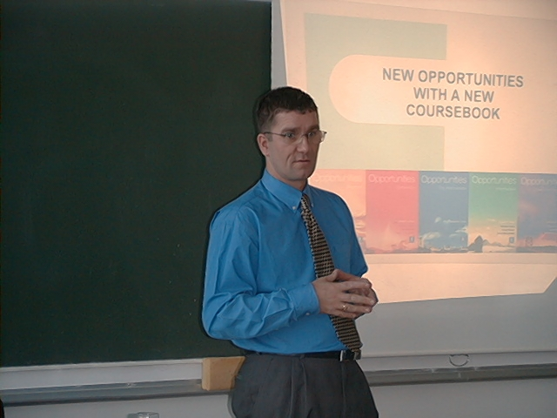
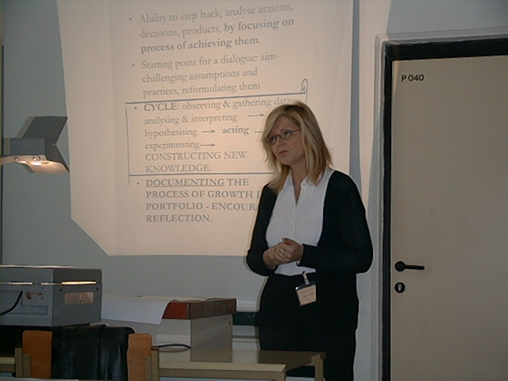
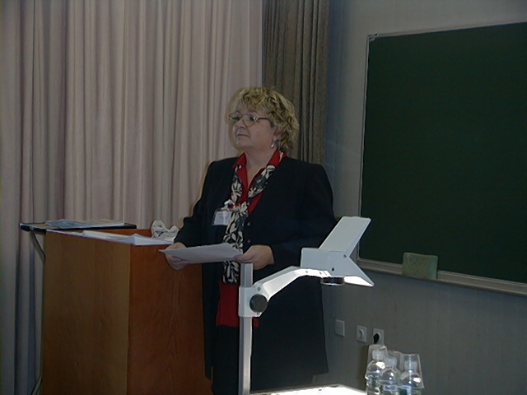
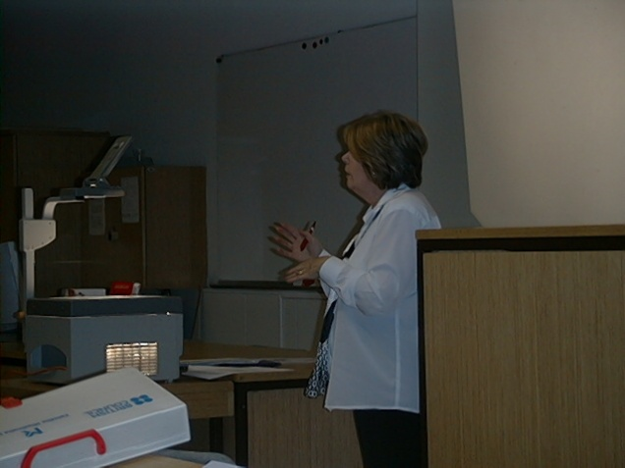
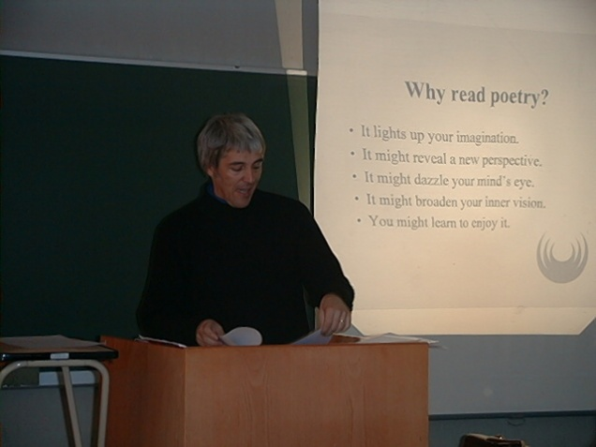
Making presentations

Slide 34

This is what irritates people during presentations
the speaker was nervous
the speaker was disorganised
the speaker never looked at me
the speaker had bad accent
the speaker did not sound enthusiastic
the speaker was monotonous
the visuals were bad
I was irritated by his/her clothing
the speaker was speaking too softly
the speech was confused; I didn’t know what
he/she was trying to tell me

Slide 35
So…. Different aspects
To avoid any negative outcome the following aspects are important in making a presentation:
Preparation and planning
Language of presentations
Visuals/equipment
the presentation itself

Slide 36
Preparation at home
When you plan your presentation you need to answer the following questions:
Who is my audience
(how much do they know about my topic?)
How am I going to organise my topic?
(it needs to tell a story)
How long should my presentation be?
(you will have time limits and you need to say everything within that limit)
What visual support shall I use?
(PowerPoint, transparencies, models, objects...?)

Slide 37
Plan you presentation carefully
This is the basic structure of a talk:
Introduction
Main part (body)
Conclusion
Question & Answer session
This means that you need to plan every part carefully.

Slide 38
Introduction
During the introduction you need to achieve the following aims:
Gain Attention
attract Interest
create Desire
stimulate Action

Slide 39
Getting started - greeting the audience
What you need to do first is to greet your audience. Here are some useful phrases:
Good morning, ladies and gentlemen.
Welcome to my presentation.
It’s very nice to see you all here today.
Can we get started?
Let me say just a few words about my background...
Then you proceed to the introduction to your topic

Slide 40
Making an effective opening
There are several ways how to attract the audience right from the beginning. Think of
one of the following techniques to introduce your talk:
Give them a problem to think about (Suppose you... Why is it that...)
Give them some amazing facts.(Did you know that ...)
Give them a story or a personal anecdote (stories always atract attention)
Use a citation (if you want to start on a more philosophical note)
Make a funny remark (but be careful with humour, not all jokes work well)
Record a music piece perhaps (if appropriate for the topic)

Slide 41
Some useful phrases
What I want to do this morning is to …..
My talk will take about 30 minutes.
During my presentation, I’m going to be focusing on four main areas.
I’ll be giving out copies of my transparencies at the end.
If you have any questions, or comments you’d like to make,
please don’t hesitate to stop me.

Slide 42
Adapting the Language
Chemistry
Chemistry is an area of study which touches human life at innumerable points. It is the science which forms a bridge between physics and biology as well as between earth sciences and life and medical sciences. It is therefore a central science which holds the key to an appreciation and understanding of life cycles on the one hand through to man-made processes on the other.
Just look at the example above: it has been taken from a course-book. It was meant for reading and not for speaking. You cannot possibly use the same text for speaking. The language is much too condensed and complicated, the sentences are too long, and difficult to follow. The same idea can be simplified by paraphrasing, as for example:
Chemistry is a science which touches our lives at many points. It forms a bridge between physics and biology, earth sciences and medical sciences. We can say that with chemistry we can better understand life cycles on the one hand, and man-made processes on the other.

Slide 43
Signposting
Let’s take a look at..
Let’s consider..
When you drive on roads you follow the signs and you cannot get lost. Similarly, when you give a presentation, you need to give signals to your audience to know where they are and what is coming next. They know it because you tell them by giving signposts at the beginning and all along the way. This technique is called 'signposting' (or 'signalling').
Look at this example:
I’d like to...
Let me now turn to...
To go back for a moment...
"I'll start by describing the current position in Europe. Then I'll move on to some of the achievements we've made in
Asia. After that I'll consider the opportunities we see for further expansion in Africa.
Lastly, I'll quickly recap before concluding with some recommendations."

Slide 44
Use singposting in your presentations
Singposting is the halmark of the language of presentations. See the example below:
Good afternoon everybody. I’d like to thank you all for coming here today and listen to me. I hope by the end of the day you will leave with a knowledge of what equipment can do for you and how the government can benefit by using it.
If you would like to take notes, please do so. However, all of you will be given a handout at the end of my presentation.
I am going to talk today about a new product, a breath control measurement instrument ALCOTEST. The first such product was introduced to the market 40 years ago and has been used all over the world.
The new range of products I’m going to familiarise you with are the Alcotest 7110 MK III and Alcotest 7410. Now, the main purpose of the talk, of my talk, is to outline the major benefits of using these models.
Before doing so, I would like you to look at some general technical features which I hope you will find encouraging. Then I’ll move on to the benefits for the users.
Let’s look at some figures. I’ll put them on the screen now. As you can see the Alcotest comes as a portable instrument, integrated in a metal case, including heatable sampling hose, a 40-digit alphanumerical display, integrated printer, mains connection and 12 V battery.

Slide 45
Ending your talk
When you come to the end of your presentation you need to indicate this to the people. Don’t just end up abruptly without giving a conclusion.The purpose of the conclusion is to “tell the people what you have told them”.
Follow this scheme:
summarise facts
give recommendations
give proposals
Thank the audience
Invite questions

Slide 46
Ending your talk : useful phrases
Wrapping up
This brings me to the end of my presentation.
Let me just run over the key points again…
To sum up briefly…
To conclude …
As we’ve seen…
So, my recommendation is ….
I would welcome any suggestions.
Thanking the audience & Inviting questions
Thank you for your attention and if you have any questions I’ll be pleased
to answer them.
I’ll be happy to answer any questions.
Are there any questions you’d like to ask?

Slide 47
PRESENTER AS AN “ACTOR”
When you come to stand on the podium you become the actor of your presentation. During your presentation you are going to speak and not read from your notes. This means using your voice, and also your body language. What is importnat is that you establish eye contact with each member of your audience.
Each person should feel that you are speaking directly to him or her. You need to think in advance:
        Where shall I stand?
        How shall I keep eye contact?
        Where shall I keep my hands?
        What if I get lost?
        How to manage audience phobia?
Most speakers are a little nervous during a presentation but there are some strategies to control your nerves.
Also, you need to be aware of your body language. Open the links to learn more about these.

Slide 48
Conclusion
Consider this in preparing your presentation:
Simplify the text.
Focus your material. You can’t say everything.
Use transitions (signsposting) to move smoothly.
Use examples, anecdotes, statistics to support your message.
Use a lot of visuals to reinforce the message.
Consider timing.
Apply the KISS principle.
Practise alone and with the whole group.

Slide 49
References
http://www.dvd-ppt-slideshow.com/blog/how-to-overcome-nervousness-when-doing-powerpoint-presentation/
http://www.ljlseminars.com/anxiety.htm
http://presenting2007.blogspot.com/2007/02/notes-on-being-nervous.html

