Slide 1
Lecture 27
Nonverbal Communication in Presentations

Slide 2
Recap
How to prepare, make and deliver presentation effectively?

Slide 3
Introduction to Communication
Communication in general is process of:
  Sending
  Receiving
These messages enable humans to share:
  Knowledge
  attitudes, and
  skills.
Messages

Slide 4
Introduction to Communication
Communication is composed of two dimensions –
  Verbal Communication
  Nonverbal Communication

Slide 5
Presentation skills, conversation skills and writing skills are the three keys to effective communication.
The Lecture defines some tips for using non verbal communication to improve your presentation skills.

Slide 6
Components of Communication
Verbal Messages
the words we choose
Paraverbal Messages
how we say the words
Nonverbal Messages
our body language

Slide 7
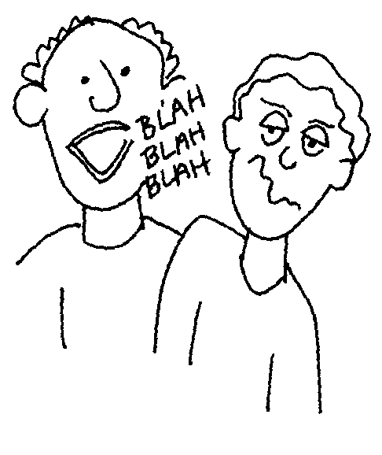
Verbal Messages
Effective Verbal Messages
1. Are brief, concise, and organized
2. Are free of jargon
3. Do not create resistance in the listener

Slide 8
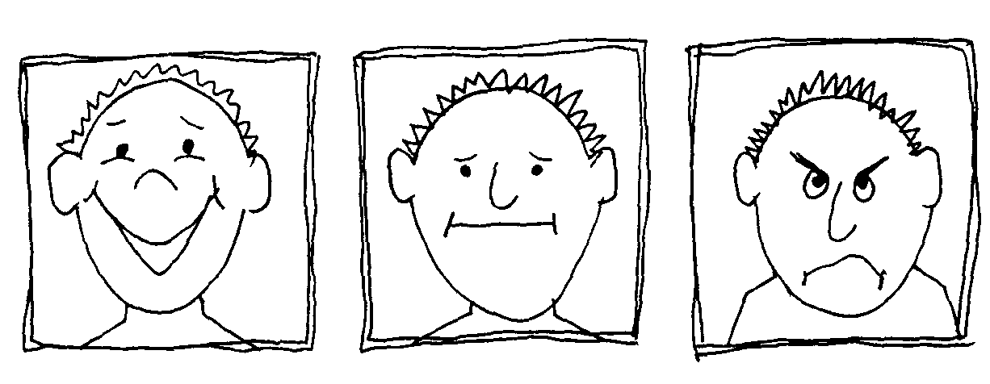
Categories in Non-Verbal Messages
Facial Expressions
A face can light up with:
  enthusiasm
  energy
  approval
  express confusion or boredom
  frown with displeasure
  eyes telegraphing joy
  sadness
  anger
  confusion

Slide 9
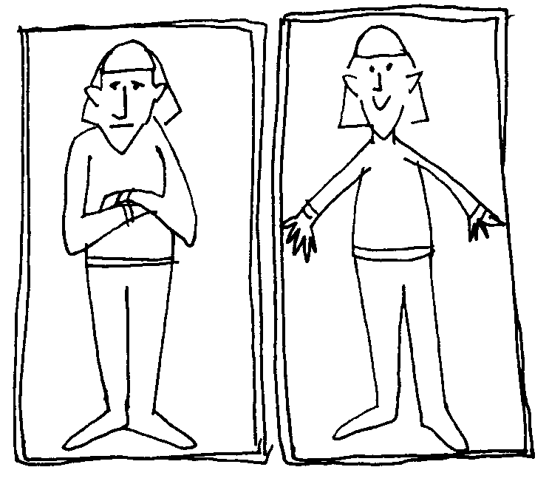
Postures and Gestures
Categories in Non-Verbal Messages
Warm openness
Cold rejection
Feeling of anticipation
Feeling of inflexibility etc

Slide 10
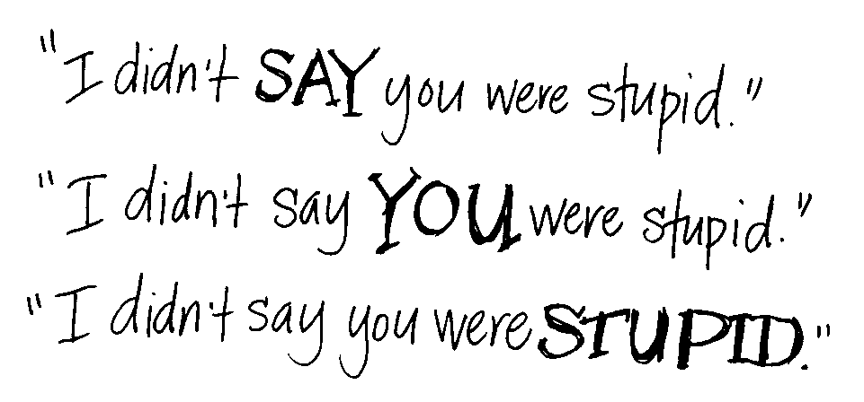
Paraverbal Messages
Messages that we transmit through the tone, pitch, and pacing of our voices.
It is how we say something, not what we say.

Slide 11
According to the social anthropologist, Edward T. Hall,
in a normal conversation between two persons, less than 35% of the social meanings is actually transmitted by words. So, at least 65% of it is conveyed through the body
(non-verbal channel).

Slide 12
Definition of Nonverbal Communication
Non-spoken context within where all face-to-face communication takes place.
Every conscious or subconscious behavior is covered with meaning without which all verbal communication would be ambiguous.

Slide 13
Nonverbal Communication
Non-verbal communication includes:
  Pitch
  Speed
  Tone
  Voice volume
  Gestures
  Facial expressions
  Body posture
  Stance/ Attitude
  Eye movements
  Dress and appearance

Slide 14
Nonverbal Communication
It also includes:
  Touch
  Glance
  Vocal tone
  Pause (silence)
  Intonation
  Smell
  Word choice and syntax
  Sounds (paralanguage)

Slide 15
Have you ever heard anyone say;
His actions spoke so loudly I couldn't hear what he said?

Slide 16
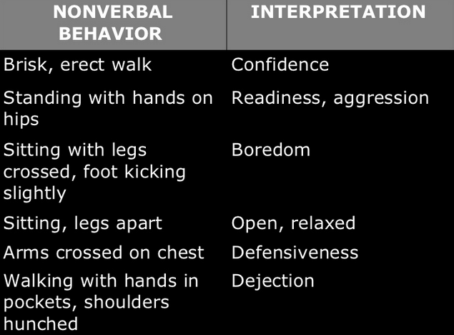

Slide 17
A Small Exercise

Slide 18

So What Does This Mean?
Can I help!
Trust me!
You’re in good hands!
Helping Hand!

Slide 19
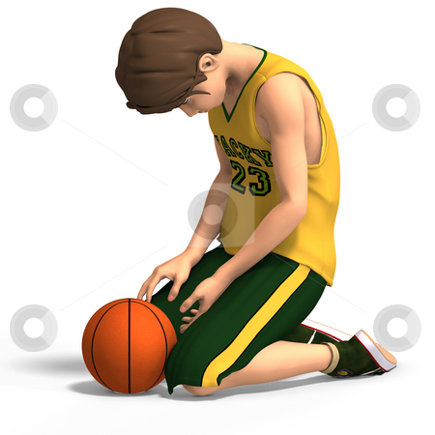
So What does This Mean?
Dejected
Disappointed
Lost it!

Slide 20
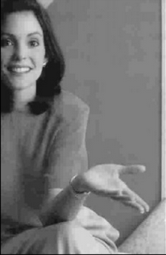
So What does This Mean?
So tell me more!
Open
Accepting
Welcoming

Slide 21
How to work on Nonverbal Communication during Presentations?

Slide 22
First Impressions
You have only a few seconds to make a good impression. So make your “audience" at the centre of the universe:
  face them
  give direct eye contact
  palms outwards
  open arms
  a big smile and a firm
  but not bone-crushing handshake

Slide 23
First Impressions
First impressions are also about your:
  Dress
  Hair
  Shoes and
  Air of confidence
Be aware that others are rushing to judgment about you - especially important if you are going for a PRESENTATION!!!

Slide 24
Eye contact
Eye Contact helps indicates your interest in the people in the audience.
It increases your credibility.
When you make eye contact with people in the audience, you increase your chances of getting your message across.

Slide 25
Eye Contact
Eye contact helps you establish a connection with the audience.
When you make eye contact with people as you are speaking, you build one to one bonds with them.

Slide 26
Smiles are Powerful
Always try to keep a smile on your face when you are speaking.
Smiling makes a speaker more warm, likable and friendly.
When you smile, people see you as happy -- and this makes them more receptive to you.

Slide 27
Smiles are Powerful
People react positively to smiles.
When you smile, the audience smiles and a smiling audience is a receptive audience.
Smiling will help you get your points across and accepted.

Slide 28
Gestures
Gestures are another important form of non verbal communication.
But you have to be careful with gestures.
    Practice your talks in front of a mirror.
    Watch your natural gestures.
    Then enhance them.
    Strengthen your gestures.

Slide 29
Gestures
Big rooms demand BIG gestures.
  However tone them down –
  depending on the audience.
Making your gestures natural and reflective of what you’re saying.
Try to avoid choppy, sudden gestures when you’re speaking. Focus on making your gestures fluid.

Slide 30
Posture and Body Orientation
Always stand up straight and look directly at the audience; it indicates confidence.
  Slumped shoulders and facing towards the floor.
If you're using slides, speak to the audience, not the slide. It's OK to look at a slide -- especially if you want to draw the audience's attention to it, but always turn back to the audience after a few seconds.

Slide 31
Posture and Body Orientation
Tall and erect communicates energy and purpose whereas slouched and hunched implies tired and lacking in energy.
Looking up is generally regarded as indicative of optimism whilst persistently looking downward suggests secrecy or insecurity.

Slide 32
Hands and Arms
Some guidelines...
  Palms turned outwards implies warmth and friendship.
Don't point, it is aggressive and perceived as such - especially if you do it in an irritated way.
  Examples:
    Gordon Brown uses his hands a lot but he will gesture with the backs of his hands turned towards the audience in a way is suggestive of "giving".
    Tony Blair would pull his fingers together into a point and make slight movements.

Slide 33
Proximity
Many speakers get away from the platform and walk the room.
  This means that they get up close and personal with people in the audience.
    Use of wireless device to advance slides,
    people feel that you’re part of them
    having a conversation with them
    appear more natural!!!

Slide 34
Be aware of the space between you and others
Cultural norms vary between country and are also different for:
  friends v strangers
  children v adults.
If someone is backing away from you, then you are too close.

Slide 35
Your Voice
Be animated –
  avoid speaking in a monotone.
  Show excitement for your material with your voice
  Always practice talks out loud
  It will improve your impact with your audience.
Using your arms in an animated way can bring:
  energy
  enthusiasm and
  a bit of fun to the proceedings.

Slide 36
Use body language as a Tool
Active nodding and eye contact is especially useful to indicate interest when someone else is speaking.
If your friend is speaking and you are doodling, yawning, looking around aimlessly or reading notes, then it undermines their credibility.

Slide 37
Use body language as a Tool
Need to be boss? Be the first to offer a handshake, the last to go through the door.
Put yourself at the head of the table, head up with a purposeful manner.
  Need to sweet-talk audience?
  Make them feel in control
  give them the best seat/position
  use soft, smiley body language

Slide 38
Mirroring tactics can create empathy?
Signal similarity.
  Show that you have something in common –
  everyone likes dealing with people they can empathize with.
  Make every non-verbal approach
    dress code
    formality of manner
    presentation style
    precisely reflect your audience.

Slide 39
Mirroring tactics can create empathy?
Synchronize with the other party!
Its true that:
  matching others' movements makes them feel in sync with you
Just don't make it too obvious.
  Instead, nod when they're emphasizing an important point
  smile when their words indicate pleasure

Slide 40
Sincerity
People will judge you sincere if they think you are listening to them
  so look for signs that someone wants to speak and invite them to contribute.
Example:
  Politicians sometimes touch their heart to underpin their sincerity or commitment to a key point.
  Don't overplay this though or it will look cheesy and completely insincere.

Slide 41
Reading "tells“…
Quite often...
Closed expressions & gestures
leaning back
Closed body language
folded arms
  suggests the audience may be bored. (etc)
  they may be unconvinced
  whereas open body language and leaning forward suggests interest.
The word to remember here is "may". Reading body language is not a science of certainty.

Slide 42
Reading the audience: don't rush to conclusions
Be cautious of reading too much into innocent gestures.
  Folded arms, for example, may simply mean that someone in the audience is cold or likes to fold their arms.
Look for groups of gestures –
  if someone has angled their body away from you
  is looking out the window
  then yes, you may well have lost their interest.

Slide 43
If you use these non verbal communication ideas you'll become someone whose presentations carry an impact -- and you'll be on your way to career and life success.

Slide 44
Nonverbal Communication
Introduction to Communication
Components of communication
  Verbal
  nonverbal
  Para verbal
Definition of nonverbal communication
Exercise
How to work on Nonverbal Communication during Presentations?
  First Impressions
  Eye contact
  Smiles are powerful
  Gestures
  Body postures and orientation
  Hand and arms
  Proximity
  Voice
  Body language as a tool
  Sincerity
  Reading your Audience

Slide 45
References
http://EzineArticles.com/3675164
www.readysetpresent.com
http://www.slideshare.net/deepakagarwal7/non-verbal-communication-and-use-of-body-language-presentation
http://EzineArticles.com/?expert=Bud_Bilanich
www.skillsworkshop.net

