Slide 1
DOS & DON’TS
Lecture 24
Presentation Skills

Slide 2
Your best is to remember the following…
Dos & Don’ts

Slide 3
DO’S & DON’TS
Clean & Simple Slides
    Keeping 1/3rd of a slide clear is a good idea
Effective Content
Format appropriately
Title & Text placements are consistent
Charts 7 Tables are labeled

Slide 4
DON’T
Choose Serif fonts like Times New Roman
They are harder to read on a screen
For Instance:
Business communication is different from other types of communication. It always needs to be clear and concise, and most of the time it needs to be fast. But fast or slow, when you give a speech or presentation, or send an email or memo, remember that you’re giving them information, but you also want them to do something with it.

Slide 5
Do
Use san-serif fonts like:
  Ariel
  Gil Sans, or
  Century Gothic
They are easier on the eye

Slide 6
Example:
Ariel
Business communication is different from other types of communication. It always needs to be clear and concise, and most of the time it needs to be fast. But fast or slow, when you give a speech or presentation, or send an email or memo, remember that you’re giving them information, but you also want them to do something with it.

Slide 7
DON’T
Underline words for emphasis
  People mistake these for hyperlinks and they are harder to read.

Slide 8
DO
Vary a font’s size
style or
color for emphasis or
group words together
  *But avoid doing it all on one slide

Slide 9
DON’T
Use visually complex fonts
Especially a variety of them

Slide 10
DO
Choose easy to read fonts
&
Stay in a font family

Slide 11
DON’T
Use fonts that are smaller than 24 points
Any smaller and it can’t be read easily from a distance

Slide 12
Text Tips
Text slides should be brief:
  No more than eight words per line
  No more than eight lines per slide
  Fewer words will force an explanation rather than reading slide word for word

Slide 13
Font Analysis
Font and Transition
If you use small font your audience wont be able to read from the slide
CAPITALIZE ONLY WHEN NECESSARY. IT IS DIFFICULT TO READ.
Don’t use complicated/ distracting transitions.
Don’t use a complicated font. Stick to sans serif fonts (without twiddles) like arial.

Slide 14
Text Tips
Titles should be 36-40 point
Title (40 points)
Body text should be at least 24 points
Body Text (24 points)
Use sans serif font such as Arial
She sells seashells
Serif font
She sells seashells
Sans Serif font

Slide 15
DO
Back up about 2 feet Watch your presentation
See if you can read everything

Slide 16
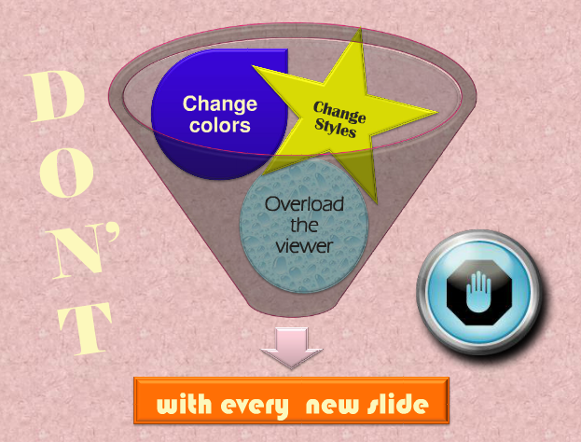

Slide 17

DO
Choose a color palette & layout style
And stick with it

Slide 18
DON’T
Fill up the screen with lots and lots information written in sentence form. Or even bullet after bullet after bullet. The visuals in your presentation should help guide your speaking, not replace it. People can read faster than they can speak, and they don’t want to hear you just read from the slides. Plus, the more you put on a slide, the smaller the text will get and the smaller the text gets, the harder it is to read. Then, you will annoy your audience as they try to follow along, but falter in their attempts. An annoyed audience is not a happy audience and an unhappy audience won’t really give you the attention your hard and carefully researched presentation deserves. In other words, did you really read all of this? Would you expect your audience to?

Slide 19
Too much Text
This page contains too many words for a presentation slide. It is not written in point form, making it difficult both for your audience to read and for you to present each point. In short, your audience will spend too much time trying to read this paragraph instead of listening to you. Eventually it will make your slide wordy and boring. You will loose your audience’s attention before you even reach the end of your………………………

Slide 20
aaaaaaaa…. First slide.

Slide 21
DO
Choose only key points to highlight Follow a
7 words / 6 lines guideline
Make every slide matter

Slide 22


Slide 23


Slide 24
DON’T
Go crazy with sound effects and animations*
*Imagine many things spinning
& whizzing around on the page

Slide 25
DO
Change the pace by adding
Relevant video and website links*
*Just make sure you’ve loaded
those pages ahead of time

Slide 26
DON’T
Include werds that are spellled incorractly
Include incorrect information

Slide 27
Spelling & Grammar
Avoid Spelling and Grammar mistakes
  Proof-read careful your slides for:
      Smelling mistakes
      The use of repaetd words
      Grammatical errs you might have make
Please have someone else check your presentation, as English is not your first Language!

Slide 28
DO
Check your spelling
Proofread each slide
Make sure all information is correct

Slide 29


Slide 30
DON’T
Simply read off the screen

Slide 31
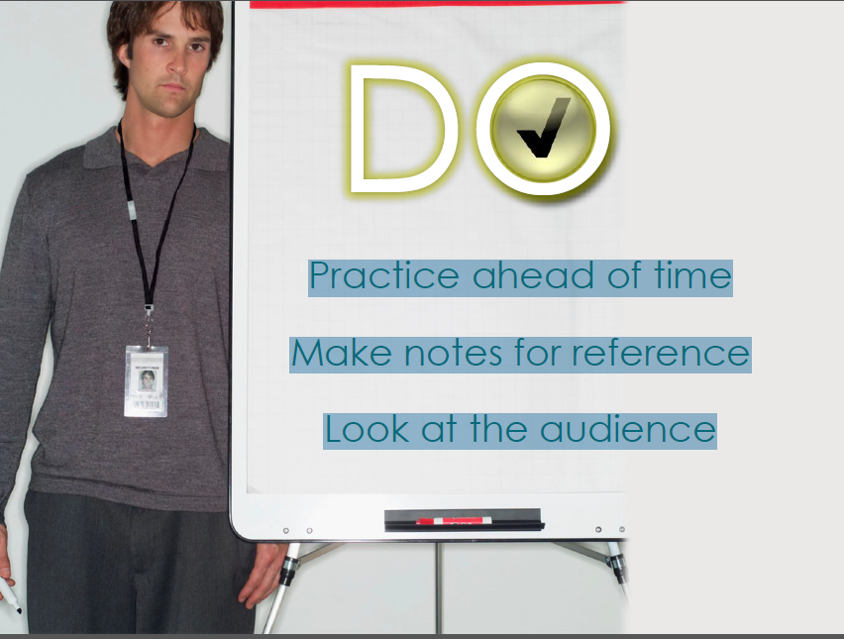

Slide 32
DON’T
Use Excessive Bullet Points
Avoid
Excessive
Bullet
Pointing
Only
Bullets
Points
Key
Points
Too many
Bullet Points
And
Your Key
Messages
Will
Not
Stand out
In fact the
Term
Bullet Point
Comes
From
People
Firing
Guns At
Annoying
Presenters

Slide 33
Background and Colors
Which of the following is most readable?
Why?
Dark Background with light text
Light Background with light text
Dark Background with Dark text
Light Background with dark text

Slide 34
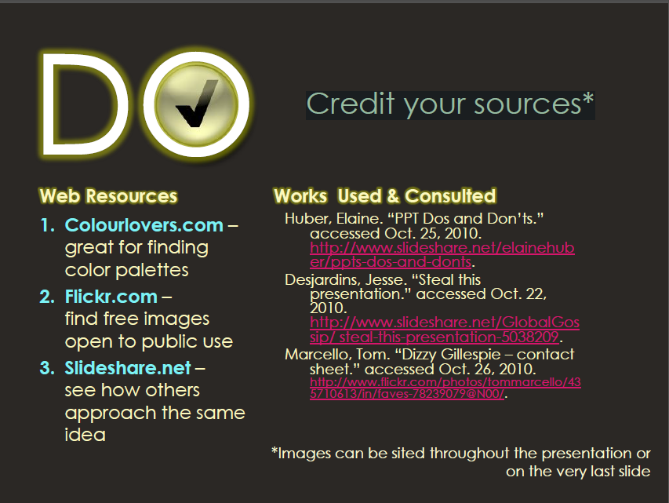

Slide 35
References
Reference in the same way you would in a written assignment
Citation: freeloading means individuals, believing that their contributions will not be valued. Contribute less effort to achieving goals when working in a group than if they were working alone. (Kerr, 1983)
Direct Quoting: “Most effective speakers are flexible, able to adapt the manner of their speaking to the particular context” (Stott, Young & Bryan, 2001:3)
Diagrams and Images:
    Adair’s (1987)
    Interlocking
    Needs of a Team
Building the Task
Building and Maintaining the Team
Developing the Individual

Slide 36
DO
Save your work frequently (Ctrl+S)
Backup your work frequently (every day, if possible)
Store each presentation and its associated files in its proper folder

Slide 37
DON’T
rely on the program's Autosave feature.

Slide 38
DO
use the powerful UNDO command (CTRL+Z) to experiment and learn to use the software
ask for help when you need it
maintain a good relationship with someone who knows more about PowerPoint than you do

Slide 39
DON’T
Run experiments at the last minute.
  Run experiments before you save a separate copy of your file.
Panic and start banging your head on the monitor. It won't help
  (personal experience talking!)

Slide 40
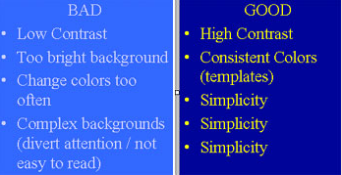
EXAMPLE

Slide 41
RECAP

Slide 42
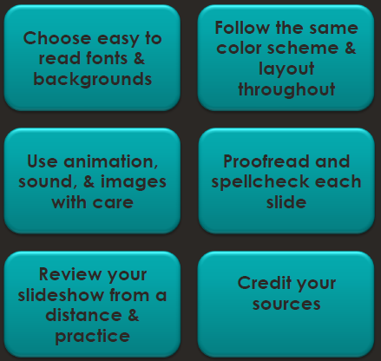
DON’T
Forget to review your main points

Slide 43
DO
Be brief
  no more than 8 bullets/points per slide
Use appropriate fonts:
  big (min. 28pts) and clear (sans-serif). If possible, test your slides:
  run the slide show and see if you can read your slides from the last row of the room where you will be presenting.
Use appropriate colors
  not too bright, high contrast, consistent.
  Remember that what looks good on your monitor does not necessarily look good on the big screen.
Create contrast using font size, colors

Slide 44
DON’TS
Put everything you present on the slides.
  Remember that slides are just a visual aid -- if you overload them, the audience will end up trying to read the slides and not paying attention to you.
Use different colors / fonts on every single slide.
Use bright background colors that will strain your audience's eyes
Use too many animation effects!
  They are VERY distracting for the audience and make you look like a show-off. Use animation only to make a point and not to make your presentation more interesting (use content to do that!)

Slide 45
References
http://www.slideshare.net/covs/ppt-dos-and-donts
http://gethelp.library.upenn.edu/workshops/biomed/ppt/dodont.html

