Slide 1
Lecture 2
Language and Communication Skills

Slide 2
Language Skills

Slide 3
Discourse/
Dialogue
Phoneme
Phone=Sound
Morpheme
Combination of two or more phonemes= prefixes, suffixes
Word
Phrase, Clause
Sentence
Syntax= Semantics
Paragraph
Text

Slide 4
Listening
Reading
Receptive Skills
Speaking
Writing
Productive Skills

Slide 5
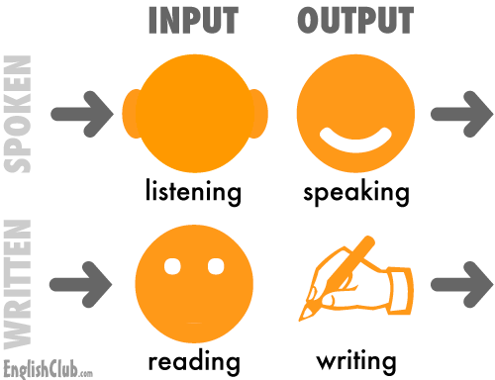

Slide 6
Communication Frequency
Listening
32 %
Reading
19%
Speaking
26 %
Writing
23 %

Slide 7
Communication Skills

Slide 8
How do we Communicate?
?

Slide 9
Communication
Verbal
the message that we deliver
Vocal
the voice that we convey
Visual
our body language

Slide 10
Topic Highlights
What is Communication?
How do we Communicate?
What is a Skill?
Language Skills
Types of Communication
The Communication Cycle
Barriers in Language Communication
Overcoming Barriers

Slide 11
What is Communication?
The dictionary defines communication as a process by which information is exchanged between individuals through a common system of symbols, signs or behaviors.
Communication is the activity of conveying information
Communication has been derived from the Latin word "communis", meaning to share
Communication requires:
      a sender
      a message, and
      an intended recipient

Slide 12
What is a Skill?
Skill is defined as a learned power of doing something competently. It is a developed aptitude or ability.

Slide 13
Communication is of 2 Types:
Verbal Communication
      Words
      Voice Modulation
Non-verbal Communication
      Posture & Movement
      Gestures
      Facial Expressions

Slide 14
A communication system normally goes through a cycle involving:
1 | The Sender | person who sends the message; the source
2 | The Receiver | The person who receives the message
3 | The message | Subject matter of communication. It may contain facts, ideas, feelings and thoughts
4 | The Channel | Verbal/ Nonverbal
5 | The Feed back | Receiver’s response or reaction or reply to the message, which is directly towards the sender

Slide 15
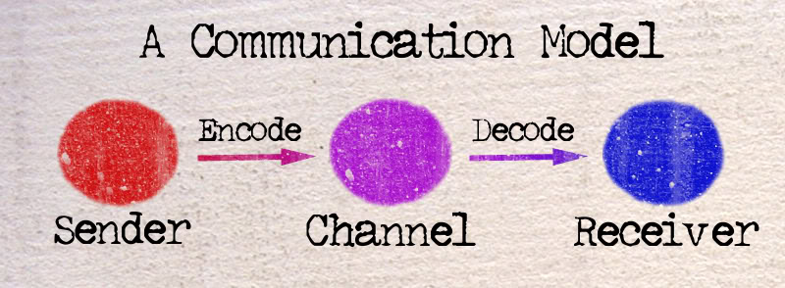
The Communication Cycle

Slide 16
1. Sender
2. Message
3. Channel
4. Receiver
5. Feedback
Encoding
Noise
Barrier
Decoding

Slide 17
1. A message sent | Gesture Facial expression Drawing Spoken/written
Entry in sensory world (all senses) | Sight Smell Hearing Taste Touch
Stimuli (Picks up message) | Stimuli varies from person to person: Person’s abilities Cultural background Drowsy/dizzy/day dreaming/ not alert Outside noises Facial expressions Double/ dual meaning
The Filtering Process (brain) | Through contents Experiences Knowledge Emotions Cultural background
5. Message Response through: | Words Gestures Physical actions
6. The Cycle Repeated

Slide 18
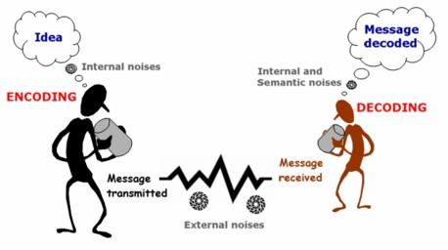

Slide 19
Important Details
Be calm and collected at all times
Be loud enough to be easily heard
Use words with accurate diction & correct pronunciation
Speak slowly and make use of pauses to stress important ideas

Slide 20
Barriers in Communication

Slide 21
Components of Communication
Verbal Messages
the words we choose
Paraverbal Messages
how we say the words
Nonverbal Messages
our body language

Slide 22
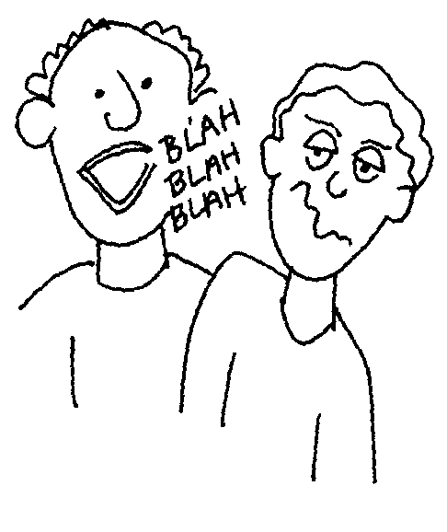
Verbal Messages
Effective Verbal Messages
1. Are brief, concise, and organized
2. Are free of jargon
3. Do not create resistance in the listener

Slide 23
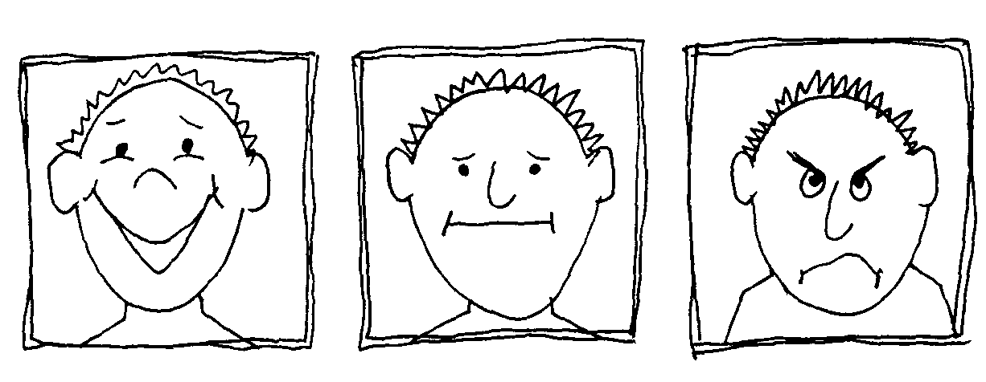
Categories in Non-Verbal Messages
Facial Expressions
A face can light up with:
  enthusiasm
  energy
  approval
  express confusion or boredom
  frown with displeasure
  eyes telegraphing joy
  sadness
  anger
  confusion

Slide 24
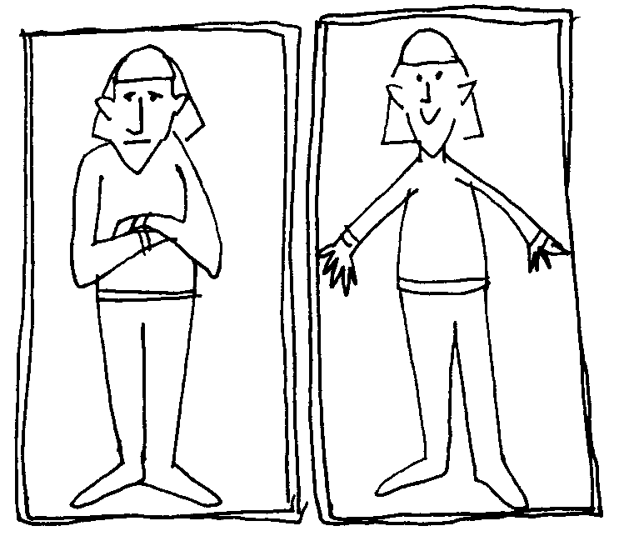
Postures and Gestures
Categories in Non-Verbal Messages
Warm openness
Cold rejection
Feeling of anticipation
Feeling of inflexibility etc

Slide 25
Non-Verbal Messages
1. Account for about 55% of what is perceived and understood by others.
2. Are conveyed through our facial expressions as well as our postures and gestures.

Slide 26
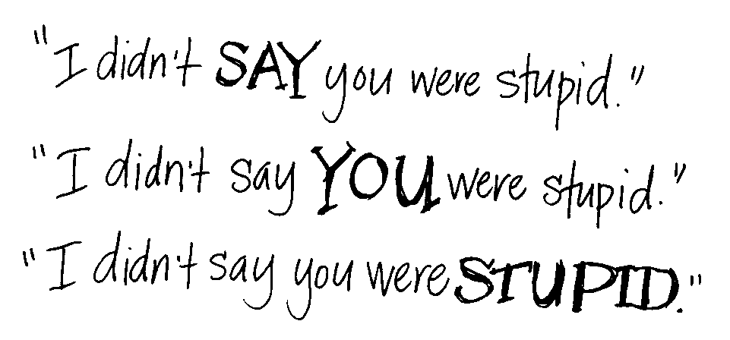
Paraverbal Messages
Messages that we transmit through the tone, pitch, and pacing of our voices.
It is how we say something, not what we say.

Slide 27
Verbal Messages
Paraphrasing | a brief, concise statement reflecting the content of the speakers message
Reflecting Feeling | a statement, in a way that conveys understanding, of the feeling that the listener has heard
Summarizing | a statement of the main ideas and feelings to show understanding
Questioning | asking open questions to gain information, encourage the speaker to tell her story, and gain clarification

Slide 28
What is a Barrier?
Hindrance
Blockage
Stoppage
Hurdle
Hampered
Obstacle
Cordon

Slide 29
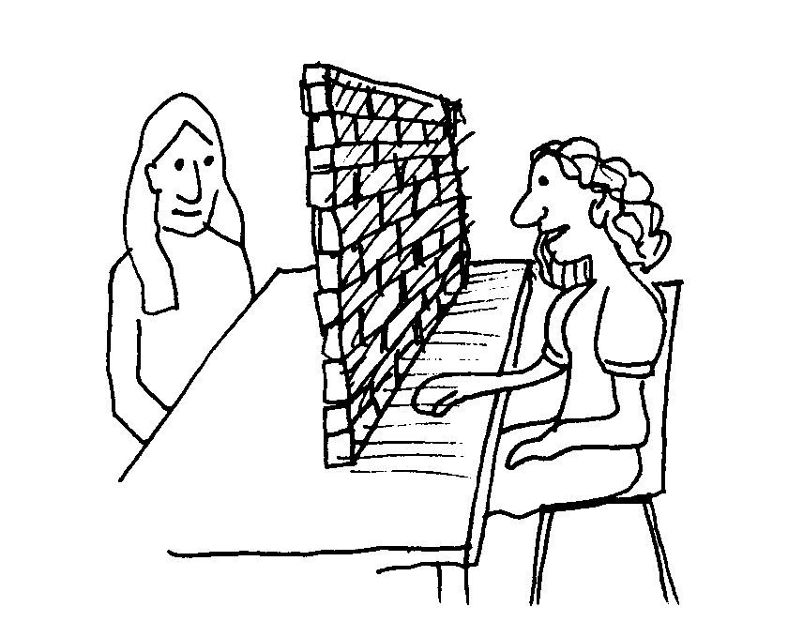
How would you define a Communication Barrier?
Message is misinterpreted
Receiver
Sender

Slide 30
Barriers to Communication
Language Barriers Physiological Barriers Psychological Barriers Cultural Barriers Bypassed Instructions Abstracting

Slide 31
Language Barriers
  Personal Experiences
  Knowledge Background
  Education
  Cultural background
Background
Words
  Connotations
  Denotations
  + & -

Slide 32
Language Barriers
Use of:
  Jargons
  Obsolete words
  Slangs
  Misleading Terminologies
Examples:
  ‘burn the paper’
  ‘get rid of the plant’
Bypassed
Instructions

Slide 33
Language Barriers
Abstracting
Short Summary
  + -
  Journalist
  Factual Non-Factual
  (Yellow Journalism)
Focus on few things and omitting others

Slide 34
Physiological Barriers
  Physical Environment
  Dull voice
  Too many others talking in the room at the same time
  Outside noises
  interruptions
  Visual distraction
  Mobile phones
  Interesting People around
  Proper light
  Music
  Talking loud
  Sounds etc
Context

Slide 35
Physiological Barriers
  Drowsy/dizzy
  Air-conditioning
  Hot/stuffy/cold room
  Day dreaming (something on mind)
  Hunger/ overeating
  Health Problems
  Anxiety
  Flue/ Cough
  Exhausted
  Starving etc
Physical
Conditions

Slide 36
Psychological Barriers
  Social Status
  Less educated
  Dumb/ Goof
  Can’t talk ENGLISH??
  Gender
  Emotions
  Feelings
  Prejudices etc
Mind

Slide 37
Cultural Barriers
  Speakers accents
  Vocabulary
  Cultural assumptions
  Cultural Biases
  Cultural connotations
Different
Cultures

Slide 38
Nonverbal Barriers
Flashing or rolling eyes
Quick or slow movements
Arms crossed, legs crossed
Gestures made with irritation
Poor personal care
Doodling
Staring at people or avoiding eye contact
Excessive twitching with materials

Slide 39
Summary
What is Communication?
How do we Communicate?
What is a Skill?
Language Skills
Types of Communication
The Communication Cycle
Barriers in Language Communication
Overcoming Barriers
In spoken as well as written communication

Slide 40
References
http://talkbank.org/media/PDF/JOC-PDF/2-Buck%20%26%20VanLear.pdf
http://cte.uwaterloo.ca/teaching_resources/tips/effective_communication_barriers_and_strategies.html

