Slide 1
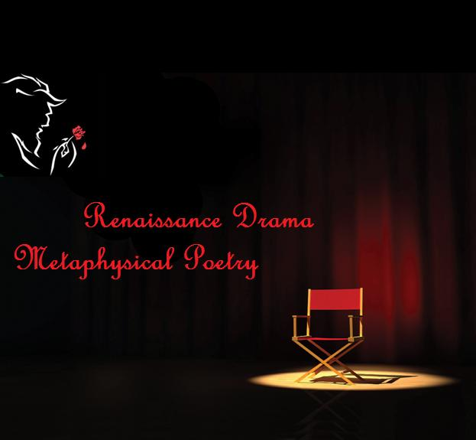

Slide 2
Renaissance
Drama
LECTURE 05

Slide 3
Renaissance
French word meaning “Re-birth”
Started in Italy and spread in other parts of Europe.
In the 15th century after the middle ages.
People took interest in early arts and culture of the Greeks and Romans.
Arts, literature, drama, science and philosophy flourished in this era.

Slide 4
Renaissance Drama
Extraordinary selection of shocking and delightful plays.
Not very strict religious stories as in the middle ages.
Plays included a variety of amusing, tragic, religious and secular dramas.
Plays were performed first at the queens’ palace and nobility houses.
They got fame and then were eventually performed in small theatres until larger public theaters were made.

Slide 5
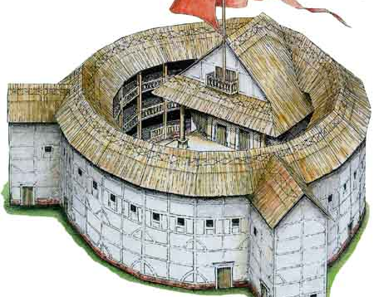
It was built in 1599 in London by Shakespeare's playing company.
Globe Theatre,
London

Slide 6
The dramas contain renowned classic English and rich poetry.
Poetry in the drama lines express the true emotions of the scene.
Provides a language for feeling that creates a picture which goes beyond the simple and ordinary words used to convey that feeling.

Slide 7
English literary renaissance consist of four major periods:
The Elizabethan Period
The Jacobean Period
The Caroline Period
Commonwealth Period

Slide 8
Style of Renaissance Drama
Music
Music was significantly influenced by the recovery of the literary and artistic heritage of ancient Greece and Rome.
Many familiar modern instruments, including the violin, the guitar, and keyboard instruments were born during the Renaissance.
An enormous diversity of musical styles and genres flourished.

Slide 9
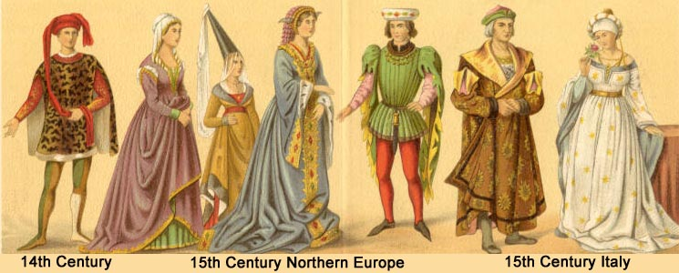
Dressing

Slide 10
Costumes were often bright in color and charming.
They were expensive but one of a kind.
Usually, the lead character would wear proper costume and secondary characters would have contemporary clothing.
Nonetheless, their dressing was inspiring.

Slide 11
Important Playwrights of Renaissance:
William Shakespeare
Ben Jonson
Christopher Marlowe
John Lyly
Robert Greene
Thomas Dekker
John Fletcher
Thomas Middleton
John Ford
Philip Massinger
James Shirley
John Webster

Slide 12
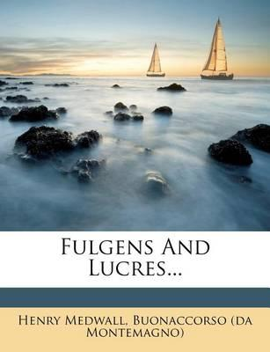
The first extant purely secular play, Henry Medwall's “Fulgens and Lucres”, was performed at the household of Cardinal Morton.

Slide 13
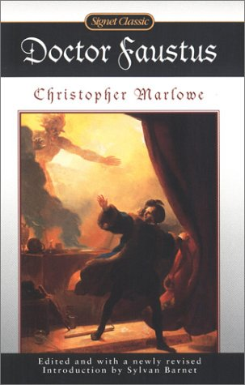
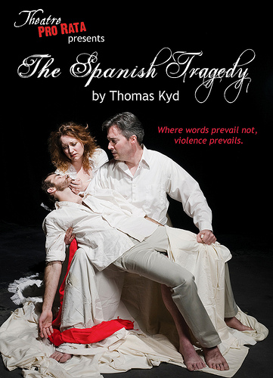
The two most popular plays of the Elizabethan era:

Slide 14
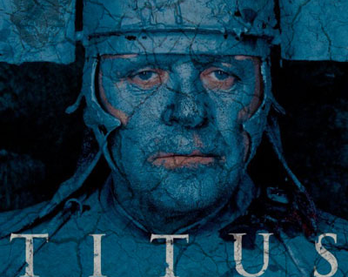
A violent, bloody play and the most popular of Shakespeare's works during his dramatic career.
Shakespeare's Play

Slide 15
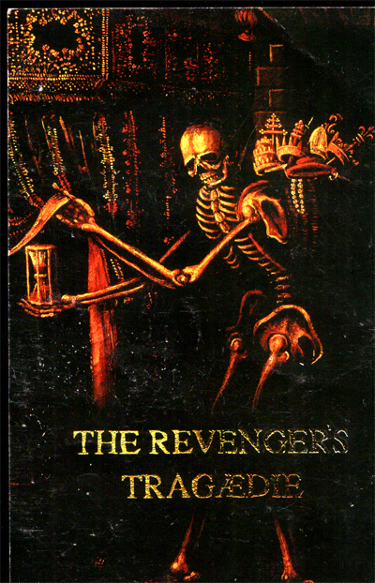
Plays of the Jacobean stage:
Stage offerings were dark, brooding renderings of the macabre that provided psychological profiles of evil, coupled with horrific events.

Slide 16
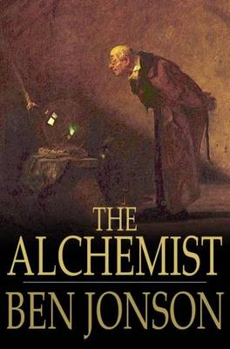
Comedies by Ben Jonson, frequently engaged their audiences with dramatic narratives of charlatans, thieves, and mountebanks who met with bad ends.

Slide 17

John Webster's “The White Devil”, a tragedy of remarkable psychological insight into a female protagonist who confronts the villainy of her own desires as well as that of a corrupt society.

Slide 18
Extracts
“ And yet I wish but for the thing I have.
My bounty is as boundless as the sea.
My love as deep: the more I give to thee
The more I have, for both are infinite.”
(Romeo, Romeo and Juliet)

Slide 19
“I'll example you with thievery:
The sun's a thief, and with his great attraction
Robs the vast sea; the moon's an arrant thief,
And her pale fire she snatches from the sun;
The sea's a thief, whose liquid surge resolves
The moon into salt tears; the earth's a thief,
That feeds and breeds by a composture stol'n
From gen'ral excrement; each things' a thief.”
(Timon, Timon of Athens)

Slide 20
“How do I love thee? Let me count the ways.
I love thee to the depth and breadth and height
My soul can reach, when feeling out of sight
For the ends of Being and ideal Grace.
I love thee to the level of every day's
Most quiet need, by sun and candlelight.
I love thee freely, as men strive for Right;
I love thee purely, as they turn from Praise;
I love thee with the passion put to use
In my old griefs, and with my childhood's faith.

Slide 21
I love thee with a love I seemed to lose
With my lost saints--I love thee with the breath,
Smiles, tears of all my life!--and, if God choose,
I shall but love thee better after death.”
(Elizabeth Barrett Browning: Sonnets from the Portuguese, no. 43)

Slide 22
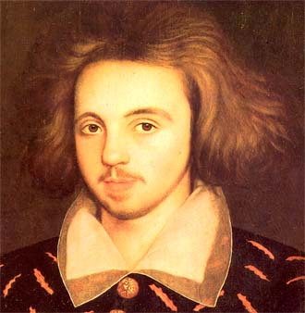
Selected Playwrights
Christopher
Marlowe

Slide 23
Born on 26 February 1564 and died on 30 May 1593.
He was an English dramatist, poet and translator of the Elizabethan era.
Known for the use of blank verse, and their overreaching protagonists.
Famous plays of Christopher Marlowe include “Doctor Faustus” and “The Jew of Malta”.
He greatly influenced William Shakespeare.

Slide 24
Thomas Dekker
Thomas Dekker was born in 1572 and died on 25th August 1632.
He was an English Elizabethan dramatist and a versatile prolific writer.
One of his most famous and delightful comedies is “Shoemaker's Holiday”.
” Old Fortunatus” was based on a well-known story already appeared in Italian, German, and French versions.
Dekker was one of the principal contestants in the famous War of the Theaters.

Slide 25
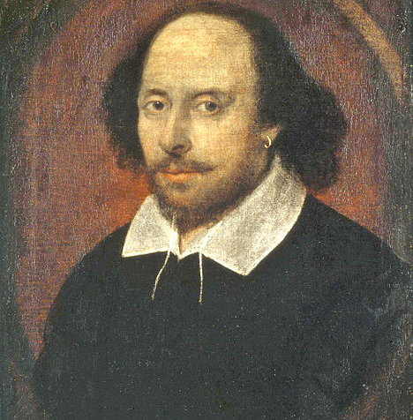
William Shakespeare

Slide 26
Born on April 26th 1564 and died in April 23rd 1616.
He was a English poet and Playwright.
Regarded as the greatest writer in the English language.
His early plays were mainly comedies and histories.
He raised genres to the peak of sophistication and artistry by the end of the 16th century.
Later on, he mainly wrote tragedies.
Hamlet, King Lear, Othello, and Macbeth, are his finest works.
In his last phase, he wrote tragicomedies i.e. romances, and collaborated with other playwrights.
Shakespeare has written a total of 37 plays.

Slide 27
Renaissance Drama in Modern Era
The era of Renaissance drama is considered to be golden.
Plays are re-performed enthusiastically.
Their works are looked upon as authentic English scripts.
The poems are read and learnt in schools.
The movies of today cannot; match their standards.

Slide 28
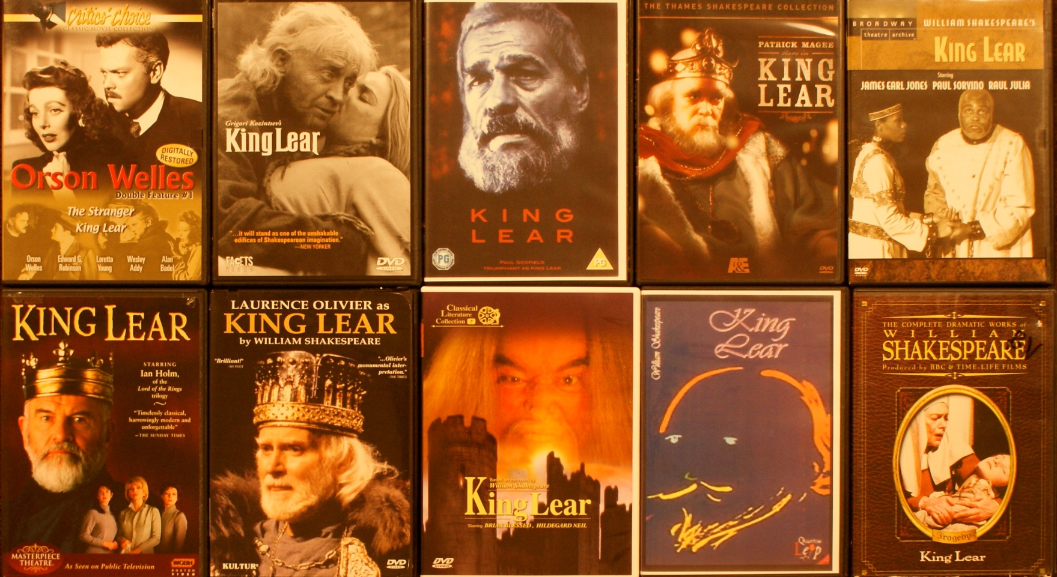
Ten film versions of King Lear

Slide 29
Metaphysical Poetry

Slide 30
Introduction
It is a term coined by Samuel Johnson.
This form of poetry started in 17th century England during Renaissance.
The theme of this poetry is love , life and existence.
Intellectual wit, unexpected comparisons and similes, strange paradox, illusion metaphors and far-fetched images were used to bring emotions and feelings in their poetry.
It is highly philosophical form of poetry.

Slide 31
Characteristics of Metaphysical Poetry
Concentration
Metaphysical conceit
Learnedness
Cynicism
Mechanism of sensibility

Slide 32
Major Poets
John Donne (1572–1631)
George Herbert (1593–1633)
Andrew Marvell (1621–1678)
Abraham Cowley (1618–1667)
Saint Robert Southwell (c. 1561–1595)
Richard Crashaw (c. 1613–1649)
Thomas Traherne (1636 or 1637 – 1674)
Henry Vaughan (1622–1695)

Slide 33
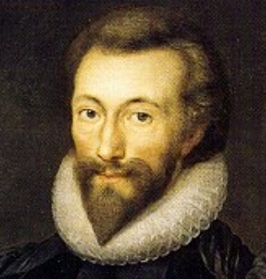
John Donne (1572–1631)

Slide 34
John Donne
He was the leading poet of 17th century.
Most striking achievements are in the Songs and Sonnets.
In his poetry, he resolves everything into unity.
He compares two lovers to insects, doves, candles etc. contrary to Elizabethan poetry style,
Used unconventional rhythm and tone.

Slide 35
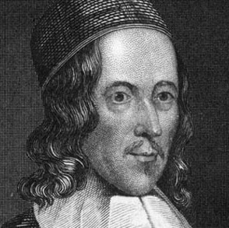
George Herbert (1593–1633)

Slide 36
George Herbert
Herbert's unique characteristic is simplicity of his language, style and metaphor.
He introduced technique of ending the poem with two quiet lines and resolving the argument.
He wrote about the struggle of religious kind.
'Conceits' are not an important part of Herbert's poetry, and his appeal is not as intellectual as Donne's.

Slide 37
Henry Vaughan (1622–1695)
He was inspired by George Herbert.
Vaughan was more immediate and overly mystical in his spirituality. He wrote about nature a great deal. . There are fewer conceits and much more nature symbolism or emblems. In the opening of The World:
“I saw Eternity the other night
Like a Great Ring of pure and endless light.”

Slide 38
COMPARISON OF DONNE’S AND HERBERT’S POETRY
Donne's Holy Sonnet 'Batter my Heart' and Herbert's 'The Collar' are both poems about the struggle to maintain faith in God.
Openings are abrupt and dramatic.
Delivered in a personal and colloquial manner.
Both poems take the form of arguments, using logic to make the reasoning convincing and persuasive.
Donne's arguments are more intellectual while Herbert's arguments relate more to feelings.

Slide 39
A Re-creation
Don’t forget yourself in the maze
You are the player not the maze
Penetrate into the bottle of wine
Either mine or thine
Look for he moon
That arises tides in the pool
Deserted town you will find
Open your heart forget about mind
Drown yourself in the deep sea
Flutter your wings and be free!

