Slide 1
Pre- History

Slide 2
Study the following text
Fæder ure þu þe eart on heofonum;
Si þin nama gehalgod
to becume þin rice
gewurþe ðin willa
on eorðan swa swa on heofonum.
urne gedæghwamlican hlaf syle us todæg
And forgyf us ure gyltas
Swa swa we forgyfað urum gyltendum
And ne gelæd þu us on costnunge
ac alys us of yfele soþlice

Slide 3
You might be surprised to discover that this is actually English! Not present day English of course, but Old English, which was spoken between 700 and 1100 AD. Now take a look at the following text of the same passage but in a different modern-day language:

Slide 4
Text 2
Faðir vor, þú sem er á himnum.
Helgist þitt nafn,
til komi þitt ríki,
verði þinn vilji,
svo á jörðu sem á himni.
Gef oss í dag vort daglegt brauð.
Fyrirgef oss vorar skuldir,
svo sem vér og fyrirgefum vorum skuldunautum.
Og eigi leið þú oss í freistni,
heldur frelsa oss frá illu.

Slide 5
Similarities/ Differences
The purpose of this compendium is to give you a brief outline of the history of English. A knowledge of the history of English will give you a better insight into the grammar and phonetics of Modern English and explain the strange makeup of its vocabulary. In addition, a study of how historical events have affected the English language will highlight many of the sociolinguistic principles that we discuss on this course.

Slide 6
Proto-Indo-European
Scholars agree that the original group of people that spoke Proto-Indo-European, the language which would later spilt into a number of branches, including the Germanic branch, lived somewhere between the Black Sea and the Caspian Sea some 6000 years ago.

Slide 7
Two definitions of Indo European
A. Indo-European refers to the hypothetical language spoken by a society that probably lived around the Ural Mountains between 5000 and 3500 B.C. When referring to this (or any) hypothetical language, linguists use the prefix "proto"; hence, the technical term for the language is "proto Indo-European."
The theory is that many of our languages today were once dialects of this "mother tongue." The existence of Indo-European accounts for the similarity of words in such languages as French, German, Czech, Lithuanian, Norwegian, Persian, etc.

Slide 8
B. Indo-European refers also to those languages which once were dialects of the language described above and which cover a large part of Europe and part of Asia.

Slide 9
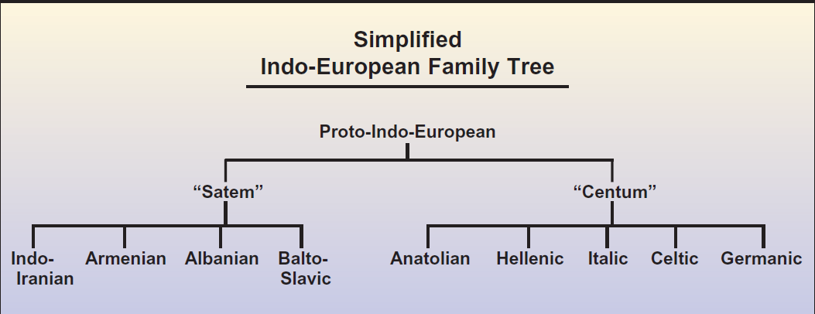

Slide 10
Most scholars believe that this population then expanded/migrated eastward, westward and northward and thereby came to inhabit most of Europe and parts of Western Asia.

Slide 11
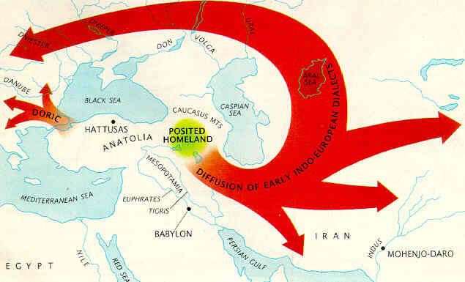

Slide 12
We can learn about the earliest Indo-Europeans from aspects of their reconstructed vocabulary. Some words, for example, describe an agricultural technology whose existence dates back to 5000 B.C. The Indo-European words for barley, wheat, flax, apples, cherries, grapes, vines, mead and beer and words for the various implements with which to cultivate, harvest and produce these products describe a way of life unknown in northern Europe until the third or second millennium B.C.

Slide 13
Reconstructed vocabulary also tells us much about the climate and geography of the region where the Proto-Indo-Europeans lived. Such words include words meaning winter, snow, birch, beech, pine, wolf, salmon, bear, and otter, and seem to suggest a northerly, temperate climate.

Slide 14
Language Reconstruction: Cognates
How then can we say anything about a language which existed more than 6000 years ago, before the time of written language? The answer comes from the study of so-called cognates, words of common origin in different languages. These words often resemble each other, and differences that exist between languages tend to be systematic (more about this later).

Slide 15
Sanskrit | Avestan | Greek | Latin | Gothic | English
pita |  | Pater | pater | fadar | father
padam |  | Poda | pedem | fotu | foot
bhratar |  | Phrater | frater | brothar | brother
bharami | barami | Phero | fero | baira | bear
virah | viro |  | vir | wair | wer (cf. were-wolf)
 |  | Tris | tres | thri | three
 |  | Deka | decem | taihun | ten
 | satem | he-katon | centrum | hund(rath) | hundred
Indo-European Cognates (adpated from Dr. Dan Mosser's HEL site):

Slide 16
Systematic sound changes in Cognates
Cognates also reveal systematic sound changes that have occurred as new languages have emerged. One such famous sound shift is Grimm’s Law. By comparing Germanic languages with Latin languages, Jakob Grimm was able to show that the following systematic changes of the plosive consonants had taken place at some point in history:
p → f (ped/foot, pisc/fish, pater/father, pyro/fire)
t → ө (th-sound) (tres/three, tu/thou, frater/bother).
k→ h (centum/hundred, cord/heart, cannabis/hemp, canard/hana, cornu/horn)
d → t (dent/tooth, duo/two, decem/ten)
g → k (genu/knee, genus/kin, gelidus/cold).

Slide 17
Reasons of Sound Change
Indo-European languages were influenced by the sound patterns of other, older European languages as the tribes moved into new parts of Europe and mixed with the native populations.
Such effects are known as substratum effects, where one language is systematically influenced by the languages of a subjugated group. Similar language phenomena exist today and one example is how Swedish pronunciation is being influenced by immigrant groups in suburbs such as Rinkeby.

Slide 18
Germanic
English belongs to the Germanic branch of the Indo-European languages.
This group began as a common language in the Elbe river region about 3,000 years ago.
Around the second century BC, this Common Germanic language split into three distinct subgroups:

Slide 19
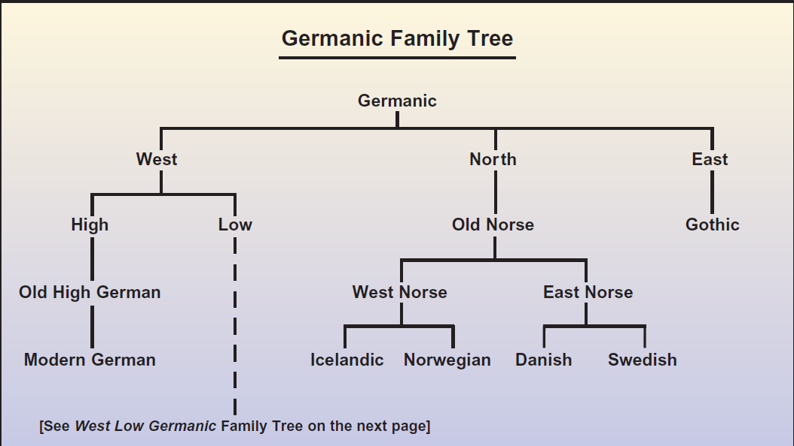

Slide 20
Sub-groups of Germanic Language
East Germanic was spoken by peoples who migrated back to southeastern Europe. No East Germanic language is spoken today, and the only written East Germanic language that survives is Gothic.
North Germanic evolved into the modern Scandinavian languages of Swedish, Danish, Norwegian, and Icelandic (but not Finnish, which is related to Estonian and is not an Indo-European language).
West Germanic is the ancestor of modern German, Dutch, Flemish, Frisian, and English.

Slide 21
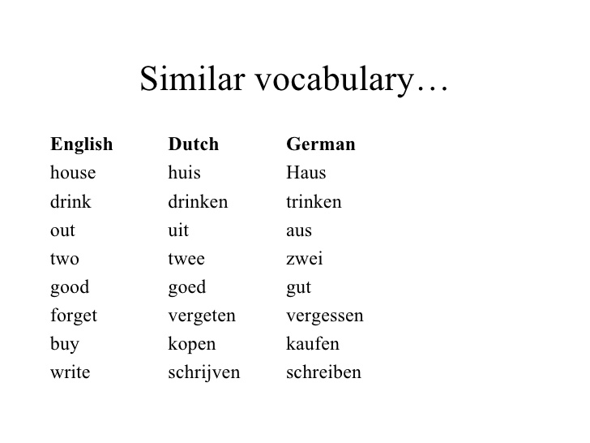

Slide 22
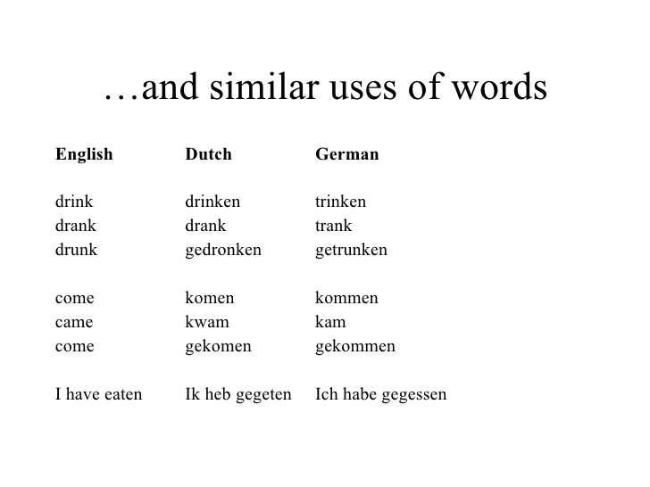

Slide 23
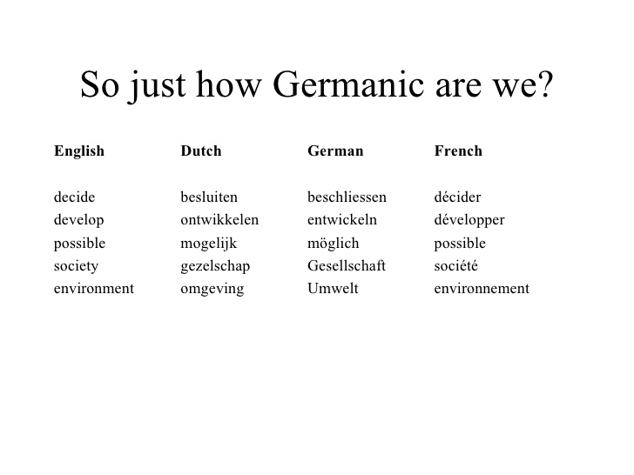

Slide 24
Similarities in English and Germanic
Why is English a Germanic language?
  1. large Germanic vocabulary
  2. dental past tense verbs
  3. fixed syllable stress
  4. 2-tense verb system (present and past; no ‘synthetic’ future tense)
  5. Grimm’s and Verner’s Laws

Slide 25
Dental suffix in English (unique to the Germanic branch of IE)
talked, bragged, boasted
past participle: I have talked
new verbs in English add – ed: I spammed the list.

Slide 26
Grimm’s Law
voiced stops (b d g) become voiceless stops (p t k)
voiceless stops (p t k) become voiceless fricatives (f th h)
voiceless fricatives ( f th h) become voiced stops (b d g)

Slide 27
Verner’s Law
an example of the same process from later English: beauty/beautician, extra/exam
worked on the voiceless fricatives:
a voiceless fricative ( f th h), when not initial and followed by a stressed syllable, becomes a voiced stop (b d g)
the accent then shifts to the first syllable, thus hiding the condition that led to the change in the first place
example: death/dead

