Slide 1
Families of Languages

Slide 2
Family of languages
It is a group of languages that are related to one another in terms of (genetic) origin
They share a common ancestor
Features such as lexicon, phonology, morphology and syntax
It contains several subdivisions called branches

Slide 3
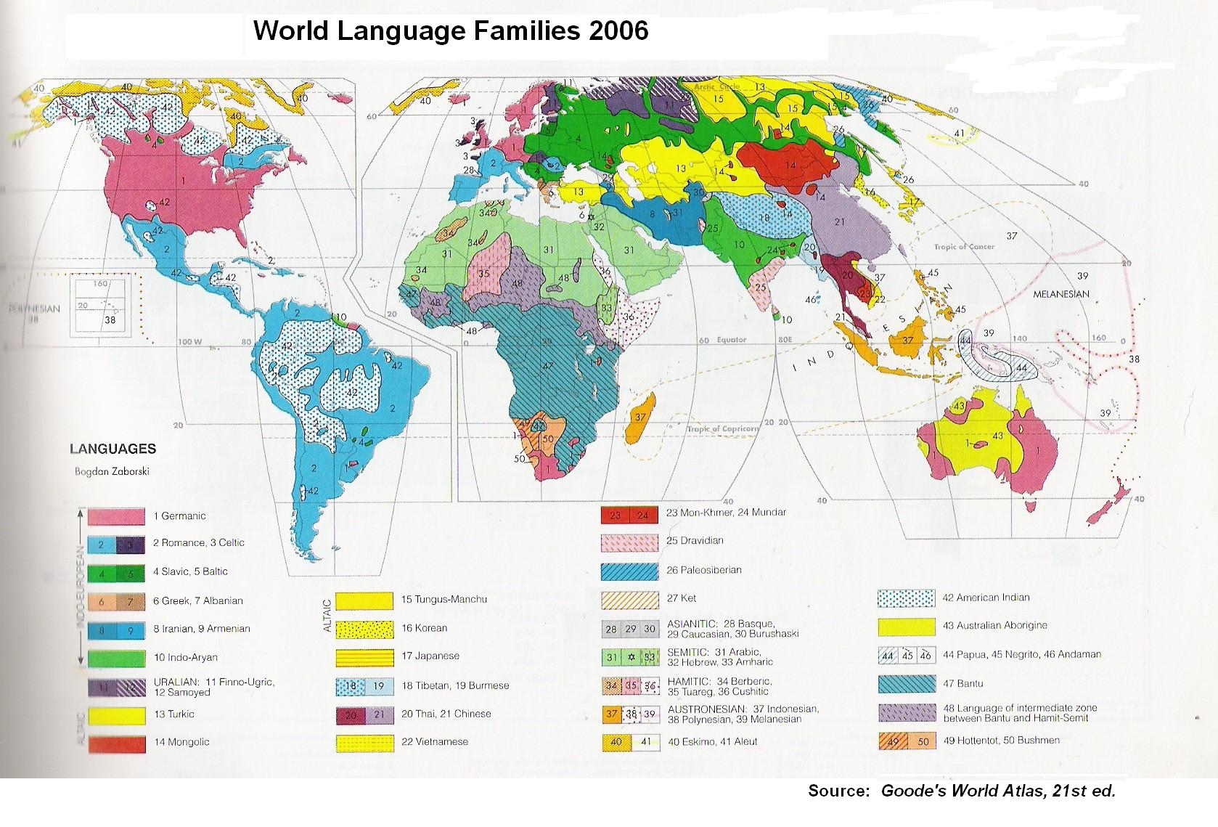

Slide 4
Indo-European family
It refers to a family of languages which by about 1000 bce were spoken over a large part of Europe and parts of southwestern and southern Asia
Compared with the other 150 to 200 families of languages in the world, the IE is smaller
It contains about 140 languages

Slide 5
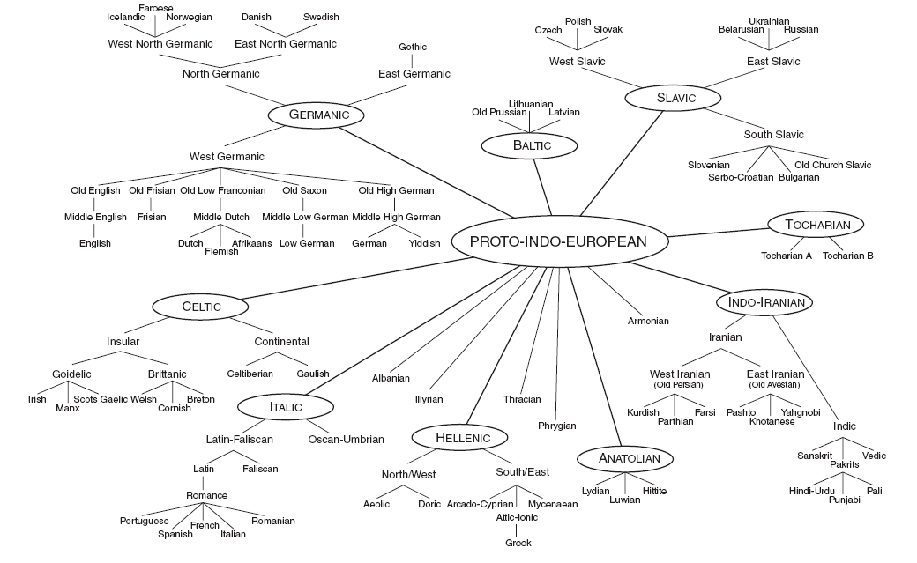

Slide 6
Branches
Anatolian: Completely extinct. Only archeological discoveries (in Turkey) demonstrate its existence

Slide 7
Proto – Indo – European
ANATOLIAN
(was known in a excavation in Bogazkoy)
Hittite
(does not share a number of structural features with the classical IE language)

Slide 8
Indo-Iranian:
It contains two main subdivisions: Indic (Indo-Aryan) and Iranian

Slide 9
Proto – Indo – European
INDO – IRANIAN
Indic ( Indo – Aryan) Iranian
Three Historical periods Old Avestan Old Persian
known as
Old Indic Middle Indic Modern Indic Ghatic Avestan
(1500-1600 BCE) (600 BCE – 1000 CE) (Since 1000 CE ) East Iranian West Iranian
The oldest middle Indic one of the largest and
are in Palid. Most heterogenous
of IE subgroups.
Parthian Kurdish Pashto Yahgnobi
Farsi Khotanesse

Slide 10
Hellenic
contains the languages spoken in the peloponnese peninsula, like Attic-Ionic, Arcado-Cyprian and Doric

Slide 11
Proto-Indo European
GREEK
Also known as
Hellenic
South/East Greek North/West Greek
Attic-Ionic Arcado-Cyprian Aeolic Doric
Mycenaean
The main Dialect Of Greek is
Standard modern Greek
ATTIC

Slide 12
Italic
contains the Latin, the creadle of the western civilization. The romances languages, like: Italian, French, Spanish, Portuguese, Catalan, and Rumanian

Slide 13
Proto-Indo-European
ITALIC
Latin-Faliscan Osco-Umbrian
(Sabellic or Sabellian)
Survives
The
Modern
Romance best known language / Less known
Language
Italian Dalmatian
French Rhaeto.Romansh
Spanish Ladino
Portuguese Sicilian
Catalan Sardinian
Rumanian Occitan

Slide 14
Germanic
includes English and belong to the north-western part of Europe. Languages like: German, Yiddish, Dutch, Flemish, Afrikaans, and English

Slide 15
Proto-Indo-European
GERMANIC
East Germanic North Germanic West Germanic
Old Icelandic (Old Norse) its descendants icludes
West North Germanic East North Germanic German
Ghotic Yiddish
(languaghe with the oldest Icelandic Norwegian Danish Swedish Dutch
Continuous documents in Germanic) Flemish
Faroese Afrikaans
ENGLISH

Slide 16
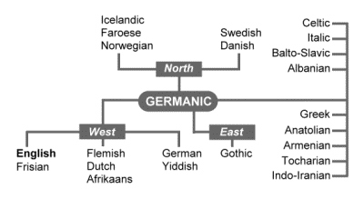
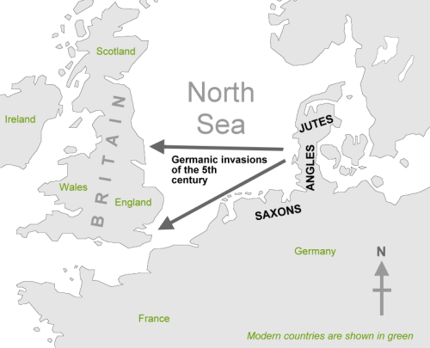
Why is English considered Germanic?
The history of the English language really started with the arrival of three Germanic tribes who invaded Britain during the 5th century AD (their language was called Englisc )

Slide 17
Romance Vs Germanic
A good surviving example of this process is the line in western Europe dividing the Romance languages (those deriving from a 'Roman' example) from the Germanic tongues.
The Romance family includes Italian, French, Spanish, Portuguese and Romanian (the result of a successful Roman campaign in the 2nd century AD).
The Germanic group is English, Dutch, Flemish, German, Danish, Norwegian, Swedish and Icelandic.
Modern English occupies a middle position within the western European family of languages, with its vocabulary approximately half Germanic and half Romance in origin.

Slide 18
Celtic
Divided into continental and insular. Celtiberian, Lepontic, Brittanic, Welsh, Scots Gaelic.

Slide 19
Proto-Indo-European
CELTIC
Continental Insular
Celtiberian Gaulish Goidelic Brittanic (Brythonic)
The oldest material
From the continentalis from sixth century BCE Irish Scots-Gaelic manx Welsh Betron
Cornish
the most robust of Spoken
the modern celtic. In
Brittany
(france)

Slide 20
Tocharian
Found in archeological excavations in Chinese Turkestan

Slide 21
Proto-Indo-European
TOCHARIAN
(discovered in archeoligical excavations)
Tocharian A Tocharian B
The documents of the language (religious, commercial)
are from the period of about 500-700 CE.

Slide 22
Baltic
Survives in two languages: Lithuanian and Latvian (Lettish)

Slide 23
Proto-Indo-European
BALTIC
Survives in two modern language
Lithuanian Latvian(Lettish) Old Purssian
( from the early sixteenth) (Probably datable to 1585) (was spoken until the early eigtheenth)

Slide 24
Slavic
south slavic Bulgarian, Macedonian, Serbian, Croatian, Slovenian. West Slavic, which comprises Czech, Slovak, Polish, Kashubian and East Slavic, made up of Russian, Ukrainian, and Belarussian.

Slide 25
Proto-Indo-European
SLAVIC
South Slavic West Slavic East Slavic
Bulgarian Czech Russian
Macedonian Slovak Ukrainian
Serbian Polish Belarussian
Croatian Kashubian
Slovenian
Old church Slavic (oldest material are written)

Slide 26
Armenian
First attested in religious documents, influenced by Greek, Arabic, Syriac, and Persian.

Slide 27
Proto-Indo-European
ARMENIAN
(first attested in religious documents)
Shows a great influence from neighboring languages
Greek Arabic Syriac Persian
Was first misclassified as a dialect of
IRANIAN

Slide 28
Albanic
Gheg and Tosk. Influenced by its neighbours Greek, Slavic, and Turkish, as well as Latin.

Slide 29
Proto.Indo-European
ALBANIAN
(uknown until the fifteenth century CE)
Shows a great influence from neighboring languages
Sach as
Greek Slavic Turkish Latin
The first document in Albanian There are two main Dialects
is a Baptismal Formula.
GHEG TOSK

Slide 30
Fragmentary Languages
In addition to the 11 major subgroups, there are also many apparently unaffiliated languages which survive only in fragments such as glosses and sporadic inscriptions.

Slide 31
Proto-Indo-European
Included among Fragmentary IE Language are:
LIGURIAN MESSAPIC VENETIC THRACIAN
(northern Italy (Southern Italy (Northeastern (In the area of modern)
Possible related possible connected Italy) Bulgaria and southern
To celtic) with Illaryrian) Romania)
PHRYGIAN ILLYRIAN
(in the area of medern (from the Dalmatian
central Turkey) coast area of the Adriatic)
Aspects of the Structure of PIE
Phonology Morphology Verbal Morphology Syntax

Slide 32
Aspects of the structure of Proto-Indo-European family of languages
These aspects are the ones that allow researchers to find out similarities in a family of languages, these are: Phonology, Morphology and Syntax.

Slide 33
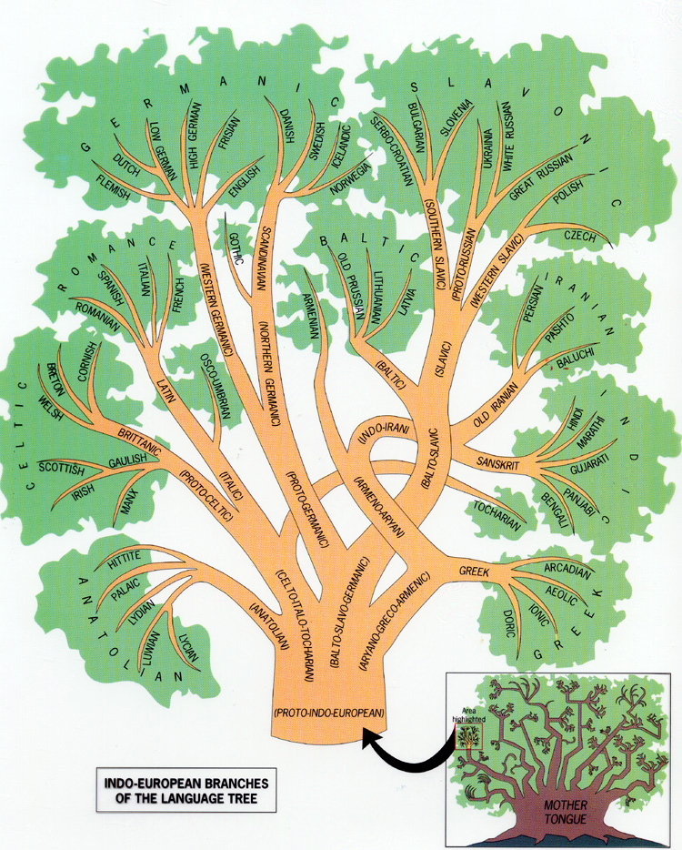
I
N
D
O
-
E
U
R
O
P
E
A
N
S
Anatolian
Tocharian
Italo-celtic
Greco-armenic
Albanian
Balto-slavo
Indo-iranian
Germanic

Slide 34
Summary
Family of Languages
Indo-European family
Branches
Fragmentary IE Language
Language Tree

