Slide 1
The Origins of Language

Slide 2
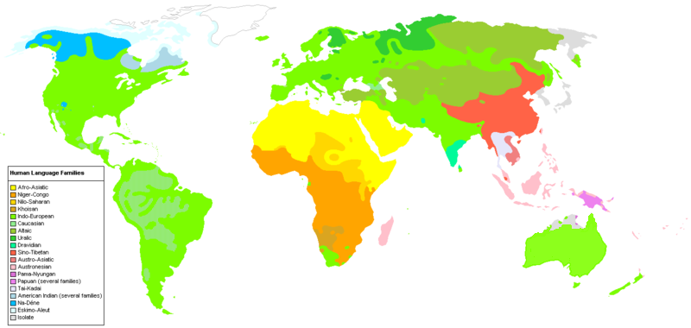
Origins
What are some things that link all languages?
There are about 5,000 languages spoken in the world today (a third of them in Africa)
Notes:
The origins of human language will perhaps remain for ever obscure. By contrast the origin of individual languages has been the subject of very precise study over the past two centuries.
Languages are linked to each other by shared words or sounds or grammatical constructions.
The theory is that the members of each linguistic group have descended from one language, a common ancestor.

Slide 3
Speculations about Origin of Language
What is the world’s oldest spoken language?
Have all languages developed from a single source?
What was the language spoken in the garden of Eden?
It dates back 3000 years and the quest remains fruitless..

Slide 4
Early Experiments
Egyptian king Psamtik 1 (reigned in 7th c. BC) tried to discover “which of all the peoples of the world was the most ancient?” He thought “Oldest language would be the evidence of oldest race”.

Slide 5
Psamtik’s Experiment
He gave two new born babies of ordinary men to a shepherd, to nurture among his flocks. He charged him that none should utter any speech before them, and they should live by themselves in solitary habitation, and at the due hours the shepherd should bring goats to them, and give their fill of milk, and perform the other things needful.

Slide 6
Results of Psamtik’s Experiment
The time passed on and after two years, the shepherd opened the door entered in and saw that both the babies fell down before him and cried becos.
Upon inquiry Psamtik got to know that Phrygian had used that word for “Bread”.
He came to know that Phrgian were elder than they.

Slide 7
Criticism on Psamtik’s Experiment
His experiment proved wrong because philological studies show that Phrygian is but one of the several languages which had developed in that period of history.
Then why did the twins pronounced “becos”
Some critics said that this was one of the “snatches” that shepherd recognized. Some also said that they copied goats.

Slide 8
Children of the Wild
For several hundred years, cases have been reported of children who have been reared in the wild by animals or kept isolated from all social context.
And the results show that none could speak at all, and most had no comprehension of speech.

Slide 9
Results of experiments
Most attempts to teach them to speak failed.
The cases of 1694, 1731 and 1767 are said to have learned some speech and the cases of 1767 have learned both Slovak and German.
The 1717 girl and 19th c child are both said to have learned some sign language as well.

Slide 10
Scientific Approaches
A considerable effort has been put to identify the scientific traces:
Glossogenetics: the study of the formation and development of human language
The other sciences that are involved in this are are: anthropology, psychology, semiotics, neurology, primatology and linguistics.

Slide 11
Evidences from Palaeontology
Efforts have been put together to deduce the origin of language fro the fossil records of early human beings, but the results are not conclusive.
One aspect was to see that whether the primitive men have the capacities to speak?

Slide 12
Theories of Human Language
Danish Linguist Otto Jesperson (1860-1943)Five Theories

Slide 13
1) The Bow-Wow Theory
Speech arose through people imitating the sounds of the environment, especially animal calls.
The main evidence was the use of onomatopoeic words such as:
Smash, crash, splash…

Slide 14
Criticism
But as few of them exist in a language, and as languages vary so much in the way they represent natural sounds, the theory has little support.

Slide 15
2) The Pooh-Pooh Theory
Speech arose through people making instinctive sounds, caused by pain, anger or other emotions.
Interjections are the best examples.

Slide 16
Criticism
But as no language contains many of these, and in any case, the clicks, intakes of breath, and other noises which are used in this way bear a little relationship to the vowels and consonants found in phonology.
The spellings is never a satisfactory guide.

Slide 17
3) The Ding Dong Theory
Speech arose because people related to stimuli in the world around them, and spontaneously produced the sounds (oral gestures) which were in harmony with the environment.

Slide 18
The main evidence
Universal use of the sounds of words of a certain meaning.

Slide 19
Criticism
But apart from a cases of apparent sound symbolism, the theory has nothing to commend it.
Mama is supposed to reflect the movement of the lips as the mouth approaches the breast, and bye-bye or ta-ta show the lips and tongue respectively “waving” good-bye.

Slide 20
4) The yo-he-ho Theory
Speech arose because, as people worked together, their physical efforts produced communal, rhythmical grunts, which in due course develped into chants, and thus language.

Slide 21
Evidence
Universal use of prosodic features, especially of rhythm, but all the gap between this kind of expression and what we find in language as a whole is so immense that an explanation for the later would still have to be found.

Slide 22
5) The la-la Theory
Jespersen himself felt that, if any single factor was going to initiate human language, it would arise from romantic side of life-the sounds associated with love, play, poetic feelings, perhaps even song.

Slide 23
Criticism
The gap between the emotional and the rational aspects of speech expressions would still have to be accounted for.

Slide 24
Summary
Speculations about origins
Early Experiments
Children of the wild
Scientific approaches
Theories of Origin

