Slide 1
Levels of Language
6 Levels of Language

Slide 2
Levels of Language
Aspect of language are often referred to as 'language levels'.
To look carefully at language
To see how it works
There are various different aspects of language structure which need separate consideration.
These are often referred to by linguists as the different levels of language. If we just think of a single sentence for the moment, we would need at least the following levels:

Slide 3
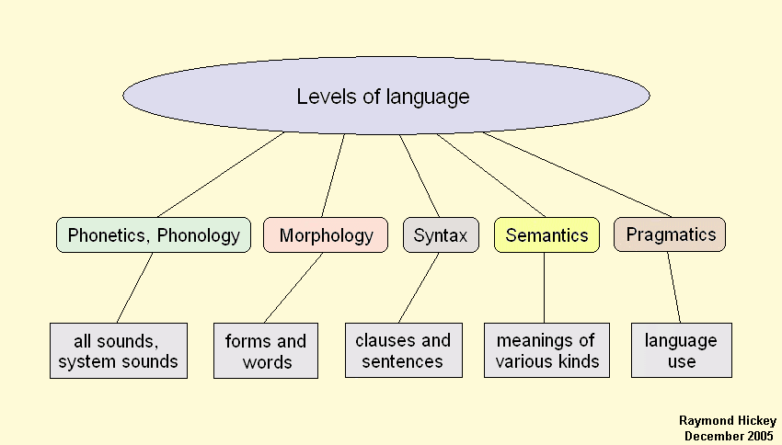

Slide 4
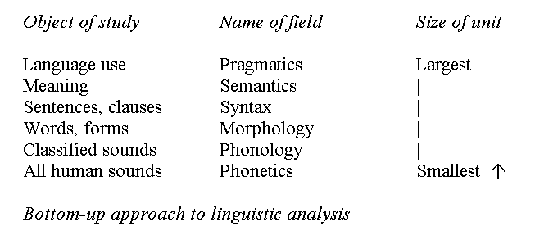

Slide 5
1) Phonetics & Phonology
Phonetics:
  The study of Production, Transmission and Perception of speech sounds
  Articulatory Phonetics
  Acoustic Phonetics
  Auditory Phonetics
Phonology
  The study of use and patterning of speech sounds

Slide 6
Phonetics & Phonology
The music of language is contained in the system of sounds which the human mouth is able to sing or say. Spoken language has a body and a breath to it. The set of possible human sounds (as used in the 3-5,000 languages) can be represented in print by the forty-six units of the international phonetic alphabet (IPA). However, each language has peculiar dialects (subsystems of sounds) and each individual voice can be recognized as a unique expression of the possible phonemes.

Slide 7
PHONEME
The smallest minimal contrastive unit of speech is known as phoneme.
English 44 Phonemes: 24 Consonants and 20 Vowels
26 Alphabets

Slide 8
CONSONANTS

Slide 9
VOWELS

Slide 10
NATURAL CLASSES OF PHONEMES
consonants: nasal, voiced, labial, sibilant, etc.
vowels: high, low, back, rounded, tense, etc.

Slide 11
PHONOLOGY
Intonation
Word Stress
Phrase Stress
Sentence Stress

Slide 12
2) MORPHOLOGY
The study of how morphemes can combine in a given language to form words falls under the rubric of morphology.
Consider this pluralizing '-s'. Clearly this conveys meaning, but it doesn't qualify as a word. What it qualifies as is a morpheme, along with 'cat', 'dog', and '-ing'. The study of how morphemes can combine in a given language to form words falls under the rubric of morphology.

Slide 13
MORPHEME
The smallest minimal contrastive unit of word is known as Morpheme.
Morpheme
Prefix
Suffix
Root

Slide 14
Examples
Wait-ing Un-usual-ly
------
ing
Wait
un
ly
usual

Slide 15
3) SYNTAX
The study of grammatical rules of a language is known as syntax.
We put words together into sentences according to the rules of syntax, what most people mean by the word grammar. This small number of rules is learned in early childhood and results in a small array of possible sentence patterns (see The Patterns of the Sentence). Syntax is the primary level of creativity in speaking and writing because from those few patterns of phrase and sentence an infinite number of sentences can be generated.

Slide 16
Examples of Syntax
NOUN PHRASE:
The pretty girl
VERB PHRASE:
Have been doing work
SENTENCE:
Its too cold in here.

Slide 17
4) Semantics
The study of meanings in language.
“Language without meaning is meaningless”… (Roman Jakobson)
Semantics:
is the technical term used to refer to the study of meaning, and, since meaning is a part of language, semantics is a part of linguistics.

Slide 18
Semantics is the branch of linguistics that deals with the study of meaning, changes in meaning, and the principles that govern the relationship between sentences or words and their meanings.
It is the study of the relationships between signs and symbols and what they represent.
An understanding of semantics is essential to the study of language acquisition (how language users acquire a sense of meaning, as speakers and writers, listeners and readers).

Slide 19

Example
“Colorless green ideas sleep furiously”

Slide 20
5) Pragmatics
The study of language in use
Kempson (1986) is of the view that the study of pragmatics is concerned with the general principles necessary for retrieving information from a specific utterance based on the context.

Slide 21
Process of Successful Communication
Speaker
(uses language)
Needs appropriateness
Listener
(retrieves language)
Needs to comprehend

Slide 22
Even after extracting a set of literal meanings from sentences, there is still the level of pragmatics. Language is usually and a cooperative process between at least two people, and conversations involve a subtle interplay of assumptions, requests, and expectations on the part of each speaker. Having said something, how can you be sure the other person understands? What should you say first? How do you keep from repeating yourself? When is it the other person's turn to talk? Does this person really want to know if I have a watch, or does she really want to know what time it is? These kinds of problems are hard enough for humans to work out, and to date no computer program even approaches human capabilities at this level.

Slide 23
Examples
Peter : Do you want some coffee ?
Mary : Coffee would keep me awake

Slide 24
6) Discourse
The study of language above the level of sentence.
Discourse includes everything.
It can be both written and spoken.
“Discourse is an identity kit” (James Paul Gee).

Slide 25
Examples
Each unit of language generally has a form that governs the whole. This piece of writing is a web page, a piece of instruction in expository prose. Just a minute ago, I was interrupted by a telephone conversation, a special form of speaking dependent on the technology and governed by certain expectations of form and content. All the literary genres are kinds of discourse units in the literary sphere of culture

Slide 26
SUMMARY
LEVELS OF LANGUAGE
Phonetics and Phonology
Morphology
Syntax
Semantics
Pragmatics
Discourse

