Slide 1
Great Vowel Shift
In Early Modern English

Slide 2
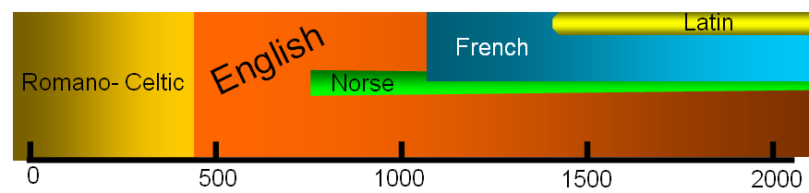
OE
before 1150
Modern English
ME
1150-1500
Early Mod. E
1500-1650

Slide 3
The Great Vowel Shift refers to the 15th century change in pronunciation of long vowels that occurred in England. After the Great Vowel Shift, vowel pronunciation shifted up one place.
Originally, these vowels had "continental" values much like those remaining in Italian and liturgical Latin. However, during the Great Vowel Shift, the two highest long vowels became diphthongs , and the other five underwent an increase in tongue height with one of them coming to the front.

Slide 4
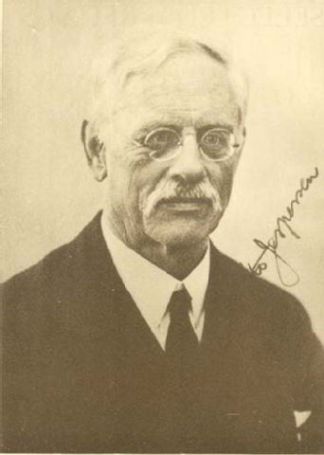
The Great Vowel Shift is something of a mystery, and linguists have been unable to account for why it took place.
It was first identified and studied by Otto Jesperson, a linguist from Denmark, during the late 19th and early 20th centuries.
specialized in the grammar of English language the. He earned degrees in English, French, and Latin and studied linguistics at Oxford.

Slide 5
Why did GVS happened
some theories attach the cause to the mass migration to the southeast part of England after the Black Death, where the difference in accents led to certain groups modifying their speech to allow for a standard pronunciation of vowel sounds

Slide 6
. The different dialects and the rise of a standardized middle class in London led to changes in pronunciation, which continued to spread out from that city. Another influence may have been the great political and social upheavals of the fifteenth century, which were largely contemporaneous with the Great Vowel Shift.

Slide 7
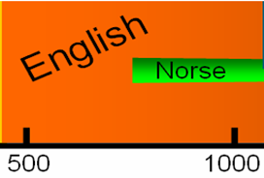
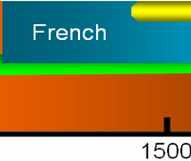

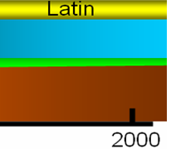








OE
before 1150
ME
1150-1500
Early Mod. E
1500-1650
Modern English
>
>
>
>
>
>
spelling
change
Great
Vowel
Shift
later
diphthonging

Slide 8
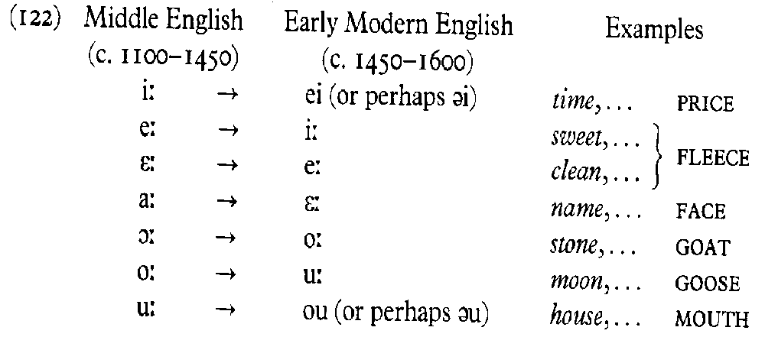
Great Vowel Shift

Slide 9
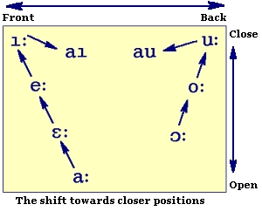
All the long stressed vowels of the phoneme system were affected when sound changes began shortly after 1400, and ended in the 18th century only (though the term GVS is mainly used to refer to the first major steps in this series of changes, until about 1650).

Slide 10
After more than 300 years, the systematic result was that the long stressed vowels had been raised to higher (closer) positions; as this was impossible for the closest vowels, they had become diphthongs.
The table gives you an abstract and idealized picture of these quality changes; it describes them on the level of the system of the language. When however you compare the late medieval and the modern systems, you will find that the phoneme inventories are fairly similar, as if nothing had really changed

Slide 11
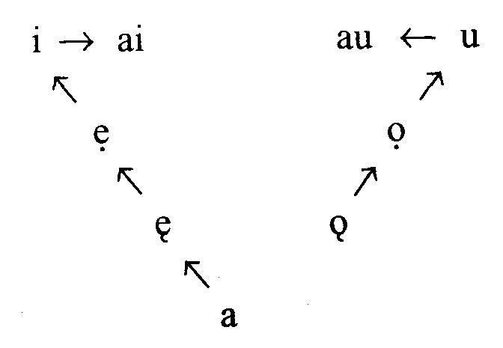




Slide 12
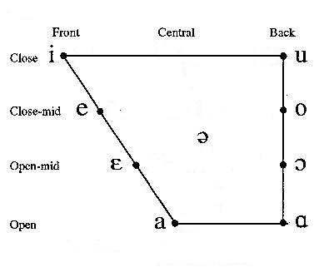
As for example:

Slide 13
tíd
hús
Tide
house
swét
móna
sweet
Moon
´
clæn
stán
clean
stone
nama
name

Slide 14
tide
house
sweet
moon
clean
stone
name

Slide 15
sweet
moon
clean
tide
house
stone
name

Slide 16
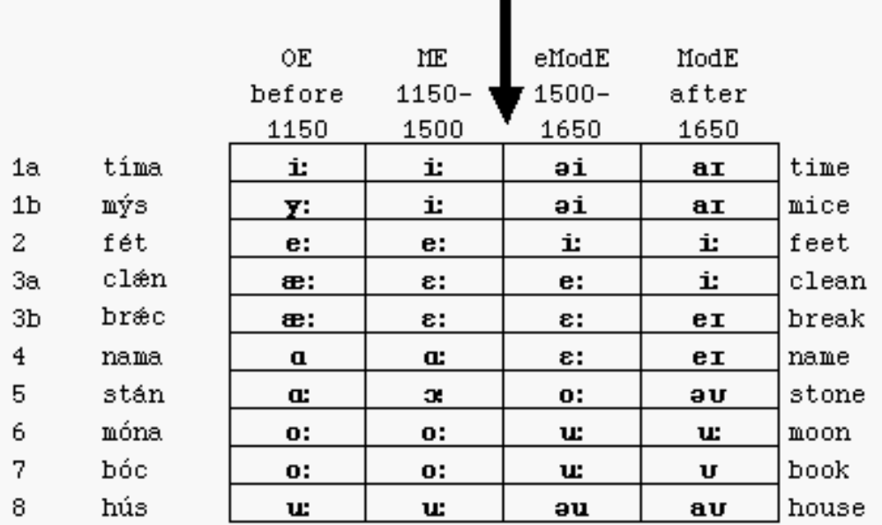
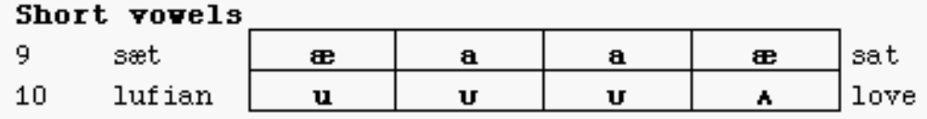

Slide 17
Present- day examples |  | PDE | EModE | ME
 | Life | {aɪ} | {əɪ} | {i:}
 | Meet | {i:} | {i:} | {e:}
 | Meat | {i:} | {e:} | {ɛ:}
 | Name | {e:} | {ɛ:} | {ɑ:}
 | How, Town | {aʊ} | {əʊ} | {u:}
 | Mood | {u:} | {u:} | {o:}
 | Boat, Home | {o:} | {o:} | {ɔ:}

Slide 18
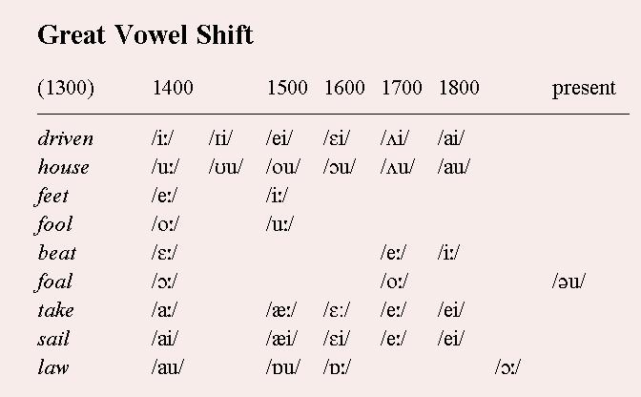

Slide 19
The Great English Vowel Shift
The Great English Vowel Shift is a Chain Shift.
A chain shift consists of a series of interrelated changes that are motivated by the pressure to restore a symmatrical system of speech sounds.

Slide 20
Changes of short vowels
In unstressed syllables [@] was lost.
ME [a] became [{] in EME.
[U] was converted to [ö] unless it was followed by [S] [l] [T] (e.g. run, mud, cut vs. full, pull, bush, butcher)

Slide 21
The Great English Vowel Shift
A: Is Tat Ti tSild
B: yE hIr nam@ Is an
A: @ god and hOlI nam@
B: son@ Se wIl be Tre yerIz Ov adZ@
A: wIl Se spEke to me
B: yE Se spEkT wUnd@r lud@
A: Iz D{t D@I tS@Ild
B: yE h@r n{m Iz {n
A: @ gud and hOlI nam
B: sun Si wIl bi Tri yirz @v {dZ
A: wIl Si spEk tu mi
B: yE Si speks w@nd@r l@Ud

Slide 22
The Great English Vowel Shift
A: Is Tat Ti tSild
B: yE hIr nam@ Is an
A: @ god and hOlI nam@
B: son@ Se wIl be Tre yerIz Ov adZ@
A: wIl Se spEke to me
B: yE Se spEkT wUnd@r lud@
A: Iz D{t D@I tS@Ild
B: yE h@r n{m Iz {n
A: @ gud and hOlI nam
B: sun Si wIl bi Tri yirz @v {dZ
A: wIl Si spEk tu mi
B: yE Si speks w@nd@r l@Ud

Slide 23
The Great English Vowel Shift
Sound changes
[a] > [{]
[i] > [@I]
[o] > [u]
[e] > [i]
[E] > [e]
[u] > [@U]
Dialect differences
advanced (B) conservative (A)
[n{m] [nam]
[speks] [spEk]

Slide 24
The Great English Vowel Shift
i u
@I @U
e o
E
{
  a

Slide 25
The Great English Vowel Shift
1550-1650
A: Iz D{t D@I tS@Ild
B: ye h@r n{m Iz {n
A: @ gud {nd hOlI n{m
B: sun Si wIl bi Tri yIrz @v {dZ
A: wIl Si spek tu mi
B: ye Si speks w@nd@r l@Ud

Slide 26
The Great English Vowel Shift
1650-1750
A: Iz D{t D@I tSaIld
B: ye h@r nem Iz {n
A: @ gud {nd holI nem
B: sun Si wIl bi Tri yIrz @v edZ
A: wIl Si spik tu mi
B: ye Si spiks w@nd@rfUlI laUd

Slide 27
The Great English Vowel Shift
1650-1750
A: Iz D{t D@I tSaIld
B: ye h@r nem Iz {n
A: @ gud {nd holI nem
B: sun Si wIl bi Tri yIrz @v edZ
A: wIl Si spik tu mi
B: ye Si spiks w@nd@rfUlI laUd

Slide 28
The Great English Vowel Shift
Sound changes
[@I] > [aI]
[{] > [e]
[O] > [o]
[{] > [e]
[@U] > [aU]

Slide 29
To sum up……
The simplest description of the Great Vowel Shift is that the seven tense or, more commonly, long vowels of Middle English shifted higher (that is, the tongue was raised somewhat more) with greater closing of the mouth. Those vowels that were already raised as far as they could be became diphthongs.

Slide 30
Using these terms, we see that in the Great Vowel Shift, the high front vowel becomes a diphthong: “fif” (which was pronounced “feef”) becomes “five” (with the “iy” diphthong pronunciation in Modern English). This left an open spot in the high front vowel space, into which the vowel that had previously been a mid front vowel moved (i.e., the mid front vowel became a high front vowel after the high front vowel became a diphthong): mede (which was pronounced “maid – eh”) became “meed .”

Slide 31
Now there was an opening for a mid front vowel, and into that slot moved the previous low front vowel: “breke” (which was pronounced “bray – keh”) became “break.” Here things get a little more complicated, as another vowel, this time from the back of the mouth, also jumped into this spot: “name” (which was pronounced “nahm – he”) becomes “name.” You will note that “break” and “name” have the same pronunciation but different spellings.

Slide 32
A similar shuffle happened in the back of the mouth. The high back vowel in Middle English “mus” (pronounced “moose,” but meaning “mouse”) became a diphthong, giving us Modern English “mouse.” Into that open high back vowel slot moved the sound that had been a mid back vowel: “roote” (pronounced “row – teh”) became “root.” That in turn left an opening for a mid back vowel into which the previous low back vowel moved: “goote” (which in English was pronounced something like “gaw – teh”) becomes “goat.”

Slide 33
As you can see, this is a very thoroughgoing shift, but it is only applicable to the long vowels. The short vowels did not change very much at all. And since short vowels are unstressed vowels, you can see why our talk of changing stress patterns and the elimination of inflectional suffixes was so important: Word elements that were not stressed did not undergo vowel changes.

Slide 34
GVS & Grimm’s Law
It is useful at this point to compare the Great Vowel Shift with Grimm’s Law, which we discussed in such detail in lecture five. Remember that Grimm’s Law described the changes in consonants in the evolutionary split between Indo- European and Germanic. When the first part of the shift occurred, the voiceless stops became voiceless fricatives; the language would have been left with no voiceless stops. But that gap was filled by the voiced stops becoming voiceless. That left another gap, since there would then be no voiced stops, but that gap was filled by the aspirated voiced stops becoming unaspirated voiced stops

Slide 35
. There is a significant cascade of sound changes, all related to one another across many, many words. The same is true of the Great Vowel Shift. Linguists have been arguing for nearly a century about whether the Shift happened in the front of the mouth and the back of the mouth separately or at the same time and whether the shuffle occurred via pushing or pulling.

Slide 36
Some theorize, for example, that the high vowels becoming diphthongs opened up gaps that pulled all the other vowels along. Others argue that the first changes happened at the bottom, with these new vowels thus pushing the other vowels up and, in the case of the vowels that were already high vowels, into diphthongs. The movement of the one type of low back vowel to a mid front vowel is taken as supporting evidence by both sides.

Slide 37
Why the Vowels Shifted
Equally controversial (possibly even more controversial) is the explanation for why the Great Vowel Shift happened. In one sense the name, coined by the great linguist Otto Jesperson (he was Danish, but is still possibly the greatest English linguist who ever lived), is misleading, as it tends to suggest rapid or immediate change.
And indeed, the Shift occurred at lightning speed for a linguistic event: It is usually dated from approximately 1500 to 1600, and traditionally has been seen as occurring mostly from 1500 to 1550 (although newer linguistics textbooks hedge a bit and spread it out over the 1500 to 1600 period). The traditional view, which has not been overturned so much as questioned, was that the Shift occurred over the course of a generation.

Slide 38
Proposed Theories
At the time of the Shift, a major demographic change was affecting England. There was mass immigration from the north to the south of England after the Black Death and a similar shift in living patterns from rural to urban environments. Although the plague had spread more rapidly in cities and towns, these began to grow rapidly in size while many villages were completely abandoned. Linguists theorize that the sudden arrival in the south of many individuals with northern accents or the arrival of many rural dwellers in urban areas triggered, somehow, a major pronunciation change.

Slide 39
Another related theory is that the rise of the Middle Class in London required the creation of a common dialect. Because there was continual growth in the importance of trading and commerce from the end of the fourteenth through the sixteenth centuries, people needed to be able to communicate more clearly in English.
Thus a new kind of English pronunciation evolved that would split the differences between various dialects in England, with the London dialect (spoken by Chaucer, among many others) eventually winning out, but adopting many of the pronunciations of the other dialects.

Slide 40
Others argue that it was not so much immigration but social mobility that changed the language. After the Black Death there was such a labor shortage, the argument goes, that many more people were able to move into the middle and even the upper class.
These people had other, class-based ways of talking, and in the process of modifying their own speech, also ended up causing the modifications of previously existing standard speech. The result was a new pronunciation for everyone.

Slide 41
A related possibility is to interpret the Shift as a form of hypercorrection, an attempt to seem more English at a time when England was at war, on and off, with France. English speakers, it is thought, would make every effort to sound less continental, and a new vowel system would do just that.
Unfortunately for this hypothesis, linguists seem to have found just as much evidence that the pronunciation shift could be an attempt to sound more French, as French was still associated with the upper classes: So all those newly rich families changed their pronunciation in order to sound as if they had always been rich.

Slide 42
Finally, some scholars argue that the arrival of the printing press at the end of the fifteenth century worked to lock in a particular pronunciation (that most familiar to the printers in London) and then disseminate it throughout England. The problem with this theory is that early printers were anything but consistent in spelling; they even deliberately spelled words two different ways in the same line in order to get the spacing right.
And although London English was the favorite of printers, one needs only to compare Chaucer’s London English with the English printed in the middle of the sixteenth century to know that something major had already changed by the time William Caxton set up the first printing press in England in 1476.

Slide 43
My own view is that the Great Vowel Shift was caused, not by any one large change, but by the harmonious convergence of many small changes. Minor shifts in pronunciation occur all the time: One generation will pronounce a word with one accent or one stress pattern and another, to mark itself as separate, will pronounce things differently.

Slide 44
There are also processes that retard change: People can rather aggressively police the boundaries of acceptable speech when it is an important part of their identities. Social rank is also associated with certain kinds of speech. For some reason in the early sixteenth century, these various stabilization processes did not hold change back, and once the change got going, the cascade effect was enough to create the Great Vowel Shift.

