Slide 1
Early Modern English

Slide 2
Spelling reforms
In the 16th and 17th century, English scholars tried to reform the spelling of English.

Slide 3
[fIS] <ghoti>
[f] <gh> ‘rough’
[I] <o> ‘women’
[S] <ti> ‘lotion’

Slide 4
Pronunciation of English nonce words
lape
morantishly
permaction
phorin

Slide 5
Spelling in Old and Middle English
Throughout the Middle Ages, the English spelling was not really standardized.
Many regional differences.

Slide 6
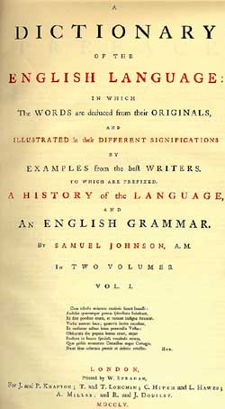
English dictionaries
1604 Robert Cawdrey
1721 Nathaniel Bailey
1755 Samuel Johnson

Slide 7
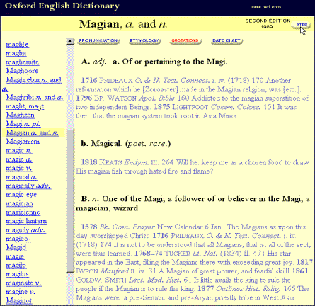
Oxford English Dictionary

Slide 8
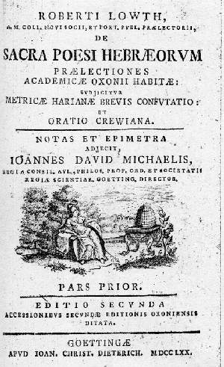
Robert Lowth
A Short Introduction to English Grammar
1762

Slide 9
Double negation
Two negatives in English destroy one another, or equivalent to an affirmative. (Robert Lowth 1762)
He nevere yet no vileynye ne sayde
In all his lyf unto no maner wight.
He was verry, parfit gentil knight.
(Chaucer: Canterbury Tales)
I didn’t know nothin’ bout gettin’ no checks to (=for) nothin’, no so (=social) security or nothin’.’
(African American English)

Slide 10
Dangling prepositions
The Preposition is often separated from the Relative which it governs and joined the verb at the end of the Sentence … as, ‘Horace is an author, whom I am much delighted with.’ … This is an Idiom which our language is strongly inclined to; it prevails in common conversations, and suits very well with the familiar style if writing; but the placing of the Preposition before the Relative is more graceful, as well as more perspicuous; and agrees much better with the solemn and elevated style.
(Robert Lowth 1762)

Slide 11
Plural of chicken
cicen-u or cicen-s?
Those who say ‘chicken’ in the singular and ‘chickens’ in the plural are completely wrong.
wegen des Wetters
wegen dem Wetter

Slide 12
Grammatical innovations in English
This is strictly speaking not good English.
Hopefully, they will come.
The man who Peter met is my friend.
You and me, we should do this together.
Peter dreamed of a large cake.

Slide 13
Grammatical innovations in German
Wegen dem schlechten Wetter sind wir zu Hause geblieben.
Ich mach das nicht, weil dazu habe ich einfach keine Lust.
Wenn er doch bloß bald kommen würde.
Das ist mein Vater sein Auto.
Ich mach das nur wegen dir.

Slide 14
English or Latin?
But why not all in English, a tung of it self both depe in conceit, and frank in deliverie? I do not think that anie language, be it whatsoever, is better able to utter all arguments, either with more pith, or greater planesse, then our English tung is, if the English utterer be as skillful in the matter, which he is to utter, as the foren utterer is.
[Robert Mulcaster 1582]

Slide 15
English or Latin?
I do write in my naturall English toungue, bycause though I make the learned my judges, which understand Latin, yet I meane good to the unlearne, which understand English, and he that understands Latin very well, can understand English farre better, if he will confesse the trueth, though he thinks he have the habite and can Latin it exceedingly well.
[Robert Mulcaster 1582]

Slide 16
Latin loan words
Some seeke so far for outlandish English, that they forget altogether their mothers tongue. And I dare sweare this, if some of their mothers were aliue, thei were not able to tell what they say: … The vnlearned or foolish phantasticall, that smelles but of learning … wil so Latin their tongues, that the simple can not but wonder at their talke, and thinke surely they speake by some reuelation.

Slide 17
Latin loan words
I know them that thinke Rhetorique to stande whole vpon darke wordes, and hee that can catche an ynke horne terme by the taile, him they coumpt to be a fine Englishman, and a good Rhetorician.
[Thomas Wilson 17th century]

Slide 18
Latin loan words
And though for my part I use those words (i.e. Latin loans) as little as any, yet I know no reason why I should not use them, and I finde it a fault in my selfe that I do not use them: for it is in deed the ready way to inrich our tongue, and make it copious, and it is the way which all tongues have taken to enrich them selves…
[George Pettie]

Slide 19
Word coinages – ‘Caucerisms’
Latin English word coinage
lunatic mooned [Sir John Cheke]
crucified crossed [Sir John Cheke]
parable biword [Sir John Cheke]
prophet foresayer [Sir John Cheke]
muscles fleshstrings [Arthur Golding]
triangle threlike [Robert Recorde]
conclusion endsay [Robert Recorde]
definition saywhat [Robert Recorde]
irony dry mock [Robert Recorde]

Slide 20
Word coinages
blatant chirrup
delve belt
glance endear
wary gloomy

Slide 21
Clippings
van (<vanguard)
rear (<arrear)
fortnight (<fourteen-night)

Slide 22
Blends
dumbfound (<dumb + confound)
apathetic (< apathy + pathetic)
splutter (< splash + sputter)

Slide 23
Back formations
difficult (<difficulty)
unit (<unity)

Slide 24
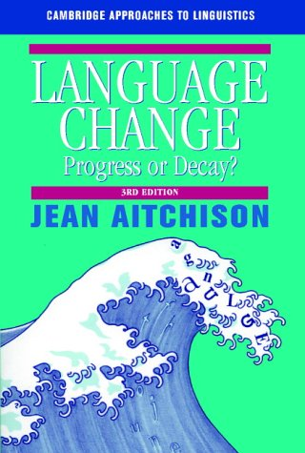
Language Change: Progress or Decay

Slide 25
Language Change: Progress or Decay
The standard of speech and pronunciation in England has declined so much … that one is almost ashamed to let foreigners hear it.
[The Guardian]

Slide 26
Language Change: Progress or Decay
Through sheer laziness and sloppiness of mind, we are in danger of losing our past subjunctive.
[Daily Telegraph]

Slide 27
Language Change: Progress or Decay
We seem to be moving … towards a social and linguistic situation in which nobody says or writes anything more than an approximation to what he or she means.
[Kingsley Amis: The laments about language in general]

Slide 28
Language Change: Progress or Decay
We go out of our ways to promulgate incessantly … the very ugliest sounds and worst possible grammars.
[Evening Standard]

Slide 29
Language change is decay
The history of all the Aryan languages [i.e. Indo-European languages] is nothing but a gradual process of decay.
[Max Müller 1868]

Slide 30
Language change is progress
In the evolution of languages the discarding of old flexions goes hand in hand with the development of simpler and more regular expedients that are rather less liable than the old ones to produce misunderstandings.
[Otto Jesperson 1922]

Slide 31
Language change is neither progress nor decay
Progress in the absolute sense is impossible, just as it is in morality or politics. It is simply that different states exist, succeeding each other, each dominated by certain general laws imposed by the equilibrium of the forces with which they are confronted. So it is with language.
[Joseph Vendryès 1923]

Slide 32
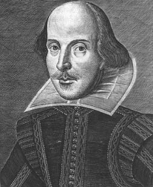
William Shakespeare 1564-1616

Slide 33
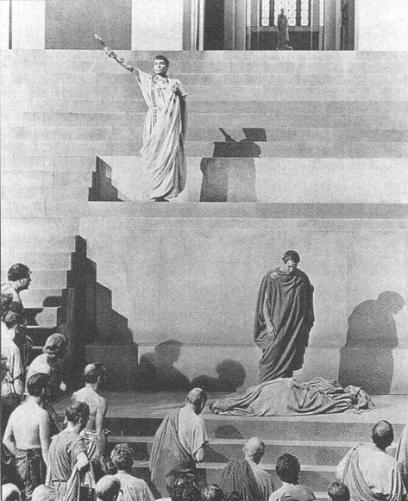
William Shakespear
Julius Caesar 1599

Slide 34
Julius Caesar – Act 2
BRUTUS Lucius, who's that knocks?
Re-enter LUCIUS with LIGARIUS
LUCIUS He is a sick man that would speak with you.
BRUTUS Caius Ligarius, that Metellus spake of.
Boy, stand aside. Caius Ligarius! how?
LIGARIUS Vouchsafe good morrow from a feeble tongue.

Slide 35
Julius Caesar – Act 2
BRUTUS O, what a time have you chose out, brave Caius,
To wear a kerchief! Would you were not sick!
LIGARIUS I am not sick, if Brutus have in hand
Any exploit worthy the name of honour.
BRUTUS Such an exploit have I in hand, Ligarius,
Had you a healthful ear to hear of it.

Slide 36
Julius Caesar – Act 2
LIGARIUS By all the gods that Romans bow before,
I here discard my sickness! Soul of Rome!
Brave son, derived from honourable loins!
Thou, like an exorcist, hast conjured up
My mortified spirit. Now bid me run,
And I will strive with things impossible;
Yea, get the better of them. What's to do?

Slide 37
Julius Caesar – Act 2
BRUTUS A piece of work that will make sick men whole.
LIGARIUS But are not some whole that we must make sick?
BRUTUS That must we also. What it is, my Caius,
I shall unfold to thee, as we are going
To whom it must be done.

Slide 38
Julius Caesar – Act 2
LIGARIUS Set on your foot,
And with a heart new-fired I follow you,
To do I know not what: but it sufficeth
That Brutus leads me on.
BRUTUS Follow me, then.
Exeunt

Slide 39
Summary
Spelling Reforms in Early English Period
Grammatical innovations
Language Change
Examples from Shakespeare’s writings

