Slide 1
HISTORY OF ENGLISH LITERATURE
Anglo – Norman Period
(1066 - 1500)
Lecture 5
MA English
COMSATS Virtual Campus Islamabad

Slide 2
Outline of the lecture
Introduction to Anglo – Norman Period
Anglo – Norman Literature
Languages during this period
Characteristics of Medieval Literature
Conventions of Medieval Romance
Chivalric Code and Introduction to Courtly Love
The Romances in Anglo – Norman Period
The Miracle plays
Prominent Literary Figures---focus on Chaucer

Slide 3
Introduction to Anglo – Norman Period
The Norman---residing in Normandy (France)----defeated Anglo Saxon King at the Battle of Hastings (1066)----and conquered England
Saxon King---Harold---defeated by William, the Duke of Normandy
The Norman Conquest inaugurated a new era in the literary as well as political history of England
The Anglo – Saxon writers are permanently displaced as their king

Slide 4
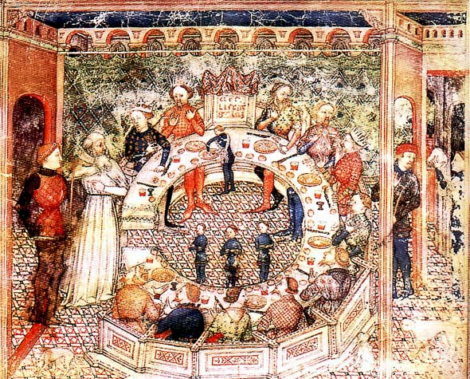
Literature Medieval Period

Slide 5
Anglo – Norman Literature
Transformation of Anglo – Saxon literature
Artistic expression and religious service----Latin control

Slide 6
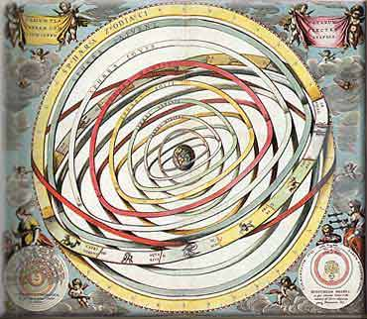
Languages
Latin was the language of the Roman Catholic Church, which dominated Europe
The Church was the only source of education
Thus, Latin was a common language for Medieval writings.

Slide 7
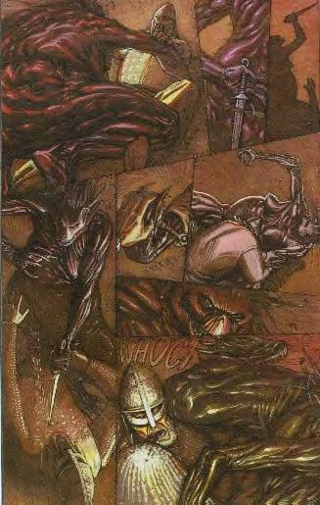
A great amount of medieval literature is anonymous. Medieval authors often tended to re-tell and embellish stories they heard or read rather than invent new stories.

Slide 8
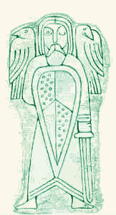
Writings
Catholic clerics were the intellectual center of society in the Middle Ages, and it is their literature that was produced in the greatest quantity.

Slide 9
Characteristics of Medieval Literature
Romance
  A narrative in prose or verse that tells the high adventures and heroic exploits of chivalric heroes
    Tells of exploits of knights
    often a supernatural element involved
Christian message
  concern s with salvation and the world to come
  no interest in social change, only spiritual change
    This was true until the late 14th century
    Geffrey Chaucer and Dante Alighieri signal new thinking, try up-ending social order

Slide 10
Characteristics of Medieval Literature
Heroism
  from both Germanic and Christian traditions, sometimes mingled
    Beowulf
    Sir Gawain and the Green Knight
    Song of Roland
    The Nieblungenlied
Presentations of idealized behavior
  literature as moral lesson
    loyalty to king
use of kennings
  A figurative, usually compound expression used in place of a name or noun. Example, storm of swords is a kenning for battle.

Slide 11
Characteristics of Medieval Literature – Use of Allegory
An allegory is a figurative mode of representation conveying a meaning other than the literal.
Much of medieval literature relied on allegory to convey the morals the author had in mind while writing--representations of abstract qualities, events, and institutions are thick in much of the literature of this time.
We’ll read Dante’s Inferno this quarter – a classic example of medieval allegory!

Slide 12
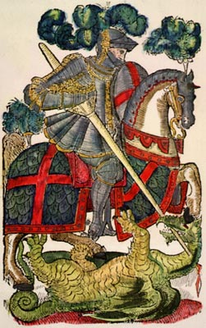
Conventions of Medieval Romance
Medieval Romances:
Often have unprovoked and violent fighting!
Are set in a mystical place and time (the Dark Ages)
Present supernatural elements, and magical powers from the pagan world
Have a hero who is on a noble adventure or quest
Have a loose, episode-like structure
Include elements of courtly love
Embody ideals of chivalry
Time frame of a year and a day

Slide 13
Chivalric Code and Introduction to Courtly Love
Chivalry is from the French word, chevalier, meaning horseman, or knight.
The Code of Chivalry influenced the formation of religious military orders during the period of the Crusades. The now famous Knights Templar and the Hospitalers are among the most noted knights of this period.
During the later middle ages, chivalry had become largely as system of manners for the knights and a source of entertainment during tournaments – which themselves gradually became less threatening to the participants than live battle.”
Notes:
13

Slide 14
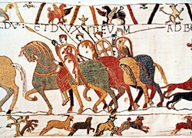
Chivalric Code and Introduction to Courtly Love
The chivalric code combined Christian virtues with military virtues:
Temperance, Fortitude, Prudence and Justice
Faith, Hope, Charity
Valor and strength in battle
Loyalty to God and King
Courtesy towards enemies
Generosity towards the sick, women, widows and the oppressed
Courtly Love*
Notes:
See separate power point program.
14

Slide 15
The Ideal of Courtly Love
This relationship was modeled on the feudal relationship between a knight and his liege lord.
The knight serves his courtly lady with the same obedience and loyalty which he owes to his liege lord.
She is in complete control; he owes her obedience and submission

Slide 16
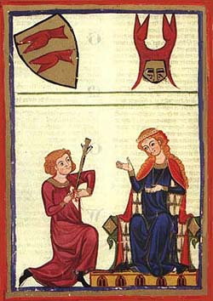
The knight's love for the lady inspires him to do great deeds, in order to be worthy of her love or to win her favor.

Slide 17
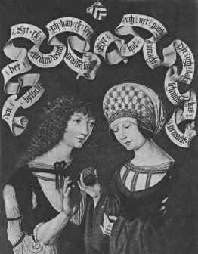
“Courtly love" was not between husband and wife because it was an idealized sort of relationship that could not exist within the context of "real life" medieval marriages.
In the middle ages, marriages amongst the nobility were typically based on practical and dynastic concerns rather than on love.

Slide 18
“Courtly love" provided a model of behavior for a class of unmarried young men who might otherwise have threatened social stability.
Knights were typically younger brothers without land of their own (hence unable to support a wife).
They became members of the household of the feudal lords whom they served.

Slide 19
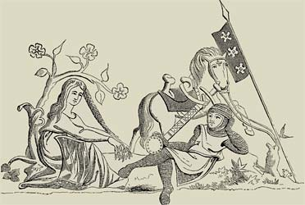
The lady is typically older, married, and of higher social status than the knight because she was modeled on the wife of the feudal lord, who might naturally become the focus of the young, unmarried knights' desire.

Slide 20
The literary model of courtly love may have been invented to provide young men with a model for appropriate behavior.
It taught bored young knights to control their baser desires and to channel their energy into socially useful behavior (love service rather than wandering around the countryside, stealing or raping women).

Slide 21

The "symptoms" of love were described as as if it were a sickness.
The "lovesick" knight’s typical symptoms: sighing, turning pale, turning red, fever, inability to sleep, eat or drink.

Slide 22
The Romances in Anglo – Norman Period
Most popular form of literature
Popular for their stories rather than poetry
Borrowed from Latin and French sources

Slide 23
The Miracle Plays
Very popular
From the growth and development of the Bible story, scene by scene, carried to its logical conclusion
Developed to an enormous cycle of sacred history:
  Beginning with the creation of man
  His fall and banishment from the garden of Eden
  Death of Christ
  Final day of Judgment
  Miracle play----mystery play
  Flourished in England from the reign of Henry II to that of Elizabeth (1154-1603)

Slide 24
Morality Plays
The uniform theme is the struggle between the powers of goods and evil for the mastery of the soul of man
The life of the Christ
Redemption of the world

Slide 25
William Langland
One of the greatest poet
His poem --- A Vision of Piers the Plowman----very popoluar
Classical work
Satire on the corrupt religious practices
Throws light on the ethical problems
Assumed character-----the prophet----denouncing the sins of society and encouraging men to aspire to a higher life
He represents the dissatisfaction of the lower and more thinking class of English society

Slide 26
John Gower
Courtly medieval poetry
Narrative poet
Most important work
  Confession Amantis
  Form of conversation between poet and a divine interpreter
  Satire on the vanities of current time

Slide 27
Chaucer
Made a fresh beginning in English literature
Man of the world and of affairs like Shakespeare and Milton
Most popular work---The Canterbury Tales

Slide 28
Geoffrey Chaucer (1340-1400)
Personal experience:
1. The father of the English poetry, the founder of modern English, Chaucer was born of a wine merchant family, with rising fortunes and some standing at the court.
2. 1357 served as a court page (boy servant ), and in 1359 in an English arm fighting in France and was taken prisoner.
3. Probably in 1361 to 1367 studied at the Inner Temple where he received training for a career at the court.

Slide 29
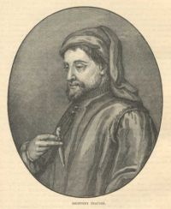
The Age of Chaucer
Geoffrey Chaucer
• He is an English poet regarded as the greatest literary figure of medieval England and the first great English poet.
• His works include
The Book of the Duchess (1369)
Troilus and Criseyde (c. 1385)
The Canterbury Tales (1387–1400)
• He established the southern English dialect as the standard English literary language in his works.

Slide 30
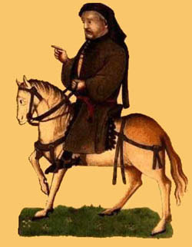
The Canterbury Tales
• It is a work written by Geoffrey Chaucer in the late fourteenth century
• It is a collection of stories, two of them in prose, the rest in verse.
• The work uses a frame story structure in which a main story told by the writer himself organizes other shorter stories told by a group of pilgrims, of many different occupations and personalities.
• Some of the stories are originals and others not.

Slide 31
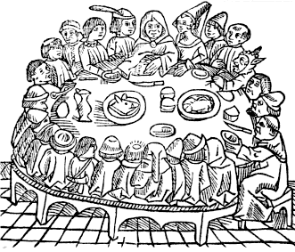
The Canterbury Tales
• The pilgrims meet at an inn near London as they are setting out for Canterbury.
• Their host proposes a storytelling contest to make the journey more interesting.
• The themes and genres of the tales vary, reflecting the diversity of the pilgrims.
• Characters are real people with distinct personalities and human weaknesses.
• The merits of the work are: sense of humour, sympathetic insight, and a sense of proportion.
• The work is incomplete: it was originally intended as a collection of one hundred twenty tales, but twenty-six tales were actually written.

Slide 32
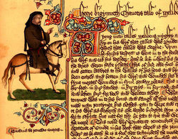
The Language of The Canterbury Tales
• The language of The Canterbury Tales is Middle English.

Slide 33
The Canterbury Tales
Collection of stories related to the pilgrims on their way to the shrine of Thomas Becket at Canterbury
These people represent different sections of the contemporary English society
A landmark in the history of English poetry.
Chaucer's works fall into three periods.

Slide 34
First Period
He imitated French models, particularly the famous and very long poem – Le Roman de la Rose
He translated it Remaunt of the Rose
  Introduction to the medieval French romances and courtly love
  He also wrote the Book of Duchess
  religious tone

Slide 35
Second Period
Influence of Italian Literature especially Dante`s Divine Comedy
He wrote the Parliament of Fowls----contains very dramatic and satiric dialogues between the assembled birds; Troilus and Criseyde--- narrates the story of the Trojan prince Troilus and his love for Creseida
The Story of Griselda– a pitiful picture of womanhood
The House of Fame---master piece of comic fantasy

Slide 36
Third Period
English period
He threw off foreign influences and showed native originality
Legend of Good Woman
The Canterbury Tales----the greatest poetic achievement which places us in the hear of London

Slide 37
After Chaucer!!!!
There was a decline in English poetry for about 100 year from 1400 to the Renaissance.
Only few minor poets, the imitators and successors of Chaucer---are called the English and Scottish Chaucerian

Slide 38
References
A Critical History of English Literature by Dr. Mullik
A Critical History of English Literature by David Daiches
A Dictionary of Literary Terms by Martin Gray

Slide 39
THANK YOU!!!!!!

