Slide 1
Modern Poetry
Lecture 23
History of English Literature
COMSATS Virtual Islamabad

Slide 2
Modern poetry, of which T. S. Eliot is the chief representative, has followed entirely a different tradition from the Romantic and Victorian tradition of poetry. Every age has certain ideas about poetry, especially regarding the essentially poetical subjects, the poetical materials and the poetical modes.

Slide 3
These preconceptions about poetry during the nineteenth century were mainly those which were established by great Romantic poets—Wordsworth, Coleridge, Byron, Shelley and Keats. According to them the sublime and the pathetic were the two chief nerves of all genuine poetry. That is why Spenser, Shakespeare and Milton were given a higher place as poets than Dryden and Pope, who were merely men of wit and good sense, and had nothing of the transcendentally sublime or pathetic in them.

Slide 4
The great poetical problem in the beginning of the twentieth century was, therefore, to invent technique that would be adequate to the ways of feeling, or modes of experience of the modern adult sensitive mind. The importance of T. S. Eliot lies in the fact that, gifted with a mind of rare distinction, he has solved his own problem as a poet.

Slide 5
Moreover, being a poet as well as a critic his poetical theories are re-inforced by his own poetry, and thus he has exerted a tremendous influence on modern poetry. It is mainly due to him that all serious modern poets and critics have realised that English poetry must develop along some other line than that running from the Romantics to Tennyson, Swinburne and Rupert Brooke.

Slide 6
The twentieth century poets who were in revolt against Victorianism and especially against the didactic tendency of poets like Tennyson, Browning, Arnold and even Swinburne and Meredith, felt that the poet’s business was to be uniquely himself, and to project his personality through the medium of his art.

Slide 7
Poetry to them was not a medium for philosophy and other extraneous matters; nor was it singing for its own sake. It was a method first of discovering one’s self, and then a means of projecting this discovery. Thus the problem before each of them was how to arrive at a completely individual expression of oneself in poetry.

Slide 8
Naturally it could not be solved by using the common or universally accepted language of poetry. On account of the change in the conceptions of the function of poetry, it was essential that a new technique of communicating meaning be discovered. It was this necessity which brought about the movements known as imagism and symbolism in modern poetry.

Slide 9
Symbolism was first started in France in the nineteenth century. The business of the symbolist poet is to express his individual sensations and perceptions in language which seems best adapted to convey his essential quality without caring for the conventional metres and sentence structures.

Slide 10
He aims at inducing certain states of mind in the reader rather than communicating logical meaning. The imagists, on the other hand, aim at clarity of expression through hard, accurate, and definite images.

Slide 11
They believe that it is not the elaborate similes of Milton or extended metaphors of Shakespeare which can express the soul of poetry. This purpose of poetry can be best served by images which by their rapid impingement on the consciousness, set up in the mind fleeting complexes of thought and feeling.

Slide 12
In poetry which is capable of capturing such instantaneous state of mind, there is no scope for Wordsworth’s “emotion recollected in tranquillity”. In it suggestion plays the paramount part and there is no room for patient, objective descriptions.

Slide 13
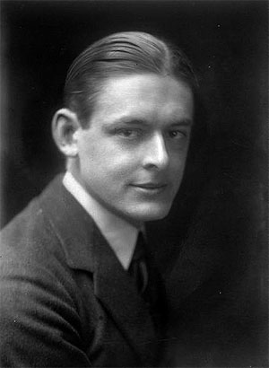
T.S. Eliot
1888—1965

Slide 14
Biography
BIRTH:
  Thomas Stearns Eliot
  September 26, 1888 in Missouri.
CHILDHOOD:
  father, Henry Ware Eliot,
    the president of the Hydraulic Brick Company.
  mother, Charlotte Champe Stearns,
    volunteer at the Humanity Club of St. Louis.
    was a teacher.
  At the time of Eliot’s birth, his parents were in their mid-forties
    siblings were already grown.
EDUCATION:
  attended Harvard University
  left with a masters and undergraduate degrees.
  returned to Harvard to receive a doctorate degree in philosophy.

Slide 15
Biography
Toured the continent after Harvard
1915 married first wife, Vivienne Haigh-Wood
1917 began working at Lloyd’s bank in London
1925 left the bank to work at a publishing firm
1927 converted to Anglicanism, dropped U.S. citizenship, became a british subject
1933 separated from Vivienne
  Vivienne’s possible affair with Bertrand Russell?
  Eliot: "I came to persuade myself that I was in love with Vivienne simply because I wanted to burn my boats and commit myself to staying in England. And she persuaded herself that she would save the poet by keeping him in England. To her, the marriage brought no happiness. To me, it brought the state of mind out of which came The Waste Land.“
  avoiding all but one meeting with her between 1932 and her death in 1947.
  1938 Vivien was committed to the Northumberland House mental
    remained there till her death.
    Eliot remained her husband during this time though he never visited.

Slide 16
Biography
1948 won Nobel prize
1957 married Esme Valerie Fletcher
  Had been his secretary at the publishing house since 1949
  37 years his junior (he was nearly 70, she was 32)
  Preserved his literary legacy after Eliot’s death
In 1965, he died of emphysema in London at the age of seventy-seven.
1983 won two posthumous Tony Awards for “Cats”

Slide 17
Themes
Eliot’s theories about modern poetry are enacted in his work:
  his writing exemplifies not only modernity, but also the modernist mode
  it seeks to put the reader off balance so as to capture the incoherence and dislocations of a bewildering age.
    the modern individual is “no longer at ease here”
      he has witnessed the birth of something new and unprecedented, and finds the change to be a “[h]ard and bitter agony”
    he also attempts to counteract its disorderliness:
      bringing disparate elements into some sort of conceptual unity.
      “The poet’s mind is in fact a receptacle for seizing and storing up numberless feelings, phrases, images, which remain there until all the particles which can unite to form a new compound are present together”

Slide 18
Aesthetic Views
A poem should be an organic thing in itself, a made object.
Once it is finished, the poet will no longer have control of it.
It should be judged, analyzed by itself without the interference of the poet’s personal influence and intentional elements and other elements.

Slide 19
Reflection of Life:
Modern life is chaotic, futile, fragmentary
  Eliot argues that modern poetry “must be difficult” to match the intricacy of modern experience.
  poetry should reflect this fragmentary nature of life:
  “ The poet must become more and more comprehensive, more allusive, more indirect, in order to force, to dislocate if necessary, language into his meaning”
this nature of life should be projected, not analyzed.

Slide 20
The Poet Should Draw Upon Tradition:
use the past to serve the present and future
  “simultaneous order”
    how the past, present, future interrelate
    Sometimes at the same time
borrow from authors that are:
  remote in time
  alien in language
  diverse in interest
use the past to underscore what is missing from the present.

Slide 21
Style/Technique
disconnected images/symbols
literary allusions/references
  Sometimes VERY obscure!!!
highly expressive meter
rhythm of free verses
metaphysical whimsical images/whims
flexible tone

Slide 22
The Waste Land & Prufrock
The Love Song of J.Alfred Prufrock
  love
  indecision
  Powerlessness, impotence
  Stream-of-conciousness
The Waste Land
  Written in 1922
  Marriage failing
    Both he and Vivienne were suffering from “nervous disorders”
      He was in convalescence, recovering from a “break-down”
      Emotionally distanced himself from the work before it was published in book form
  The impotence and sterility of the modern world; cultural fragmentation
  disaffected sexual relationships in the modern, faithless world
  The disrupted cycles of:
    death and regeneration
    decay and growth;
  the possibility of spiritual and aesthetic unity:
    through religious belief and mythic structure;

Slide 23
techniques:
  fragments, images accumulated, suggestions, allusions
  Imagery of death and rebirth
contrasts:
  Song:
    grey, listless, lack of vitality, life, energy
  Land:
    despair, more gloomy, bleaker
    death can also lead to rebirth

Slide 24
The Wasteland
This attempt at order/consolidation
  uses myth as a unifying idea.
  resists narrative closure and easy resolutions
Loosely based on:
  an anthropological study of the medieval grail romances
  primitive fertility rites
presents the reader with dissimilar textual fragments:
  woven together in a kind of mantra
  restore some sort of order and life to a civilization
    spiritually empty and sterile by World War I.

Slide 25
The Wasteland
Modern age:
  unprecedented slaughter
  eradication of all faith in God, in nature, and even in literature
  has rendered the soil—and modern culture—barren.
Eliot’s personal brand of religious faith and his belief in the unifying elements of myth offer possibilities for spiritual and aesthetic consolation
  albeit in a very abstract sense.

Slide 26
Influences:
1. Sir James George Frazer(1854-1941):
  The Golden Bough 1890-1922)
    primitive rituals which indicated similar patterns of behavior and belief
    diverse and widely separated cultures:
    Ie: ritual king killing
  2. Miss Weston(1850-1928):
    From Ritual to Romance:
      Fisher King is impotent,
      to be healed by finding answers to the riddle and then the curse can be removed

Slide 27
Major motifs, images, symbols
Rejuvenation:
  quest for regeneration in a kaleidoscopic landscape of sexual disorder and spiritual desolation
    fertility(love, sex, vitality ) vs sterility(impotence)
death vs. rebirth
  death in life
  rebirth in death
  cycle of seasons
external barren landscape mirroring an internal barren landscape:
  wilderness, barren land, desert, rock
cause of this sterility of modern life: lack of belief
  god is buried, god is dead

Slide 28
Complexity/Ambiguity of the Poem
Double/conflicting meanings
  water: life, death, rebirth;
  rock: sterility and hope
Stumbling blocks:
  many allusions, vague in origin
  Exploration on the nature of life, of modern world, complexity of experience
  symbols are not two-dimensional, thin, but rich in meaning; the poem was not meant to be a didactic allegory

Slide 29
Titles of five parts
I The Burial of the Dead
II A Game of Chess
(two women, high and low, but both are frustrated and unhappy. Low woman, her life is arbitrary and like a game of chess)
III The Fire Sermon
(the river past and present, also the scene of sordid love affairs)
IV Death by Water
V What the Thunder Said

Slide 30
Delving Deeper
Why is April the “cruelest month” (line 1)?
What do we usually associate with spring:
  new growth, flowers, warmth, life, planting seeds
  Christian belief: the resurrection of Christ celebrated at Easter
What kinds of things do we associate with winter?
  death, coldness, sterility, bare trees, a lack of growth
And why are “memory and desire” (line 3) painful?
elaboration of these concepts throughout the poem:
a fertile and joyous new world might spring from the site of mass slaughter
  “so many, / I had not thought death had undone so many” [lines 62–63]) is grotesque and unreal.
  The death and destruction of war is a major presence here:
    “That corpse you planted last year in your garden, / Has it begun to sprout? Will it bloom this year?” (lines 71–72).

Slide 31
Delving Deeper:
No rebirth is possible in this barren landscape.
  Not surprisingly, arid human relations provide no more consolation than nature.
    Sex is not life-affirming but sordid, and brings no pleasure.
  The “bored and tired” typist yields with indifference to her clumsy lover, a “young man carbuncular” (lines 256, 231)
  Lil’s friend advises her to smarten herself up a bit so that her husband, returning from his stint in the army, won’t look elsewhere for “a good time” (line 148).
  inability of these disaffected couplings to sustain growth in a spiritual and emotional sense.
Note the sudden, sometimes jarring changes in tone, diction, and rhyming patterns, which add to the sense of disjunction.
  The bartender’s repeated interruption into Lil’s conversation with her friend:
    “HURRY UP PLEASE ITS TIME” (lines 141, 152, 165, 168, 169)
      disrupts the continuity of the exchange while emphasizing its crass nature.

Slide 32
“What the Thunder Said”
enigmatic concluding section,
  Eliot’s note this section addresses themes about:
    Christ
    the Grail myth
    conflict in Eastern Europe.
There are many different ways to read this section:
  convergence of Eliot’s themes:
    Grail legend
    faith in Christ
  have something to offer all desperate souls, although that offering does not take place within the poem itself.
If myth can impose order on chaos, then the allusions to the Chapel Perilous (lines 386-95) imply:
  “tumbled graves,” “the empty chapel,” and “Dry bones” (lines 388, 389, 391)
  that if the questing knight continues his journey and participates correctly in the ritual,
  vitality will return to the land.

Slide 33
“What the Thunder Said”
The Chapel Perilous passage:
  illuminates the previous references to Christ’s journey to Emmaus,
  implying that if one can have faith in the resurrected Christ,
  figuratively seeing “the third who walks always beside you” (line 360),
  then spiritual sustenance will be forthcoming.
Religious faith may in some way alleviate the misery caused by political turmoil and cultural dislocation.

Slide 34
W. B. Yeats
© Seomra Ranga 2010 www.seomraranga.com

Slide 35
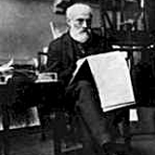
W. B. Yeats
While reading law at the Irish Bar, John Butler Yeats met Susan Pollexfen, the sister of an old school friend. They married in 1863.
© Seomra Ranga 2010 www.seomraranga.com

Slide 36
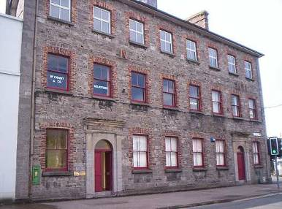
W. B. Yeats
Susan’s father, William owned a milling company and shipping firm in Sligo.
One of the Pollexfen Shipping Line buildings on Wine St., Sligo
© Seomra Ranga 2010 www.seomraranga.com

Slide 37
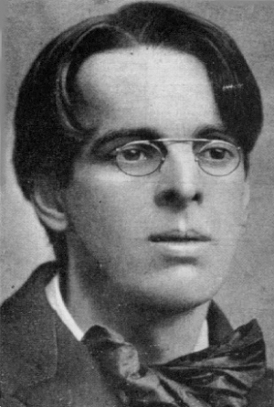
W. B. Yeats
John and Susan Butler Yeats had six children, four of whom survived. William Butler Yeats, the eldest, was born in 1865.
© Seomra Ranga 2010 www.seomraranga.com

Slide 38
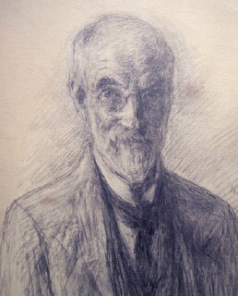
W. B. Yeats
In 1867, John B. Yeats gave up the practice of law and started a career as an artist. He moved Susan and the children to London.
Pencil self-portrait of John Butler Yeats, 1919
© Seomra Ranga 2010 www.seomraranga.com

Slide 39
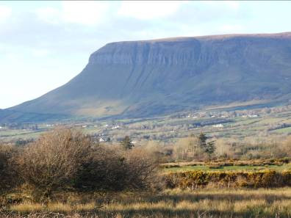
W. B. Yeats
The family spent their holidays every year in Sligo and lived there between 1872 and 1874.
Ben Bulben, Sligo
© Seomra Ranga 2010 www.seomraranga.com

Slide 40
W. B. Yeats
In 1881, the Yeats family moved to Dublin, at first living near the sea at Howth, later moving to Harold’s Cross. As a youngster, William dabbled in writing plays and poems and became more and more interested in using Irish history and stories as themes for his writing.
© Seomra Ranga 2010 www.seomraranga.com

Slide 41
W. B. Yeats
Yeats’ writings began to be published in newspapers and journals. His first work, an epic poem, The Wanderings of Oisín, was published in 1887. It was written in the form of a dialogue between St. Patrick and Oisín, the ancient Irish hero. Yeats was immediately recognised as a significant poet.
© Seomra Ranga 2010 www.seomraranga.com

Slide 42
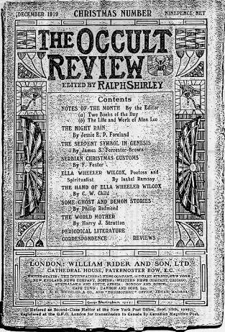
W. B. Yeats
Throughout the 1890’s, Yeats became fascinated by the occult, ritual magic and mystic Celtic tales, all of which were to influence his writings.
© Seomra Ranga 2010 www.seomraranga.com

Slide 43
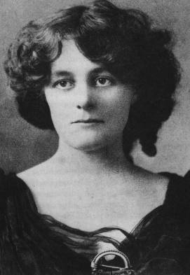
W. B. Yeats
In 1889, William met Maud Gonne. He immediately fell in love with her and over the years frequently asked her to marry him.
Maud Gonne
© Seomra Ranga 2010 www.seomraranga.com

Slide 44
W. B. Yeats
They never married but she became an inspiration for his poetry and he wrote many poems about her and for her.
“I have spread my dreams under your feet,
Tread softly – because you tread on my dreams.”
- from He Wishes For the Cloths of Heaven
© Seomra Ranga 2010 www.seomraranga.com

Slide 45
W. B. Yeats
While living in London in 1890, Yeats founded the Rhymer’s Club in order to meet other poets of the time. Right up to his later years he always encouraged new young poets.
“I went out to the hazel wood
Because a fire was in my head
And cut and peeled a hazel wand
And hooked a berry to a thread.”
- from The Song of Wandering Aengus
© Seomra Ranga 2010 www.seomraranga.com

Slide 46
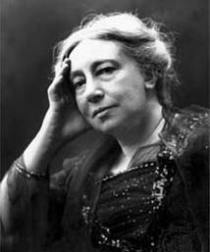
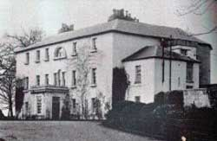
W. B. Yeats
Yeats met Lady Gregory in 1896. The following summer he spent two months at her house, Coole Park, in Galway, the first of many summers he spent there. They collected folklore together and she provided him with space to write.
Lady Gregory
Coole Park, Gort, Co. Galway
© Seomra Ranga 2010 www.seomraranga.com

Slide 47
W. B. Yeats
Plays of W.B. Yeats:
The Land of Heart’s Desire
Deirdre
At the Hawk’s Well
The Only Jealousy of Emer
Calvary
The Cat and the Moon
The Dreaming of the Bones
About this time Yeats also became interested in poetic drama and proceeded to write many verse plays.
© Seomra Ranga 2010 www.seomraranga.com

Slide 48
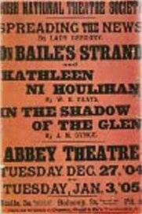
W. B. Yeats
Yeats and others set up the Irish National Theatre Society to perform plays with a distinctly Irish theme. Early productions included John Millington Synge’s In the Shadow of the Glen and Yeats’ own The Shadowy Waters.
Poster for the opening of the Abbey Theatre, Dublin
© Seomra Ranga 2010 www.seomraranga.com

Slide 49
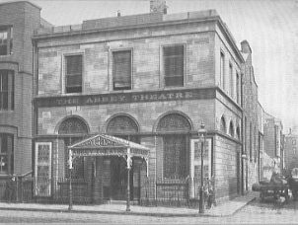
W. B. Yeats
This led to the establishment of the Abbey Theatre in 1904. In January 1907, the Abbey put on a new play by J.M. Synge, The Playboy of the Western World. Audiences were outraged and riots ensued.
Abbey Theatre, Dublin
© Seomra Ranga 2010 www.seomraranga.com

Slide 50
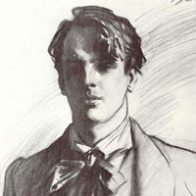
W. B. Yeats
In 1903, Yeats embarked on his first lecture tour of the USA. This was followed up by further tours in 1911, 1914, and 1920. These enabled him to earn substantial sums of money.
© Seomra Ranga 2010 www.seomraranga.com

Slide 51
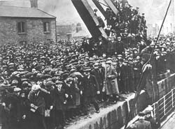
W. B. Yeats
Yeats was also aware of the politics of the time. He supported the workers in the 1913 Dublin Lockout. He also supported Lady Gregory and Hugh Lane in their efforts to establish a modern art gallery in Dublin.
© Seomra Ranga 2010 www.seomraranga.com

Slide 52
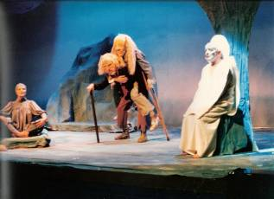
W. B. Yeats
Ezra Pound, a young American poet, introduced Yeats to the stylised Japanese Noh drama which immediately influenced his writings. He used this form of drama in At the Hawks Well, first performed in London in 1916.
The Cat and the Moon,
Sligo Drama Circle, 1984
© Seomra Ranga 2010 www.seomraranga.com

Slide 53
W. B. Yeats
The Easter Rising of 1916 took Yeats by surprise. Having previously bemoaned the fact that:
“Romantic Ireland’s dead and gone, It’s with O’Leary in the grave”
(from September 1913),
Yeats was shocked at the execution of the leaders of the Rising.
© Seomra Ranga 2010 www.seomraranga.com

Slide 54
W. B. Yeats
Read some of these Yeats Poems:
The Stolen Child
The Lake Isle of Innisfree
Down by the Salley Gardens
The Ballad of Moll Magee
The Ballad of Father Gilligan
The Fiddler of Dooney
September 1913
Easter 1916
A Prayer for my Daughter
© Seomra Ranga 2010 www.seomraranga.com

Slide 55
Thank you

