Slide 1
Computer Architecture
Lecture 09
Fasih ur Rehman

Slide 2
Last Class
Serial Port and Serial Interface circuit
Buses
  Types
  Synchronous
  Asynchronous
  Arbitration

Slide 3
Today’s Agenda
Central Processing Unit
  Internal Arch
  Familiarization with the units of CPU
  Their functioning
  Memory operations

Slide 4
Basic Processing
A typical program consists of a series of steps specified by a sequence of machine instructions.
An instruction is executed by carrying out a sequence of one or more primitive (arithmetic or logic) operations.
Processor fetches one instruction at a time and performs the specified operation.
Processor fetches instructions from consecutive memory locations until a jump or a branch instruction is come across.
Program counter, a processor register, is used to keeps track of the address of the memory location containing the next instruction to be fetched.

Slide 5
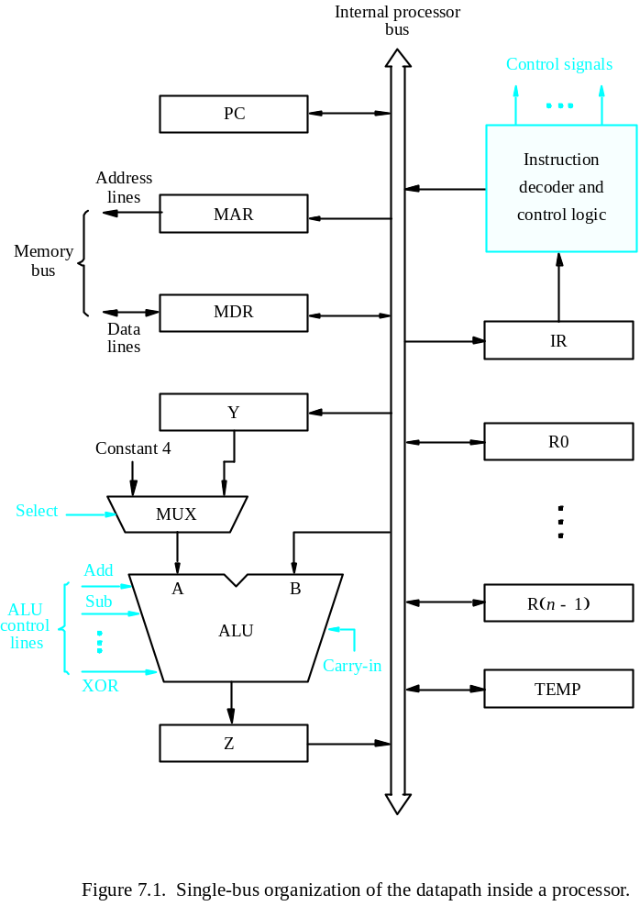
Inside a CPU

Slide 6
Nomenclature
PC: Program Counter
  Register that hold the address of next instruction to be executed
MAR: Memory Address Register
  Holds the address of memory location whose content is to be fetched in the processor or where processor wants to write
MDR: Memory Data Register
  Content of memory is fetched in this register or the data is sent to outside world through this register
Y: A temporary register
  Holds one of the operands to be operated by ALU

Slide 7
Nomenclature (Cont.)
Mux: Multiplexer
  Selects constant 4 or content of Y register to be fed into ALU
ALU: Arithmetic and Logic Unit
  Performs arithmetic and logic operations on the input(s)
Z: Temporary Register
  Temporarily holds the output of ALU
TEMP: Temporary Register
  Another temporary register that can be used to store operands or intermediate results
R0 – R(n – 1): n general purpose registers

Slide 8
Nomenclature (Cont.)
IR: Instruction Register
  Instruction being executed currently is stored here
Instruction Decoder and Control Logic
  Decodes current instruction and generates necessary control signals

Slide 9
Execution Fundamentals
Program execution
  Fetch. IR ← [[PC]]. Increment PC. PC ← PC+4
  Execute actions specified by instruction in IR
Memory bus controlled through MAR, MDR
Registers include Rx, Y, Z and TEMP
MUX selects one of 2 inputs
Black lines are datapath
Blue lines are control signals

Slide 10
Execution
Involves sequence of steps based on the following rudimentary operations
  1. Transfer word of data from register to another or the ALU
  2. Perform arithmetic or logical operation and store result in a register
  3. Fetch contents of a memory location to a register
  4. Store register to a memory location

Slide 11
Register Transfer
Input and output of register Ri controlled via switches Riin and Riout
R4 ← R1: Set R1out to 1 and R4in to 1 (others all 0)
All transfers synchronized to a processor clock
Riout called tri-state buffer
Internal processor
b
us
R
i
in
R
i
R
i
out
Y
in
Y
Constant 4
Select
MUX
A
B
ALU
Z
in
Z
Z
out
Figure 7.2. Input and output gating for the registers in Figure 7.1.

Slide 12
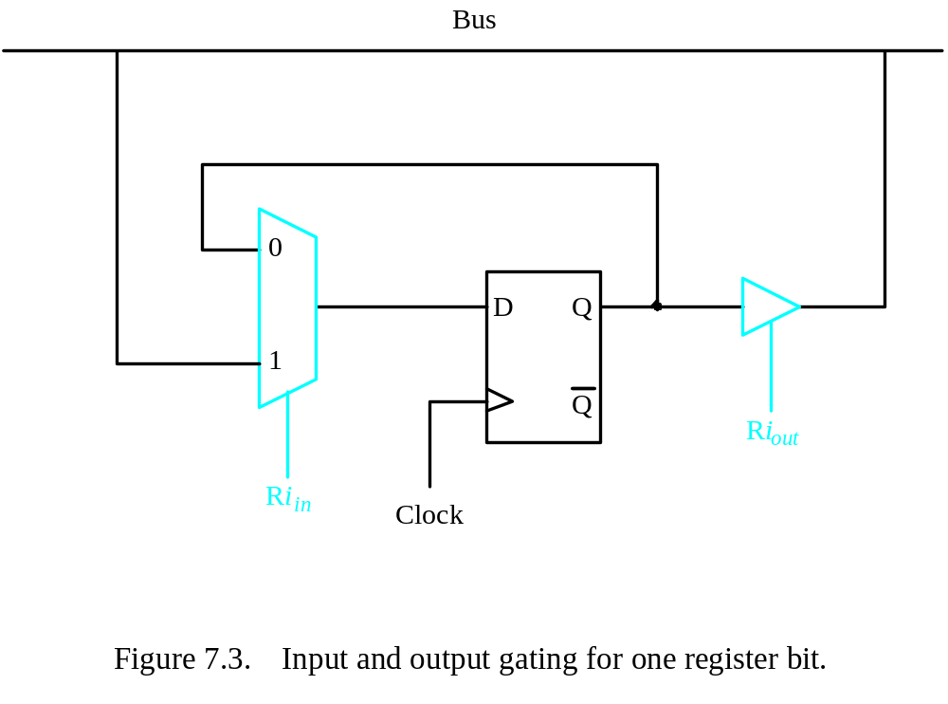
Register Transfer

Slide 13
Arithmetic or Logic Operations
The ALU is a combinational circuit that has no internal storage.
ALU gets the two operands from MUX and bus. The result is temporarily stored in register Z.
What is the sequence of operations to add the contents of register R1 to those of R2 and store the result in R3? i. e. R3 ← R1+R2
  R1out, Yin
  R2out, SelectY, Add, Zin
  Zout, R3in

Slide 14
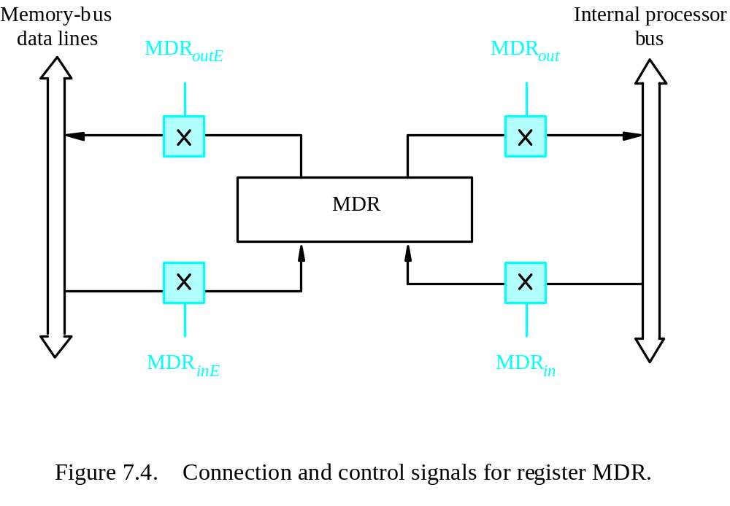
Fetching a Word from Memory

Slide 15
Fetching Word from Memory
MDR, MAR connections to bus controlled as in figure
For Move (R1),R2
  1. MAR←[R1]
  2. Start read on memory bus
  3. Wait for Memory Function Completed (MFC) from memory
  4. Load MDR from bus
  5. R2←[MDR]
Control Signals
  1. R1out, MARin, Read
  2. MDRinE, WMFC (wait for MFC)
  3. MDRout,R2in

Slide 16
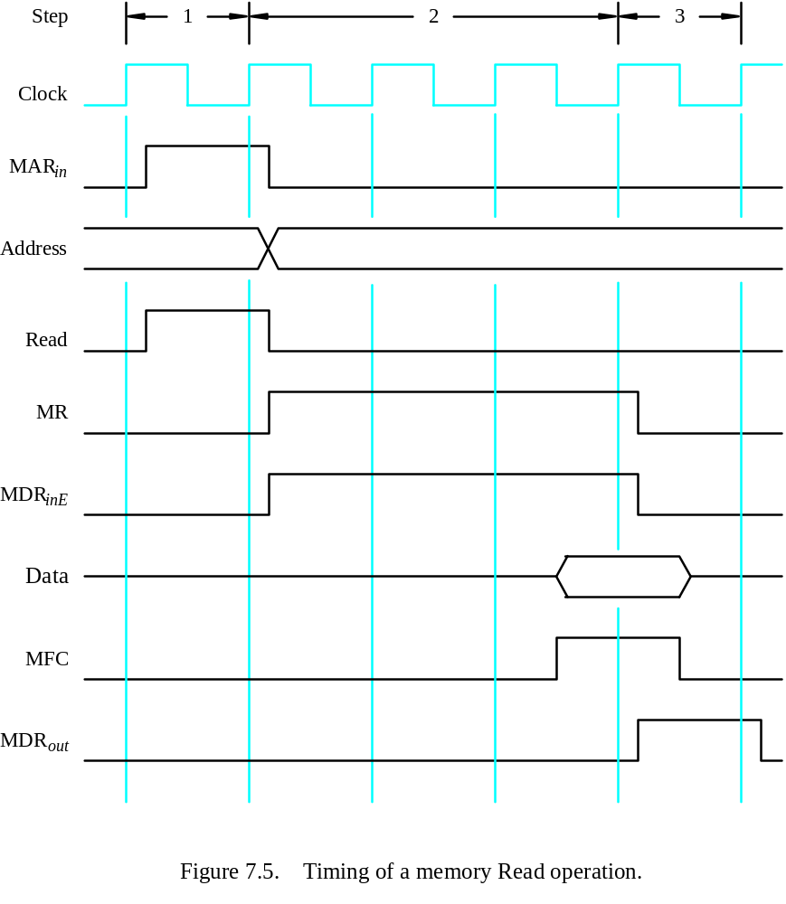
Read Timing

Slide 17
Storing a Word in Memory
Move R2,(R1) is similar to the previous example
  1. R1out, MARin
  2. R2out, MDRin, Write
  3. MDRoutE, WMFC

Slide 18
Summary
Central Processing Unit
  Internal Arch
  Familiarization with the units of CPU
  Their functioning
  Memory operations

