Slide 1
Computer Architecture
Lecture 08
Fasih ur Rehman

Slide 2
Last Class
DMA
Interface Circuits
  Purpose
  Port
    Serial
    Parallel

Slide 3
Today’s Agenda
Serial Port and Serial Interface circuit
Buses

Slide 4
Serial Port
Serial port connects the processor to I/O device through “one” data line allowing transfer of only “one bit” at a time.
  However, Parallel to serial conversion takes place within the interface circuit
Serial port transfers data in serial mode to or from the device while on bus side the communication has to be in parallel.

Slide 5
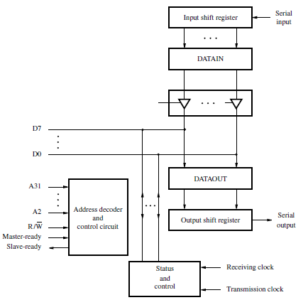
Serial Interface

Slide 6
Serial Interface
Input shift register accepts input one bit at a time from the I/O device.
Once all the bits in a word are received, the contents of the input shift register are loaded in parallel into DATAIN register.
Output data in the DATAOUT register are loaded into the output shift register.
Bits are shifted out of the output shift register and sent out to the I/O device one bit at a time.
As soon as data from the input shift reg. are loaded into DATAIN, it can start accepting another word of data bit – by – bit.
Input shift register and DATAIN registers are both used at input so that the input shift register can start receiving another word from the input device after loading the contents to DATAIN, before the processor reads the contents of DATAIN. This is called as double-buffering.

Slide 7
Serial Interface
Fewer lines are needed in serial interface
  therefore more feasible for devices that are at larger distance from the computer.
Speed of transmission over serial link is called “bit rate”.
Since devices are available in range of speed, a serial interface must be able to work with a range of clock speeds.
Examples
  Universal Asynchronous Receiver Transmitter
  RS – 232 – C.

Slide 8
Buses
Processor, main memory and I/O devices are interconnected by a common bus
  Provides communications path for transfer of data
  Includes signals to handle interrupts and arbitration
Bus protocol
  Set of rules for transferring data on a bus

Slide 9
Bus Lines
Three types
  Data
  Address
  Control
specify whether read or write, usually a single R/W signal, read when 1 write when 0
specify operand size
Normally processor is master and device being addressed is the slave
In terms of clock signals, a bus can be Synchronous or Asynchronous

Slide 10
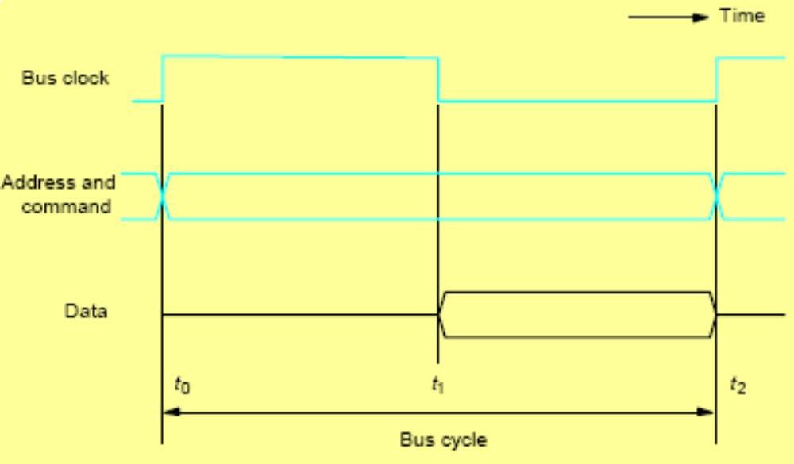
Synchronous Bus
Common clock used to derive timing
Read: t0 master puts address and command on bus. Slave responds at t1, data is strobbed into master at t2

Slide 11
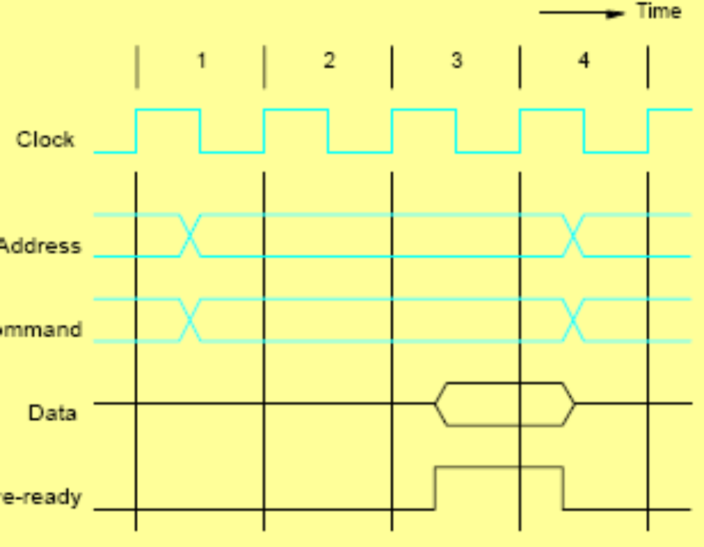
Multiple Cycle Transfer
In previous example, slave must respond between t0 – t2, usually a control signal is used to inform master that the slave data is ready
Thus slave could be of arbitrary speed
Master can abort operation if no slave ready signal is received
IA-32 uses this scheme

Slide 12
Asynchronous Bus (input)
Handshake between master and slave
t0: master places address and command on bus
t1: master asserts Master-ready
t2 slave puts data on bus and asserts Slave-ready
t3: master sees that Slave-ready asserted, strobes in the data and releases Master-ready
t4: master can now change address/command
t5: slave removes Slave-ready

Slide 13
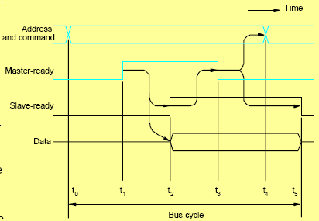
Asynchronous Bus (input)

Slide 14
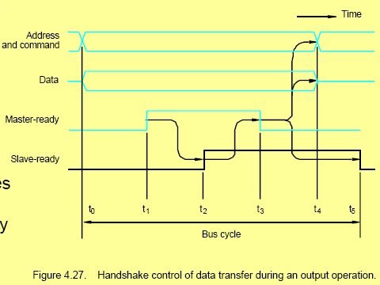
Asynchronous Bus (output)
Slave strobes data in after Master-ready is asserted

Slide 15
Bus Arbitration
Device allowed to initiate data transfers on bus transactions is called bus master
After using the bus, bus master relinquishes control of the bus so others can acquire it
Bus arbitration is required to decide who is master when more than one requests bus at the some time. Two types
  Centralized
    Arbiter circuit ensures only one request is granted at any time and enforces a priority scheme. Rotating priority is also possible.
  Distributed
    All devices waiting to use the bus have equal responsibility in carrying out bus arbitration without using a central arbiter.

Slide 16
Summary
Serial Port and Serial Interface circuit
Buses
  Types
  Synchronous
  Asynchoronus
  Arbitration

