Slide 1
Computer Architecture
Lecture 07
Fasih ur Rehman

Slide 2
Last Class
Multiple Interrupts
Examples

Slide 3
Today’s Agenda
Direct Memory Access
I/O Interface

Slide 4
Direct Memory Access
A special control unit is provided to transfer a block of data directly between an I/O device and the main memory, without continuous intervention by the processor.
  The operation of DMA controller, however, must be under the control of the program executed by the processor.
  Means the processor must initiate the DMA transfer
Normally, used to transfer large blocks of data at high speed.

Slide 5
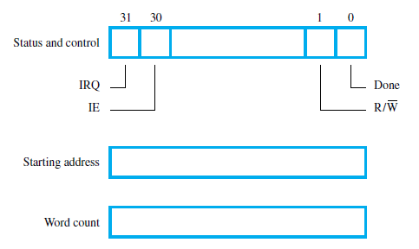
DMA Registers

Slide 6
Computer System with DMA
DMA controller connects network to bus
Disk controller has 2 independent DMA channels to 2 independent disks
  Start DMA transfer by writing address and word count information to disk controller
  DMA controller operates independently of processor (processor does other things, perhaps runs a different program in a multitasking system). Memory accesses by processor and DMA controller perhaps prioritized.
  DMA completes and sets done and IRQ bit
DMA accesses can by interwoven with processor accesses (cycle stealing) or take over the bus (called block or burst mode)
  Arbitration is required to control DMA controllers and processors accessing memory at the same time

Slide 7
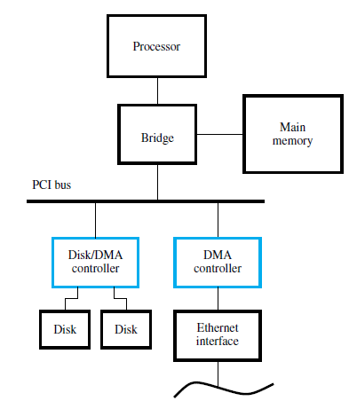
Use of a DMA Controller

Slide 8
DMA (Cont.)
DMA controller connects a high-speed network to the computer bus.
Disk controller, which controls two disks also has DMA capability. It provides two DMA channels.
It can perform two independent DMA operations, as if each disk has its own DMA controller. The registers to store the memory address, word count and status and control information are duplicated.

Slide 9
DMA (Cont.)
Processor and DMA controllers have to use the bus in an interwoven fashion to access the memory.
  DMA devices are given higher priority than the processor to access the bus.
  Among different DMA devices, high priority is given to high-speed peripherals such as a disk or a graphics display device.
Processor originates most memory access cycles on the bus.
  DMA controller can be said to “steal” memory access cycles from the bus. This interweaving technique is called as “cycle stealing”.
An alternate approach is to provide a DMA controller an exclusive capability to initiate transfers on the bus, and hence exclusive access to the main memory. This is known as the block or burst mode.

Slide 10
Interface Circuits
To add a peripheral to a microprocessor, need to design an interface circuit
  Involves hooking up whenever is required to the processor’s bus
I/O devices include the following that facilitate I/O operations
  Storage buffer
  Status flags that can be accessed by the processor
  Address decoding circuitry
  Appropriate timing signals
  Format conversions e.g. serial to parallel

Slide 11
Interface Circuits
On computer side, interface circuit has bus signals for
  Address
  Data
  Control
The device has
  Datapath and associated control signals to transfer data between the interface and the I/O device.
  This side is called as a port
Ports are classified as
  Serial port
  Parallel port

Slide 12
Ports
Parallel port transfer data in the form of a group of bits, conventionally, 8 or 16 or more bits to or from the device
Serial port facilitates data transfer bit by bit
Processor and device communicate in same manner for both the type of ports
  Conversion from serial to parallel or vice versa, if needed, takes place inside the interface circuit

Slide 13
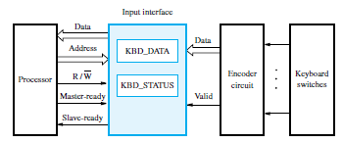
Keyboard Interface

Slide 14
Parallel Interface
Keyboard is connected to a processor using a parallel port.
Processor is 32-bits and uses memory-mapped I/O.
On the processor side of the interface we have:
  Data lines.
  Address lines.
  Control or R/W line.
  Master-ready signal and Slave-ready signal.
On the keyboard side of the interface:
  Encoder circuit which generates a code for the key pressed.
  Debouncing circuit which eliminates the effect of a key bounce (a single key stroke may appear as multiple events to a processor).
  Data lines contain the code for the key.
  Valid line changes from 0 to 1 when the key is pressed. This causes the code to be loaded into DATAIN and SIN to be set to 1.

Slide 15
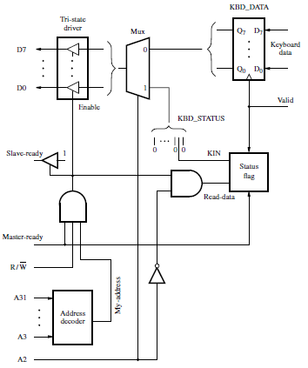
Input Interface

Slide 16
Summary
DMA
I/O Interface
  Parallel Interface circuits

