Slide 1
Computer Architecture
Lecture 06
Fasih ur Rehman

Slide 2
Last Class
Interrupts
Interrupt driven I/O
  Interrupt Request
  Interrupt Service Routine
  Enabling and Disabling Interrupts

Slide 3
Interrupt Model
Device raises interrupt request
Processor interrupts program currently being accessed
Interrupts disabled by clearing PS bit (except in the case of edge-triggered interrupts)
Device is informed that its request has been recognized by ISR. In response it deactivates its interrupt request
Action requested by interrupt performed in the ISR
Interrupts enabled and execution of interrupted program resumed

Slide 4
Today’s Agenda
Multiple Interrupts

Slide 5
Multiple Interrupts
Can multiple devices interrupt processor?
  How does the processor recognize which device is causing the interrupt?
  How does it know which ISR to execute?
  Can interrupts interrupt ISRs?
  How do we handle simultaneous interrupt requests?
Simple solution
  Poll every possible interrupting device and check if status bit indicates something is to be done and then service it
  Advantage: simple
  Disadvantage: slow

Slide 6
Vectored Interrupts
Interrupting device sends a code over the data bus to identify itself
Processor jumps to a table of addresses, indexed by the interrupt-vector code
The code may be the address of the first instruction of ISR

Slide 7
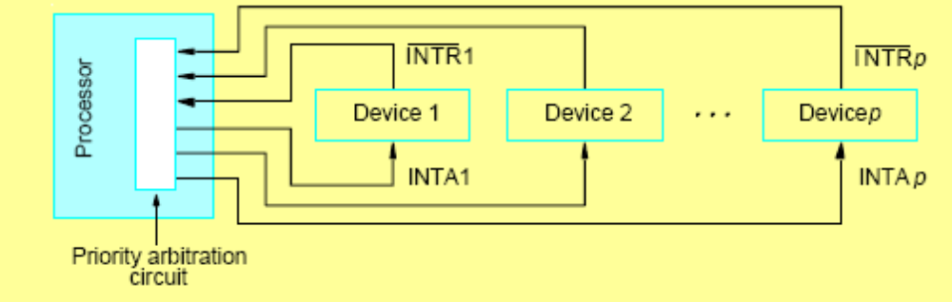
Interrupt Nesting
Interrupts usually assigned priorities
  e.g. real-time clock (RTC) interrupt must respond before the next one whereas a keyboard interrupt has no such constraint
  RTC should have higher priority
During execution of an ISR, interrupts only accepted from higher priority devices
Special priority arbitration hardware is used for this purpose

Slide 8
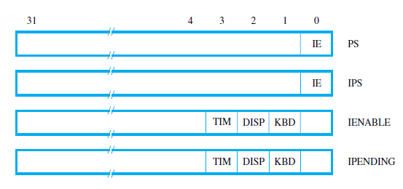
Example
Suppose
  Processor uses vectored interrupts
  Starting address of ISR stored at INTVEC in memory
  Interrupts enabled by setting bit 9 (the IE bit) in the processor status word
  Keyboard and display devices are connected to the processor

Slide 9
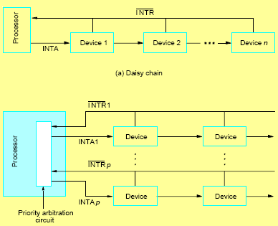
Priority Schemes
Priority is determined by order of polling
Daisy chain, the INTA signal only passed on if the device does not have a request
  Uses fewest wires but slower than …
Priority groups (most common in modern high speed processors)

Slide 10
Example
To initialize the ISR
  Load starting address of ISR to INTVEC
  Load address LINE to PNTR (input chars will be stored here)
  Enable keyboard interrupts (set bit 2 in register CONTROL)
  Enable processor interrupts (set IE bit in processor status word PS)
ISR
  Read input character from keyboard input register (will cause the interface circuit to remove interrupt request)
  Store character to location PNTR and increment PNTR
  When end of the line reached, disable keyboard interrupts and inform program Main
  Return from interrupt

Slide 11
Interrupt Device Request
A bit in the status flag that can be set/cleared in software enables/disables interrupts

Slide 12
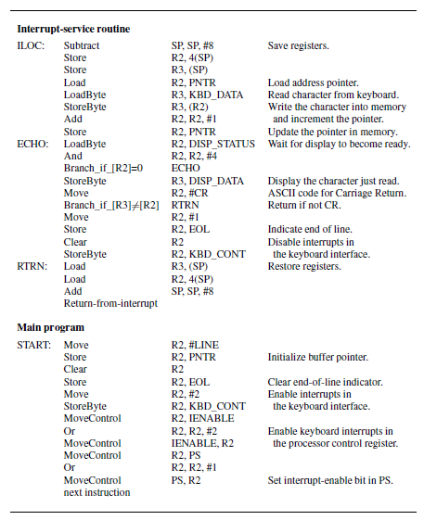
Complete Example

Slide 13
Example Cont.
Save the contents of the program counter, either in a processor register that holds the return address or on the processor stack.
Save the contents of the status register PS by transferring them into the IPS register, and clear the IE bit in the PS.
Load the address ILOC into the program counter.

Slide 14
Example Cont.
Load the address LINE into a memory location PNTR. The interrupt-service routine will use this location as a pointer to store the input characters in the memory.
Enable interrupts in the keyboard interface by setting to 1 the KIE bit in the KBD_CONT register.
Enable the processor to accept interrupts from the keyboard by setting to 1 the KBD bit in its control register IENABLE.
Enable the processor to respond to interrupts in general by setting to 1 the IE bit in the processor status register, PS.

Slide 15
Example Cont.
Read the input character from the keyboard input data register. This will cause the interface circuit to remove its interrupt request.
Store the character in the memory location pointed to by PNTR, and increment PNTR.
Display the character using the polling approach.
When the end of the line is reached, disable keyboard interrupts and inform the Main program.
Return from interrupt.

Slide 16
Summary
Multiple Interrupts
Examples

