Slide 1
Computer Architecture
Lecture 05
Fasih ur Rehman

Slide 2
Last Class
Continued with Addressing Modes
Indexing and Arrays
Stacks
Basic I/O
  Programmed I/O
  Memory Mapped I/O

Slide 3
Today’s Agenda
Interrupts
Interrupt driven I/O
  Interrupt Request
  Interrupt Service Routine
  Enabling and Disabling Interrupts

Slide 4
Interrupts
Program controlled I/O
  Processor repeatedly monitors the status flag of the device.
  Thus processor does not perform any useful work during polling which has to be done repeatedly.
Other Techniques are
  Interrupt driven I/O
  Direct Memory Access
While using interrupts, the device itself tells processor by sending a signal to the processor through the processor interrupt line
  Processor thus, can utilize the time to perform useful task.

Slide 5
Interrupts
Processor is, say, executing the instruction located at address i when an interrupt occurs.
Routine executed as a result of interrupt request is known as the interrupt-service routine (ISR).
When an interrupt occurs, control must be transferred to the ISR.
But before transferring control, the current contents of the PC (i+1), must be saved in a known location usually stack
This way the execution at i+1 will resume upon return from interrupt.

Slide 6
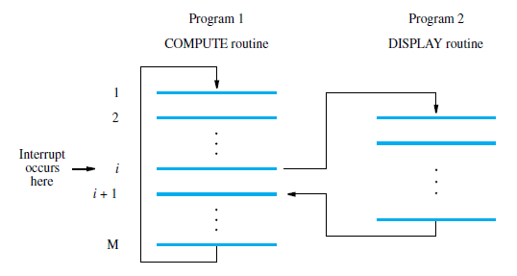
Interrupts
Overlap display and computing
When display ready, sends an interrupt request
This causes COMPUTE execution to be suspended and the interrupt routine DISPLAY to gain control
DISPLAY interrupt routine executed and returns from the interrupt
COMPUTE execution continued
Has similarities with subroutine execution

Slide 7
Differences ISR & Subroutine
A subroutine performs a task that is required by the calling program.
Interrupt-service routine may not have anything in common with the program it interrupts.
Interrupt-service routine and the program that it interrupts may belong to different users.
As a result, before branching to the interrupt-service routine, not only the PC, but other information such as condition code flags, and processor registers used by both the interrupted program and the interrupt service routine must be stored.
This will enable the interrupted program to resume execution upon return from interrupt service routine.

Slide 8
Interrupts
Saving the executing program status involves memory operations.
  Execution of Interrupt service routine may be delayed a bit.
  This delay is called interrupt latency
Most processors save minimal information in order to reduce interrupt latency.
When a processor receives Interrupt, it must jump/branch to ISR
Interrupting device must also be informed that processor has received the request
  This either is done by a proper acknowledge signal or by data transfer between processor and device

Slide 9
Interrupts
ISR alters the execution sequence of currently running program.
  Some times this may not be desirable
  So processors generally have ability to enable or disable interrupts
    Normally ISR starts with Interrupt Disable instruction to avoid interruption from the same device
    Last instruction enables the interrupts

Slide 10
Enable or Disable
Sometimes need to ensure that interrupts cannot occur
  May need to assign priorities e.g. high priority interrupts cannot be interrupted by low priority ones
  Ensure that an active request doesn’t lead to an infinite loop
  Interrupt routines may need to access data structures and ensure they do not get interrupted while doing so

Slide 11
Avoiding Infinite LOOP
Can be handled by
  Ignoring interrupts until after 1st instruction of ISR
    Interrupt disable instruction is first instruction
    No further interrupts can occur
    Controlled by 1 bit in the processor-status (PS) register, when 1 will process interrupts, when 0 disables them
    Set to 1 after the return from interrupt instruction
  Processor automatically disable interrupts before starting ISR
  Edge triggered interrupts. Processor receives one interrupt request per activation of the hardware interrupt line

Slide 12
A Typical Scenario
The device raises an interrupt request.
The processor interrupts the program currently being executed and saves the contents of the PC and processor status registers (PS).
Interrupts are disabled by clearing the IE bit in the PS to 0.
The action requested by the interrupt is performed by the interrupt-service routine, during which time the device is informed that its request has been recognized, and in response, it deactivates the interrupt-request signal.
Upon completion of the interrupt-service routine, the saved contents of the PC and PS registers are restored (enabling interrupts by setting the IE bit to 1), and execution of the interrupted program is resumed.

Slide 13
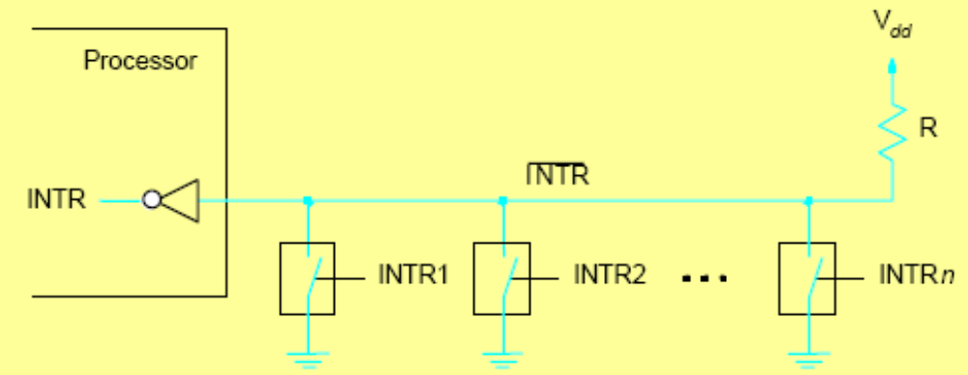
Interrupt Hardware
Need to be able to handle a unknown number of possible interrupting devices
INTR = INTR1 or INTR2 or … INTR n

Slide 14
Multiple Devices
Can multiple devices interrupt processor?
  How does the processor recognize which device is causing the interrupt?
  How does it know which ISR to execute?
  Can interrupts interrupt ISRs?
  How do we handle simultaneous interrupt requests?
Simple solution
  Poll every possible interrupting device and check if status bit indicates something is to be done and then service it
– Advantage: simple
– Disadvantage: slow

Slide 15
Summary
Interrupts
Interrupt driven I/O
  Interrupt Request
  Interrupt Service Routine
  Enabling and Disabling Interrupts

