Slide 1
Computer Architecture
Lecture 04
Fasih ur Rehman

Slide 2
Last Class
Fetch and Execute
Registers
Memory locations and addresses
Branching and Condition codes
Addressing Modes
  Implied
  Autoincrement/Autodecrement

Slide 3
Today’s Agenda
Continue with Addressing Modes
Indexing and Arrays
Stacks
Basic I/O
  Programmed I/O
  Memory Mapped I/O

Slide 4
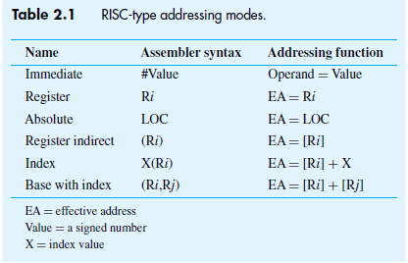
Addressing Modes

Slide 5
Indexing and Arrays
Index mode – the effective address of the operand is generated by adding a constant value to the contents of a register.
A general purpose register is designated as Index register
X(R_{i}): EA = X + [R_{i}]
X may be a +ve or –ve constant representing a numerical value.

Slide 6
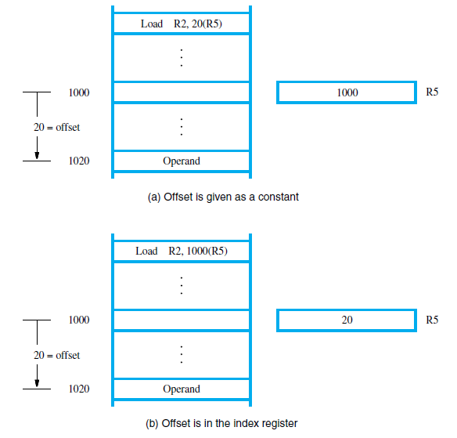
Indexing and Arrays

Slide 7
Indexing and Arrays
General, the Index mode provides access to an operand whose location is specified relative to a reference point within the data structure in which the operand appears.
Some variants:
(R_{i}, R_{j}): EA = [R_{i}] + [R_{j}]
X(R_{i}, R_{j}): EA = X + [R_{i}] + [R_{j}]

Slide 8
Relative Addressing
Relative mode – the effective address is computed by the Index mode using the program counter in place of the general-purpose register.
X(PC) – (X is a signed number)
Branch>0 LOOP
This location is computed by specifying it as an offset from the current value of PC.
Branch target may be either before or after the branch instruction, therefore, offset is given as a singed num.

Slide 9
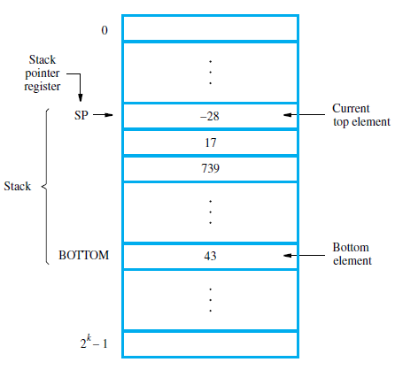
Stack
List of data elements
(usually bytes or words)
  Elements can only be removed at one end of the list
  Last-in-first-out
Can be implemented in several ways, one way is
  First element placed in BOTTOM
  Grows in direction of decreasing memory address
  Assume 32-bit data word

Slide 10
Stack Implementation
Subtract #4,SP
Move NEWITEM,(SP) ; push
Move (SP),ITEM ; pop
Add #4,SP
With auto-increment and
Auto-decrement
Move NEWITEM,-(SP) ; push
1. Can you write pop using autoincrement?
2. How can I check that push/pop doesn’t overflow/underflow?

Slide 11
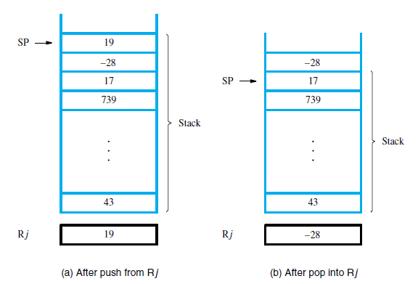
Effect of Stack Operation

Slide 12
Basic Input and Output (I/O)
The data on which the program instructions operate are not necessarily available in memory.
Data may be transferred between processor and peripheral devices (disk, keyboard, etc.)
I/O operations are essential.
The way I/O operations are performed can significantly affect the performance of the computer.

Slide 13
I/O Interfaces
Multiple I/O devices may be connected to the processor and the memory via a bus.
Bus consists of three sets of lines to carry address, data and control signals.
Each I/O device is assigned an unique address.
To access an I/O device, the processor places the address on the address lines.
The device recognizes the address, and responds to the control signals.

Slide 14
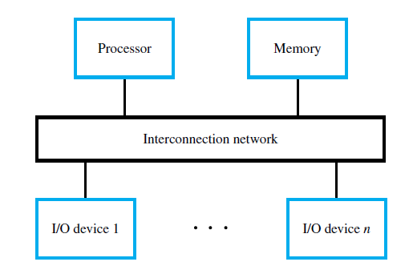
I/O Device Interface
Programmed I/O
Memory Mapped I/O
Interrupt based Interface

Slide 15
Programmed I/O
READWAIT Branch to READWAIT if SIN=0
INPUT from DATAIN to R1
WRITEWAIT Branch to WRITEWAIT if SOUT=0
Output from R1 to DATAOUT

Slide 16
Memory Mapped I/O
On many machines, registers such as DATAIN, DATAOUT are memory-mapped
  Read and write specific memory locations to communicate with device
  MoveByte DATAIN,R1
  MoveByte R1,DATAOUT
SIN and SOUT might be bits in a device status register e.g. bit 3
READWAIT Testbit #3,INSTATUS
Branch=0 READWAIT
MoveByte DATAIN,R1

Slide 17
Comparison
Memory Mapped I/O
  Devices and the memory share the same address space
  Any machine instruction that can access memory can be used to transfer data to or from an I/O device.
  Simpler software.
Separate Addr. space for I/O
  Devices and the memory have different address spaces
  Special instructions to transfer data to and from I/O devices.
  I/O devices may have to deal with fewer address lines.
  I/O address lines need not be physically separate from memory address lines.
  In fact, address lines may be shared between I/O devices and memory, with a control signal to indicate whether it is a memory address or an I/O address.

Slide 18
Summary
Continue with Addressing Modes
Indexing and Arrays
Stacks
Basic I/O
  Programmed I/O
  Memory Mapped I/O

