Slide 1
Computer Architecture
Lecture 32
Fasih ur Rehman

Slide 2
Last Class
Revision
  Basic Concepts
  Components of a Computer
  Performance
  Addresses and Addressing Modes
  Input and Output organization
  Interrupts
  DMA and I/O interface Circuits
  Bus Organization
  Basic Processing Unit
  Control Unit Design

Slide 3
Today’s Agenda
Revision
  Arithmetic Unit Design
  Floating point Unit
  Memories
  Data Communication and Error Control

Slide 4
Signed Numbers
Representation Methods
  Signed Magnitude
  1’s Complement
  2’s Complement

Slide 5
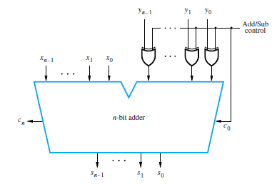
Binary Addition/Subtraction Logic Circuit

Slide 6
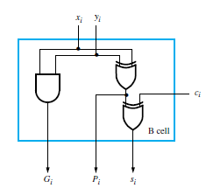
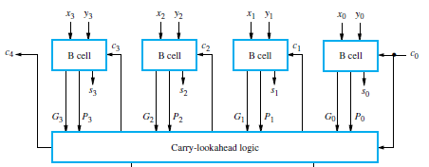
4 – bit Carry Lookahead Adder

Slide 7
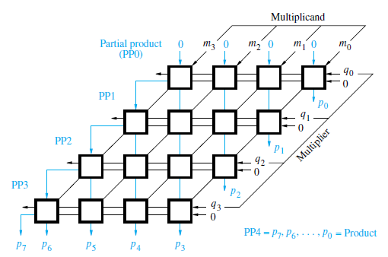
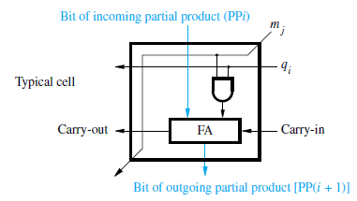
Array Multiplication (Unsigned)

Slide 8
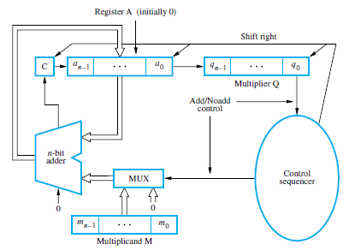
Sequential Multipliers

Slide 9
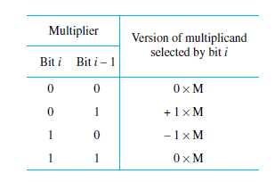
Booth Algorithm
Thus recoding can be done using following table called Booth Recoding Table

Slide 10
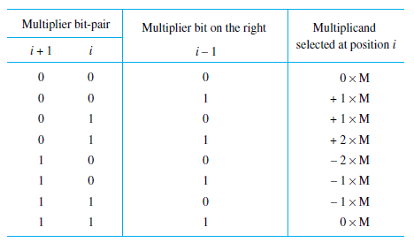
Multiplier Bit Recoding

Slide 11
Fast Multiplication
Bit pair recoding reduces summands by a factor of 2
Summands are reduced by carry – save addition
Final product can be generated by using carry lookahead adder

Slide 12
Longhand Division Steps
Position the divisor appropriately with respect to the dividend and performs a subtraction.
If the remainder is zero or positive, a quotient bit of 1 is determined, the remainder is extended by another bit of the dividend, the divisor is repositioned, and another subtraction is performed.
If the remainder is negative, a quotient bit of 0 is determined, the dividend is restored by adding back the divisor, and the divisor is repositioned for another subtraction.

Slide 13
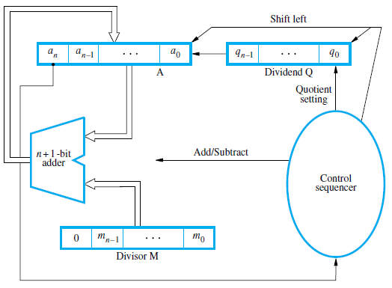
Circuit Arrangement

Slide 14
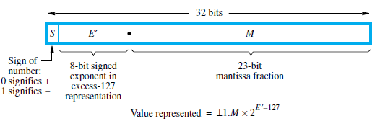
IEEE Standard for Representation

Slide 15
Addition / Subtraction Rules
Choose the number with the smaller exponent and shift its mantissa right a number of steps equal to the difference in exponents.
Set the exponent of the result equal to the larger exponent.
Perform addition/subtraction on the mantissas and determine the sign of the result.
Normalize the resulting value, if necessary.
3.1415 x 10⁸ + 1.19 x 10⁶ = 3.1415 x 10⁸ + 0.0119 x 10⁸ = 3.1534 x 10⁸

Slide 16
Multiplication Rules
Add the exponents and subtract 127 to maintain the excess-127 representation.
Multiply the mantissas and determine the sign of the result.
Normalize the resulting value, if necessary.

Slide 17
Division Rules
Subtract the exponents and add 127 to maintain the excess-127 representation.
Divide the mantissas and determine the sign of the result.
Normalize the resulting value, if necessary.

Slide 18
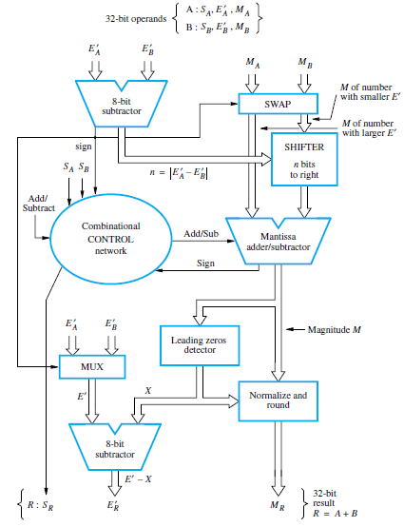
Implementation of Addition

Slide 19
Random Access Memory
Random access memory (RAM), any location can be accessed with comparable access time (e.g. CD vs. tape drive)
Processor usually runs much faster than main memory
  Small memories fast, large memories slow
  Use a cache memory to store data that is likely to be used
Types of RAM
  Static RAM
  Dynamic RAM
    SDRAM
    SDRAM DDR

Slide 20
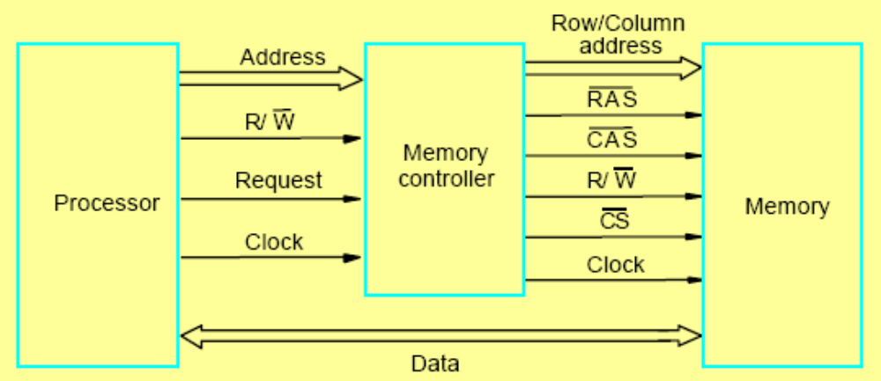
Memory Controller
A memory controller is normally used to interface between DRAM and the processor. Dynamic RAMs have a slightly more complex interface as they multiplex signals in time to reduce pins
SRAM interfaces are simpler and may not need a memory controller

Slide 21
Read Only Memories
RAMs are volatile
We need some memory to be retained even if the power is switched off.
  For example, booting a computer
So we need some arrangement or non – volatile memory to store some instructions that need to be executed at start up.
Non – volatile memory is read in a same manner as the RAM and called Read only Memories
  Special writing process is needed
Types of ROMs

Slide 22
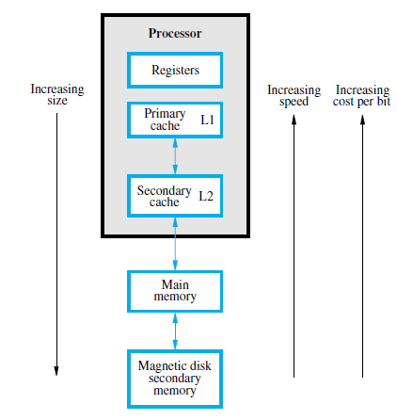
Memory Hierarchy

Slide 23
Cache Memories
Processor runs at much faster speed than its main memory (MM)
  Processor will then have to wait for a while data and instruction are read from the memory
  degrades the performance of the computer system
  Speed of MM is bounded by certain constraints
Cache memory uses principal of “Locality of Reference” which makes MM appear (to the processor) faster than it actually is.
Cache Read/Write/Hit/Miss/Miss Penalty

Slide 24
Mapping Functions
Three types of Mappings
  Direct Mapping
  Associative Mapping
  Set Associative Mapping

Slide 25
Replacement Algorithms
Direct mapped cache
  Position of each block fixed, no replacement algorithm needed
Associative and Set associative
  Need to decide which block to replace (keep ones likely to be used in cache)
  One strategy is least recently used (LRU) e.g. for a 4 block cache, use a 2-bit counter. Set =0 for block accessed, other blocks incremented. Block with count=3 replaced upon miss
  Another is random replacement (choose random block). Advantage is that it is easier to implement at high speed

Slide 26
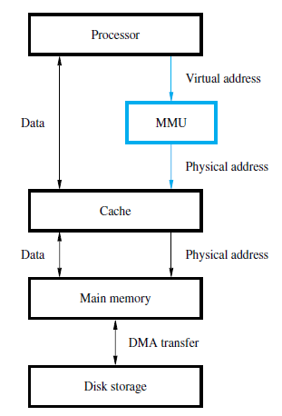
Virtual Memory Organization

Slide 27
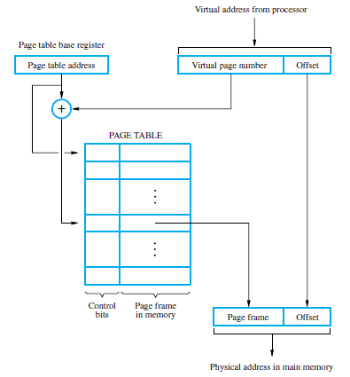
Address Translation
Address of
the page table.
Virtual address = page
number + offset.
PTBR + virtual page number = Entry of the page in the page table.
Starting address of the page
in the main memory.
Starting location of the page.

Slide 28
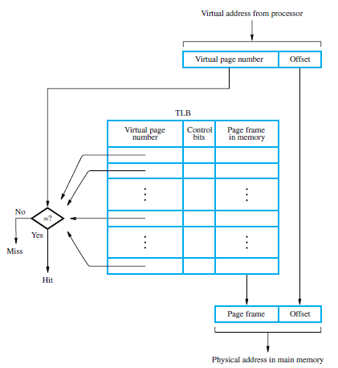
Translation Lookaside Buffer
Associative or set associative scheme normally used
Processor must keep TLB and page table information consistent

Slide 29
Computer Communication
Data
Digital Vs. Analog
Codes

Slide 30
Multiplexing
More than one signals using same channel simultaneously for communication.
  Advantage is Cost effective
Types of Multiplexing
  Frequency Division Multiplexing (FDM)
  Time Division Multiplexing (TDM)
  Wavelength Division Multiplexing
  Code Division Multiplexing

Slide 31
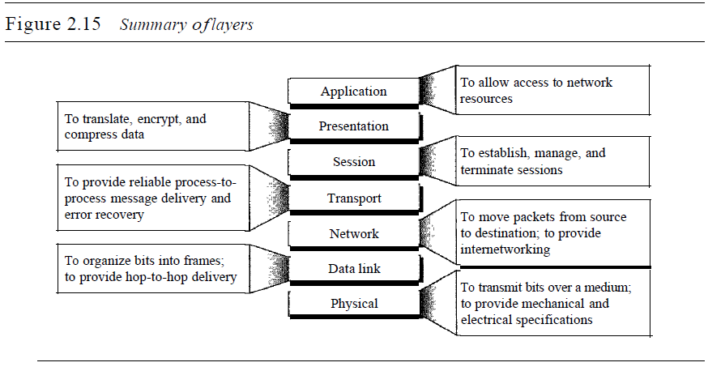
OSI Model

Slide 32
Error Detection
Data transfer between two devices must be error free.
Data Can be corrupted during transmission
A reliable communication system must have capability to detect and correct errors.
Error detection and correction is implemented at the data link or transport layer of the ODI model
Types of errors are
  Single bit errors
  Multiple bits errors
  Burst Errors

Slide 33
Error Detection
Redundancy is used to detect errors
  Vertical redundancy
  Horizontal redundancy
  Cyclic Redundancy

