Slide 1
Computer Architecture
Lecture 31
Fasih ur Rehman

Slide 2
Last Class
Computer Communication
  Multiplexing
  OSI Layers
  Error Detection and Correction

Slide 3
Today’s Agenda
Revision
  Basic Concepts
  Components of a Computer
  Performance
  Addresses and Addressing Modes
  Input and Output organization
  Interrupts
  DMA and I/O interface Circuits
  Bus Organization
  Basic Processing Unit
  Control Unit Design

Slide 4
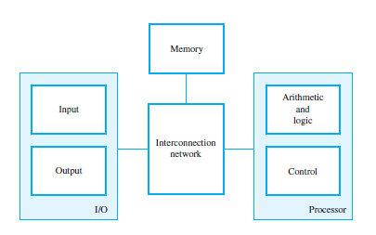
Fundamental Concepts

Slide 5

Bus Organization
Interconnect used for communication between the processor, memory and I/O devices
Multiple buses are often used for better performance

Slide 6
Operational Concepts
Instructions (programs) govern the activities of computer
Appropriate list of instructions is stored in the memory to perform a task
Processor performs the operation of instruction by
  bringing the instruction in to processor
  decoding the instruction
  perform the task
  everything is coordinated by control unit that generates appropriate control and timing signals
All operands (data) are also stored in memory

Slide 7
Performance
Performance depends on following factors
  T: processor time required to execute a program that has been prepared in high-level language
  N: number of actual machine language instructions needed to complete the execution (note: loop)
  S: average number of basic steps needed to execute one machine instruction. Each step completes in one clock cycle
  R: clock rate

Slide 8
Primitive Operations
A computer must have instructions capable of performing four types of operations
  Data transfers between the memory and the processor registers
  Arithmetic and logic operations on data
  Program sequencing and control
  I/O transfers

Slide 9
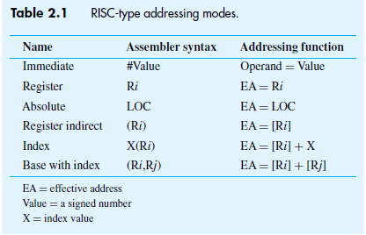
Addressing Modes

Slide 10
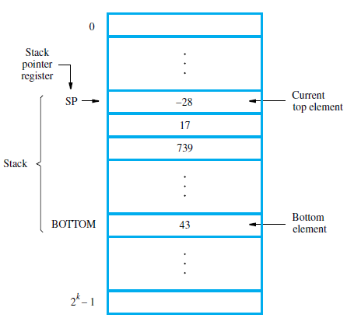
Stack
List of data elements
(usually bytes or words)
  Elements can only be removed at one end of the list
  Last-in-first-out
Can be implemented in several ways, one way is
  First element placed in BOTTOM
  Grows in direction of decreasing memory address
  Assume 32-bit data word

Slide 11
Comparison
Memory Mapped I/O
  Devices and the memory share the same address space
  Any machine instruction that can access memory can be used to transfer data to or from an I/O device.
  Simpler software.
Separate Addr. space for I/O
  Devices and the memory have different address spaces
  Special instructions to transfer data to and from I/O devices.
  I/O devices may have to deal with fewer address lines.
  I/O address lines need not be physically separate from memory address lines.
  In fact, address lines may be shared between I/O devices and memory, with a control signal to indicate whether it is a memory address or an I/O address.

Slide 12
Interrupts
Processor is, say, executing the instruction located at address i when an interrupt occurs.
Routine executed as a result of interrupt request is known as the interrupt-service routine (ISR).
When an interrupt occurs, control must be transferred to the ISR.
But before transferring control, the current contents of the PC (i+1), must be saved in a known location usually stack
This way the execution at i+1 will resume upon return from interrupt.

Slide 13
Vectored Interrupts
Interrupting device sends a code over the data bus to identify itself
Processor jumps to a table of addresses, indexed by the interrupt-vector code
The code may be the address of the first instruction of ISR

Slide 14
Direct Memory Access
A special control unit is provided to transfer a block of data directly between an I/O device and the main memory, without continuous intervention by the processor.
  The operation of DMA controller, however, must be under the control of the program executed by the processor.
  Means the processor must initiate the DMA transfer
Normally, used to transfer large blocks of data at high speed.

Slide 15
Interface Circuits
To add a peripheral to a microprocessor, need to design an interface circuit
  Involves hooking up whenever is required to the processor’s bus
I/O device involves the following
  Storage buffer
  Status flags that can be accessed by the processor
  Address decoding circuitry
  Appropriate timing signals
  Format conversions e.g. serial to parallel

Slide 16
Bus Arbitration
Device allowed to initiate data transfers on bus transactions is called bus master
After using the bus, bus master relinquishes control of the bus so others can acquire it
Bus arbitration is required to decide who is master when more than one requests bus at the some time. Two types
  Centralized
    Arbiter circuit ensures only one request is granted at any time and enforces a priority scheme. Rotating priority is also possible.
  Distributed
    All devices waiting to use the bus have equal responsibility in carrying out bus arbitration without using a central arbiter.

Slide 17
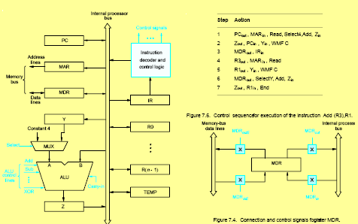
CPU and Execution

Slide 18
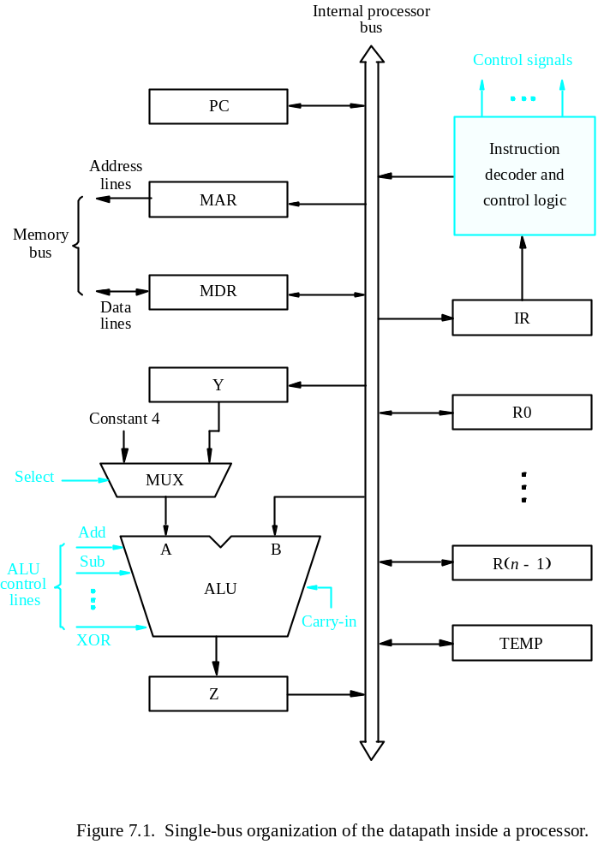
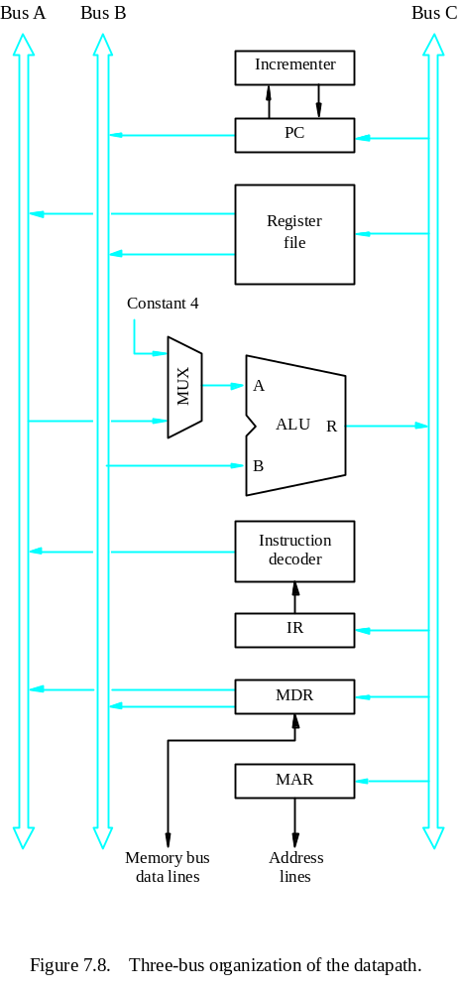
Multiple Bus Organization

Slide 19
Control Unit
Basic Tasks
  To go through a control sequence for each instruction
  To generate appropriate control signals for each task (or control step)
Control unit is driven by the processor clock
Generated Control signal depends on
  The actual step to be executed
  The condition and status flag of the processor
  The actual instruction executed
  Any external signal received (such as interrupts)

Slide 20
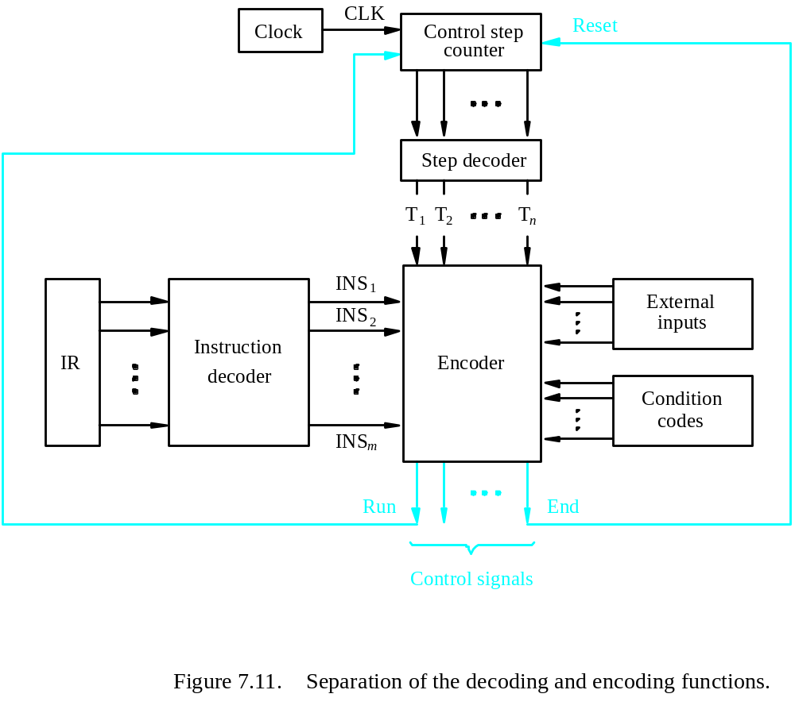
Hardwired Control

Slide 21
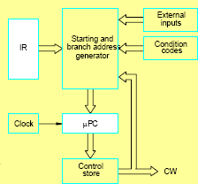
Microprogrammed Control

