Slide 1
Computer Architecture
Lecture 30
Fasih ur Rehman

Slide 2
Last Class
Computer Communication

Slide 3
Today’s Agenda
Data Communication
  Multiplexing
  Error Detection and Correction

Slide 4
Multiplexing
More than one signals using same channel simultaneously for communication.
  Advantage is Cost effective
Types of Multiplexing
  Frequency Division Multiplexing (FDM)
  Time Division Multiplexing (TDM)
  Wavelength Division Multiplexing
  Code Division Multiplexing

Slide 5
Frequency Division Multiplexing
Non – overlapping frequency ranges are assigned to each user or signal in a medium
  Signals are transmitted simultaneously but use different frequencies
  Oldest multiplexing technique
  Used in analog domain
  more susceptible to noise
  Broadcast Radio and Television, Cable TV, and AMPS cell phone system

Slide 6
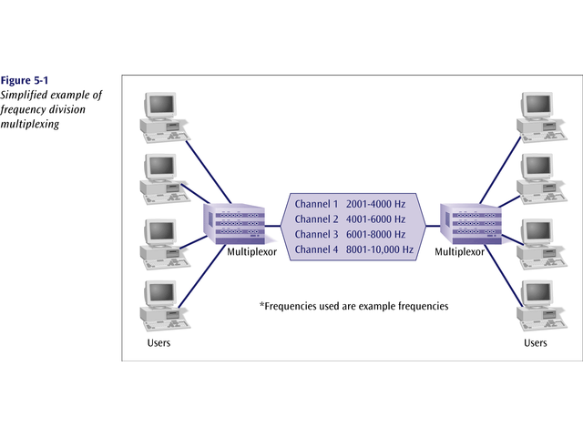
Frequency Division Multiplexing

Slide 7
Time Division Multiplexing
Available time of the channel is shared by the users
Digital signals used TDM
Two basic types
  Synchronous Time Division Multiplexing
  Statistical TDM
T1/E1and Integrated Services Digital Network (ISDN) use TDM

Slide 8
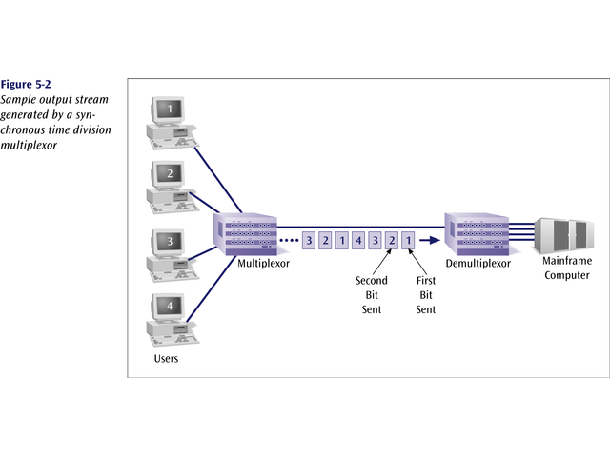
Time Division Multiplexing

Slide 9
Synchronous Time Division Multiplexing
Two sources may generate bits at different rates
Multiplexor inserts sequence of 1s and 0s alternatively for the source that is not generating bits
Very popular
  T-1, ISDN and SONET use this
Bandwidth requirement is same as that of all sources

Slide 10
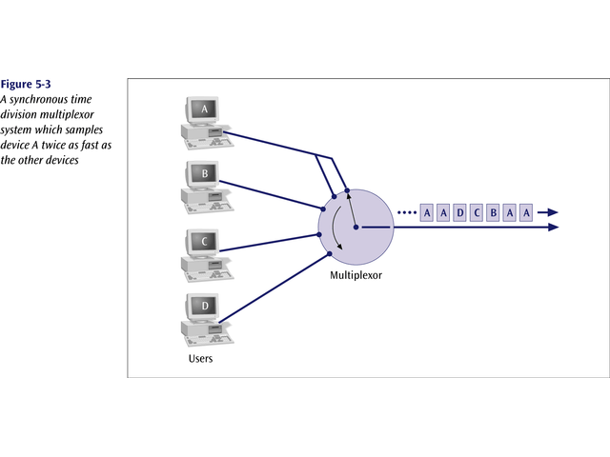
Synchronous Time Division Multiplexing

Slide 11
Statistical Time Division Multiplexing
Time slots are allocated to active nodes only
Make efficient use of bandwidth
  Good for low bandwidth application

Slide 12
Wavelength Division Multiplexing
Each message is given a different frequency
  Used in Optical fiber

Slide 13
Code Division Multiplexing
Same frequencies are used at same time but different code is used for different messages
Also called Code Division Multiple Access (CDMA)
Mobile phone systems use this

Slide 14
Layered Structure
Layered structure is used to reduce the complexity of tasks
A Seven layered model Open System Interconnection is a popular choice.
  Each layer has its own job and protocol

Slide 15
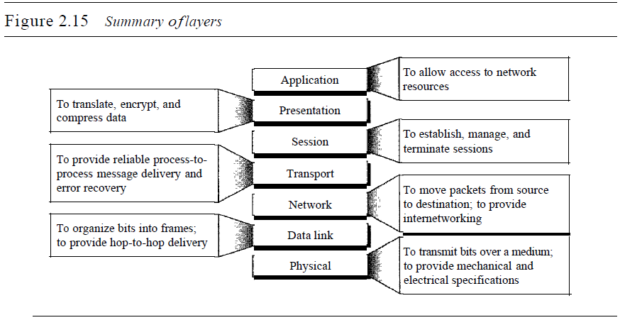
OSI Model

Slide 16
Error Detection
Data transfer between two devices must be error free.
Data Can be corrupted during transmission
A reliable communication system must have capability to detect and correct errors.
Error detection and correction is implemented at the data link or transport layer of the ODI model
Types of errors are
  Single bit errors
  Multiple bits errors
  Burst Errors

Slide 17
Error Detection
Redundancy is used to detect errors
  Vertical redundancy
  Horizontal redundancy
  Cyclic Redundancy

Slide 18
Error Correction
Two ways possible
  A re-transmit message can be sent to the sender
  Receiver can use error correcting codes.

Slide 19
Summary
Data Communication
  Multiplexing
  Error Detection and Correction

